Slide 1
What's Next for GED Products
Research, Roadmaps, and Tools to Support Learner Success
Victor Fitzjarrald / Jane Bledsoe | GED Testing Service | GED Conference 2026
Notes:
Welcome. Inside look at where GED products are headed — grounded in 2025–2026 research.

Slide 2
1
4
GED Ready® research, score reports, and readiness correlation
GED+, Prentis/Stride, Libraries
2
5
GED Flash® usage, Spanish expansion, and impact on outcomes
Product roadmap and classroom-ready tips for educators
3
GED & Me™ — secure, guided support
Notes:
Present: GED Ready® research, score reports, and readiness correlation

Slide 3
Session Objectives
Interpret GED Ready scores and updated score reports to guide testing decisions
Understand who uses GED Flash today and how it supports learner performance
Learn how AI tutors extend instruction while maintaining content integrity
Take away practical tips for classrooms, independent study, and program access
Notes:
Frame outcomes for educators, program managers, and administrators.

Slide 4
Research Context
Why product choices matter for learner persistence
Notes:
Present: Research Context

Slide 5
The Activation Gap
Accounts setup is growing — but first-time testers and credentialers remain flat
72% of learners are Non-Activators; only 16% take a GED Ready vs. 68–81% of activators
Non-Activators: median age 27, work-motivated, low engagement with learner tools
Taking a GED Ready is the #1 predictor of moving from account setup to testing
Notes:
Source: Kris Mehan, Why Learners Persist—or Don't (2025–2026).

Slide 6
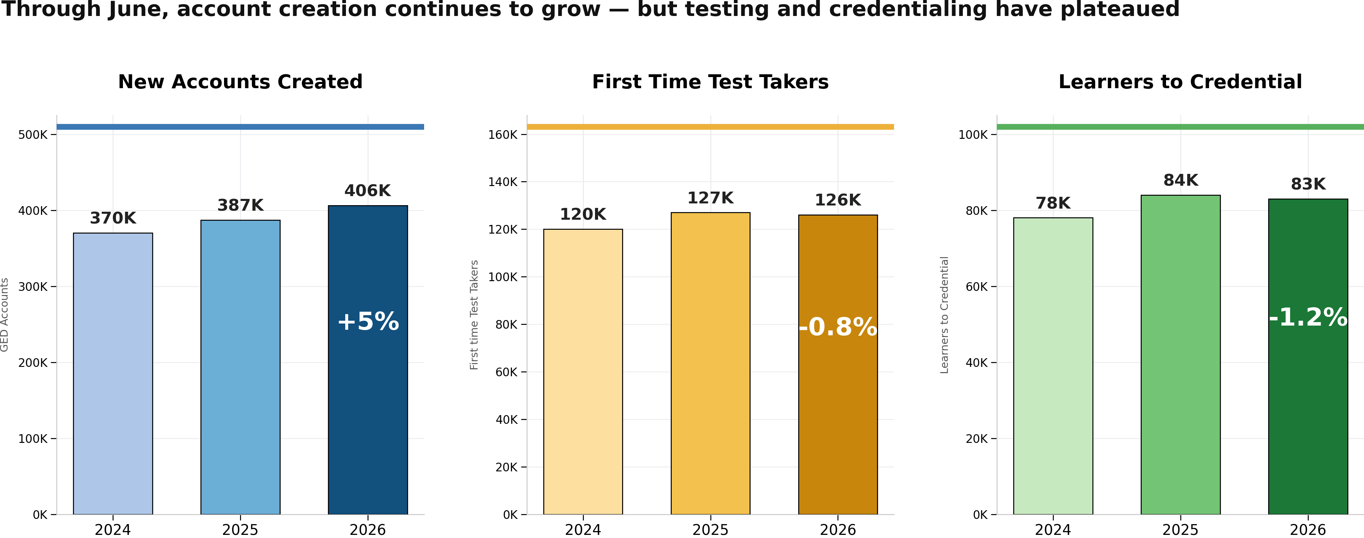
National Trends: Accounts Growing, Testers Flat
Notes:
2025–2026 learner volume data.

Slide 7
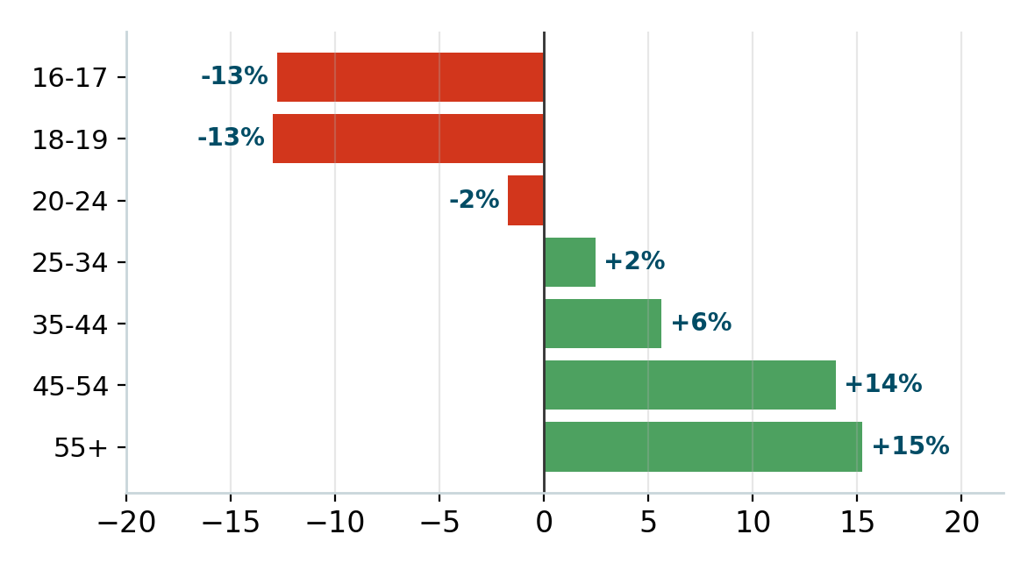
Under-25 Growth Has Stalled — 25+ Still Growing
Notes:
Test-taker volume change by age bucket (2025 → 2026).

Slide 8
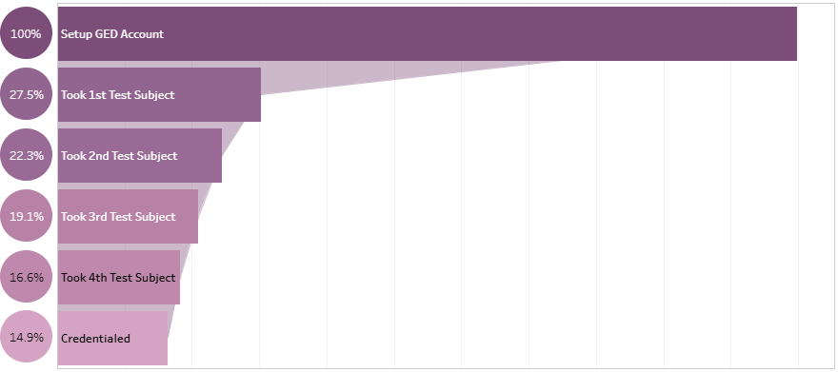
Learner Funnel: Where Persistence Drops
Notes:
Setup→1st Test: 28% | 1st→2nd: 81% | 2nd→3rd: 86% | 3rd→4th: 87% | 4th→Credential: 84%.

Slide 9
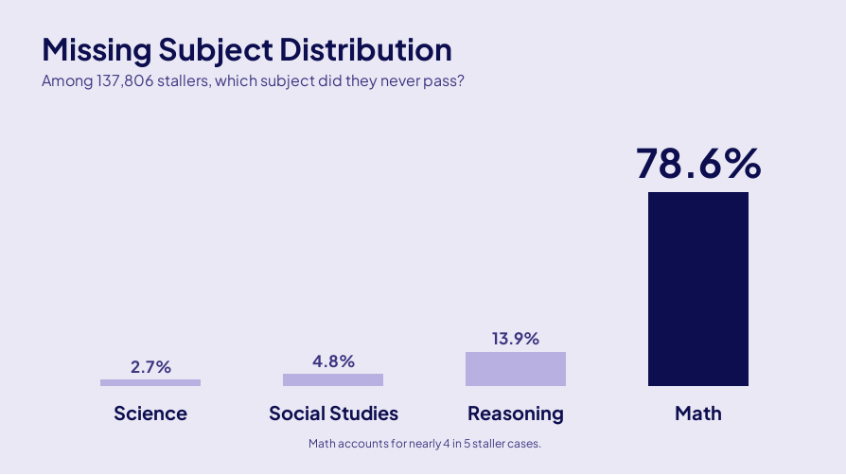
The Math Skill Gap
Notes:
79% of stallers are missing Math.

Slide 10
Connecting Research to Today's Session
Today's session connects learner data to product updates you can use now
GED Ready: better diagnostics and score reports grounded in research
GED Flash & GED & Me: tools that close skill gaps — especially in Math
Libraries & roadmaps: expanding access and building what's next
Notes:
Present: Connecting Research to Today's Session

Slide 11
GED Ready®
Research, score reports, and readiness correlation
Notes:
Present: GED Ready®

Slide 12
GED Ready Score Report: What's New
New score section design — moving from stoplight thermometer to accessible zone colors (A/B validated)
Tablet device study
Notes:
Present: GED Ready Score Report: What's New

Slide 13
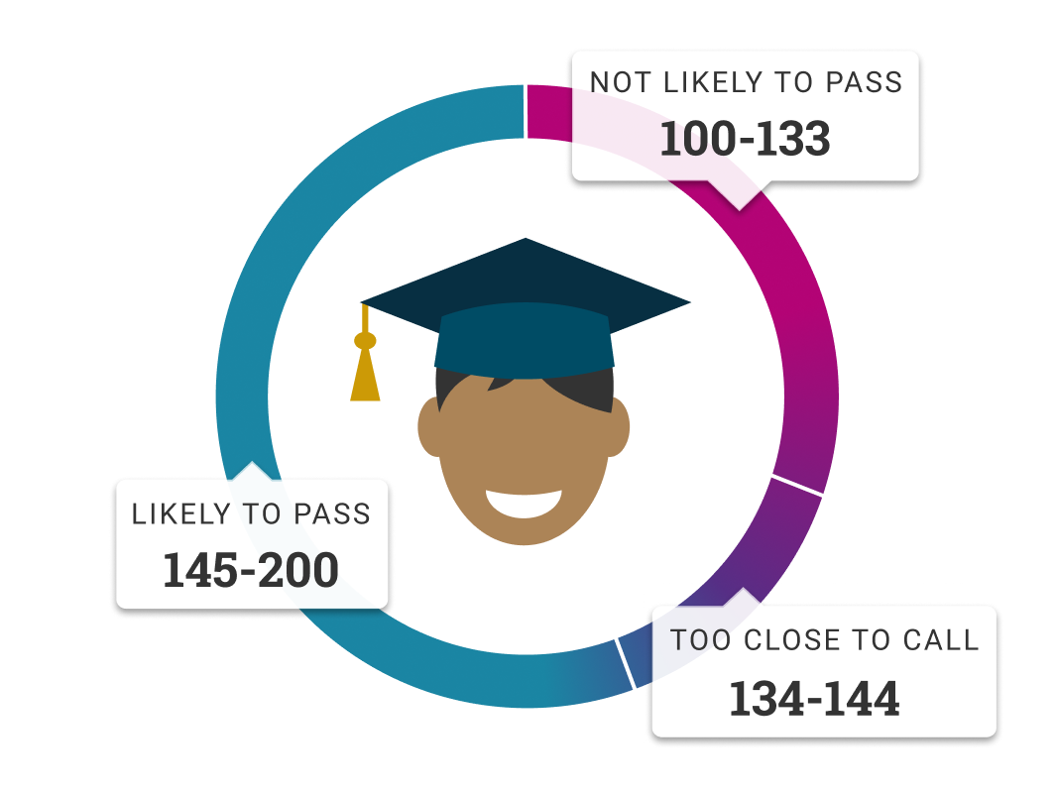
Score Report Redesign: Beyond Stoplight Colors
A/B test (Jan 20–Feb 6, 2026): 8,076 control vs. 8,098 challenger first-time Ready scorers
Challenger removes the score thermometer/stoplight; uses accessible purple/pink/blue zone colors
Hypothesis: de-emphasizing comparative stoplight colors improves scheduling and confidence
Notes:
Source: Confluence — Score Report Colors/Score Section A/B Test.

Slide 14
Color A/B Results
Next-activity rates (Ready or GED test scheduled) are essentially flat between groups
Borderline Unlikely-to-Pass scores (127–133): Challenger has 36% higher odds of passing Official GED
Challenger learners study longer before testing; no difference in credential or pass rates overall
Control group re-tested more frequently — but did not pass more tests
Notes:
Chef Hamza deep-dive: Challenger GED test takers scored higher across attempts (see chart).

Slide 15
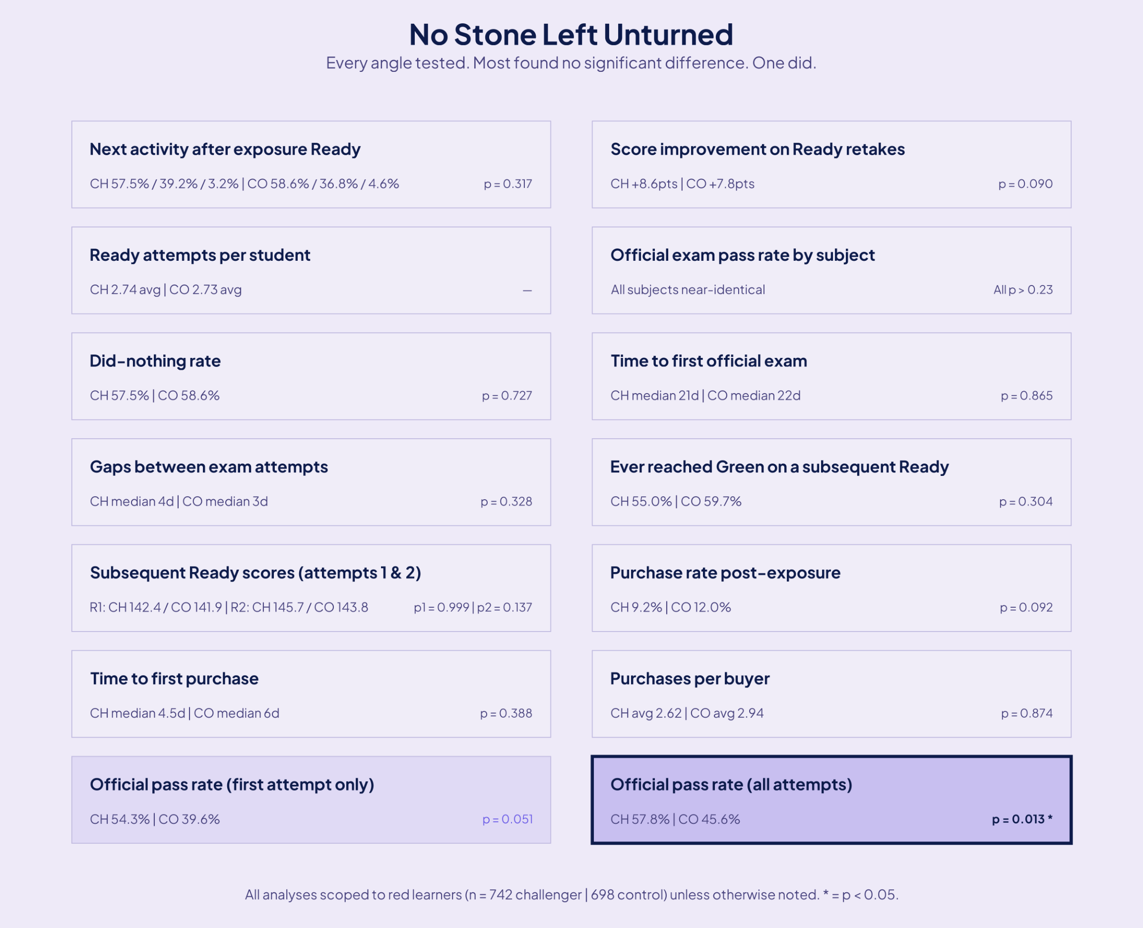
Score Report Color Test
Notes:
Chef Hamza analysis — Confluence UX space, May 21 2026 check-in.

Slide 16
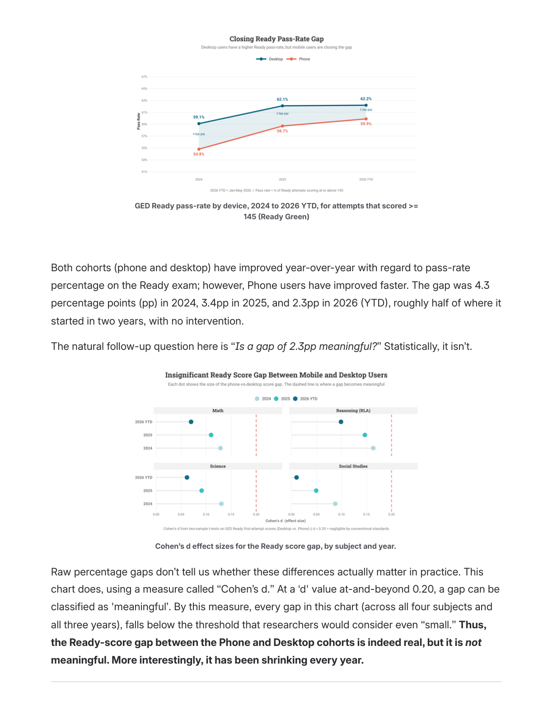
Ready Pass Rates by Device — Gap Is Shrinking
Notes:
Phone users improving Ready-Green rates at 4.7pp/year vs. 2.6pp for desktop.

Slide 17
GED Ready ↔ Official Test Performance
Learners who take a GED Ready perform on average 10 points higher on the official test
60% likelihood to take 1st GED Test if Ready taken vs. 13% if no Ready
The most successful 'Determined' learners take ~5 GED Ready tests before credentialing
More than 1 million GED Ready official practice tests taken per year
Notes:
Present: GED Ready ↔ Official Test Performance

Slide 18
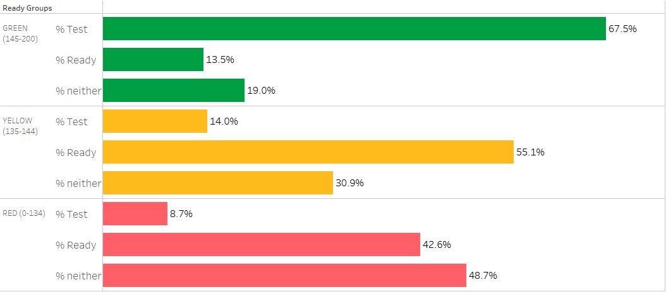
Ready Score Drives Next Activity
Notes:
Present: Ready Score Drives Next Activity

Slide 19
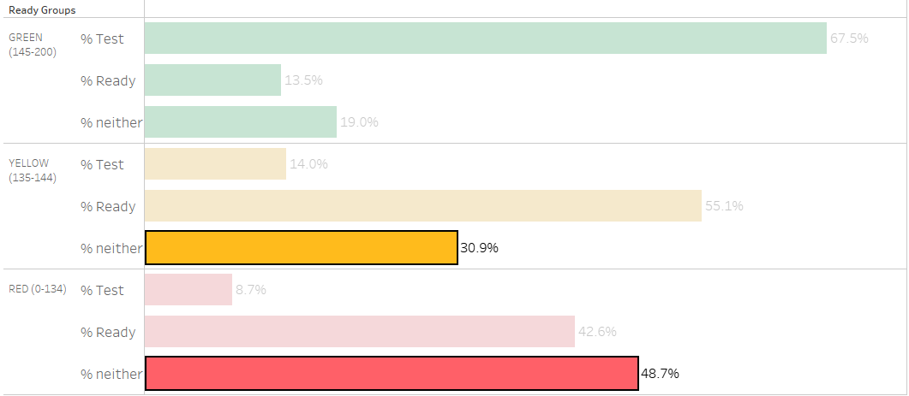
Activity Persistence by Ready Score Band
Notes:
Present: Activity Persistence by Ready Score Band

Slide 20
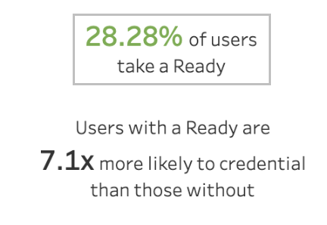
Taking a Ready Has the Most Influence on 1st Test
Notes:
Present: Taking a Ready Has the Most Influence on 1st Test

Slide 21
The Ready Is a Thermometer, Not Medicine
Works as a signal: 99.9% with Math Ready attempted the exam vs. 52.6% without
Not a cure: more Readys ≠ higher scores
Does: measure readiness, predict pass likelihood, build confidence to test
Doesn't: replace instruction, close skill gaps, or build new Math skills
Notes:
Educator action: pair Ready results with instruction, Flash, or GED & Me.

Slide 22
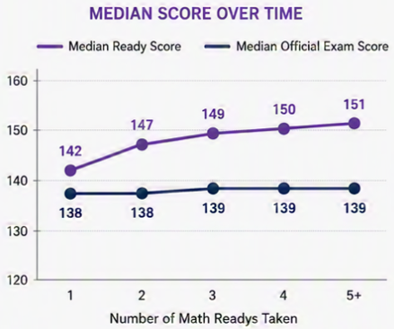
Ready as Thermometer: Math Attempt Rates
Notes:
99.9% with Math Ready attempted exam vs. 52.6% without.

Slide 23
GED Flash®
Usage, Spanish expansion, and learner impact
Notes:
Present: GED Flash®

Slide 24






GED Flash®: Expanding Access & Adoption
3,100+ Spanish practice questions, each with answer rationales
Now in Spanish — April 2026 launch with an English/Spanish toggle
Nearly 85,000 units sold from Jan 2023 to Dec 2025
Has performed well since its introduction in 2018
93% of students want more practice and feedback — the #1 requested resource
All 4 Subjects (1-month) is the top seller at 39% of units

Slide 25
Introducing GED Flash in Spanish
Official GED Flash Spanish content now available across all four subjects
Math, RLA, Science, and Social Studies — expanding access for Spanish-speaking learners
Notes:
Educator tip: pair Spanish Flash with Spanish instructional resources.

Slide 26
GED Flash: Skill Drill for Test Day
Thousands of practice questions for targeted skill drilling before test day
Teachers and GEDWorks advisors use Flash as a pre-test skill drill
Learners who practice frequently on GED Flash score on average 4 points higher
Used in many adult ed classrooms alongside instruction
Notes:
Present: GED Flash: Skill Drill for Test Day

Slide 27
GED Flash Impact & Classroom Use
Pair with GED Ready diagnostics: Flash drills skills identified in the score report
Classroom: assign subject-specific Flash sets; use as pre-test warm-up
Independent: purchase on GED.com; pair with GED & Me for AI-guided help on missed questions
Math is the top single-subject purchase — 4-subject bundles most popular overall
Notes:
Present: GED Flash Impact & Classroom Use

Slide 28
GED & Me
GED & Me™ and secure, guided learner support
Notes:
Present: AI Tutors

Slide 29
GED & Me: The Official GED Mobile App
187K+ downloads through June 2025; 4.8★ rating (1,600+ ratings)
73% finish account setup; 45% engage with in-app practice questions
Confidence shift: 'not confident at all' eliminated; very/extremely confident 22% → 50%
Free app with optional Boost ($19.99/mo) for unlimited Syd AI chats
Notes:
Present: GED & Me: The Official GED Mobile App

Slide 30
Meet Syd — Your AI Study Buddy
AI-powered personal tutor in GED & Me, built with Pace AI on official GED materials
Math launched July 2025; Science recently added; RLA and Social Studies coming soon
250+ languages; popular feature: 'Break it down for me'
Provides hints and step-by-step explanations — not direct test answers
Notes:
Present: Meet Syd — Your AI Study Buddy

Slide 31
Syd by the Numbers (April 2026)
18,000+ learners engaged | 132,000+ AI chat interactions | 10.7 min avg session
46% of Math question answerers use AI support | 2.4x more learning time vs. non-Syd users
54,000 active users in Feb 2026 — highest month since launch
+3 pp first-test pass rate | up to +5 pp on subsequent attempts | +4.9 avg score points
Notes:
Source: GED April 2026 press release; Pace AI case study.

Slide 32
AI Tutors: Secure, Guided Support
How Syd Helps
Syd, the AI Tutor in the GED & Me™ app, explains practice questions step-by-step in math and science.
Support is available in 250+ languages, right inside the practice questions.
A judgment-free space lets learners ask anything, anytime.
Responsible AI
Trained only on official GED content to protect test integrity.
Secure, learner-first design with usage limits and monitoring.
Delivers personalized practice, timely feedback, and encouragement.
Built to guide learners, never to compromise test security.
Proven Impact
Learners using the AI Tutor are 2.4x more engaged and study twice as long per session.
Retention nearly doubled—from 34% (Feb 2025) to 66% (Feb 2026).
50,000+ learners use the app monthly, answering 1M+ questions in 90 days.
Engaged retakers pass Math at twice the rate, averaging a ~5-point score gain.

Slide 33
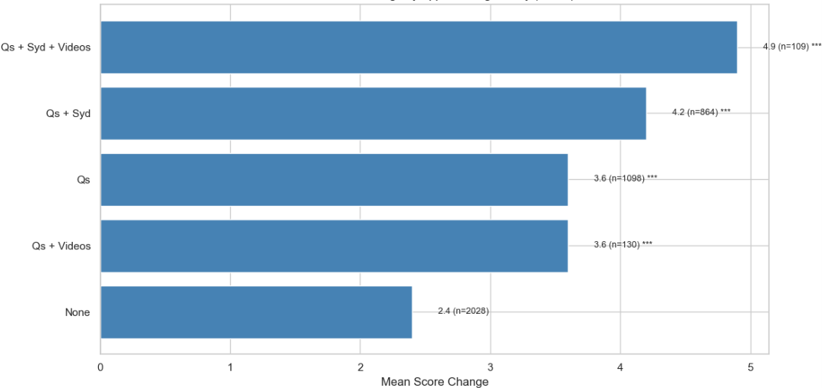
Mobile Math Practice Helps Close the Gap
Notes:
Average score increase from failed test to next attempt.

Slide 34
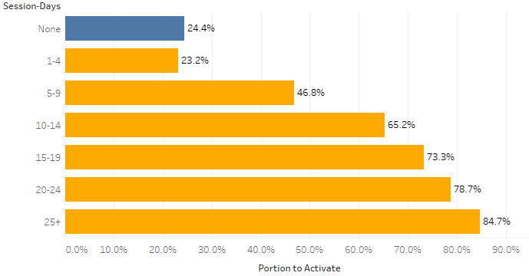
Mobile Activity Correlates with Activation & Credential Rates
Notes:
5+ mobile session-days → significantly higher activation and credential rates.

Slide 35
Responsible AI: How GED Protects Learners
Trained on official GED materials — scaffolded hints and breakdowns, not answer keys
No automated high-stakes testing decisions — AI is an aid, not a replacement
Privacy-first: minimal data collection; partners don't retain test taker data
Syd extends instructor reach — it does not replace teachers, advisors, or tutors
Notes:
Full policy: ged.com/ged-testing-service-ai-policy-statement

Slide 36
Classroom Tip: Recommend GED & Me for Math-Stuck Learners
79% of stallers are missing Math — mobile Math practice helps close the gap
Recommend the app after a failed Math test or low Math Ready score
Mobile-engaged learners show higher pass rates on follow-up attempts
Notes:
Present: Classroom Tip: Recommend GED & Me for Math-Stuck Learners

Slide 37
Post GED Opportunities
Partnerships with Stride and Prentus
Notes:
Present: Libraries Strategy

Slide 38


PRENTUS · FOR GED GRADS
https://prentus.com/ged
Turn a GED® into a career
An all-in-one AI career agent built for adult learners entering the workforce — resumes, mock interviews, and no-degree jobs, all in one place.
54%
24/7
9+
$49
Faster job searches
AI career coach access
Career tools included
One-time, lifetime access
AI Resume Builder
Voice Mock Interviews
No-Degree Job Board
Automatic LinkedIn-verified outcome tracking gives your program placement data

Slide 39


https://www.ged.com/careerconnect.html
MEDCERTS × GED CAREER CONNECT
From a GED® to a healthcare career
GED graduates are first in the nation to access MedCerts' industry-recognized allied health certification training — job-ready in months, not years.
80K+
3–6 mo
1,000+
Trained since 2009
To job-ready
Employer partners
Medical Assistant
Phlebotomy
EKG Tech
Sterile Processing
Billing
100% online and flexible — with funding pathways like WIOA, military grants, and scholarships that fit adult learners balancing work and family.

Slide 40
Libraries Strategy
Expanding access to GED Ready and prep resources
Notes:
Present: Libraries Strategy

Slide 41

A Libraries Strategy for GED Ready®
New channel: Libraries expand access to GED Ready practice tests and prep resources for independent learners.
Voucher pilot: Each participating library receives 25 free GED Ready vouchers, with an easy path to purchase larger volumes.
Ready-to-use toolkit: In-library flyers, a voucher redemption one-pager, and a learner guide make setup simple.
In market now: library visits are underway; flyers available if you’d like to take to libraries in your area.
Classroom tip: Point learners without program access or a computer at home to their local library as an on-ramp to official practice.

Slide 42
GED+
Dedicated Advising for GED Candidates
Notes:
Present: Libraries Strategy

Slide 43
GED+ & GED+ for Organizations
What Learners Receive
A dedicated GED Advisor helps each learner build a study plan and answer questions.
Unlimited official practice tests through GED Ready®.
Study tools selected to fit each learner’s needs.
Unlimited GED exam sessions for the purchased subject.
Online tutoring when extra help is needed.
How It Works & Why It Helps
One subject at a time: organizations buy GED+ on behalf of learners, so each person progresses at their own pace.
Purchase GED+ for Organizations, then receive voucher codes by email.
Share the codes so learners enroll and study one subject with Advisor support.
Educator opportunity: a fit for waitlisted learners or those in remote locations—help on a schedule that works for them.
Ready to scale? GEDWorks adds custom landing pages and reporting.

Slide 44
Product Roadmap
Looking ahead — grounded in research and learner data
Notes:
Present: Product Roadmap

Slide 45
GED Ready Roadmap Highlights
Now: Color evaluation & testing, tablet support, tablet use data analysis
Later: Voucher distribution, publisher content mappings, terms & locations updates
Related: Ongoing security reviews, A11Y/access improvements, indicator skills chart
Adoption of new score report colors requires cross-team messaging updates (Zone 1/2/3 language)
Notes:
Full roadmap: GED Product Overview 2026.

Slide 46
North Star: Research-Driven Product Development
Activation: get learners from account setup to first test (Ready is #1 lever)
Persistence: protect momentum after failure — 30+ days of inactivity is a red flag
Math skill gap: Flash + GED & Me target the #1 staller bottleneck
Access equity: libraries, vouchers, and free app tier reach Non-Activators (72%)
Notes:
Present: North Star: Research-Driven Product Development

Slide 47
Classroom-Ready Tips
Put these tools to work for learners today
Notes:
Present: Classroom-Ready Tips

Slide 48
5 Things Educators Can Do Today
1. Get learners to a GED Ready early — it's the #1 predictor of testing and success
2. Use Ready as a skill inventory; pair with instruction, Flash, or GED & Me — not as study alone
3. Recommend GED & Me (especially for Math) for stuck learners and post-failure retests
4. Protect momentum — watch for 30+ days of inactivity after a failed test or low Ready
5. Leverage library and program bulk purchase options for access equity
Notes:
Source: Kris Mehan takeaways + GED product team.

Slide 49
In Summary
GED Ready score reports now give learners actionable, skill-level study plans
GED Flash (now in Spanish) delivers targeted skill drill with measurable score impact
Syd AI tutor in GED & Me provides secure, 24/7 support that drives persistence
Libraries and program partnerships expand access to the tools that work
Notes:
Present: In Summary

Slide 50
Questions?
Victor Fitzjarrald — Sr. Product Manager, GED Testing Service
Notes:
Present: Questions?

Slide 51
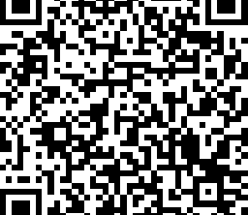
Session Survey
Your feedback is important. Please scan the QR code to rate this session.
Notes:
Replace QR with 2026 conference survey code when available.

