Slide 1

Cracking the Code to Successfully Conduct GED Math Boot Camps That Drive Student Success
Timothy Reed | Adult Education Instructor | Augusta Technical College

Slide 2
Welcome Q & A Question for the Room
The Question is
"How many of you have students who have passed every GED test — except math?"
The Answer
If your hand is up, you already understand the challenge. Math is consistently the final barrier standing between adult learners and their GED credential. Today's session is built for educators just like you — practical, data-driven, and immediately applicable.
Who This Is For
Adult Education Instructors, Coordinators, and Program Directors working with GED learners
What You'll Leave With
A proven bootcamp framework, engagement strategies, and tools ready to use
Structured learning, hands-on activities, and open discussion

Slide 3
Icebreaker: Table Discussion
Take 2 minutes to discuss the following questions.
Question 1
What percentage of your students struggle most with math compared to other GED subjects?
Question 2
What do you believe is the single biggest obstacle your students face when preparing for GED Math?

Slide 4

Common Responses
Common responses: math anxiety, lack of confidence, long gaps in education, and negative school experiences — all of which a well-designed bootcamp directly addresses

Slide 5
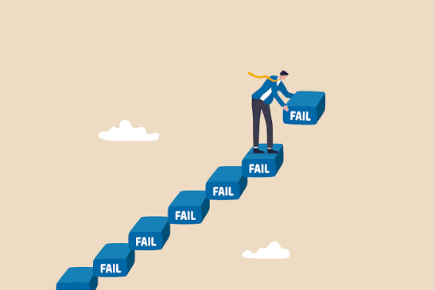

The State of GED Math
Understanding why students struggle and why traditional approaches often fall short

Slide 6

The Reality of GED Math
Math doesn't just challenge students academically — it challenges them emotionally. For many adult learners, the GED Math test represents years of accumulated frustration, avoidance, and self-doubt. Before we can improve scores, we need to understand the full picture of what our students are up against.
The Last Test Standing
Math is almost always the final GED subject remaining. Students have already proven they can succeed — but math feels like an insurmountable wall.
Years of Skill Gaps
Many adult learners left school before mastering foundational math concepts. Those gaps compound over time, making even basic problems feel overwhelming
Fear Before Failure
Students often fail math mentally before they fail it academically. Test anxiety and math phobia are real cognitive barriers that must be addressed in instruction.

Slide 7


Discussion: What's Harder to Fix?
"What is harder to fix: a math skill gap or a confidence gap?"
This question doesn't have one right answer — but in practice, most experienced instructors will tell you that confidence is the larger obstacle. A student who believes they cannot learn math will resist every instructional strategy you try. Skill gaps are teachable. Belief systems take deliberate, sustained effort to shift.
Skill Gap
Addressable through targeted instruction, spaced practice, and focused curriculum design
Confidence Gap
Requires consistent encouragement, growth mindset language, and repeated small wins to rebuild belief in oneself as a math learner

Slide 8

What We Hear in Our Classrooms
These statements are not rare — they are the everyday reality of teaching GED Math. Recognizing these belief patterns is the first step toward designing instruction that dismantles them
"I've never been good at math. I wasn't good at it in school and I'm not good at it now."
"I hate fractions. I've never understood them and I never will."
"I'm too old to learn this. My brain doesn't work the way it used to."
"I can't remember formulas. I just go blank when I see a test."
The reality: Most students CAN learn the required GED math skills. The challenge is helping them believe that — and then proving it through experience.

Slide 9


Why Traditional Instruction Often Falls Short
Standard adult education classes serve many goals simultaneously — they can't always provide the intensity that a student stuck on math needs. Bootcamps solve this by creating a dedicated, immersive environment where math is the only focus.
Pacing Mismatch
Traditional instruction moves at a pace that serves the whole group. Students who need more time on algebra don't get it.
Infrequent Feedback
Weekly classes don't provide the rapid correction cycle students need to break through persistent misconceptions.
Diffuse Focus
Covering all GED subjects simultaneously dilutes instructional intensity on the skill set that needs the most attention.
Low Urgency
Without a concentrated experience, students can stagnate for months without progress toward their testing date.

Slide 10
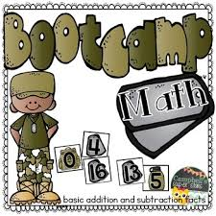
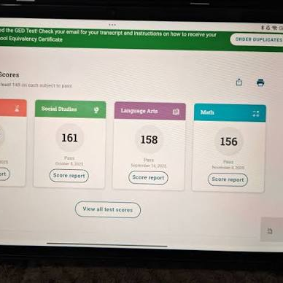
The Bootcamp Model
What it is, why it works, and how to design it for your program
What Is a GED Math Bootcamp?
A GED Math Bootcamp is a short-term, intensive learning experience designed with one purpose: move students over the finish line on their most persistent barrier. It's not remediation. It's targeted acceleration.
"The goal is not to reteach years of mathematics. The goal is to teach students how to be successful on the GED Math test."
Address High-Priority Skills
Focus instruction on the domains and question types that appear most frequently on the actual GED Math test
Improve Test Readiness
Build familiarity with GED Math format, calculator tools, and time management under realistic conditions
Build Confidence
Create repeated experiences of success so students arrive at test day believing they can pass
Accelerate Credential Completion
Compress the timeline to testing, helping students earn their GED faster and move on to their next goal

Slide 11
Bootcamp Format Options
There is no single "right" format. The best bootcamp is the one that fits your students' schedules, your facility's capacity, and your program's goals. Here are the most common formats in practice:
Format | Length | Best
One-Day Bootcamp | 6-8 hours | High-urgency students near passing range
Weekend Bootcamp | 2 Days Sat/Sun | Working adults with limited availability
Weekly Bootcamp | 2 per week session 3 hours | Students who need pacing and time to process
Virtual Bootcamp | Online only | Remote learners
Why Bootcamps Work
Laser Focus
Students aren't juggling multiple subjects. Every minute is devoted to math skills that appear on the test.
High Engagement
Intensive formats create urgency and energy that traditional weekly classes struggle to replicate
Immediate Feedback
Students know quickly what they got right, what they missed, and how to correct it — accelerating learning.
Visible Progress
Pre- and post-assessments show measurable gains, which powerfully reinforces student belief and motivation.

Slide 12

Building Your Bootcamp
From identifying the right students to designing the right lessons
Step 1: Identify the Right Students
Not every student is the ideal bootcamp candidate. The highest-impact bootcamps are built around students who are close to the finish line but haven't crossed it yet. Strategic targeting maximizes your outcomes data and your students' chances of success.
Primary Targets
Students who need only math to complete their GED — all other subjects already passed
Repeat Testers
Students who have failed the GED Math test one or more times and need a
Score Range Sweet Spot
GED Ready scores of 135–144 represent students within striking distance of the 145 passing score
Students in the 135–144 GED Ready score range typically experience the largest gains from intensive bootcamp instruction. Prioritize this group for maximum program impact.

Slide 13
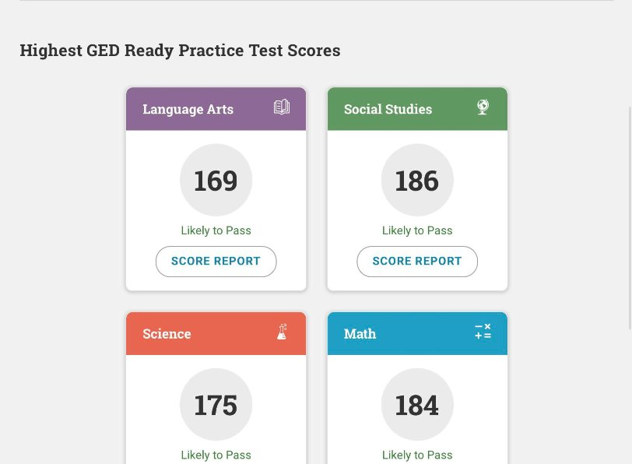
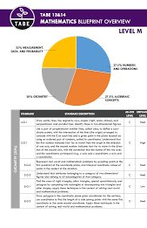
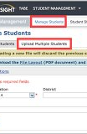
Step 2: Start With Data
The most successful bootcamps don't begin with a lesson plan — they begin with a diagnostic picture of where each student currently stands. Data tells you where to spend your limited instructional time for the greatest return.
GED Ready Scores
The official practice test — your most reliable predictor of test readiness and your baseline measurement
TABE Scores
Identify foundational skill gaps in number operations, algebra, geometry, and data analysis
Classroom Assessments
Teacher-created pre-assessments aligned to GED Math domains — quick, targeted, and immediately actionable
Student Self-Assessments
Ask students to rate their own comfort level with key topics — confidence data is just as important as skill data

Slide 14
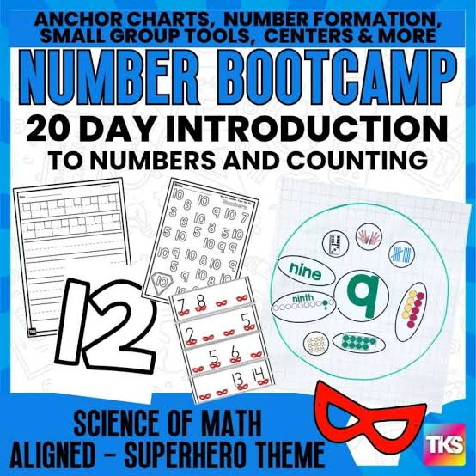
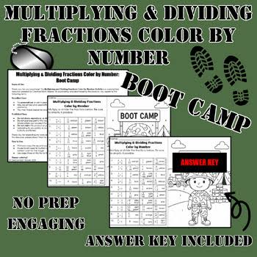
Creating Skill Groups From Data
Once your diagnostic data is collected, use it to group students by instructional need. This allows you to differentiate instruction within the bootcamp without losing the group energy that makes the format effective.
Group 1
Number Operations & Fractions — foundational skills that unlock algebraic understanding
Group 2
Algebra — equations, slope, functions, and linear relationships (highest test weight)
Group 3
Geometry — area, perimeter, volume, and coordinate geometry
Group 4
Data Analysis & Statistics — mean, median, graph interpretation, and probability

Slide 15
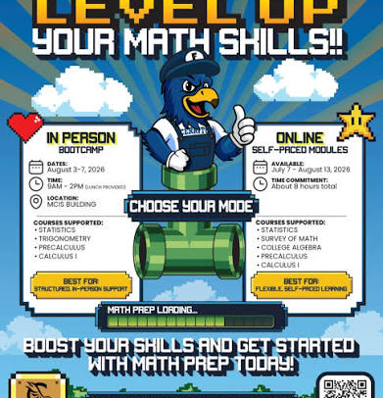
Step 3: Focus on the Highest-Impact Skills
The GED Math test is not a comprehensive math exam — it tests a specific, finite set of skills. If your instructional time is limited (and it always is), concentrate your effort where the test concentrates its points.
GED Math Domain Weights
Algebraic Thinking: 55%
Quantitative Problem Solving: 45%
If time is limited, spend the majority of instruction on Algebra. It provides the greatest return on investment of any single domain.
High-Priority Topics
Solving linear equations
Slope and linear functions
Ratios and proportions
Percentages
Area, perimeter, and volume
Data interpretation and graph analysis
Basic statistics (mean, median, mode)

Slide 16
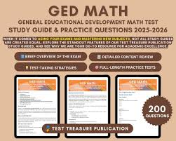
The Bootcamp Instructional Framework
Every bootcamp session should follow the same predictable cycle. Repetition of this structure builds student confidence — they know what to expect, which reduces cognitive load and anxiety. The cycle works at any skill level and for any topic.
DIAGNOSTIC
DIRECT INSTRUCTION
GUIDED PRACTICE
INDEPENDENT PRACTICE
REVIEW

Slide 17
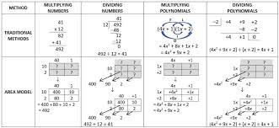
What to Teach: Algebra (55% of the Test)
Algebra is the single highest-leverage domain on the GED Math test. Mastery of these core concepts gives students more than half of the test's content — making it the non-negotiable foundation of any effective bootcamp.
Solving Equations
One- and two-step linear equations; equations with variables on both sides; solving for a specified variable
Slope & Linear Functions
Calculating slope from two points; interpreting slope in context; slope-intercept form; graphing lines
Graphs & Tables
Reading and interpreting coordinate graphs; matching equations to graphs; identifying key features of functions
Inequalities
Solving and graphing linear inequalities; understanding inequality notation and real-world applications

Slide 18
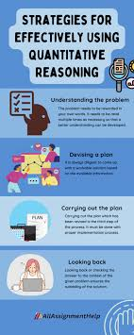
What to Teach: Quantitative Reasoning (45%)
Quantitative reasoning includes the practical math skills students use in everyday life — which makes it one of the most accessible domains for adult learners when taught with real-world context
Ratios & Proportions
Unit rates, proportional reasoning, and solving proportion problems in context — commonly tested in workplace and consumer scenarios
Percentages
Percent increase/decrease, tips, tax, interest, and discount problems — highly test-relevant and highly relatable for adult learners
Fractions & Decimals
Operations with fractions, converting between forms, and applying them in multi-step problems
Geometry
Area, perimeter, and circumference of 2D shapes; volume of 3D figures; coordinate geometry and the Pythagorean theorem
Statistics & Data
Mean, median, mode, and range; reading bar graphs, line plots, histograms, and scatterplots

Slide 19
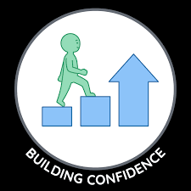
Building Confidence
Because no amount of content knowledge matters if students don't believe they can pass
The Confidence-Performance Connection
"Students often borrow our confidence before they develop their own."
Research in adult learning consistently shows that self-efficacy — the belief that one can succeed — is one of the strongest predictors of academic performance. For GED Math students, building confidence isn't a "nice to have" — it's a core instructional strategy. An instructor who believes in every student, and communicates that belief explicitly and repeatedly, can change the arc of a learner's trajectory.

Slide 20

Confidence-Building Strategies That Work. These strategies should be embedded into every bootcamp.
Celebrate Small Wins Explicitly
When a student solves a problem they previously couldn't, name it. Say "You just solved a slope problem — that's on the GED." Specificity makes encouragement credible.
Use Growth Mindset Language Consistently
Replace "you're wrong" with "not yet." Replace "do you understand?" with "what questions do you have?" Language shapes how students experience failure and effort.
Allow Productive Struggle
Resist the urge to rescue students immediately. Sitting with difficulty and pushing through it is how real confidence is built. Guide — don't do it for them.
Normalize Mistakes as Learning Data
Create a classroom culture where getting something wrong is a signal to look closer — not a reason to give up. Post and discuss common errors openly.

Slide 21
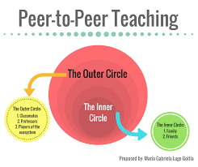
Peer Teaching: Confidence Through Contribution
One of the most underutilized confidence strategies is peer teaching. When a student explains a concept to a classmate, something powerful happens: they move from passive learner to active expert. This shift is transformative for adult learners who may have spent years feeling like failures in academic settings.
Explain-It-Back Pairs
After direct instruction, students pair up and take turns explaining the concept in their own words before solving problems independently.
Whiteboard Teach-Backs
A student who has mastered a concept writes the steps on a whiteboard and walks the class through a problem — with your coaching support.
Study Buddy Groups
Assign consistent peer groups across all bootcamp sessions so students build relationships and accountability with each other.

Slide 22
Engagement Strategies
Active learning transform math from intimidating to achievable
Why Active Learning Matters in Math
"The more students interact with mathematics, the less intimidating it becomes."
Passive instruction — listening to a teacher explain math — creates observers. Active learning creates doers. In a bootcamp setting where time is limited and confidence is fragile, active engagement isn't optional. It's the mechanism through which real learning happens. When students talk about math, write math, and teach math to each other, they internalize it in ways that lecture alone cannot achieve.
Retention Through Teaching
Students retain approximately 90% of material when they teach it to others vs. 5% from lecture alone.
Practice by Doing
Students retain approximately 75% of material learned through hands-on practice activities.
Discussion Groups
Collaborative discussion produces approximately 50% retention — far above passive formats.

Slide 23

Engagement Activities That Work
Math Stations
Rotate small groups through 4–5 problem sets, each focused on a different skill. Builds breadth and keeps energy high.
Team Challenges
Groups compete to solve a set of GED problems in the shortest time with the highest accuracy. Accountability + motivation.
Whiteboard Competitions
Small groups solve problems on whiteboards simultaneously. The visual element makes thinking visible and errors easy to correct.
Kahoot Reviews
Digital quiz games using GED-style questions. Immediate feedback, friendly competition.

Slide 24
Your Turn Let's put it together
Every participatant will receive a set of GED-style math problems. Your job is to work through them as a group — just like your students would in a bootcamp. But your analysis goes one level deeper: You're not just solving, you're teaching.
Step 1: Solve Together
Work through all 5 problems collaboratively at your table. Use any tools available — calculator, formula reference, scratch work.
Step 2: Identify the Skill
For each problem, identify which GED Math domain is being tested and what specific skill the student must demonstrate.
Step 3: Find the Pitfalls
Predict the most common student misconceptions or errors for each problem. Where would your students most likely go wrong?
Step 4: Share Strategies
Prepare to share: How would you teach this? What approach, context, or visual would help a struggling student understand?
Math Stations
Rotate small groups through 4–5 problem sets, each focused on a different skill. This builds breadth and keeps energy high.
Team Challenges
Groups compete to solve a set of GED problems in the shortest time with the highest accuracy,Accountability + motivation.
Whiteboard Competitions
Small groups solve problems on whiteboards simultaneously. The visual element makes thinking visible and errors easy to correct.
Kahoot Reviews
Digital quiz games using GED-style questions. Immediate feedback, friendly competition

Slide 25

Activity Debriefing and Discussion
Which problem was hardest — and why?
Was it the math itself, or the way the problem was worded? GED problems often embed skills inside unfamiliar contexts, which trips up even capable students.
How would your students approach this?
Think about your specific student population. What prior knowledge would they bring? What would they be missing? What assumptions does the problem make about the reader?
What teaching move would be most effective?
Would you use a visual model, a real-world context, a worked example, or a student demonstration? What's your first instructional instinct and why?

Slide 26


Data and Outcomes
Measuring Bootcamp Success
Data is how you know your bootcamp is working — and how you make the case to administrators, funders, and your own teaching practice that the investment is worth it. Track both quantitative outcomes and qualitative indicators.
GED Ready Score Gains
Compare pre-bootcamp and post-bootcamp GED Ready scores for every participant. This is your primary outcome measure.
Attendance & Retention
Track who comes, who stays, and who completes all sessions. High attendance signals that the bootcamp is meeting student needs.
Practice Test Scores
Administer a practice test at the start and end of each bootcamp to show within-program growth, not just pre/post comparisons.
GED Pass Rates
Track how many bootcamp participants go on to pass the official GED Math test — within 30, 60, and 90 days of completion.

Slide 27
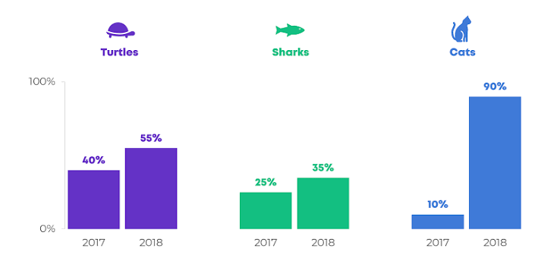
Before vs. After: Your Data Framework
The most powerful data story you can tell is a simple before-and-after comparison. Build this into every bootcamp from Day 1 so you always have the evidence you need.
Discussion: What are you measuring Now
Take a moment at your table to discuss how your program currently captures data on math readiness and outcomes. Consider: Are you measuring what matters most? Are there gaps in your data picture that a bootcamp framework could help fill?
What to Start Measuring
GED Ready score trajectories, time from bootcamp completion to test scheduling, and student confidence ratings as a leading indicator
What to Stop Doing
Relying solely on pass/fail as your outcome metric — that tells you what happened but not why, making it hard to improve your model
What to Celebrate
Every point of GED Ready score growth is worth recognizing — especially for students who have been stuck at the same score

Slide 28

Student Success Stories
Because numbers tell you what happened — stories tell you why it matters.
A Story Worth Telling
Every student who walks into our classroom brings a dream, a goal, and a reason for pursuing their GED. Our responsibility is to remove barriers, build confidence, and provide opportunities for success.

Slide 29

Case Study: From Stuck to Credential
This composite case study, drawn from real bootcamp participants, represents the journey we see repeatedly when the right support is put in place at the right time.
Already Proven
Student had passed RLA, Science, and Social Studies — demonstrating real academic ability and commitment to completing the GED.
The Wall
Failed GED Math twice. Each failure reinforced the belief: "I'm just not a math person." Standard class instruction wasn't creating enough momentum.
The Bootcamp
Enrolled in a six-session bootcamp. Received targeted instruction on algebra and geometry. Built calculator confidence. Experienced repeated small wins.
The Breakthrough
GED Ready score moved from 138 to 149. Student said: "I think I'm actually ready this time." Scheduled the test. Passed.
The Credential
Earned GED credential. Enrolled in workforce training program the following semester. One test. One bootcamp. One life changed.

Slide 30

The Ripple Effect of One Credential
When a student earns their GED, the impact extends far beyond a single test score. This is why the work of designing effective bootcamps matters so deeply — the credential is a gateway, not just a destination.
Economic Mobility
GED holders earn significantly more over their lifetime than those without a high school equivalency — the credential opens doors to better jobs and higher wages
Post-Secondary Access
Many community college, workforce training, and apprenticeship programs require a GED or diploma — earning it unlocks the next step
Family Impact
Research shows that when parents earn credentials, their children are significantly more likely to stay in school and pursue higher education
Self-Perception
Perhaps most importantly, earning a GED changes how students see themselves — as capable, persistent, and worthy of further investment in their own growth

Slide 31

Resources Participants Can Take Home
Bootcamp Planning Template
A session-by-session planning framework with timing, skill targets, and activity structures built in
GED Math Warm-Ups
30 ready-to-use daily warm-up problems organized by domain — perfect for the first 10 minutes of every bootcamp session
Practice Question Bank
GED-aligned practice questions organized by domain, difficulty level, and calculator/non-calculator designation
Student Tracking Sheet
Track each student's GED Ready scores, attendance, practice test results, and testing readiness status across the bootcamp
TI-30XS Calculator Guide
A student-friendly reference card covering all major calculator functions tested on the GED Math exam
Testing Readiness Checklist
A structured self-assessment students complete at the end of the bootcamp to determine if they're ready to schedule their official test

Slide 32
Anticipating Common Challenges
Every program faces obstacles when implementing something new. Anticipating them means you won't be stopped by them. Here are the most common bootcamp implementation challenges and how to address them proactively.
Challenge | Solution
Low enrollment | Personal outreach beats mass announcements — call students directly and explain exactly what to expect.
Inconsistent attendance | Build accountability partnerships between students and create a clear attendance commitment at enrollment.
Mixed skill levels in one group | Use station-based instruction to differentiate — different groups work different problems simultaneously.
Limited resources or materials | Free GED-aligned resources from GED Testing Service and Khan Academy can fill nearly any content gap.
Administrative buy-in | Lead with data: show GED Ready score ranges of your target students and the projected pass rate lift.

Slide 33
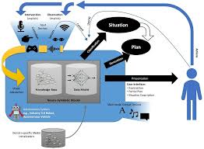
Adapting the Model to Your Context
No two adult education programs are identical. The bootcamp framework is a flexible model, not a rigid prescription. Here's how to adapt the core principles to fit your specific setting, population, and resources.
Small Programs (Under 20 Students)
Run a one-day or weekend bootcamp. Personal relationships are already built — leverage them. You can differentiate more easily in a small group setting.
Large Programs (50+ Students)
Run multiple cohorts targeted by GED Ready score range. Consider training a second instructor to co-facilitate, or using peer tutors from previous cohorts.
Virtual or Hybrid Programs
Use Zoom breakout rooms for group activities, digital whiteboards for problem-solving, and pre-recorded skill instruction to extend the bootcamp across multiple asynchronous sessions.
Community-Based Programs
Partner with libraries, churches, or workforce centers to host bootcamps in locations where students already feel comfortable and trusted.

Slide 34
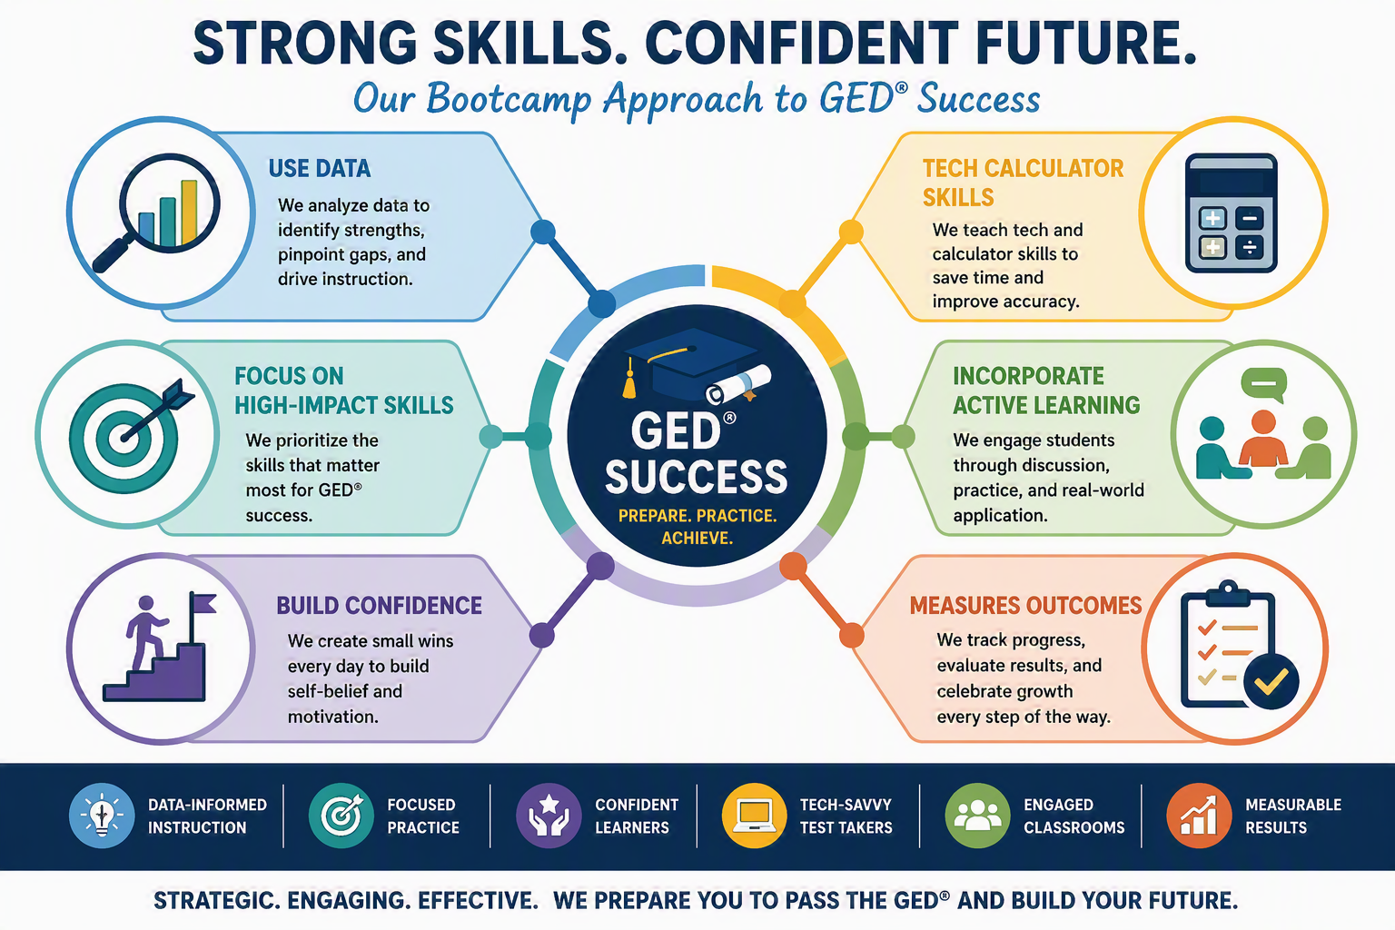
Key Take Aways
The essential distilled to what you need to remember and what you can do tomorrow
Use Data
Focus on High-Impact Skills
Build Confidence
Teach Calculator Skills
Incorporate Active Learning
Measure Outcomes

Slide 35

Final Thoughts
Your job is to engineer experiences of success until students believe, in their bones, that they are capable of passing this test so lets help them prove it.

Slide 36
References
Bandura, A. (1997). Self-efficacy: The exercise of control. W. H. Freeman.
Business Initiative. (n.d.). Skill gaps vs. confidence gaps: How to tell which you have and what to do about it. Retrieved July 1, 2026, from https://www.businessinitiative.org/business-tips/skill-gaps-vs-confidence-gaps-how-tell-which-have-what-do-about-iDweck, C. S. (2006). Mindset: The new psychology of success. Random House.
GED Testing Service. (2024). Assessment guide for educators. GED Testing Service.
GED Testing Service. (2024). GED educator handbook. GED Testing ServiceKnowles, M. S., Holton, E. F., III, & Swanson, R. A. (2015). The adult learner: The definitive classic in adult education and human resource development (8th ed.). Routledge.
Khan Academy. (n.d.). Math learning resources. https://www.khanacademy.org
ProLiteracy. (n.d.). Adult literacy and numeracy resources. https://www.proliteracy.org
U.S. Department of Education, Office of Career, Technical, and Adult Education. (n.d.). Adult education and family literacy resources. https://www.ed.gov

