Slide 1
Global Growth:
How GED Is Supporting Educators Worldwide
Ann Evers and Lindsay Calder

Slide 2
1
The GED Globally
2
Same Credential. Same Standard. Anywhere in the World
3
GED Professional Development Series™ for Adult Educators

Slide 3
1.
The GED Globally

Slide 4
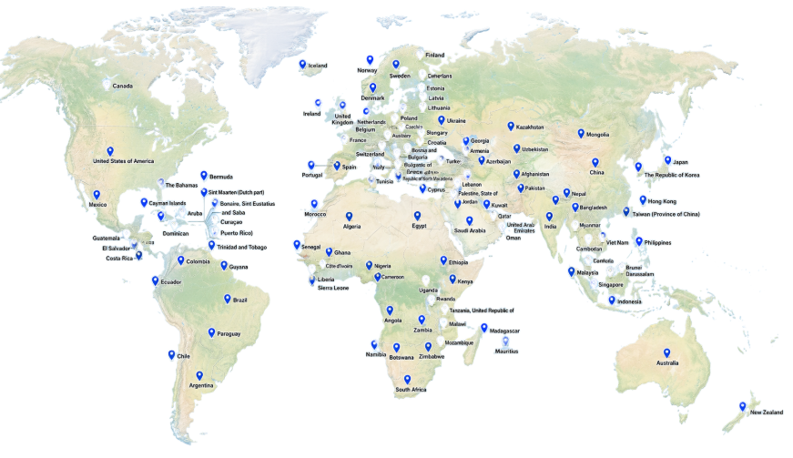
The GED: A Global Credential
120+ Countries
330+ Test Centers
Notes:
We are very proud to be serving candidate in over 120 countries, supported by over 330 GED authorized Pearson VUE test centres and growing.
This proves that the GED isn’t just a test, it is a globally recognised credential opening doors for candidates to higher education and employment.
Same credential. Same standard. Anywhere in the world.

Slide 5

Who Are Our International Students?
Notes:
The international student profile looks substantially different of that to our US student profile.
Our international students are incredibly diverse, as well as their reason for taking the GED test.
In some countries, GED functions similarly to the US model. In others, it’s a second chance for learners who never had access to formal education.
We’re also increasingly seeing GED used among refugee and displaced populations, which raises the stakes for consistency and quality.

Slide 6
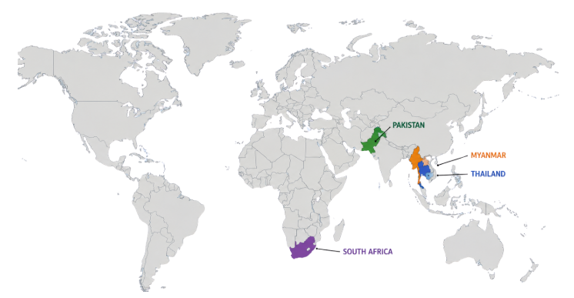
Top International GED Countries
A large youth and adult population with an unmet demand for secondary credentials.
High levels of educational disruption and cross-border mobility.
A regional hub for migrants and international education.
High unemployment and education gaps drive demand for alternative credentials.
Notes:
When people typically think of the GED, they think of the US only.
However, we are very proud to be serving candidate in over 120 countries, supported by over 330 GED authorized Pearson VUE test centres and growing.
This proves that the GED isn’t just a test, it is a globally recognised credential opening doors for candidates to higher education and employment.
Same credential. Same standard. Anywhere in the world.

Slide 7






Understanding the International Student
Int’l students mostly between 17-19 years
Science is the most-passed Int’l subject
Over 140,000 graduates in 2025
76% of GED-I graduates in 2025 used their GED credential to apply for university (locally and internationally)
Credential rate is nearly double that of US students
Majority of students self-funded.
Test fee is $90 per test.

Slide 8
2.
Same Credential. Same Standard. Anywhere in the World

Slide 9

Why Global Growth Matters
Expands access to education worldwide
Drives economic and education opportunity
Enables cross-border mobility
Strengthens the global value of the GED credential
Requires consistency across all markets
Same credential. Global expectation.
Notes:
Global growth is often framed as expansion—more countries, more learners, more access.
And it is that—but it’s also something much more important.
It’s about access—creating opportunities for learners who might not otherwise have a pathway.
It’s about opportunity—unlocking jobs, education, and economic mobility.
And increasingly, it’s about mobility across borders—learners using GED to move between systems, countries, and opportunities.
But as this happens, something really important changes.
The GED stops being a regional credential… and becomes a truly global one.
And when that happens, the expectation changes too.
Because now, a GED credential—no matter where it’s earned—has to represent the same level of readiness, the same standard, and the same trust.
And that means global growth doesn’t just increase opportunity—
it creates a shared responsibility across all of us who are part of the GED ecosystem.
GED is global The credential must be consistent Responsibility is shared

Slide 10
Quality vs Reality
What Drives Quality Outcomes?
Strong curriculum alignment
Experienced educators
Consistent preparation standards
Learner-centered delivery
The Reality Across Markets
Varying educator experience
Limited GED-specific training
Inconsistent program delivery
Rapid market expansion
Notes:
Across all markets, one factor consistently drives success: educator quality.
Many international educators are new to GED.
They may not have access to structured training—or may rely on inconsistent information.
And as we expand quickly, this challenge only grows.

Slide 11
What This Means for US Educators
One credential, shared globally
Global consistency depends on educator quality
Learner outcomes anywhere impact trust everywhere
The strength of the GED isn’t defined by one market; it is defined by the consistency across all of them.
Opportunity to collaborate and lead globally
No matter where a learner earns their GED, it carries the same name, the same recognition, and the same expectation.
Notes:
No matter where a learner earns their GED—whether it’s in the US or internationally—it carries the same name, the same recognition, and the same expectation.
Every GED credential—whether earned in Texas or Thailand—reflects on the same brand.
There’s also a huge opportunity for cross-market learning—international programmes are often incredibly innovative out of necessity.
And that means consistency doesn’t sit in one region—it’s something we all contribute to.
Because at the end of the day, the strength of the GED isn’t defined by one market—it’s defined by the consistency across all of them.
Which brings us to a key question:
How do we actually ensure that level of consistency—especially as we continue to grow globally?
Same credential. Same standard. Anywhere in the world.

Slide 12
Building Global Educator Consistency
The Gap Identified
No global standard for GED educator preparedness
Inconsistent training resources
Need for scalable, accessible solution
Globally, 8 in 10 teachers meet minimum qualification standards
Our Strategic Response
Global Professional Development Series
Standardized training framework
Accessible worldwide
Designed for diverse education contexts
Why Standardization Matters
Ensures consistent learner outcomes
Protects credential validity
Builds educator confidence
Strengthens global reputation
Notes:
We didn’t have a consistent, scalable way to prepare educators globally.
And without that, we risk inconsistency in how learners are supported.
So we built a solution: a Global Professional Development Series for Adult Educators.
This isn’t just content—it’s a strategic framework to ensure educators everywhere are aligned to GED standards.
Standardisation sometimes sounds rigid—but in this case, it’s what enables flexibility.
By aligning on core principles, we ensure learners everywhere are prepared to the same standard while still allowing local adaptation.

Slide 13
3.
GED Professional Development SeriesTM for Adult Educators

Slide 14
Timeline
Social Studies 101
Introducing foundational teaching materials (AGE, Focusing Themes, High Impact Indicators) and teaching strategies
RLA 101
Introducing the foundations and include the Extended Response
Math 101
Introducing foundational teaching materials and the known skill where at students ‘struggle
Science 101
Introducing foundational teaching materials (AGE, Focusing Themes, High Impact Indicators) and teaching strategies
4 Content Areas 201
Take a deeper dive into specific skills to teach

Slide 15

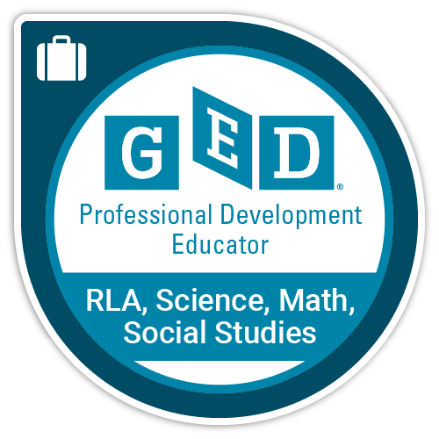
Course Highlights
Purchase
Learn
Credly Badge
Multi-Module 6 hour course
Readings
Videos
Teaching Strategies
Review questions to answer

Slide 16
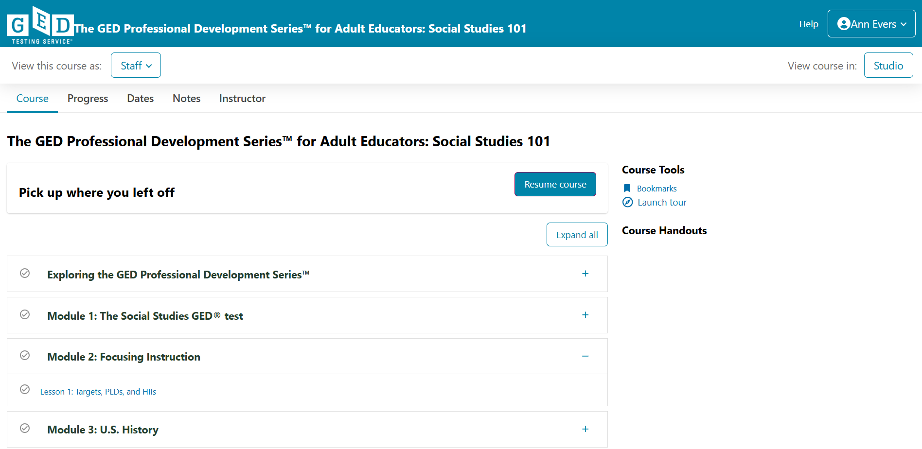
Welcome to Social Studies 101

Slide 17
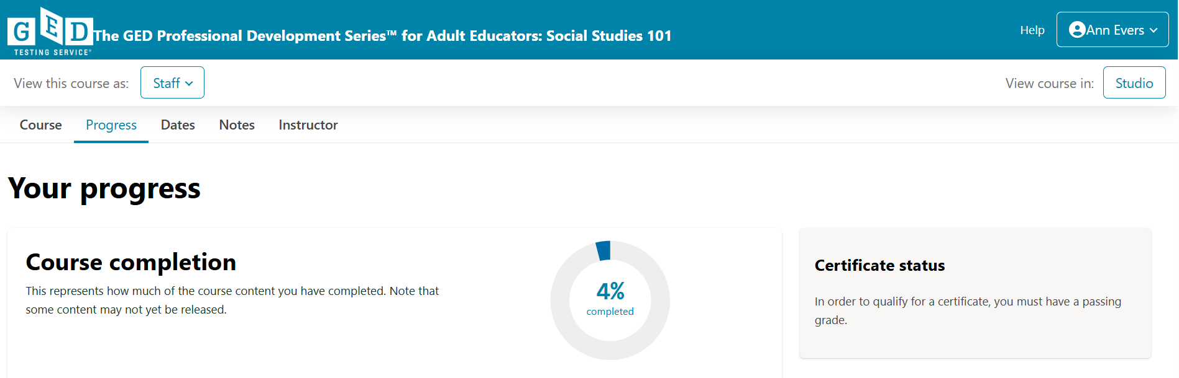
Progress Dashboard

Slide 18
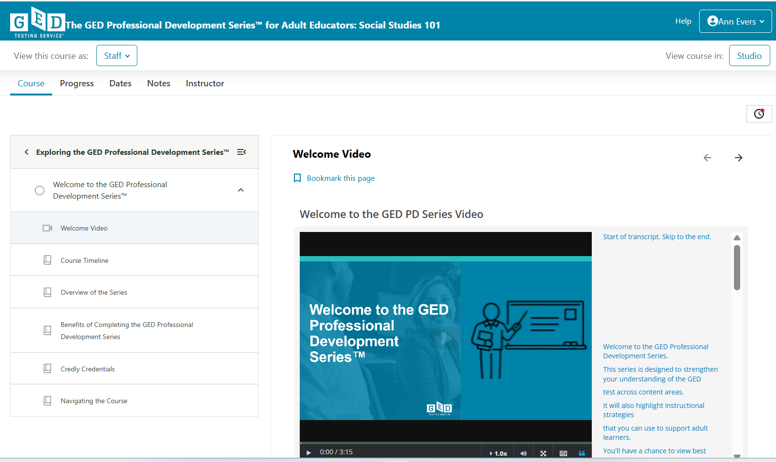
Welcome Video

Slide 19
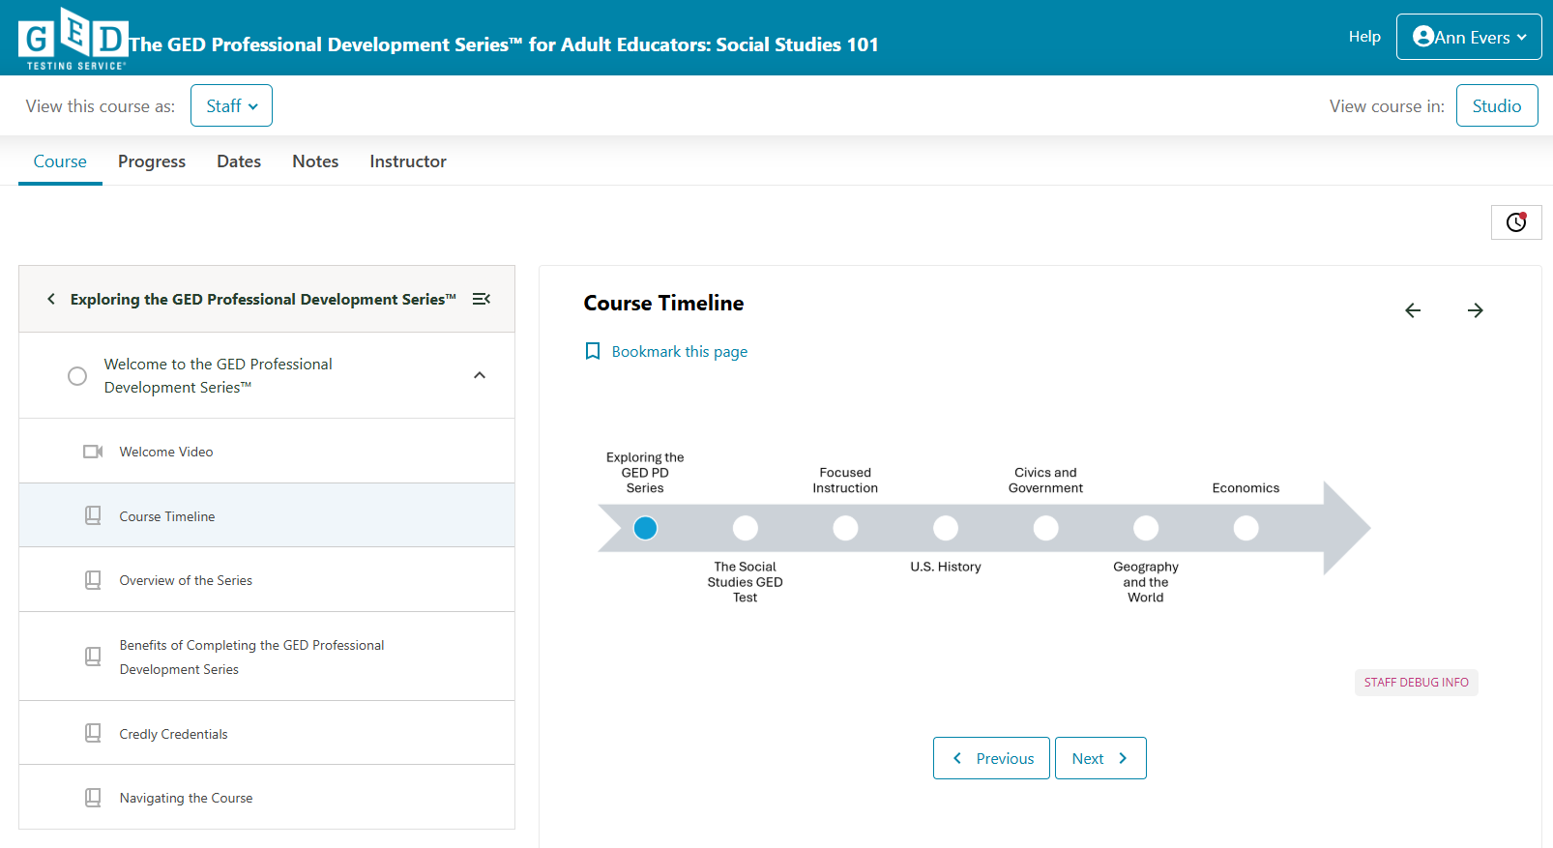
Social Studies Timeline

Slide 20
Live Demo
Watch the Welcome Video for Social Studies 101

Slide 21

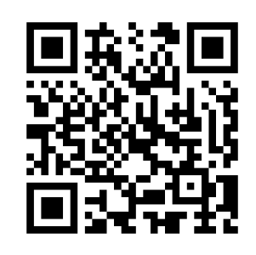
Session Survey
Your feedback is important. Please scan the QR code below to rate this session.

Slide 22
Thank you!
Ann Evers
Sr. Test Product Development and Innovation Research Manager
Ann.Evers@GED.com
Lindsay Calder
International Senior Program Manager
Lindsay.Calder@GED.com

