Slide 1
Getting Started with GED
Brian Smith, Director, State Accounts

Slide 2
1
2
GED test overview
Free Classroom Materials
3
4
Teaching Resources
The Learner Journey and You: Creating Connection and Supporting Success
5
6
Professional Development
What Comes Next?

Slide 3
An Overview of the GED® Test

Slide 4
GED Testing by the Numbers in 2025
350,506 people took the GED Test
208,201 completed all 4 parts
154,821 earned a GED credential
1,084,004 individual tests
1,184,872 GED Ready tests
7 – 11% of testers received a College Ready Score
2 – 5% of testers received a College Ready+Credit score
Science had a pass rate of 89%
Social Studies had a pass rate of 84%
RLA had a pass rate of 82%
Math had a pass rate of 74%
Median age of our testers is 23
75% of testers are 34 or under

Slide 5
The GED® Test
Available in English and Spanish
A wide array of accommodations are available:
  Including extended time, additional breaks, reader/recorder, private room, screen reader (JAWS) and many more
  Visit the GEDTS Accommodations Information Page
Notes:
Available in English and Spanish
A wide array of accommodations available
Including zoom-text, alternate color palettes, Braille, screen reader, extended time, paper testing for special circumstances

Slide 6
GED® Test
Test | Time | Notes
Reasoning through Language Arts | 150 minutes | Includes 45 minutes for extended response (timed separately) and a 10-minute break
Mathematical Reasoning | 115 minutes | Part 1 – calculator not allowed; Part 2 – calculator allowed
Social Studies | 70 minutes
Science | 90 minutes
Notes:
The chart provides an overview of the time for each of the tests, as well as pertinent notes.

Slide 7
Variety of Item Types
Multiple-choice
Fill-in-the-blank
Drag-and-drop
Hot-spot
Drop-down
Extended-response (Language Arts)
Notes:
The new GED test includes a wider variety of item types than were on the 2002 Series test. Multiple choice items continue to appear on the test as one of the key item types. Multiple choice items are a reliable method of measuring skills and knowledge at a range of cognitive levels in a standardized manner. But remember that the additional item types allow us to measure a wider range of skills and cognitive levels.
Constructed response items come in two versions – one, we call short answer, and that type can usually be answered in a few sentences (e.g. Science), and the extended response, which requires a longer response – multiple paragraphs (e.g. Reasoning Through Language Arts)

Slide 8

Overview of RLA Test
Content - Integrated reading and writing
  Close reading
  Clear writing
  Editing and understanding the use of standard written English in context
Source texts – 75% nonfiction; 25% fiction
Passage length – 400-900 words
Range of text complexity, including texts at the college- and career-ready level
Technology-enhanced items and extended response
Notes:
Key Points
This slide provides a short overview of the content and context of the RLA Test. Review the information on the slide. For additional information, access the Assessment Guide for Educators Reasoning through Language Arts section.

Slide 9
Extended Response on RLA
A constructed response item includes:
One or more source texts
Texts offer two positions on a given topic
A prompt that provides instruction on what the students is expected to do

Slide 10
Purpose of Extended Response
To provide test-takers with an opportunity to demonstrate
Knowledge of writing conventions in English
Understanding of what they’ve read
How well they use evidence to build arguments
Their ability to clearly communicate their thinking in their own words

Slide 11
Don’t Forget the Little Stuff
Expose students to a structured approach to the writing task and help them understand that they need to:
Write a complete response, not just a short paragraph (300-500 words)
Provide commentary on the evidence cited (explain the “why”)
Fully develop two or three ideas, rather than mention a lot of things without detail
Leave five minutes at the end for proofreading—that is one of the things evaluated
Notes:
Key Points
[Review the bullets on the slides.]
Discuss that these are ideas on how to improve scores. Also, note that the length is not about counting words, but rather is indicates that the writing sample needs to be long enough to adequately address the prompt. A short paragraph is not enough.

Slide 12
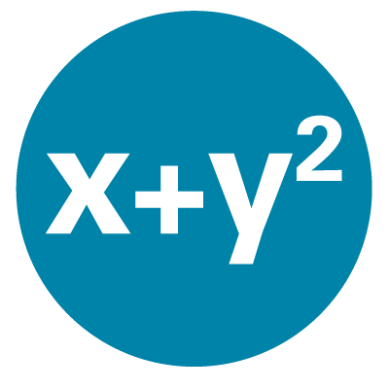
Overview of Mathematical Reasoning Test
Content
  45% - Quantitative Problem Solving
    Number operations
    Geometric thinking
  55% - Algebraic Problem Solving
Texas Instruments - TI 30XS Multiview™ (calculator allowed on most items)
Integration of mathematical practices
Formula page, symbols, and calculator page provided
Notes:
Key Points
This slide provides a short overview of the content and context of the Mathematical Reasoning Test. Review the information on the slide. For additional information, access the Assessment Guide for Educators Mathematical Reasoning section.

Slide 13

Overview of Social Studies Test
Content
  50% - Civics and Government
  20% - United States History
  15% - Economics
  15% - Geography and the World
Themes
  Development of Modern Liberties and Democracy
  Dynamic Responses in Societal Systems
Social Studies Practices – analyzing, thinking, reasoning
Technology-enhanced question items
Notes:
Key Points
This slide provides a short overview of the content and context of the Social Studies Test. Review the information on the slide. For additional information, access the Assessment Guide for Educators Social Studies section.

Slide 14

Overview of Science Test
Content
  Life Science – 40%
  Physical Science – 40%
  Earth and Space Science – 20% Themes
Themes
  Human Health and Living Systems
  Energy and Related Systems
Science Practices – reasoning and thinking scientifically
Question types - Technology-enhanced items
Notes:
Key Points
This slide provides a short overview of the content and context of the Science Test. Review the information on the slide. For additional information, access the Assessment Guide for Educators Science section.

Slide 15
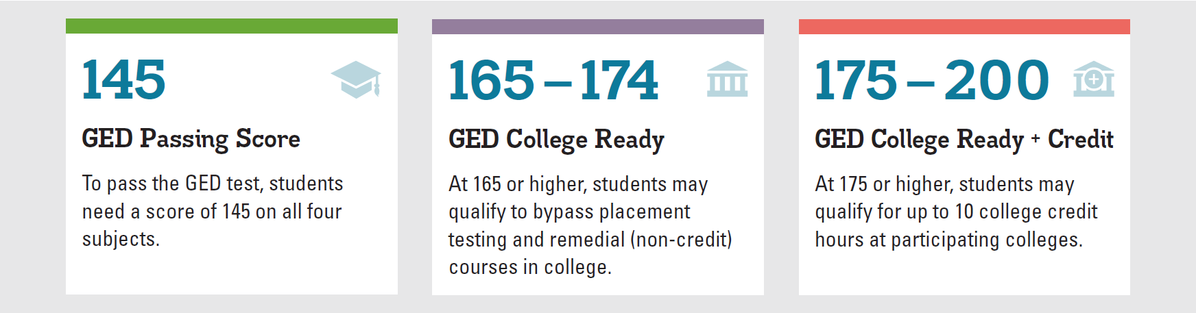
GED Score Levels Explained
GED College Ready scores improve the chances for college success.
Learn more at GED.com/collegeready
Notes:
A 145 or better in each subject will lead to a credential. However, I’ve highlighted the upper score “benchmarks” to acknowledge the opportunity for testers to either enter credit bearing course work, bypassing additional placement tests where approved (165+), OR to earn college credit, similar to AP exams for scores at or above 175, where approved.

Slide 16

Many colleges have already adopted the ACE® Credit Recommendations
Approximately 250 colleges across the U.S. have implemented one, or both, of the recommendations (CR and/or CR+credit)
  Colorado Community College System (both recommendations)
  Connecticut Public College System
  Georgia Technical College System
  Illinois Community College System
  Kansas Board of Regents (2 & 4-year colleges)
  Kentucky Community and Technical College System
  Ohio Community College System
  Virginia Community College System
  Texas Higher Education Coordinating Board
Additional Colleges in AL, AZ, KS, MA, MO, NJ, OR, RI, WA

Slide 17
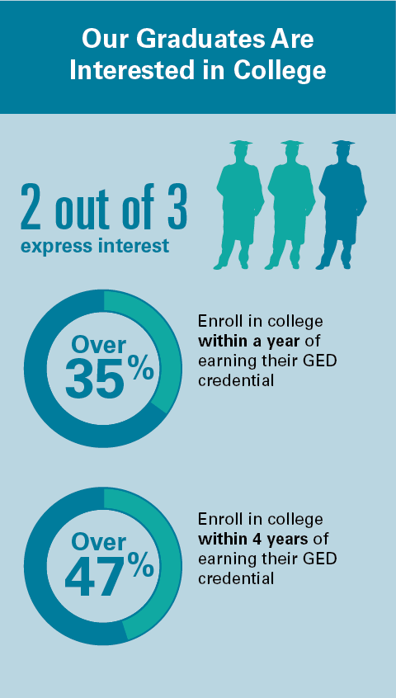

Slide 18
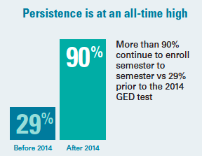
Persistence!
Congrats, all your hard work is paying off!
This number currently surpasses overall community college persistence rates

Slide 19
Teaching Resources
Performance Level Descriptors, High Impact Indicators, Assessment Guides, etc.

Slide 20


GED.com
click on “Educators & Admins”

Slide 21

Educators Tab

Slide 22

Educator Handbook!
Educator Handbook

Slide 23


A Guide for Everyone
GED_Playbook_2022-08_1937a_FINAL.pdf
Student_Handbook_ED1_FINAL-1.pdf (ged.com)
Notes:
Key points:
The GED Playbook The GED Playbook is for those who oversee and manage the GED adult education program, as well as instructors. It is a good starting point to assist in navigating and understanding the GED program.
GED Student Handbook The Student Handbook serves potential adult education program students, self-paced learners, and advocates of students navigating their GED journey. Within this document you will find many helpful resources and tips.

Slide 24
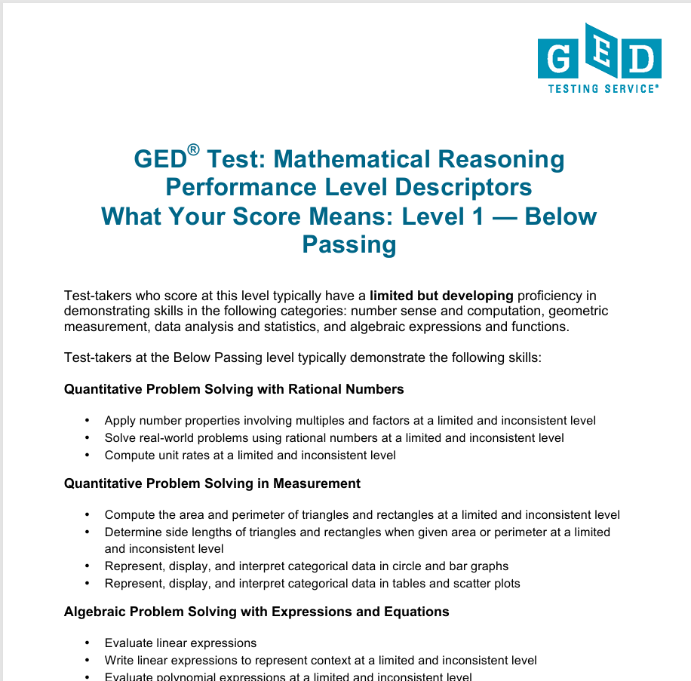
Performance Level Descriptors
Four Performance Levels
  Below Passing
  HSE
  GED® College Ready
  GED ® College Ready + Credit
What skills are demonstrated at each level
What skills need development to advance to the next leve
For more information see Skills Needed to Pass - GED Performance Level Descriptors
Notes:
Key Points
Review information on the slide regarding the resource (where it is located and what is included).
PLDs are located at: https://ged.com/educators_admins/teaching/teaching_resources/

Slide 25
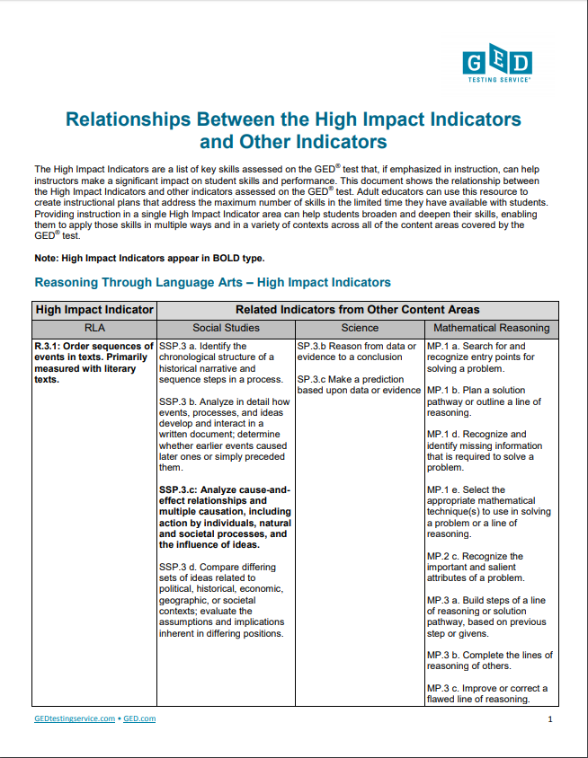
High-Impact Indicators Relationships
Show relationships among High Impact Indicators
Demonstrate interconnectedness across content areas
Develop skills available for use across a range of learning contexts
Notes:
Key Points
Review information on the slide regarding the resource (where it is located and what is included).
Relationships Between the High Impact Indicators and Other Indicators is located at: https://ged.com/wp-content/uploads/relationships_between_HII_and_other_indicators.pdf

Slide 26
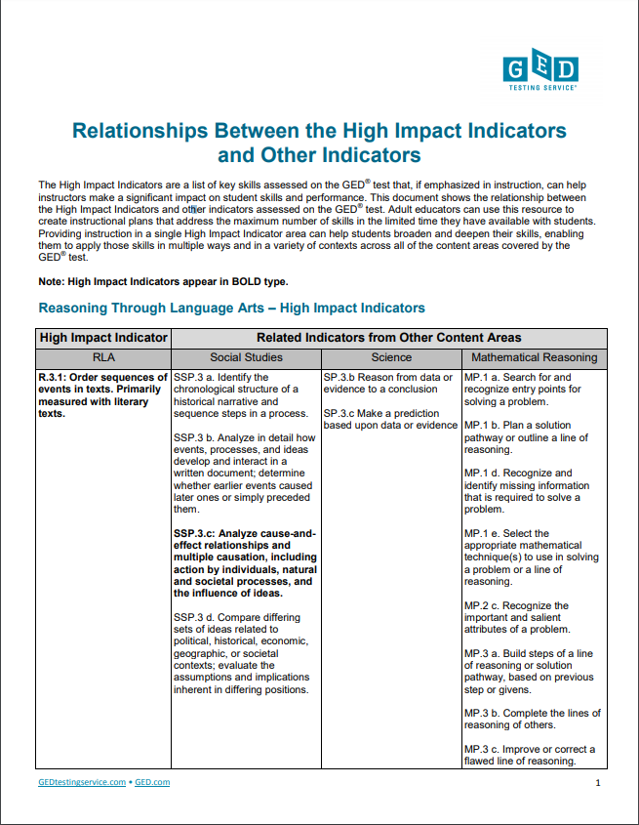
What Makes Indicators High Impact?
Important skills that are used across content areas
May currently receive light coverage in classroom
Lend themselves to straightforward instruction
See Relationships Between the High Impact Indicators and Other Indicators

Slide 27
An Example
RLA
Order sequences of events in texts
Social Studies
Identify the chronological structure of a historical narrative and sequence steps in a process
Science
Reason from data or evidence to a conclusion
Mathematics
Search for and recognize entry point for solving a problem and plan a solution pathway
Notes:
Key Points
Let’s look at an example. Think for a moment about this high impact indicator from Reasoning through Language Arts –order sequences of events in texts. Yes, it is important for RLA, especially in literary texts where students need to determine what happened first, second, etc.
However, it is also important in Social Studies where students may need to identify a chronological structure of a historical narrative and sequences steps in a process.
In science, students need to be able to reason from data or evidence to a conclusion – using a sequential approach.
Even in math it is important that students are able to sequence text. Think about problem solving and the need for a student to search for and recognize an entry point and then plan a sequenced approach to solving a problem. One indicator with implications for all four content areas.
All of these indicators are related and so are the strategies that we incorporate into our classroom. By teaching a strategy for ordering texts and ideas more deeply students can then apply this strategy or a similar strategy throughout the different content areas.

Slide 28

Assessment Guide for Educators
Includes:
How Webb’s Depth of Knowledge (DOKs) show up in each content area
Content Targets and Reporting Categories
Performance Level Descriptors
Skills and Subskills

Slide 29
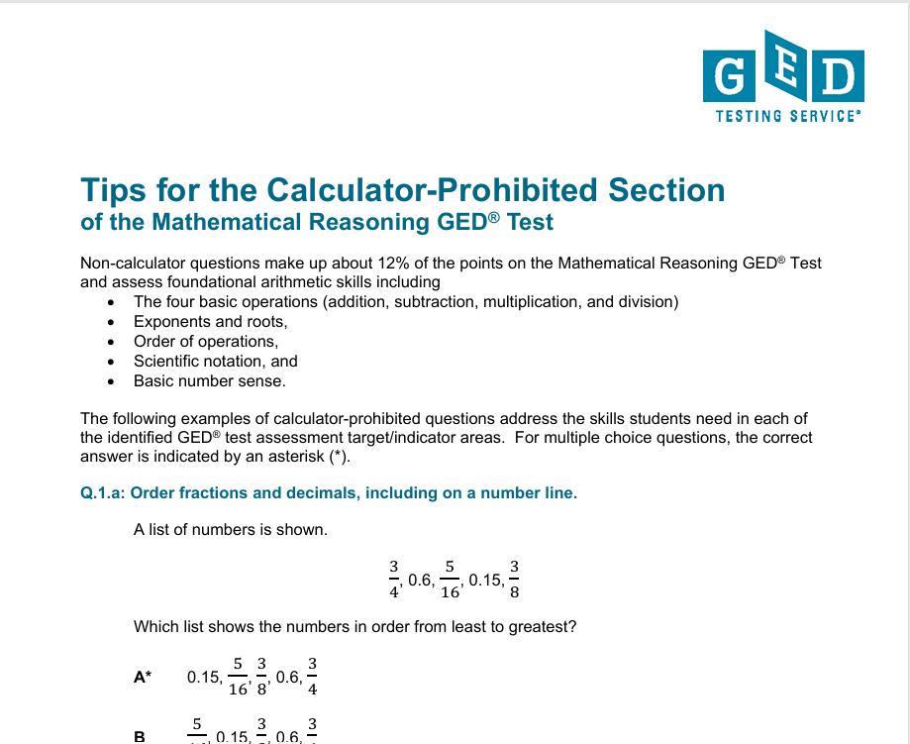
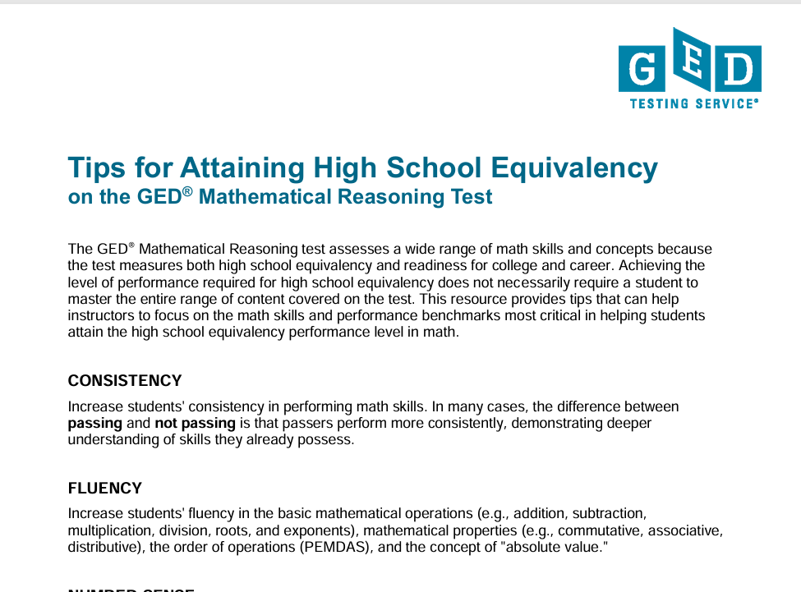
Essential Resources for Math:

Slide 30
Professional Development
Tuesdays for Teachers
In Session Newsletter

Slide 31
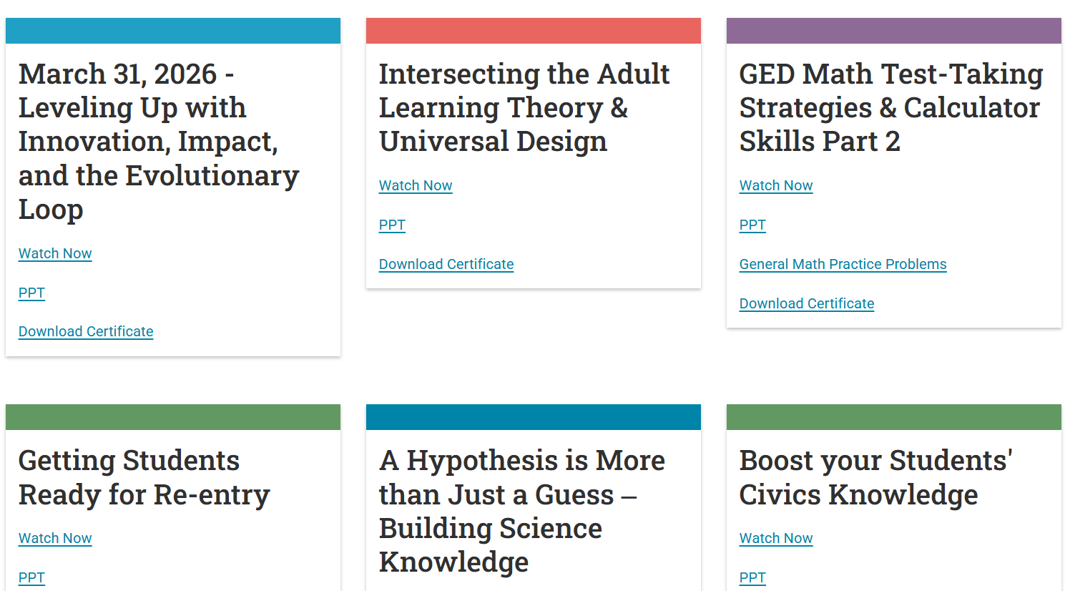

Professional Development: Tuesday for Teachers
Notes:
Tuesday for Teachers is a live event scheduled several times a year.
Notice each session is recorded “Watch Now”, and there are links to the ppt pdf and a downloadable certificate
Earlier sessions are archived on our YouTube channel, just click “Watch More” at the bottom of the page
Sign up through InSession newsletter!

Slide 32

Be “In the Know”:
Tuesday for Teachers Registration
New Product Announcements
Spotlights Celebrating Success

Slide 33
Free Classroom Materials
For Both Educators and LEARNERS!

Slide 34
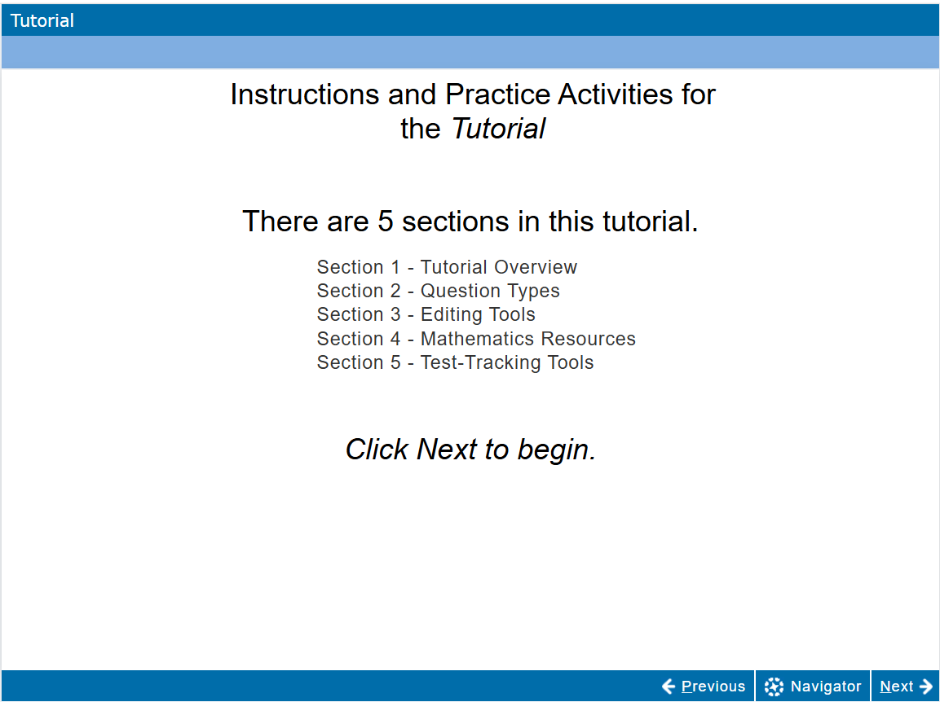
The Computer Based Tutorial
Notes:
Available in English and Spanish, learners are navigated through the test platform they will see on test day.
How to find:
Formula sheet,
Reference guides
Calculator
Editing tools (cut, copy, undo and redo, etc)
Understanding how to answer questions with various item types
How to change the font size, color contrast and use the highlighter

Slide 35
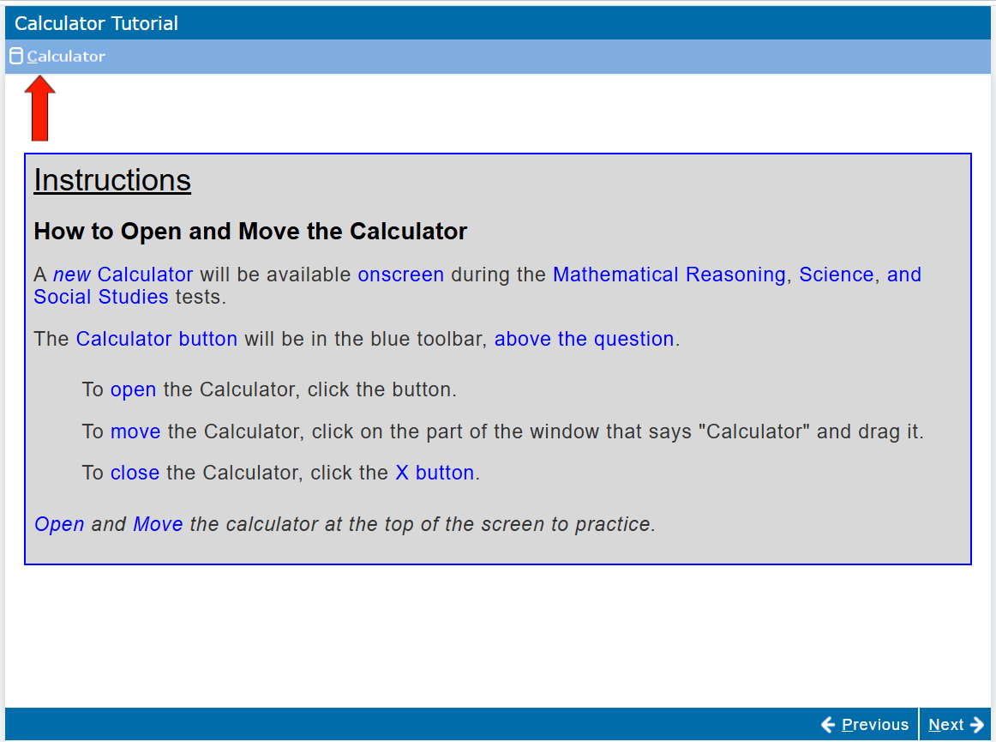
The Calculator Tutorial
Notes:
Where to find the calculator
How to find it and move it
Where to find the formula sheet and the calculator reference guide

Slide 36

Free Practice Tests:
Ten Questions
Various Item types
The look and feel of “the real thing”
FREE!

Slide 37
Reference Sheets
Calculator Reference Guide
Formula Sheet
Extended Response Answer Guidelines Guide
These are downloadable and printable resources to prepare your students on test day!

Slide 38
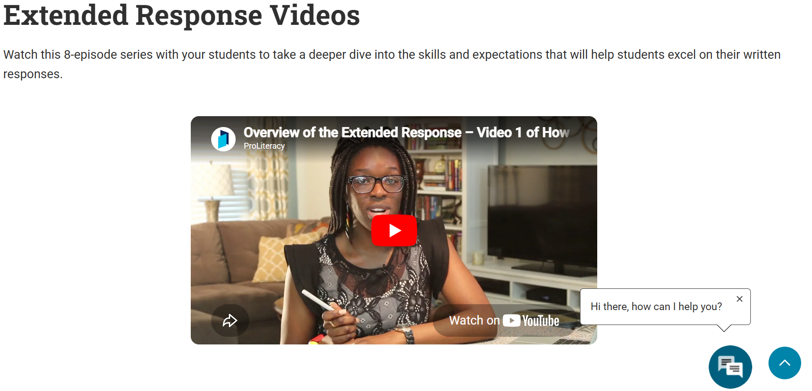
Extended Response Tools and Resources
Notes:
As you scroll down the Free Classroom Materials webpage, you will find additional resources and tools to prepare students for the RLA Extended Response, including Quick Tips, the Scoring tool, and resources for classroom practice.
Scroll further, and you will find the Extended Response Videos created by Pro Literacy by clicking “Watch More”. There are nine videos of less than five minutes each. Think of them as mini lessons on how to respond to the ER prompt. They can also be found on YouTube. You will also find more hidden gems to help learners understand the ER requirements, including an example of a perfect score.

Slide 39

GED & ME app
It’s all about PERSISTENCE!
Designed for Independent Study
Linked to the learner’s GED account at www.ged.com
Free Support:
Limited interactions with Syd, the AI Tutor
Limited study questions per day
Free Math videos in partnership with Youtuber “GetSumMath”

Slide 40
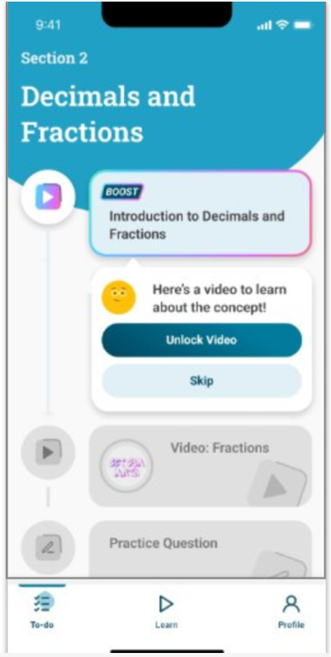


Meet “Boost”: unlocking more practice questions, more videos and unlimited interactions with the AI Tutor
Premium ‘Boost’ content denoted with a colorful play button
Free video content (Get Sum Math) and free practice questions and AI tutor in Math/Sc still available to all
Notes:
Boost is a premium “add on”. Users still have access to all of the free content, but can now opt into more resources
Unlimited questions, videos and access to Syd
The videos are from GED Play, a standalone product available in our online store
$19.99 monthly subscription

Slide 41
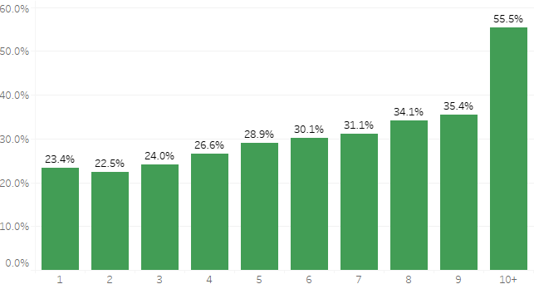
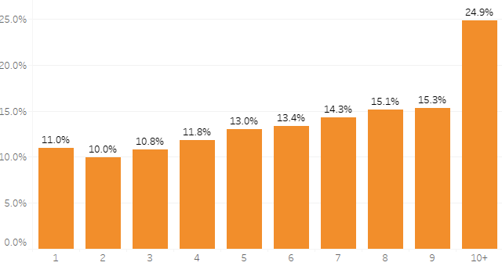
More App Sessions Correlate with Increased Testing & Credentialing
GED Testers – 55% of App users with 10 or more log-ins took tests
GED test credentialers (passed all 4 tests) – 25% of App users with 10 or more sessions credentialled

Slide 42

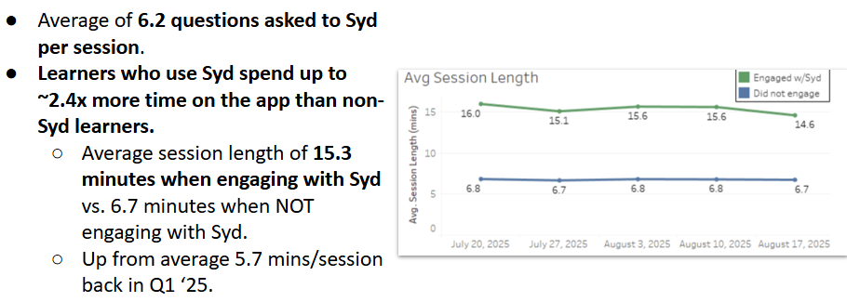

GED & Me Mobile App: nearly 300,000 downloads; 171,000 users, and 25% of users taking tests within a median of 28 days*
Syd, the AI Math Tutor used by more than 12,000 learners; AI Tutor for Science is here!

Slide 43
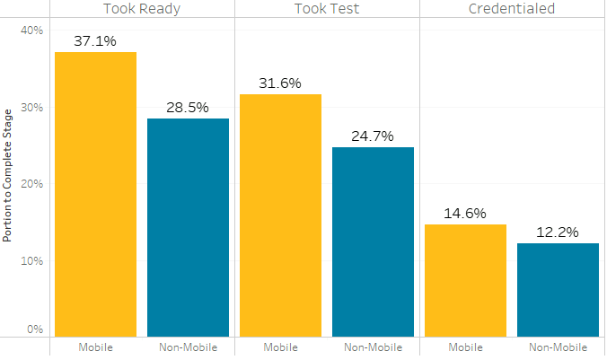
Mobile App users are taking Readys, GED Tests, and Credentialing at higher rates than non-mobile users
  Mobile users
  Non-mobile users

Slide 44
Your State Relationship Team
Brian Smith, Director
Brian.Smith@ged.com
Mellissa Hultstrand
IL,MI,MN,TN,VT,WI,
PR,VI
Mellissa.Hultstrand@ged.com
Scott Salesses
MA,NY,FBOP
Scott.Salesses@ged.com
Adora Beard
DC,DE,MD,VA,PA,PR
Military
Adora.Beard@ged.com
Lisa Pool-Osorio AK,AZ,CA,ID,NV,OR,UT, WA, Guam
Lisa.Pool-Osorio@ged.com
Diane Vaccari
CT,FL,KY,NH,NJ,OH,RI,,WV
Bermuda
Diane.Vaccari@ged.com
Liz Lanphear CO,HI,IN,KS,MO,NE,NM,ND,SD
Elizabeth.Lanphear@ged.com
Shawn Watts
AL,AR,GA,LA,NC,SC
Shawn.Watts@ged.com
Jonna McDonough
CA,MS,MT,OK,TX,WY
Jonna.Mcdonough@ged.com

Slide 45


Session Survey
Your feedback is important. Please scan the QR code below to rate this session.

