Slide 1
GED Testing in the Correctional Setting: Information & Updates
Scott Salesses & Mellissa Hultstrand

Slide 2
National Update:
GED® Testing in the Correctional Setting

Slide 3
GED Testing Service National News
The GED® test is offered in 48 U.S. states, DC and internationally.
350,000 students worldwide took a GED test in 2025.
92% were U.S. students
18% of GED tests delivered in the U.S. occurred at correctional facilities.
Testing in the correctional environment is delivered at U.S. correctional facilities only.
Learn more at GED.com
Notes:
We know time is of the essence to get NY test centers up and running with GED test delivery for students.
Please visit www.ged.com for more information on locations.

Slide 4
Correctional Testing Volume in 2025 in the United States
 | 2025 | Compared to 2024
Test-takers | 59,773 | 5% increase
Completers | 35,772 | 3% increase
Passers | 24,941 | 6% increase
Pass rates | 70% | 68%

Slide 5
2025 Pass Rates by Subject vs 2024 – Correctional Test-takers
Pass Rates by Subject Area
Math: 73% (+2 point increase from Prior Year)
RLA: 75% (-1 pt increase from PY)
Science: 85% (+2 increase from PY)
Social Studies: 80% (+1 increase from PY)

Slide 6
2025 Pass Rates by Subject – Correctional Test-takers Compared with Non-Correctional
Pass Rates by Subject Area (non-correctional students)
Math: 73% (73%)
RLA: 75% (84%)
Science: 85% (89%)
Social Studies: 80% (85%)
The subject area with the biggest delta between the pass rate for correctional testers and non-correctional testers is RLA. 9% point difference.

Slide 7
Demographic Info: Correctional Testers
-Data from 2024-2025
Median Age: 32
For context, median age of non-correctional GED testers is 21.
Gender: 84% male
Highest Grade Completed:
9% finished some of the 12th grade
24% finished the 11th grade
26% finished the 10th grade
18% finished the 9th grade
10% finished less than 9th
Non-correctional test-takers:
23% finished some of the 12th grade

Slide 8
An Overview of the GED® Test ​

Slide 9
The GED® Test
Available in English and Spanish
A wide array of accommodations are available
Including extended time, additional breaks, reader/recorder, private room, screen reader (JAWS) and many more
Visit the GEDTS Accommodations Information Page
The official GED® Practice test is called the GED Ready
Notes:
Here is where we talk about online vs CBT and security etc for no chrome books and test experience

Slide 10
The GED® Test
Test | Time | Notes
Reasoning through Language Arts (RLA) | 150 minutes | Includes 45 minutes for extended response (timed separately) and a 10-minute break
Mathematical Reasoning | 115 minutes | Part 1 – calculator not allowed Part 2 – calculator allowed
Social Studies | 70 minutes
Science | 90 minutes
Notes:
Key Points
Available in English and Spanish
A wide array of accommodations available
Including zoom-text, alternate color palettes, Braille, screen reader, extended time, paper testing for special circumstances
The chart provides an overview of the time for each of the tests, as well as pertinent notes.

Slide 11
Variety of Item Types
Multiple-Choice
Fill-in-the-Blank
Drag-and-Drop
Hot-Spot
Drop-Down
Extended-Response
Notes:
The new GED test includes a wider variety of item types than were on the 2002 Series test. Multiple choice items continue to appear on the test as one of the key item types. Multiple choice items are a reliable method of measuring skills and knowledge at a range of cognitive levels in a standardized manner. But remember that the additional item types allow us to measure a wider range of skills and cognitive levels.
Constructed response items come in two versions – one, we call short answer, and that type can be usually be answered in a few sentences (e.g. Science), and the extended response, which requires a longer response – multiple paragraphs (e.g. Reasoning Through Language Arts)

Slide 12

Overview of RLA Test
Content - Integrated reading and writing
  Close reading
  Clear writing
  Editing and understanding the use of standard written English (or Spanish) in context
Source texts – 75% nonfiction; 25% fiction
Passage length – 400-800 words
Range of text complexity, including texts at the college- and career-ready level
Technology-enhanced items and extended response
Notes:
Key Points
This slide provides a short overview of the content and context of the RLA Test. Review the information on the slide. For additional information, access the Assessment Guide for Educators Reasoning through Language Arts section.

Slide 13
Extended Response on RLA
An extended response item includes:
One or more source texts
Texts offer two positions on a given topic
A prompt that provides instruction on what the student is expected to do
Purpose of Extended Response
To provide test-takers with an opportunity to demonstrate:
Knowledge of writing conventions in English (or Spanish)
Understanding of what they’ve read
How well they use evidence to build arguments
Their ability to clearly communicate their thinking in their own words

Slide 14
Don’t Forget the Little Stuff
Expose students to a structured approach to the writing task and help them understand that they need to:
Write a complete response, not just a short paragraph (300-500 words)
Provide commentary on the evidence cited (explain the “why”)
Fully develop two or three ideas, rather than mention a lot of things without detail
Leave five minutes at the end for proofreading—that is one of the things evaluated
The extended response comprises 20% of the RLA score
Notes:
Key Points
[Review the bullets on the slides.]
Discuss that these are ideas on how to improve scores. Also, note that the length is not about counting words, but rather is indicates that the writing sample needs to be long enough to adequately address the prompt. A short paragraph is not enough.

Slide 15
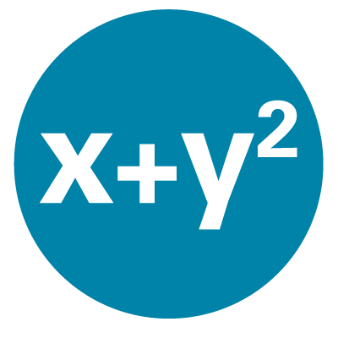
Overview of Mathematical Reasoning Test
Content
  45% - Quantitative Problem Solving
    Number operations
    Geometric thinking
  55% - Algebraic Problem Solving
Texas Instruments - TI 30XS Multiview™ (calculator allowed on most items)
Integration of mathematical practices
Formula page, symbols, and calculator page provided
Notes:
Key Points
This slide provides a short overview of the content and context of the Mathematical Reasoning Test. Review the information on the slide. For additional information, access the Assessment Guide for Educators Mathematical Reasoning section.

Slide 16

Overview of Social Studies Test
Content
  50% - Civics and Government
  20% - United States History
  15% - Economics
  15% - Geography and the World
Themes
  Development of Modern Liberties and Democracy
  Dynamic Responses in Societal Systems
Social Studies Practices – analyzing, thinking, reasoning
Technology-enhanced question items
Notes:
Key Points
This slide provides a short overview of the content and context of the Social Studies Test. Review the information on the slide. For additional information, access the Assessment Guide for Educators Social Studies section.

Slide 17

Overview of Science Test
Content
  Life Science – 40%
  Physical Science – 40%
  Earth and Space Science – 20% Themes
Themes
  Human Health and Living Systems
  Energy and Related Systems
Science Practices – reasoning and thinking scientifically
Question types - Technology-enhanced items
Notes:
Key Points
This slide provides a short overview of the content and context of the Science Test. Review the information on the slide. For additional information, access the Assessment Guide for Educators Science section.

Slide 18
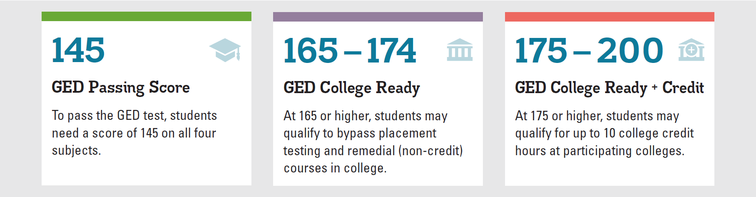
GED Score Levels Explained
GED College Ready scores improve the chances for college success.
Learn more at GED.com/collegeready
Notes:
A 145 or better in each subject will lead to a credential. However, I’ve highlighted the upper score “benchmarks” to acknowledge the opportunity for testers to either enter credit bearing course work, bypassing additional placement tests where approved (165+), OR to earn college credit, similar to AP exams for scores at or above 175, where approved.

Slide 19
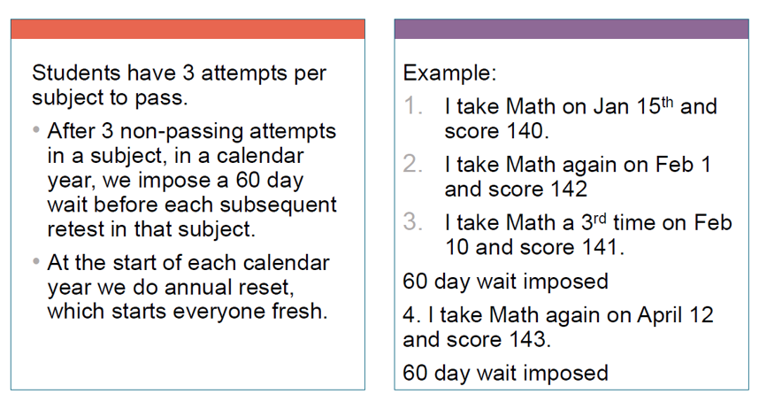
GED Testing Retest Rules
– Computer Based Testing

Slide 20
Retest Waiver Requests
If a Tester will be released before they can test again at your facility you can ask if it is possible that they be allowed to test earlier
Send an email to Operations@GED.com with the reason for the request and a screenshot that shows the testing activity in the Tester’s GED account
Be sure to include the Tester’s first and last name as well as their GED ID number
Be sure to state the date of their planned release

Slide 21
GED Ready® ​
The Official Practice Test

Slide 22
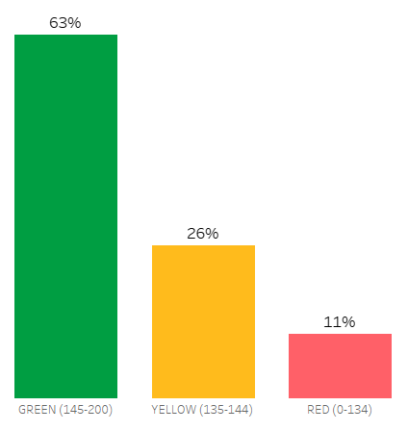
Activity Trends After GED Ready®
When learners take a GED Ready, they get one of three colors associated with their Ready based on their score…
RED – scored below 135
YELLOW – score between 135-144
GREEN – score above or equal to 145
Distribution of Readys by Score Group

Slide 23
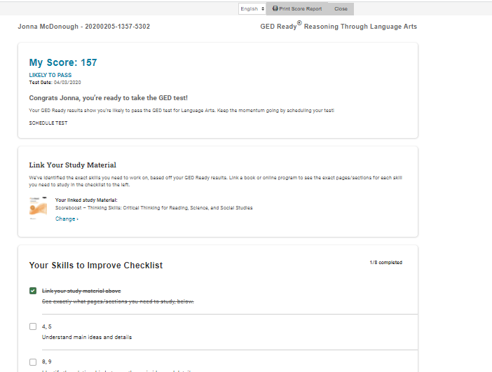
Student Score
Select Student Curriculum
Review Checklist of lessons in Student Curriculum for further study/remediation

Slide 24
GED Ready®: The Official Practice Test
Questions on the GED Ready are just like the questions on the actual test.
Test interface on the GED Ready is identical to the interface on the GED test, which helps to prepare students for test day, i.e. no surprises
Detailed score report provided
Adult educators are encouraged to take at least one subject of the GED Ready.
Happy to provide a GED Ready voucher or two if you are interested in taking a GED Ready subject test.
Good group exercise as well if several instructors in your program want to go through it together.

Slide 25
Accommodations in the
Correctional Setting

Slide 26
Accommodations Overview
Purpose of Accommodations
Not a Guarantee of improvement
Individualized Consideration
Appropriate Documentation

Slide 27

Categories of Disabilities
Learning and Other Cognitive Disabilities Documentation within the last 5 years | Attention Deficit Hyperactivity Disorder Documentation within the last 5 years | Psychological and Psychiatric Disorders Documentation within the last 1 year | Physical Disorders and Chronic Health Conditions Documentation within the last 1 year

Slide 28

Important Reminder
Effective August 1, 2023, accommodation approvals are valid for 2 years.
(some exceptions apply)

Slide 29
What is NOT considered a disability?
ESL (English as Second Language)
“Slow Learner”
Active substance abuser
Test Anxiety
Homemade diagnoses

Slide 30
Requesting Accommodations
Account is created for a correctional student via GED Manager™
  Click yes to the question about accommodations (modified testing)
  Go to https://www.ged.com/educators-admins/test_admin/corrections/
  Scroll to the bottom of the page to find the Accommodation Request Forms
  Completed forms and documentation can be emailed
  Contact accommodations@ged.com with questions/concerns

Slide 31

Commonly Requested Accommodations
Reader/
recorder
Extra Time
Separate Room
Extra “stop-the-clock” breaks

Slide 32
Important Resources and Tools for Educators​
*Free Classroom Materials​
*Teaching Resources​
*Professional Development​
*In Session Educator Newsletter​
*Adult Education Program Toolkit

Slide 33

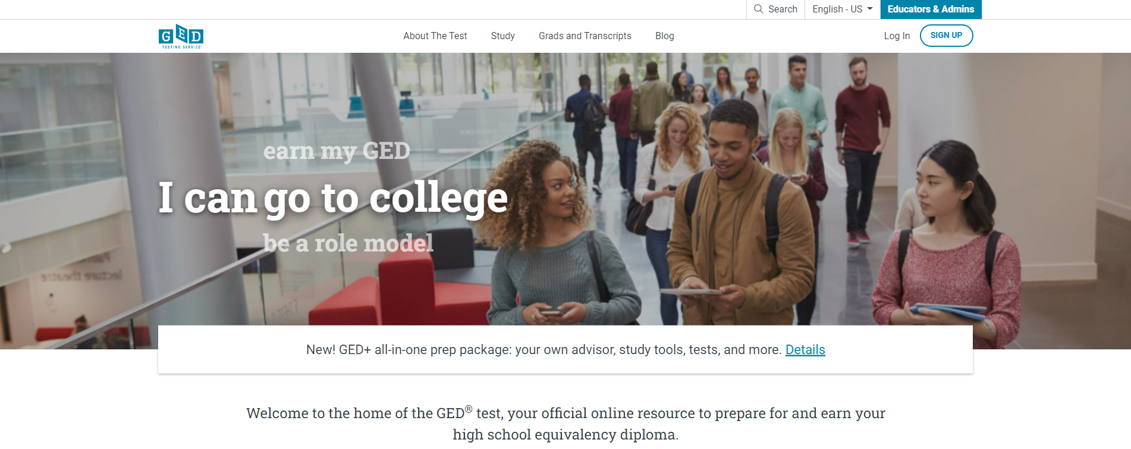
GED.com select Educators & Admins

Slide 34

Free Classroom Materials

Slide 35
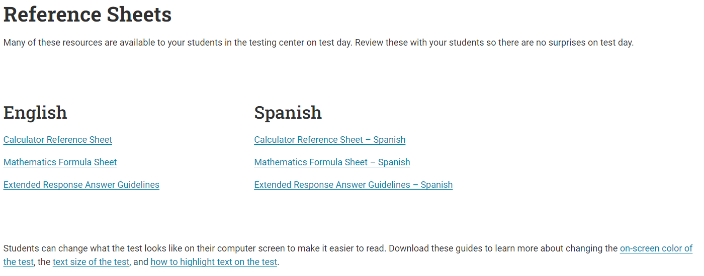
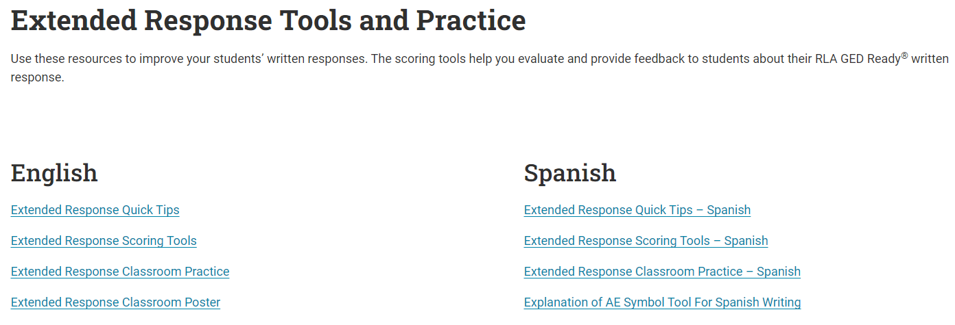
Free Classroom Materials

Slide 36

Free Classroom Materials

Slide 37

Teaching Resources
Teaching Resources

Slide 38

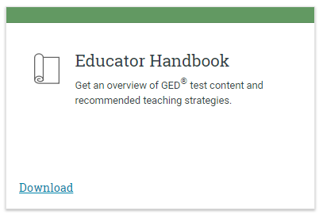
Educator Handbook
Get an overview of GED® test content and recommended teaching strategies.
In other words:
Start here!
Download at GED.com/educator_handbook

Slide 39
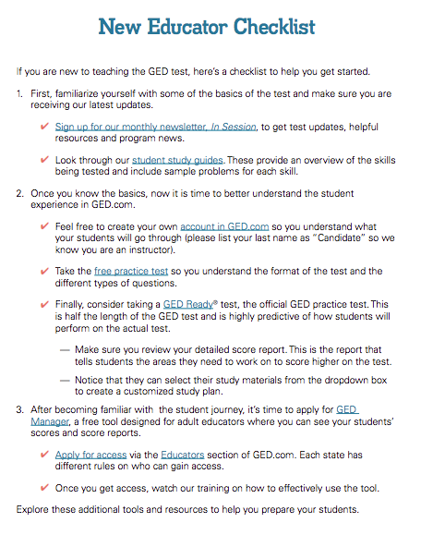
New Educator Checklist!
Our ”New Educator Checklist” is located right inside the new Educator Handbook
This is designed to help new teachers focus on the most important resources to get them up to speed on being a GED instructor

Slide 40
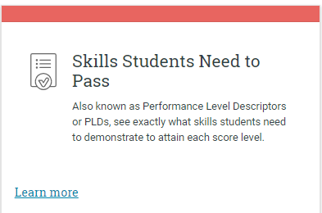
Skills Students Need to Pass
Also known as Performance Level Descriptors or PLDs, see exactly what skills students need to demonstrate to attain each score level
Four Performance Levels
  Below Passing
  HSE
  GED® College Ready
  GED® College Ready + Credit
What skills are demonstrated at each level
What skills need development to advance to the next level
PLDs

Slide 41
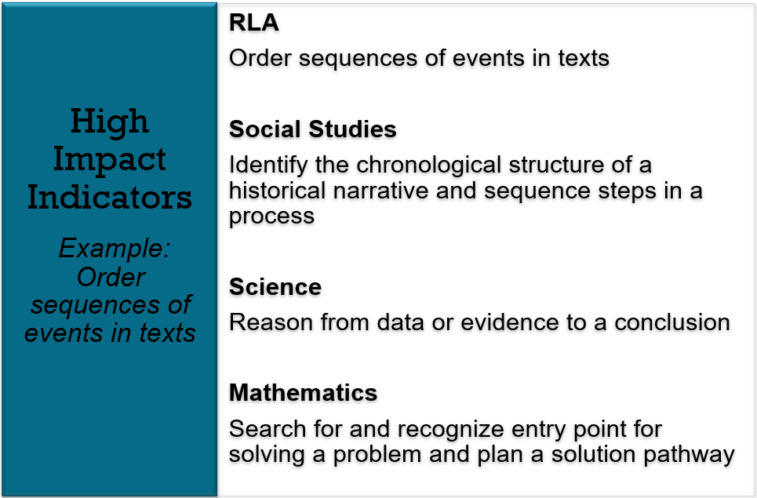
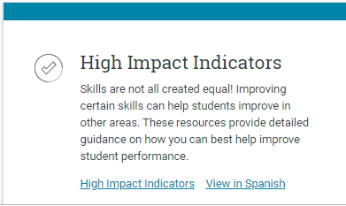
High Impact Indicators
Not all skills are created equal!
Improving certain skills can help students improve in other areas. These resources provide detailed guidance on how you can best help improve student performance.
High Impact Indicators

Slide 42
An Example
RLA
Order sequences of events in texts
Social Studies
Identify the chronological structure of a historical narrative and sequence steps in a process
Science
Reason from data or evidence to a conclusion
Mathematics
Search for and recognize entry point for solving a problem and plan a solution pathway
Notes:
Key Points
Let’s look at an example. Think for a moment about this high impact indicator from Reasoning through Language Arts –order sequences of events in texts. Yes, it is important for RLA, especially in literary texts where students need to determine what happened first, second, etc. However, it is also important in Social Studies where students may need to identify a chronological structure of a historical narrative and sequences steps in a process. In science, students need to be able to reason form data or evidence to a conclusion – a sequential approach. Even in math it is important that students are able to sequence text. Think about problem solving and the need for a student to search for and recognize an entry point and then plan an sequenced approach to solving a problem. One indicator with implications for all four content areas.
All of these indicators are related and so are the strategies that we incorporate in to our classroom. By teaching a strategy for ordering texts and ideas more deeply students can then apply this strategy or a similar strategy throughout the different content areas.

Slide 43

The Assessment Guide for Educators
Covers all content areas
Item types
Assessment targets
Guidelines for how items
are scored
More . . .
https://ged.com/educators_admins/teaching/teaching_resources/
Notes:
Key Points
Review information on the slide regarding the resource (where it is located and what is included).
Complete Assessment Guide for Educators is located at: https://ged.com/wp-content/uploads/assessment_guide_for_educators_all_subjects.pdf

Slide 44
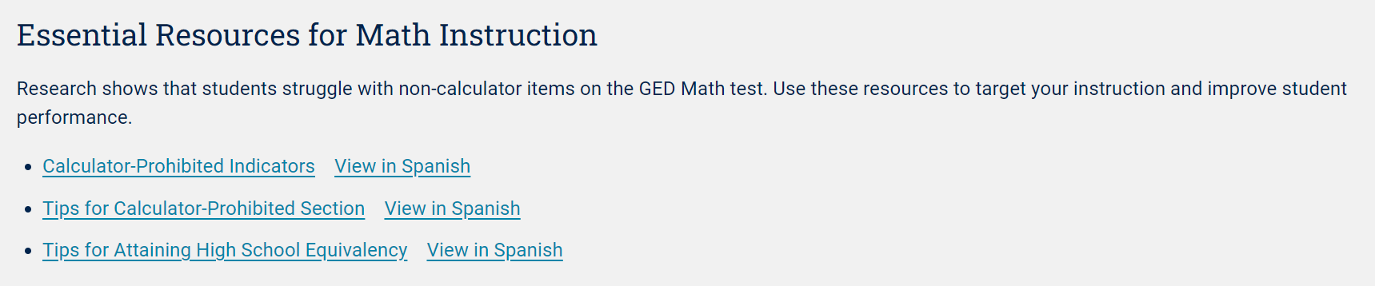
Essential Resources for Math Instruction
Research Shows
Students struggle with non-calculator items on the GED ® Math test. Use these resources to target your instruction and improve student performance.
Essential Resources for Math Instruction

Slide 45
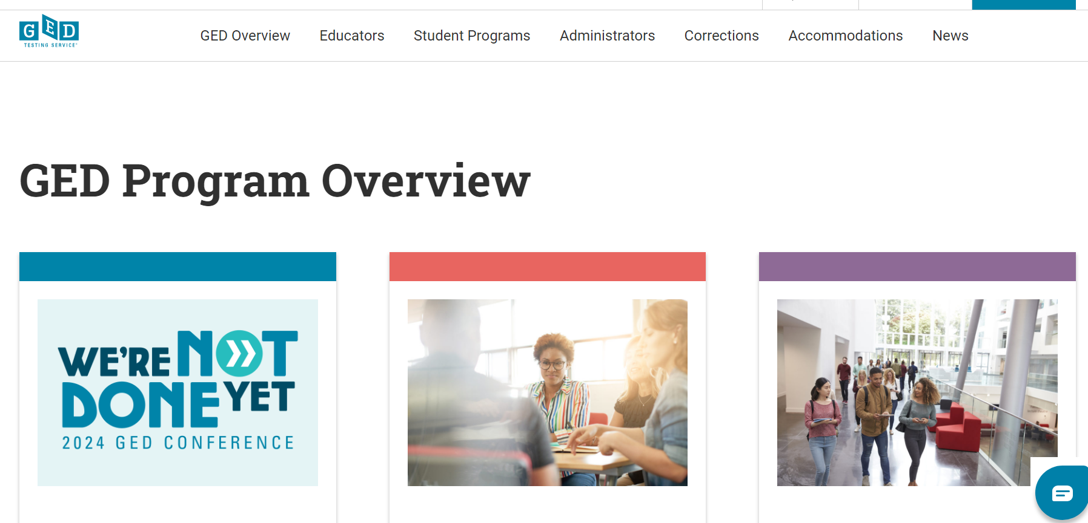
Corrections Tab

Slide 46
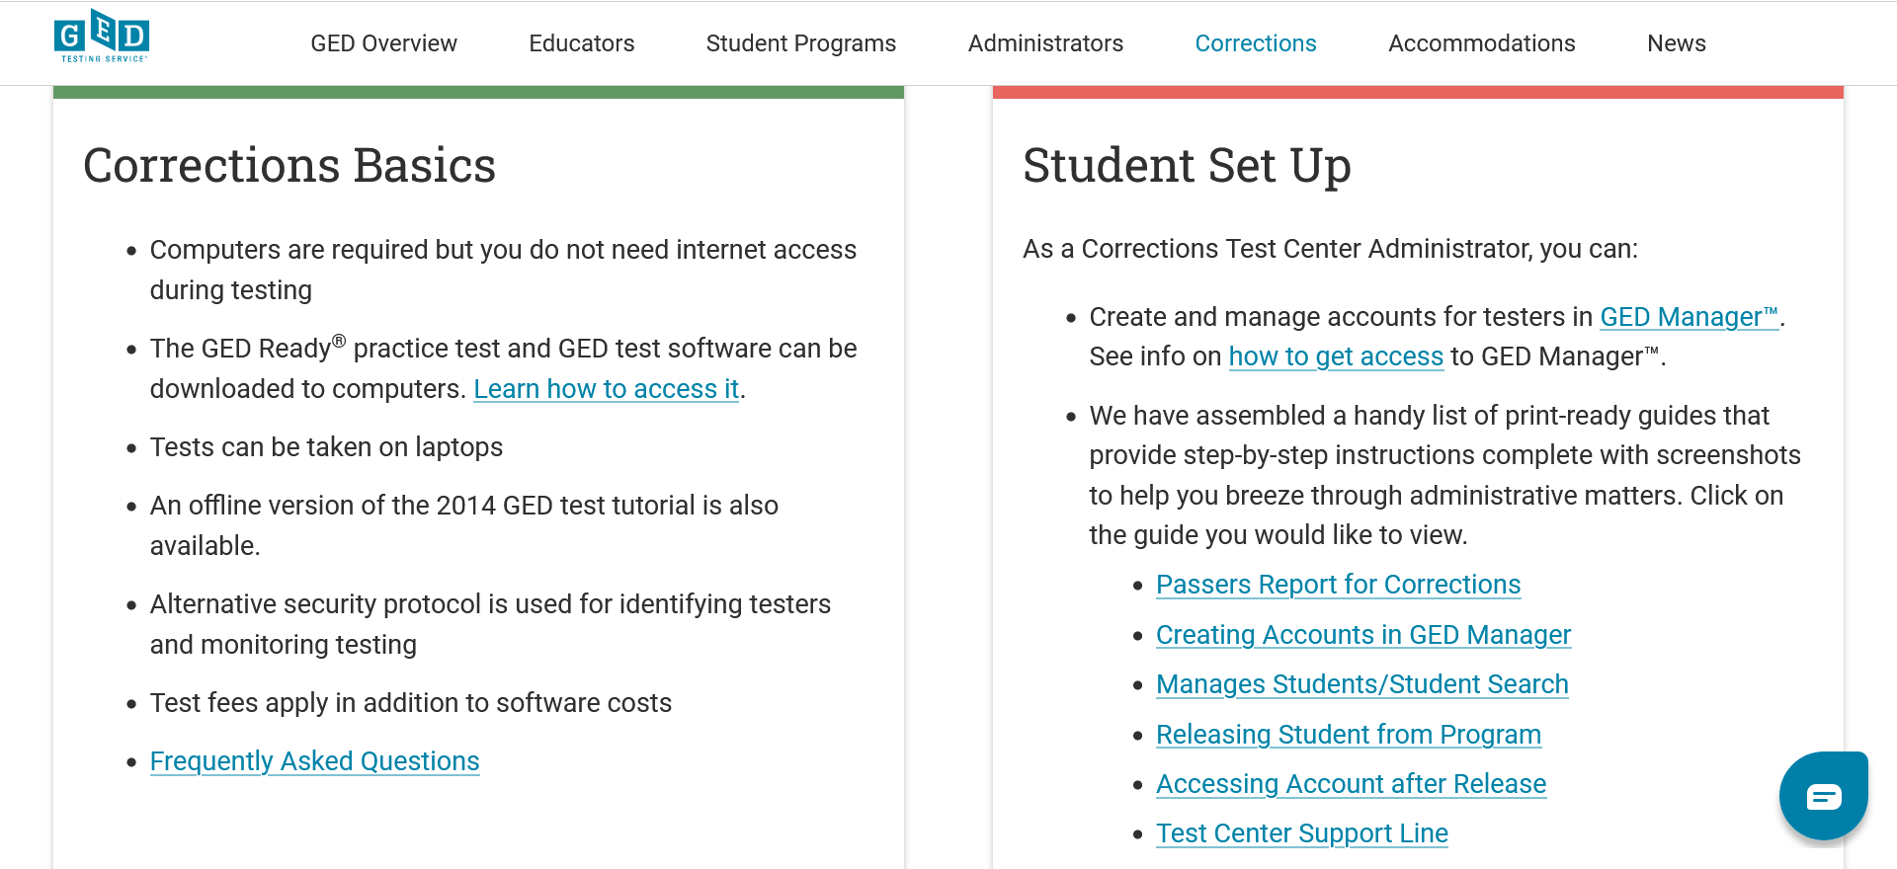
Corrections Information

Slide 47

Resources for Correctional Programs

Slide 48
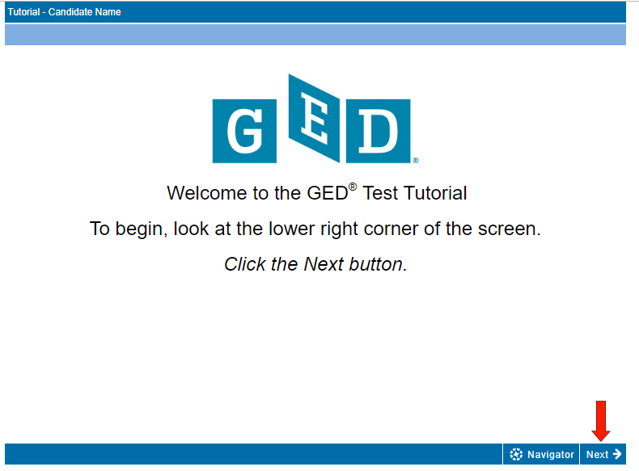
GED Test Tutorial
Use the Test Demonstrator to explore tools prior to the test
  https://ged.com/practice-test/en/computer-demonstrator

Slide 49
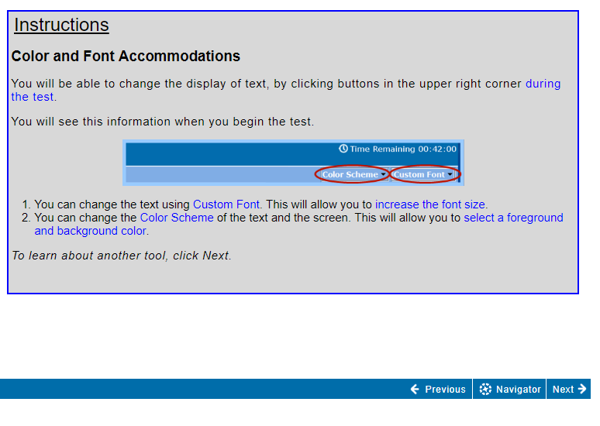
Changing the screen color and font

Slide 50
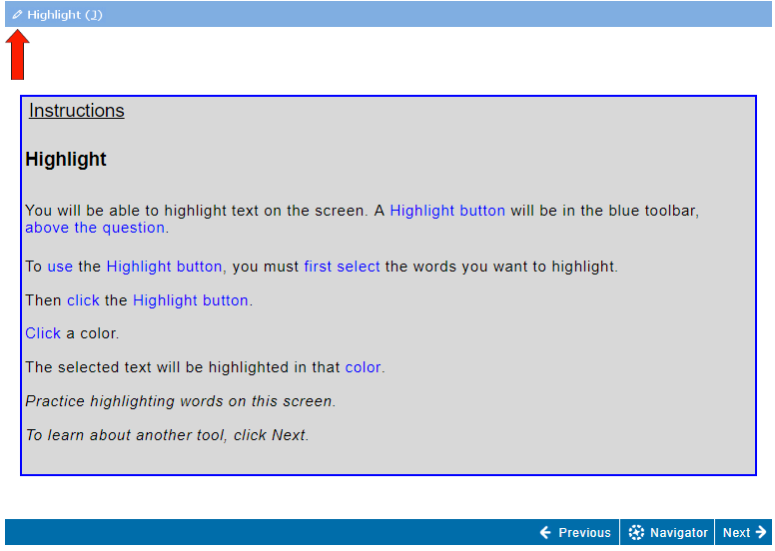
Using the highlight tool

Slide 51
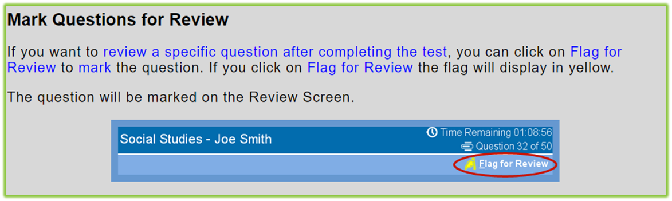
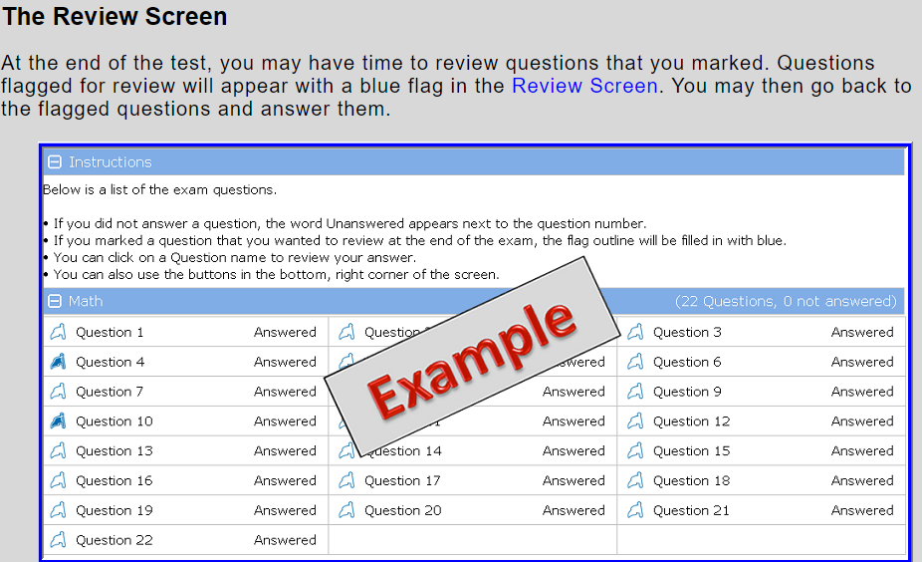
Using the Flag for Review

Slide 52
GED Manager™​

Slide 53
GED Manager™
Test Administrators
Jurisdictional Access
Educators
(GEDPrep Connect)
Student Authorized View
Corrections

Slide 54
Common Capabilities Across All Three Roles:
Student Search
Student Test Activity Report
Passers Report
Student Score Reports: GED Ready™ and GED® operational tests
Notes:
Student Search allows Users to find a specific student by using any or all available filters: ie., First/last name, DOB, or GEDID (assigned when student creates their account on www.ged.com
Student Test Activity Report allows users to apply a number of filters to identify a list of students who fit within those parameters, including test activity status for GED Ready practice tests or the live exam, data ranges, exam subjects, language taken, credential status, or even student specific details such as first/last name, DOB or GEDID
Passers Report allows users to identify passers at a given test center within a requested date range
Each Report allows users to view scores, and to view score reports- giving you a pathway to remediate skills students can improve in order to improve their test performance

Slide 55
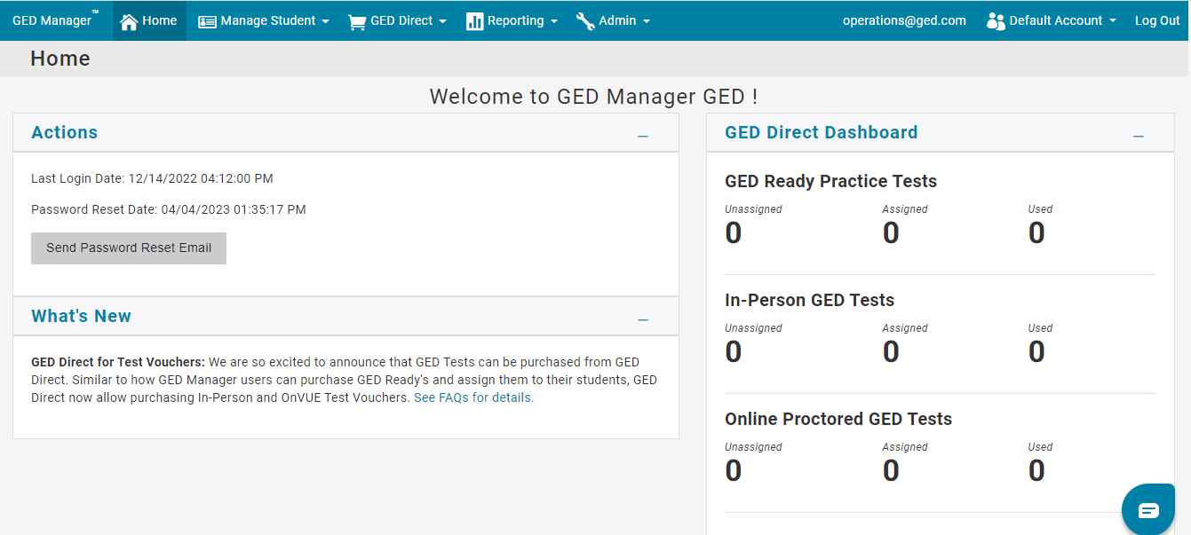

GED Manager™ Access – Home Screen
For a better experience while using GED Manager, we recommend that you open GED Manager in Google Chrome or Firefox.
Notes:
Once you are logged into GED Manager, you will see the home screen. This home screen has different tabs and sections which we will go over their functions through out this training.

Slide 56
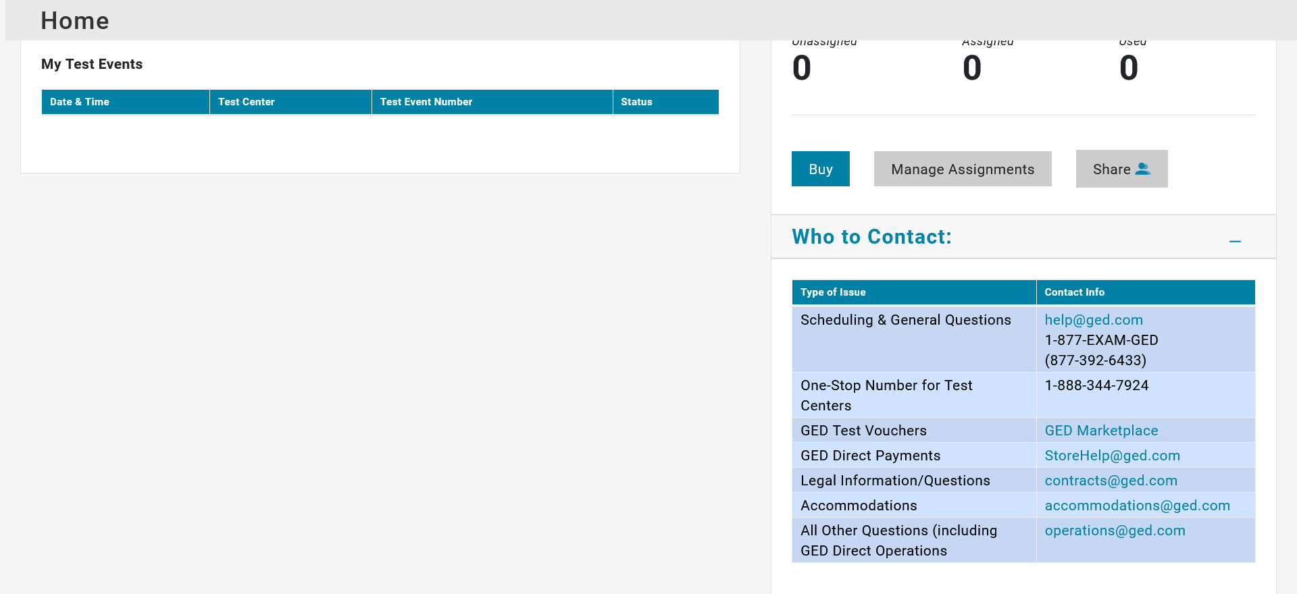
Who to Contact

Slide 57
GED Manager™ Home Page
Helpful Links
Jurisdiction Testing Policies
Corrections GED Manager Training Video
"How to Guides" for Test Centers
Student Study Guides
GED Ready ER Scoring Tool - English
GED Ready ER Scoring Tool - Spanish
Tips for successful password resets
GED Direct Info
GED Direct Training Video
Helpful Documents
GED Manager User Guide
GED Direct vs Marketplace - Bulk Purchasing
Finance and Billing Frequently Asked Questions
Instructions for Testers to Claim Their GED Account Upon Release
Manage Student/Student Search
Creating Student Accounts
Passers Report
Accessing Account After Release
Releasing Student From Program
Scheduling DOC Students

Slide 58
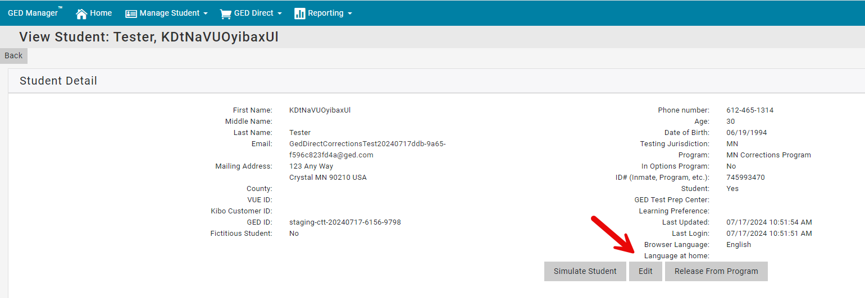
As of July 2024, Corrections Officers will be able to move a student to any Program in their Jurisdiction, even if they aren’t associated (don’t have access) to that Program.
To move a student to a different Program, from Student Detail click Edit

Slide 59
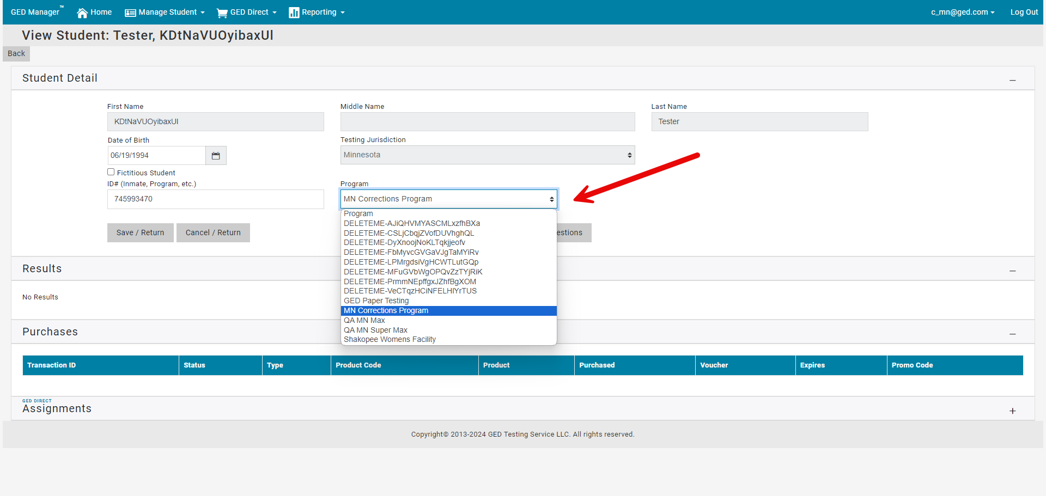
The Program dropdown will contain all Programs in your jurisdiction, even if you are not associated with the Program

Slide 60
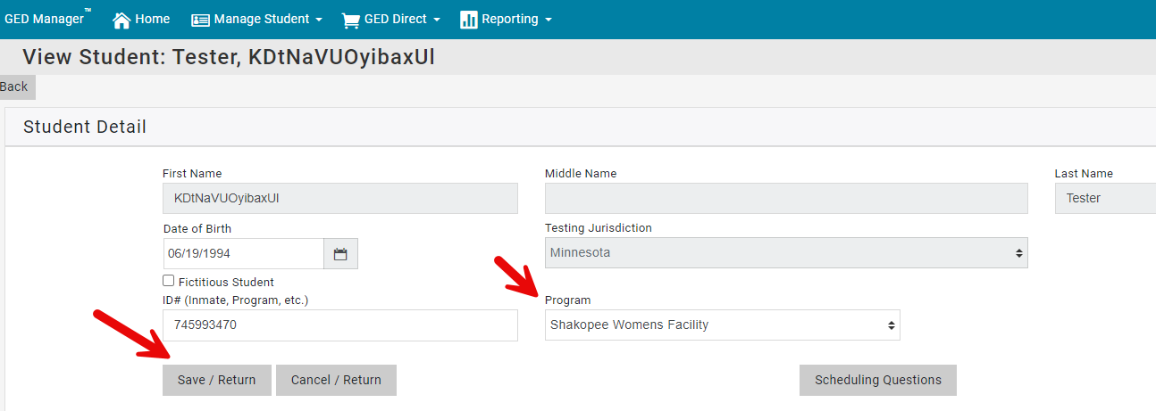
Select the Program you want to move the student into and click Save/Return

Slide 61
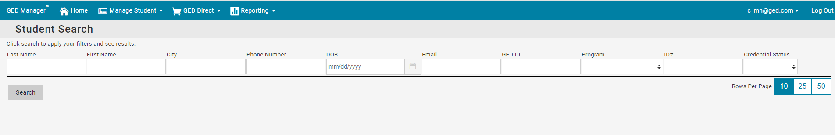
Because you no longer have access to that student (after moving them into a Program you don’t have access to), you will return to the Student Search page.

Slide 62
How Learners Access their GED.com after release from your program
Preferred Method
Learner provides the test administrator with their personal email address, which is entered into the learner’s account.
Post release learner can access their ged.com account via resetting their password.
ReleasingstudentfromProgram10.1.25.pdf
Other Method
Post release learner contacts our customer support to gain access to their account.
Learner must provide key pieces of information: name, DOB, name of the correctional facility they were incarcerated, city and state of the facility.

Slide 63
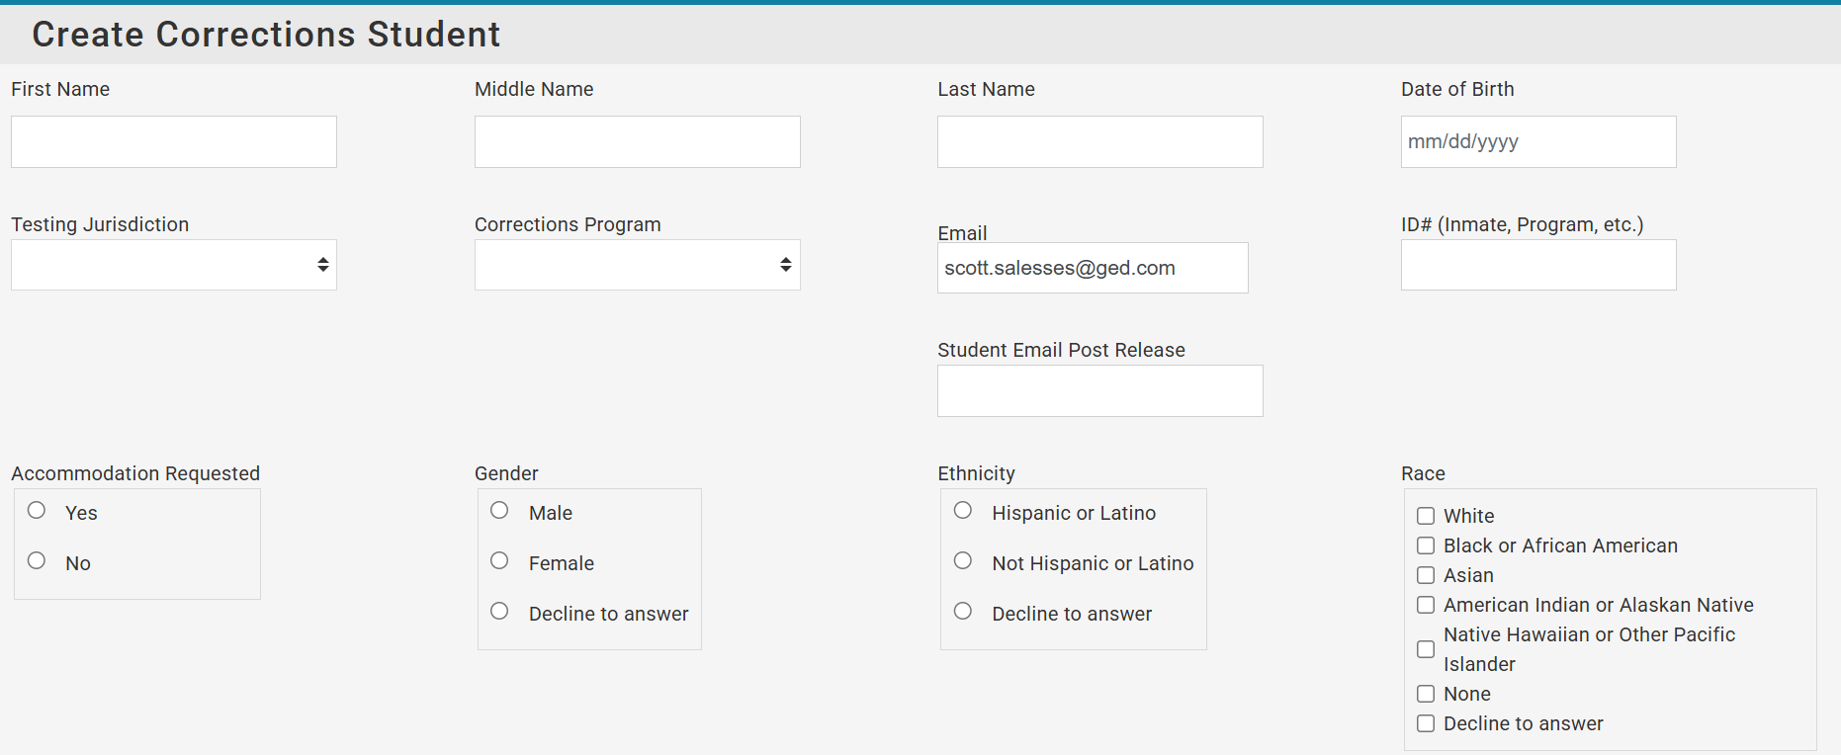

Slide 64
GED Direct™
A New Way to Purchase GED Readys

Slide 65

Problems to Solve
GED Ready voucher code spreadsheets are an administrative headache.
  Difficult to distribute to educators
  Difficult to maintain
  Difficult to share codes with students (via email)
Expiring vouchers compound the headache.
Everyone spends too much time dealing with voucher codes.
This Photo by Unknown Author is licensed under CC BY

Slide 66
Solution – GED Direct™
A feature in GED Manager which allows educators to purchase GED Ready® tests and assign them directly to students.
Benefits:
No spreadsheets of voucher codes to manage
No expiration dates to extend

Slide 67
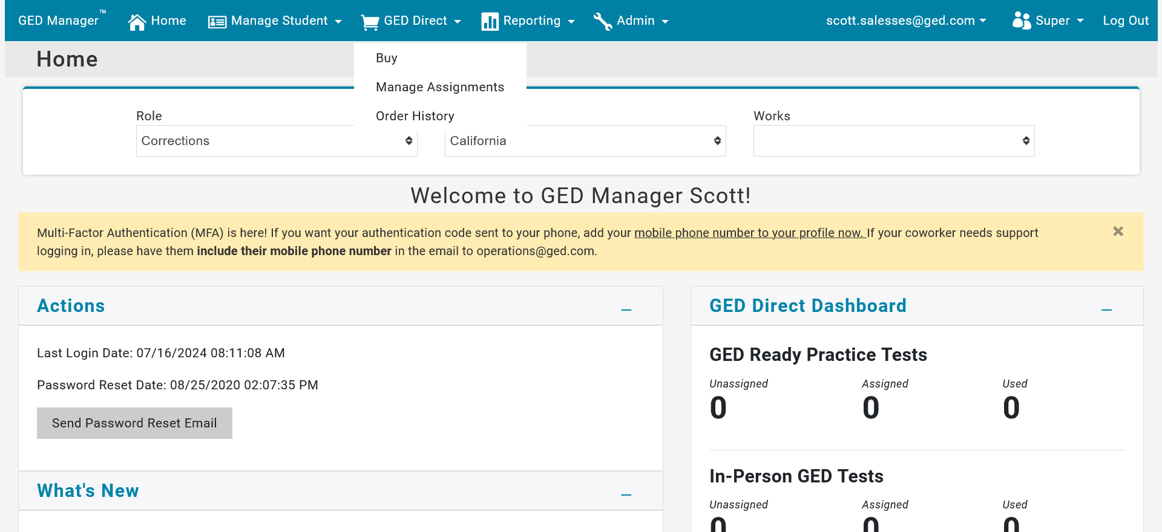
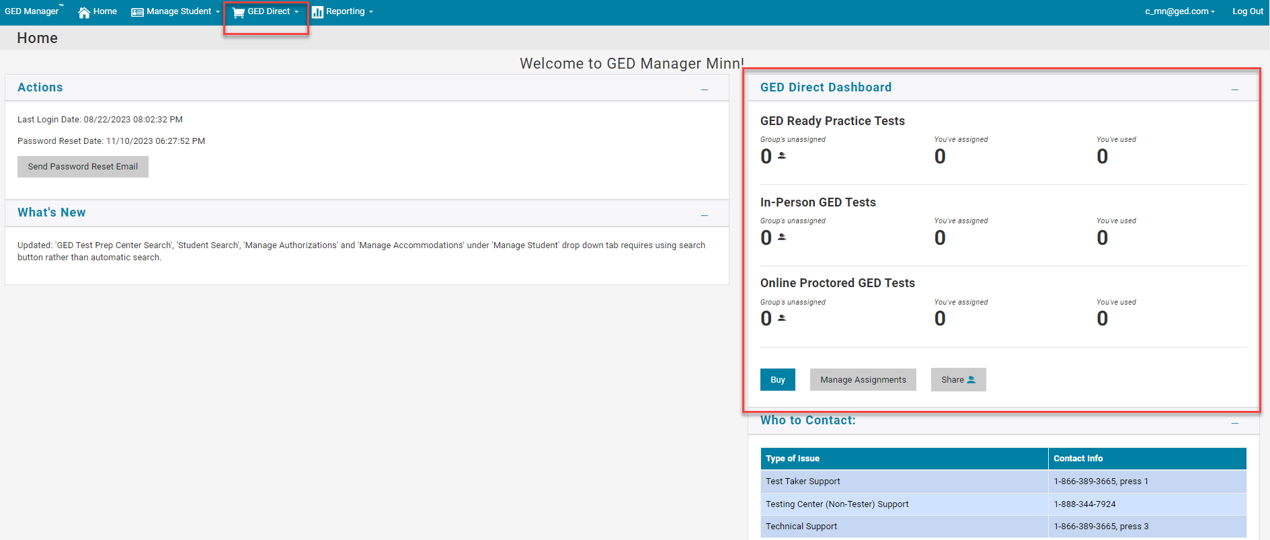
GED Direct - Corrections Officers will now be able to use GED Direct
They will see the GED Direct top nav option and the GED Direct Dashboard on their Home page.

Slide 68
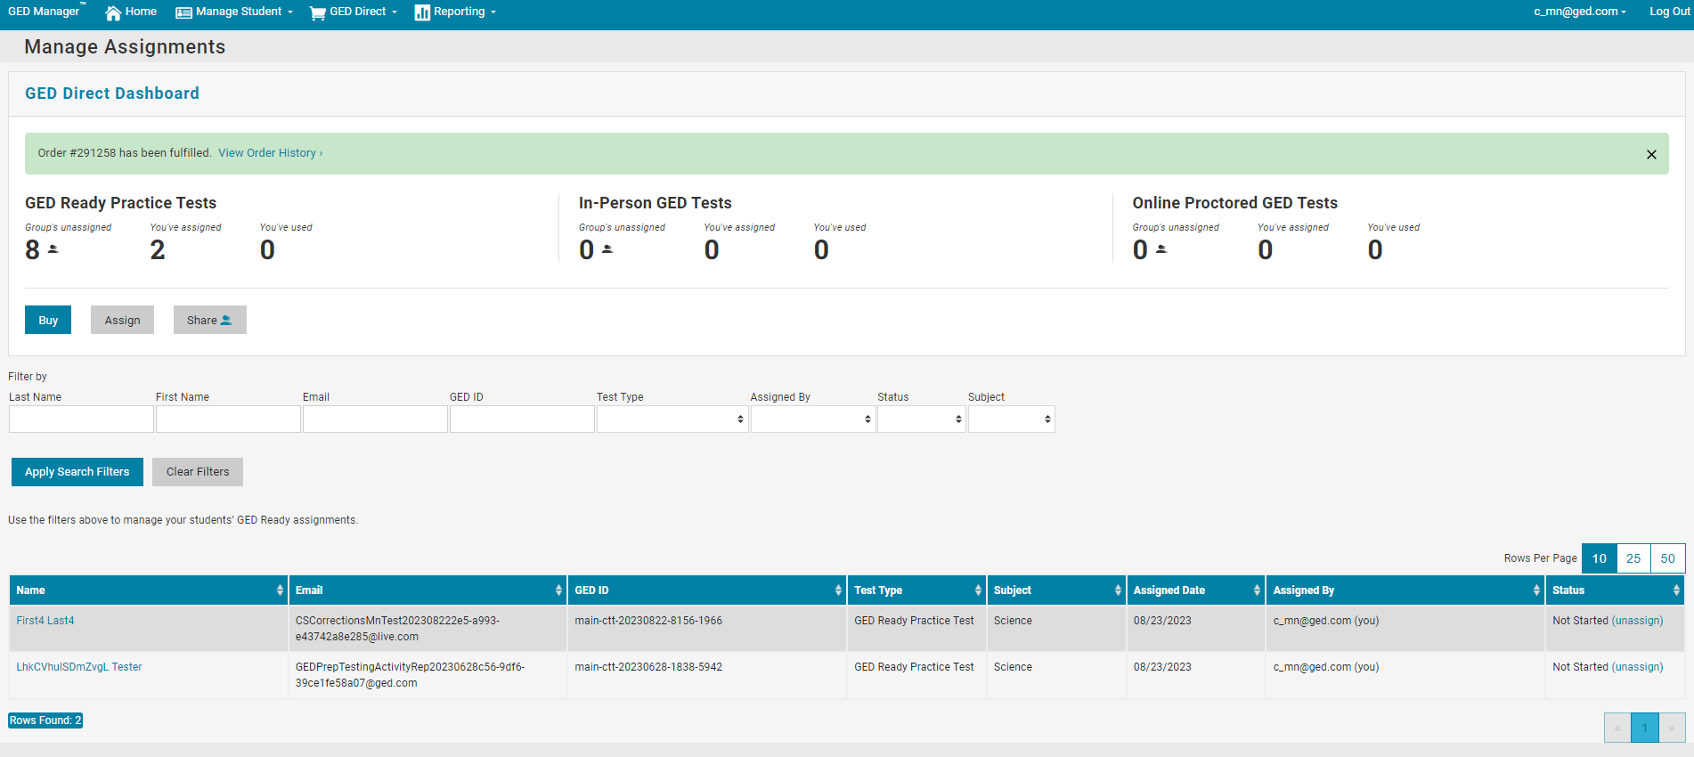
GED Direct™ - Corrections Officers are now able to use GED Direct™
They are able to assign GED Ready's to their students and see all their assignments on the Manage Assignments page.

Slide 69
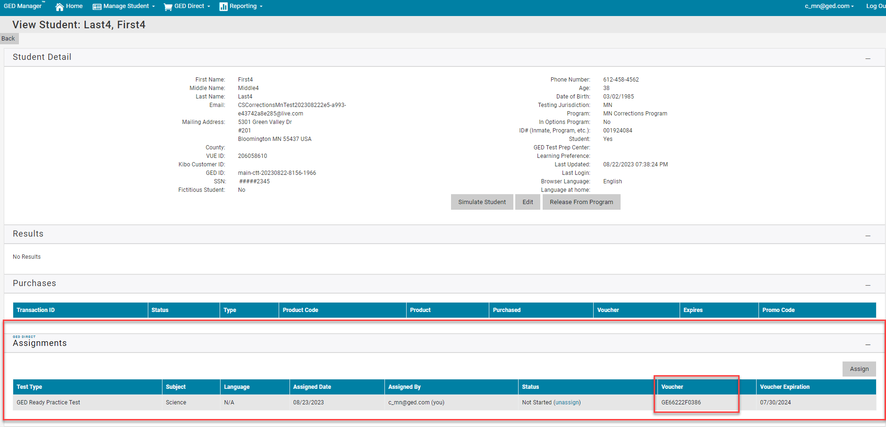
GED Direct™ - Corrections Officers are now able to use GED Direct™
They are able to see the "Assignments" section on Student Detail and copy/paste the voucher from that section into RegMan when they are scheduling the student's GED Ready® or GED® Test.

Slide 70
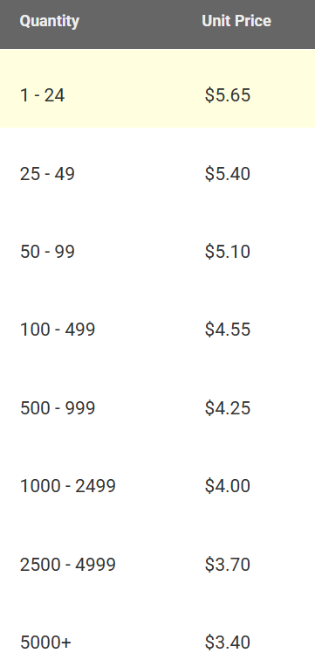
GED Direct™ Volume Discounts for GED Readys™
For comparison GED Marketplace™ unit price for GED Ready™ is $7.99

Slide 71
GED Direct™
Purchasing GED Readys via GED Direct will result in correctional facilities receiving bulk pricing and considerable savings off the retail price.
Purchasing GED tests via GED Direct is not advised for most correctional facilities as the price is what the public pays and not the correctional pricing, i.e. correctional facilities do not pay/receive channel compensation thus the price per subject is $10.00 lower for corrections ($26 vs $36 for states with standard pricing).

Slide 72


GED® SUPPORTING PRODUCTS
The Aztec Learning System
Notes:
Transition In: As I mentioned, our outcomes have gained the trust and partnership of many great organizations including the GED Testing Service.

Slide 73
GED FLASH™ FOR ORGANIZATIONS
Official Practice Tool
MORE PRACTICE.
HIGHER PASS RATES.
The official practice tool built in partnership with the GED® Testing Service to help students pass the GED® test by providing thousands of completely aligned and vetted questions with immediate feedback.
English | Spanish
Spanish Language on Sale Now
Notes:
Transition In: GED Flash the official practice tool for the GED test. This is an exclusive product only available through us. GEDTS selected us because of the trust we have gained across the country and our top performing outcomes.
This supplemental tool was developed because the field has never had a true practice tool that allowed student to access thousands of questions that can aid them along their studies.
Teachers and learners had to rely on GED Ready or third party questions that frankly may not have been aligned.
Thus we designed and built this tool.

Slide 74



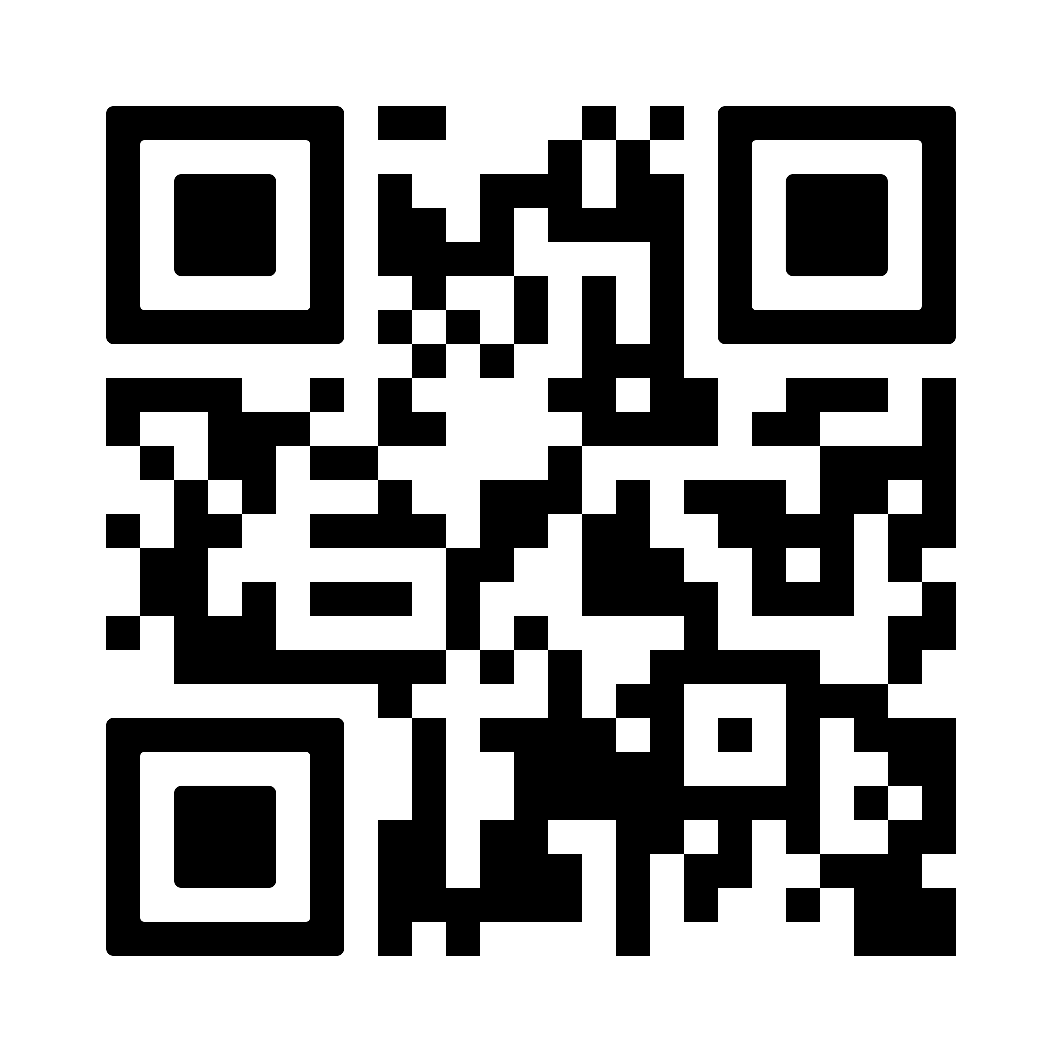
Data shows that students who practice on
GED Flash score on average 4 points higher with:
• 6,000+ practice items
• Instant answer feedback
• Randomized question bank
• Actionable student data
qrco.de/gedflash

Slide 75
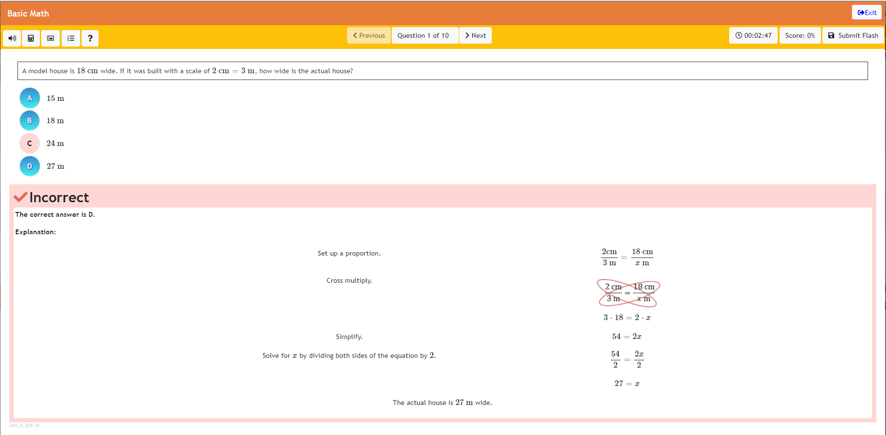
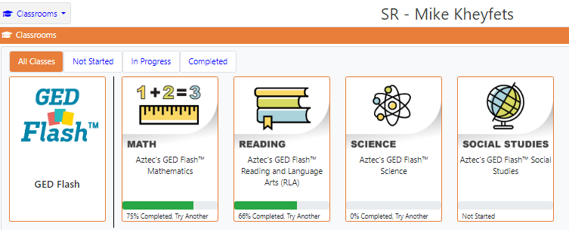
GED FLASH™ FOR ORGANIZATIONS
STUDENT ACCESS: Practice Preparation Aligned to the Test
ALIGNED TO GED® BLUEPRINT
Similar experience and features to the pre-test.
QUESTIONS IN ALL SUBJECTS
1000s of questions across all four subjects.
IMMEDIATE FEEDBACK
Step-by-step explanations after each question.
EASY TO USE & ASSIGN
Provide support in each subject.
Notes:
Explain the tool.

Slide 76
GED FLASH™ FOR ORGANIZATIONS
Increased Performance, More Confidence & Higher Likelihood of Passing
141
NATIONAL AVERAGE
NON-PASSING GED® SCORE
Students who practiced frequently with GED Flash™ scored on average 4 points higher on their GED® test versus those who rarely used it.
4 point increase in Math would make a world of difference.
Results Based from GED Testing Service Research
Notes:
The average non passing score in the US in a 141.
4 point increase in Math would make a world of difference.

Slide 77
GED FLASH™ FOR ORGANIZATIONS
Increased Performance, More Confidence & Higher Likelihood of Passing
79%
USERS FEEL MORE CONFIDENT
about taking the GED® test after practicing on GED Flash™.
Results Based from GED Testing Service Research

Slide 78
GED PLAY™
On Demand Video Learning
ON DEMAND VIDEO. ON DEMAND LEARNING
The only on demand video learning program developed by GED Testing Service, Kaplan and Aztec Software to provide targeted video learning support across key GED® measured skills.

Slide 79
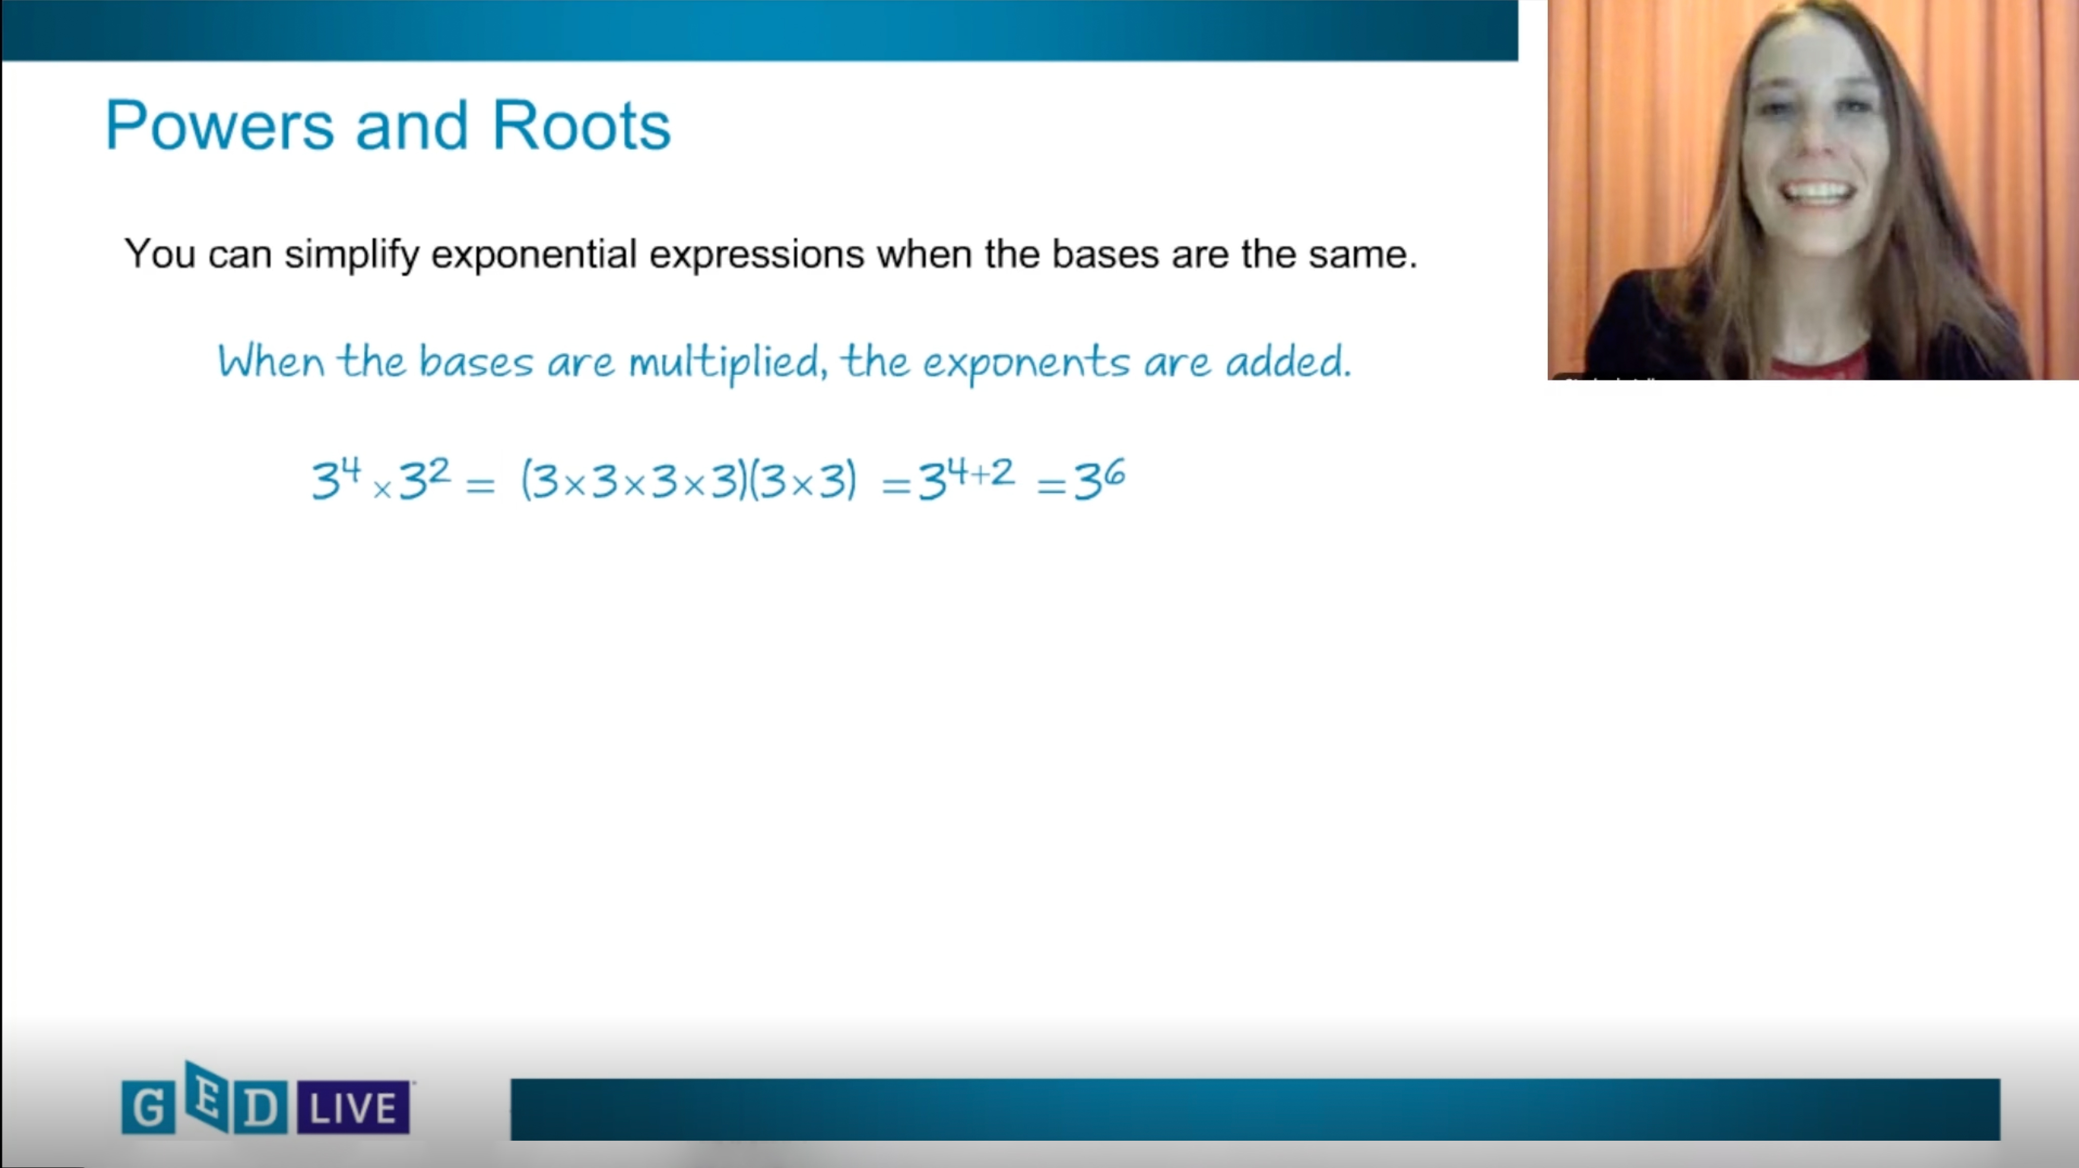
GED PLAY™
On Demand Video Learning
THE PERFECT
REINFORCEMENT SUPPLEMENT
GED™ Play was developed from our experience with GED Flash and the need for quick remediation.
VERSATILE USE
Can be used as direct instruction and distance learning supplement & reinforcement tool.
ALIGNMENT TO
GED FLASH & GED® TEST
Questions are aligned to and cover the key skills from the test. Also aligned to GED Flash allowing seamless remediation of specific sections.
PERFORMANCE INSIGHT
Gain insight on students’ performance and reportable information.
Notes:
GED Play provides:
Comprehensive Content – hours of video lessons covering all GED subjects
Targeted Instruction – videos focus on key GED test skills
Top Rated Instructors – Master Kaplan instructors teach the lesson
Easy to Digest: Designed to be easily digested by students.

Slide 80



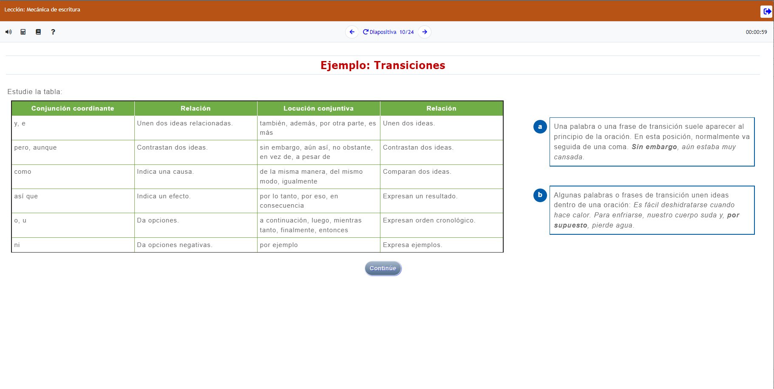
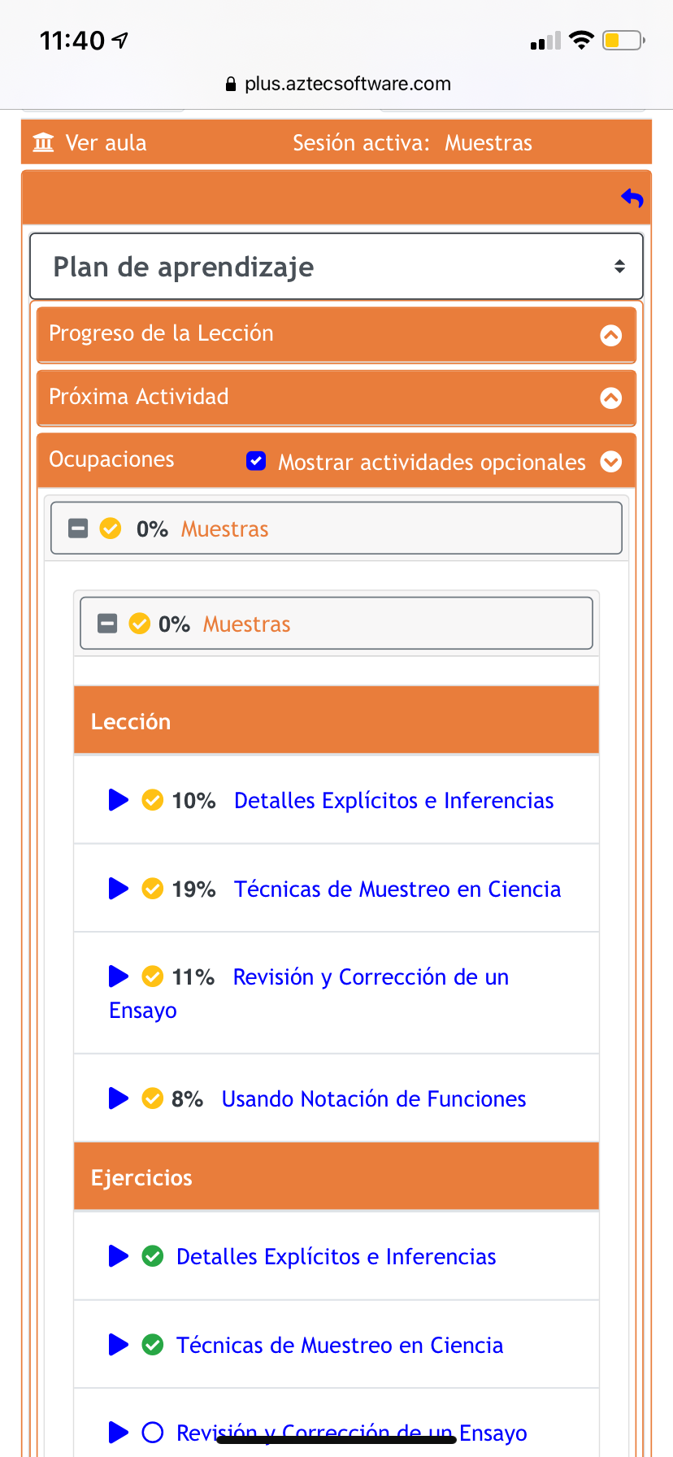

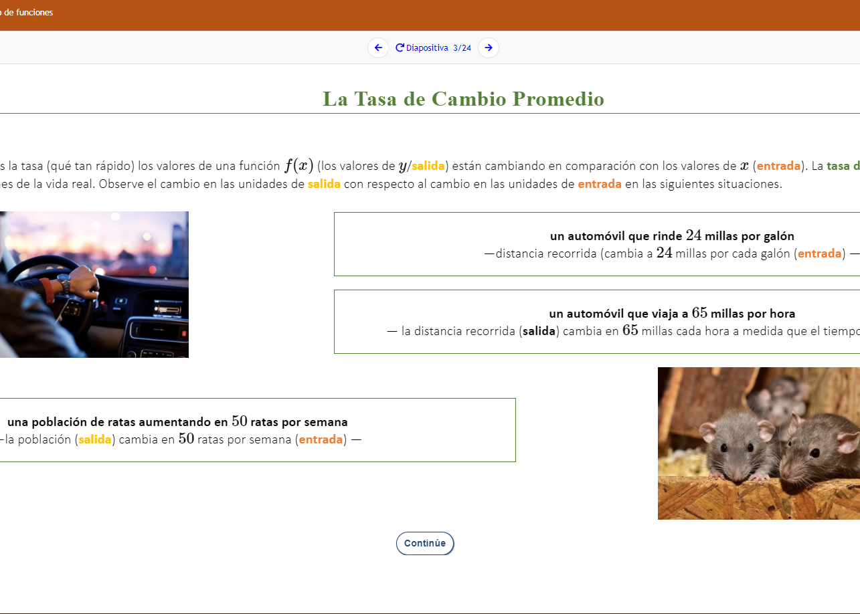
AZTEC SPANISH GED® PREP
Official Partnership with the GED Testing Service
Aztec is the GED Testing Service’s Only Preferred Partner
for the Spanish GED® Test
Notes:
We are pleased to announce this new partnership founded upon the shared belief of building equitable pathways of learning and opportunity for Spanish speaking students. Aztec is GED Testing Service’s ONLY Preferred partner for the Spanish GED Test
Aztec’s GED Spanish Prep Series is fully aligned to the Spanish GED test. It is written by a dedicated team of Aztec Spanish instructors for Spanish learners and contextualized for the Spanish GED Tests.
Aztec's NEW Spanish GED Test preparation system builds equity for your students by elevating self-esteem while delivering the academic instruction needed to successfully earn a GED.
It is authentically developed in Spanish and NOT just translated. The prep system supports students with full SPANISH audio ensuring a multi-modal experience.
Lastly, Aztec delivers this incredible resource in their Learning Management System in full Spanish mode.

Slide 81
GED® Test Delivery
CCT & Chromebooks

Slide 82
Software Installation: Cloud Computing Technology (CCT) is available for Correctional Facilities
CCT software delivers the GED test with some advantages over the standard software install.
CCT software install is faster to install than the standard software.
CCT functions as a server in large testing centers with 15 or more computers.
Software updates are handled via the cloud (not manually).
Requires internet connectivity that is stable and reliable.
You must be a GED Only center in order to go the CCT route.

Slide 83
Standard Software vs CCT (Cloud)
Standard Software
Allows test delivery in an offline manner, i.e. student is testing on a computer, but the computer does not need to be internet connected.
The test administrator computer will need to connect to the internet on test day in order to download/upload the exams.
Once the software is installed there are periodic software updates you will need to run over time in order to keep the software up to date and secure.
Cloud Computing Technology (CCT)
CCT software delivers the GED test with some advantages over the standard software install.
CCT software install is faster to install than the standard software
CCT eliminates the need for a server in large testing centers with 15 or more computers. CCT functions as the server.
No periodic software updates for you as the test center to do. Software updates are handled via the cloud.
Requires internet connectivity that is stable and reliable

Slide 84
CCT Delivery
We are delivering the GED test via the CCT software at 50-60 GED testing sites across the U.S.
There are correctional facilities in 7-8 states delivering via CCT.
Feedback from test administrators regarding test delivery via CCT has been positive.
If you are aware of correctional facilities in your state experiencing consistent technical issues contact your GEDTS SRM to discuss a possible transitional to CCT.
Remember, CCT requires internet connectivity that is stable and reliable

Slide 85

Delivering GED® Tests on Chromebooks in Correctional Facilities?
We are currently in pilot mode

Slide 86
GED® Test Delivery on Chromebooks
Ohio DOC is now delivering GED tests on Chromebooks This is a significant milestone.
There has been, and continues to be, a major effort by OH DOC staff to make this happen along with Pearson VUE IT staff.
Correctional facilities in other states are looking into this delivery option.
Delivering on Chromebooks is only available to correctional test centers.

Slide 87
Delivering GED® Tests on Chromebooks
Please know that GED testing on Chromebooks is in a pilot phase.
Think of GED testing on Chromebooks as a new product. A new product that has many technical challenges, bugs and product documentation is a work in progress.
OH DOC staff have invested considerable time and effort to make this happen.
We need to proceed slowly with expanding, but we are open to conversations with additional correctional sites.
Delivery on Chromebooks is for correctional facilities ONLY.

Slide 88
Final Reminders

Slide 89
Correctional Verification List
Issue: Correctional facilities have consistently expressed frustration with the difficulty in verifying whether an individual has passed the GED test in a state outside of the one they are currently incarcerated.
Ex. Ohio DOC has a new inmate who says he passed the GED test in Florida in 2012.
How GEDTS Can Help: We have compiled a correctional verification contact list by state to assist correctional facilities in verifying whether an individual in your facility passed the GED test in another state.

Slide 90
Your State Relationship Team
Brian Smith, Director
Brian.Smith@ged.com
Mellissa Hultstrand
IL,MI,MN,TN,VT,WI,
PR,VI
Mellissa.Hultstrand@ged.com
Scott Salesses
MA,NY,FBOP
Scott.Salesses@ged.com
Adora Beard
DC,DE,MD,VA,PA,PR
Military
Adora.Beard@ged.com
Lisa Pool-Osorio AK,AZ,CA,ID,NV,OR,UT, WA, Guam
Lisa.Pool-Osorio@ged.com
Diane Vaccari
CT,FL,KY,NH,NJ,OH,RI,,WV
Bermuda
Diane.Vaccari@ged.com
Liz Lanphear CO,HI,IN,KS,MO,NE,NM,ND,SD
Elizabeth.Lanphear@ged.com
Shawn Watts
AL,AR,GA,LA,NC,SC
Shawn.Watts@ged.com
Jonna McDonough
CA,MS,MT,OK,TX,WY
Jonna.Mcdonough@ged.com

Slide 91

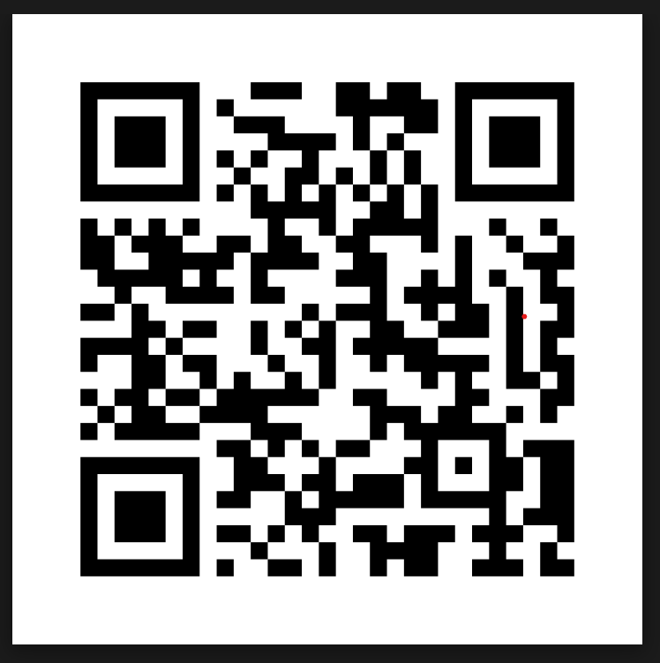
Session Survey
Your feedback is important. Please scan the QR code below to rate this session.

Slide 92
Questions

Slide 93

Contact
Information
Scott Salesses
Director, Security Operations & CorrectionsState Relationship Manager
Scott.Salesses@GED.com
Mellissa Hultstrand
State Relationship Manager
Mellissa.Hultstrand@GED.com

