Slide 1
GED® Analytics
Azeem Begum — Business Analyst
Brent Gerken — Manager, GED Technical Operations

Slide 2
01
04
Why Use GED Analytics?
Access & Permissions
02
05
What is GED Analytics?
GED Analytics Suite
03
06
What's New?
GED Analytics & Additional Reports​
...and how this all ties together toward learner success!

Slide 3



Why Use GED Analytics?
Powerful Visualizations
See testing trends and key metrics at a glance
A Source of Truth
Reliable GED data for decision makers
Targeted Outreach
Reach the 3 of 4 who pass and the prep centers that serve them
One tool. Every GED insight your jurisdiction needs.

Slide 4
What is GED Analytics?
A reporting tool that extracts GED-related insights from data, empowering users to make informed decisions
An extension of GED Manager with single sign-on (SSO)… (pending approval)
Jurisdictional stats for visualizations, date filtering, variables and downloading
Two access levels
  Viewer (aggregate only)
  Explorer (full access)
Segmented into Summary Reports and Additional Reports

Slide 5

What's New?
2026 performance upgrade
  ✅ Early July- Completed migration and upgrade of GED Analytics Tableau Server; improving platform reliability, performance, security, and long-term supportability.
New Reports
  Prep Center(s) dashboard
  Test Center(s) Performance dashboard
Mobile metrics
  Access to user usage

Slide 6
Access & Permissions
Explorer — Full Access
Candidate and test drilldown
Ability to download reports
Built for power users and marketing campaigns
Specific student grouping
Personal Identifying Information (PII)
Viewer — Aggregate Only
High-level aggregate data
No access to student-specific data
Useful for general trend analysis
Overall data visualization

Slide 7
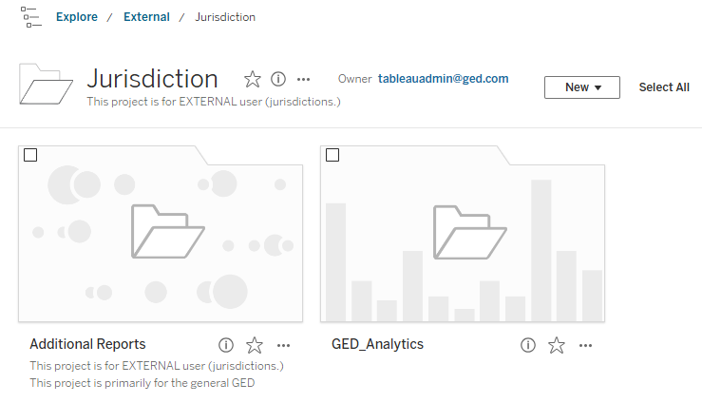
Access -
SSO from GED Manager
GED Manager
    > Reporting
      > GED Analytics
No separate passwords needed.
Your access level determines which reports you see.

Slide 8
The GED Analytics Report Suite
Summary Reports
Test Summary
Test Taker Summary
Performance Summary
Demographics Summary
Appointment Summary
3 of 4 Subjects
Additional Reports
GED Manager Utilization
Key Metrics by Jurisdiction
GED Ready Usage
Test Taker Journey
Registered – Not Tested
Prep Program Centers
Prep Center Performance
Test Center Workstations
Students Moved in/out State
No Show Appointments
Drilldowns
Candidate Drilldown
  Multiple levels
Test Drilldown
  GED Test
  GED Ready

Slide 9


Explore the Summary Reports
Test Summary
Test Taker Summary
Performance Summary
Demographics Summary
Appointment Summary
Passed 3 of 4

Slide 10
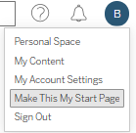
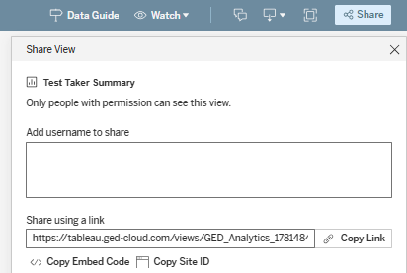

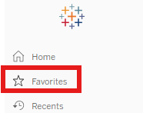
Master Tips
Add a starting page: Share Report: Other Tips & Tricks
& FAQs:
Create a favorites list:

Slide 11
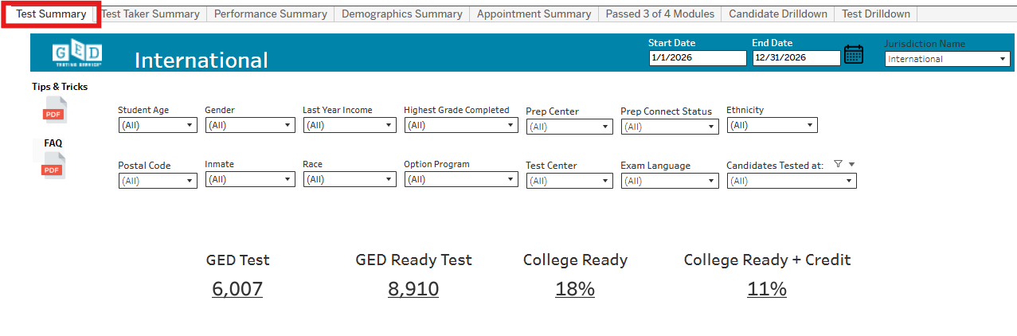
Test Summary Report
Testing volume at a glance
Jurisdiction-specific
Track total tests delivered, GED Ready & adv level scores
Date filtering
Use Variables for customization

Slide 12
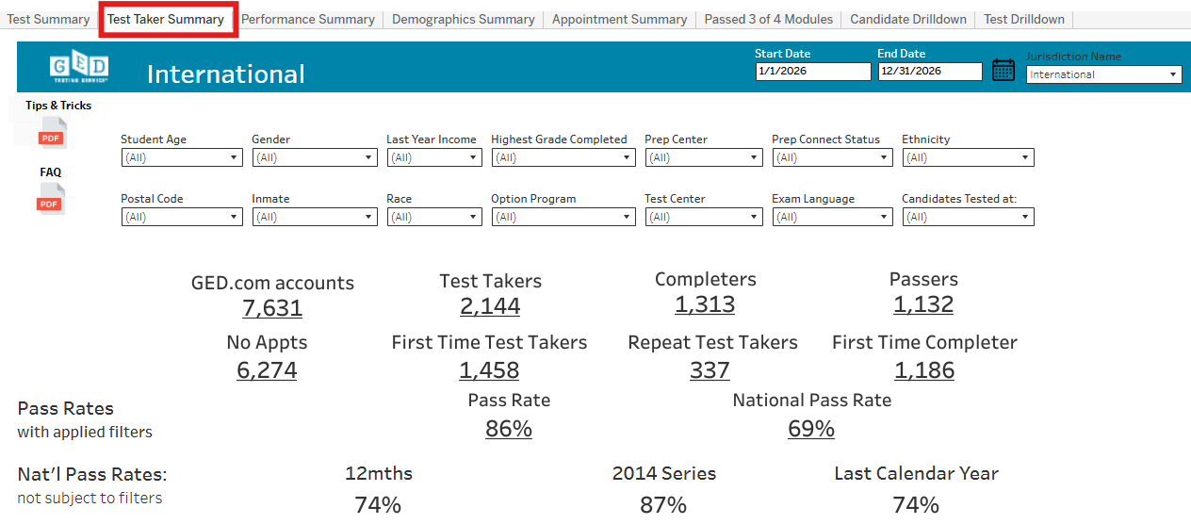
Test Taker Summary Report
Who is testing in your jurisdiction?
Student accounts
Test Takers, Completers & Passers
Test Taker progress
Pass rates vs Nat'l pass rates

Slide 13
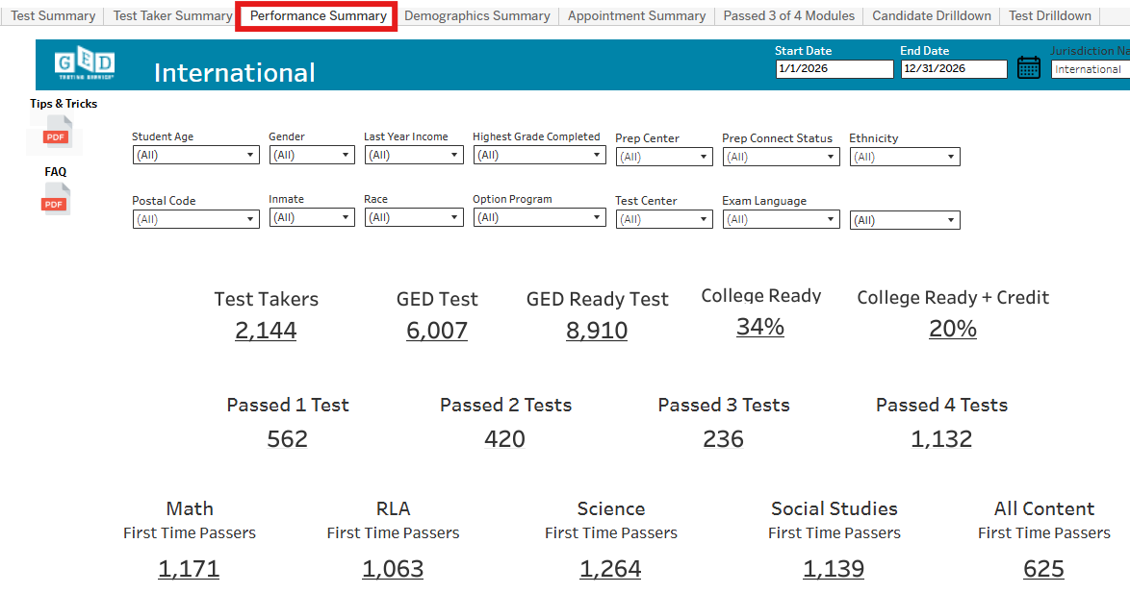
Performance Summary
How are students performing w/ test center insight?
Test subject breakdown
Test center comparison
% distribution ​
Ave scores by test center
Top 10 Test Centers

Slide 14
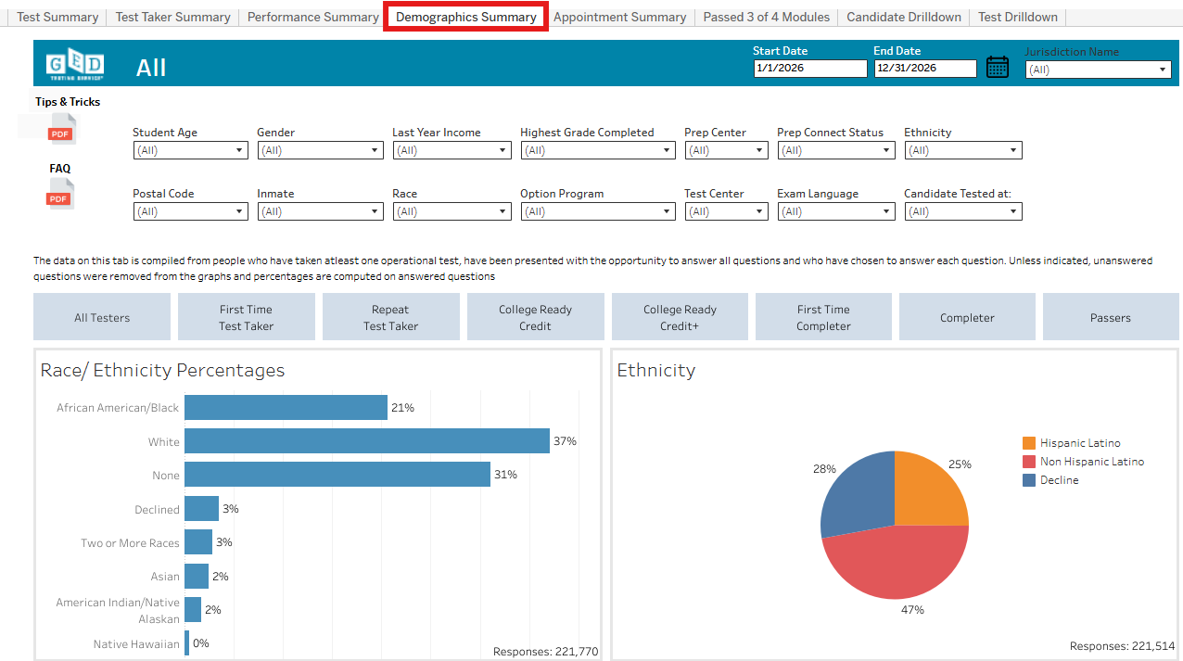
Demographic Summary
Understand your test-taker population
Breakdown by age, gender, highest grade completed, etc.
Test center comparison ​
Reason for not completing school
Test prep preference

Slide 15
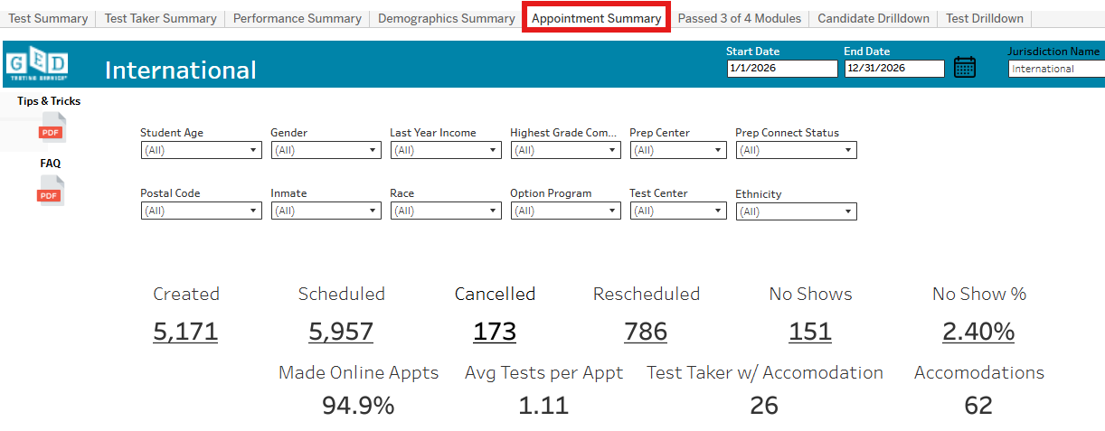
Appointment Summary
Scheduling and capacity​
Monitor scheduled, completed & no-show appointments
Test center comparison ​
Accommodations

Slide 16
Additional Reports
Key Metrics
GED Testers Demographics
GED Ready Usage
Passed 1 of 4 subjects
Passed 2 of 4 subjects
GED Manager Utilization
Prep Program Centers
Noshow appts
Registered – No Test Taken
Students Moved In/Out of State
Test Centers
Test Taker Journey Breakdown
GED Prep Center Performance

Slide 17
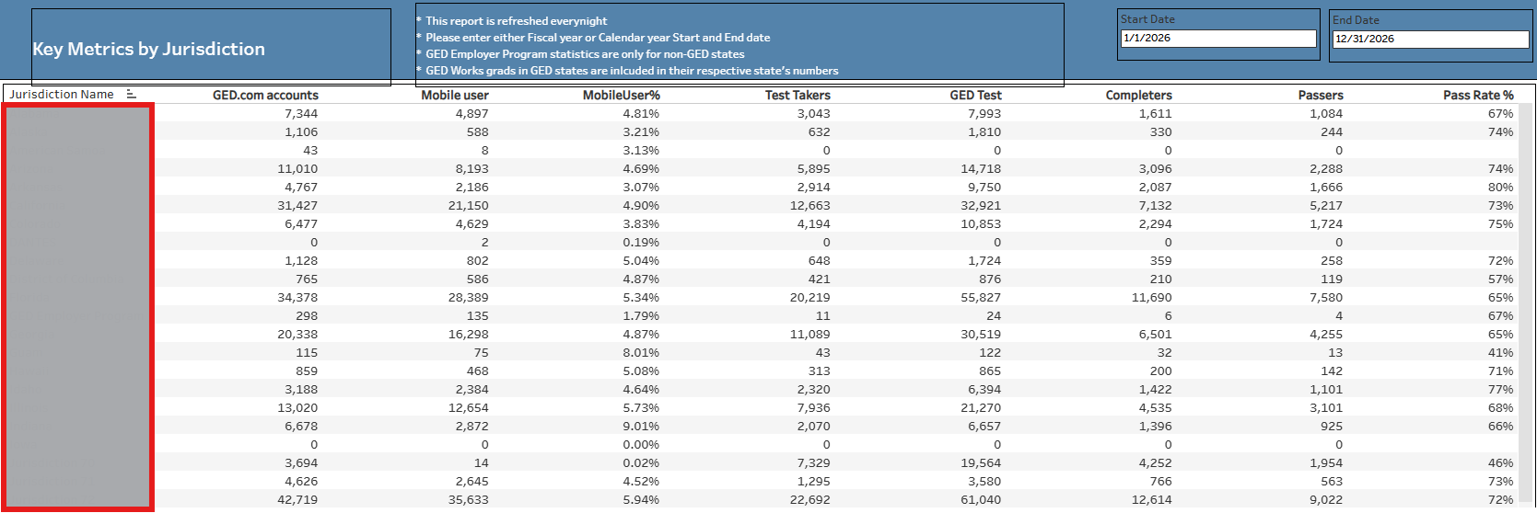
Key Metrics
How does your state compare?
This shows metrics by each state
50% of GED.com account holders are Test takers ​
Records w/ no test activity in 2 years are deleted/archived
New! Mobile users

Slide 18
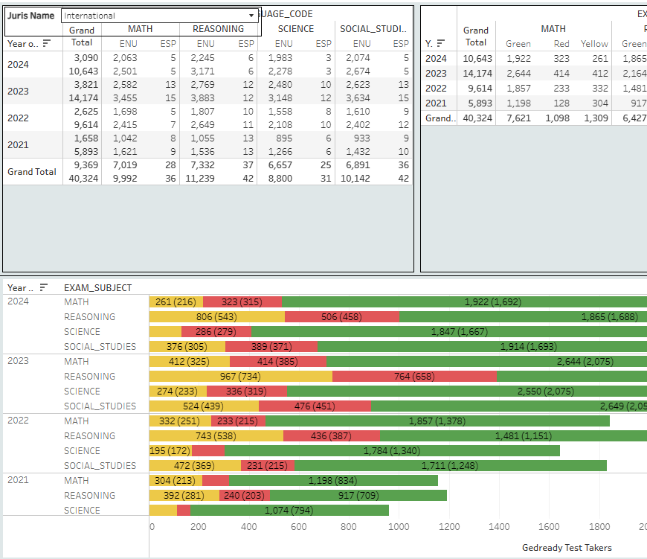
GED Ready Usage
YoY GED Ready data
Score distribution
Eng/Esp counts

Slide 19
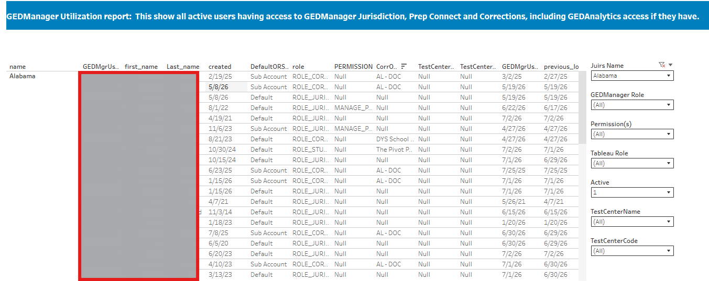
GED Manager Utilization
Manage all GED Manager users
Are permissions appropriate?
Self-serve disable users in GED Manager
  Set an end date for future leavers

Slide 20
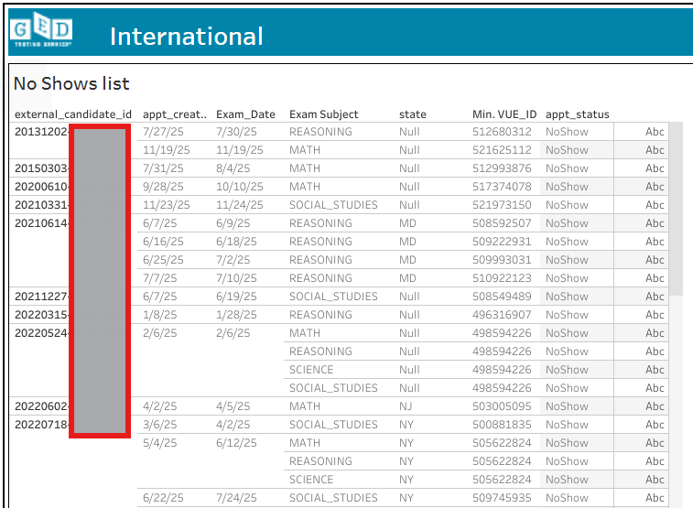
No show appointments
Download and create pivot table
How systemic are your student No Shows?

Slide 21
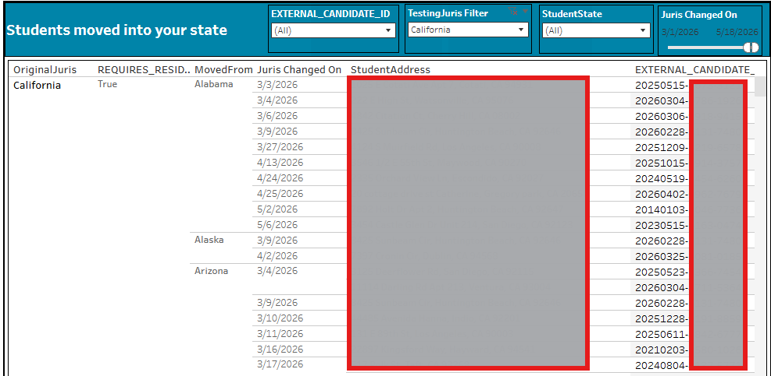
Students Moved In-Out of State
The transient student data trends
  Moving Into State
  Moving Out of State

Slide 22
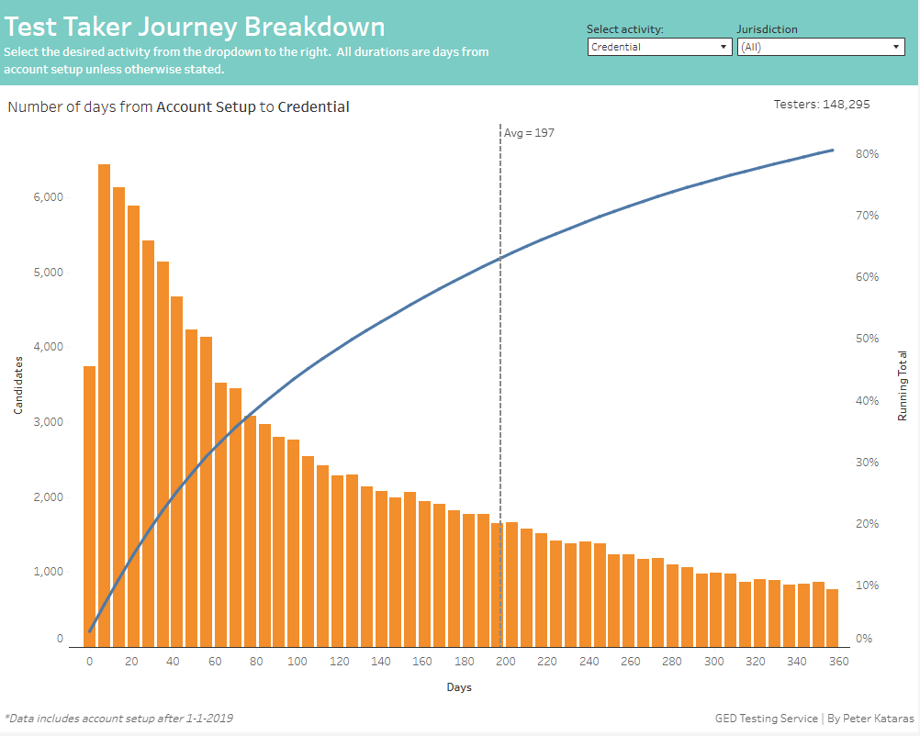
Test Taker Journey​
Activity options:
Credential
First Ready
Last Ready
First GED
Last GED
Complete
First test to Credential

Slide 23
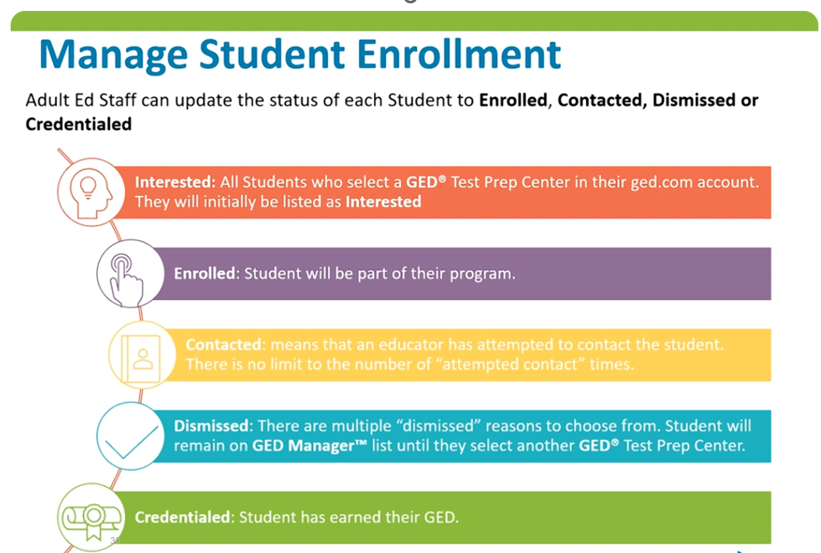

Slide 24
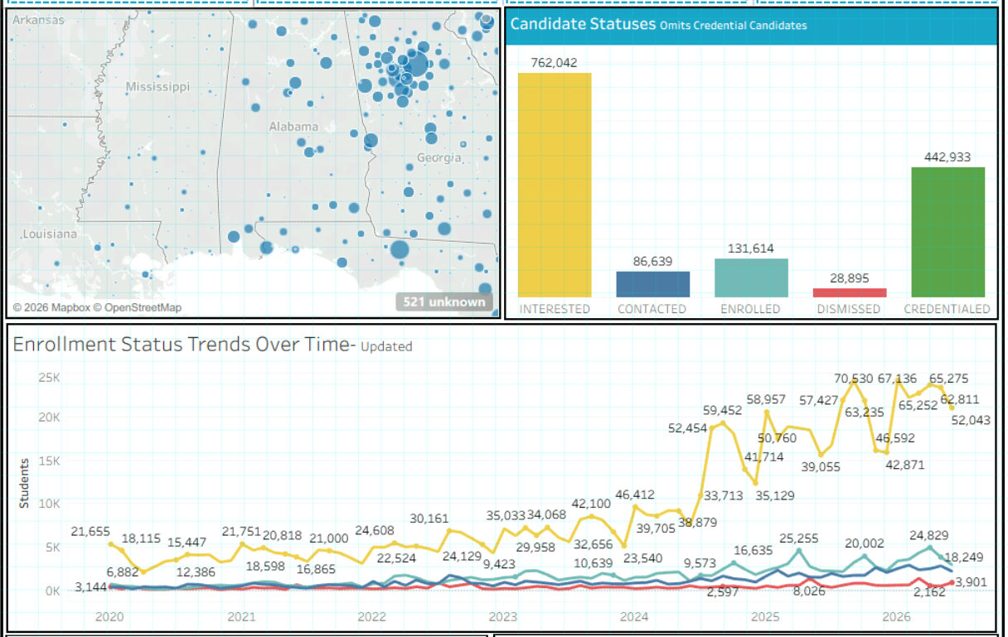
GED Prep Connect Dashboard Snapshot
Based on the current data, Interest far outpaces follow-up—most of the 760K interested learners haven’t yet been contacted or status not updated in GEDManager.
This is signaling a large conversion opportunity.
And since inactive profiles are deleted after two years, this count reflects only still-active learners—so the window to reach them is narrowing.
The Interested (yellow) bar drops only when ABE manually advance learners in GEDManager – Manage GED® Prep Connect Enrollment to Contacted, Enrolled, or Dismissed — its size reflects pending follow-up.

Slide 25
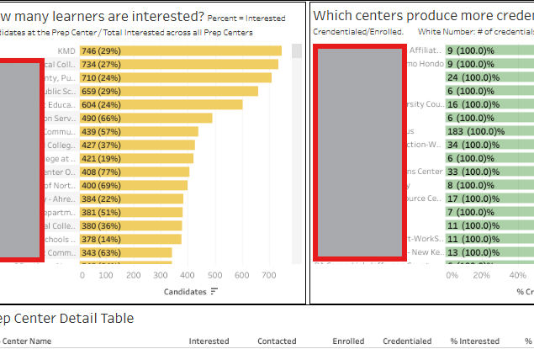
Prep Center Performance Dashboard
Identify student enrollment status
Spot map of Prep Centers in your state
Identify highest performing Prep Centers
Gauge status trends over time

Slide 26
GED Prep Connect™ and GED Direct™- Recruit Smarter, Manage Better:
How these help Strengthen Adult Education Programs
Programs juggle recruitment, enrollment, testing, budgets, and reporting — this session shows how both tools work together end‑to‑end.
GED Prep Connect™ (in GED Manager™): find GED® candidates who've expressed interest, connect at the right moment, prioritize follow‑up, and boost enrollment.
GED Direct™ (in GED Manager™): purchase, assign, and share GED Ready® tests and GED® exams, and monitor usage — no voucher codes or expiration tracking.
GED & Me™ the official GED mobile app. Teachers can now leverage the mobile app's study and practice tools to better support learner success.
Combined: save time, cut administrative burden, and strengthen program oversight.

Slide 27
Completed — Foundational Improvements to GED Prep Connect in GED Manager
Improve Prep Connect Tool
Automate Credentialed Status
Test Results Activity Columns
The tool over the years created manual overhead needing improvements
First automation win: status auto-changes "Interested → Credentialed" on GED earn; reverts if revoked.
Added two sortable columns (GED Ready Greens, GED Passed) to Prep Connect search results so teachers can prioritize follow-up.
Prep Connect Messaging
Access to State Admins by Default
Prep Center Locator Redesign
Updated GED.com portal language encouraging students to reach out to prep centers proactively.
Made "Manage Prep Connect Enrollment" a default permission
UX redesign of the Prep Center Locator on GED.com: collapsible header, sticky search, star indicators, mobile-responsive.

Slide 28
Passed 3 of 4 GED Subjects
Subject(s) failed or not taken
Student Engagement & Activity
80%
Math
13%
Reading & Language Arts
68,633
62,893
38,802
5%
Social Studies
3%
Science
27,178
25,836
18–21
22–30
31–40
41–50
51+
Based on the data as of July 2026 who passed 3 of 4 GED subjects. Students aged 23–40 are the most active, and most log into GED.com

Slide 29
Passed 3 of 4 Engagement & Enrollment Overview
219,205 total students passed 3 of 4 GED subjects
87%
184,565
Logged into GED.com
40%
87,005
Selected a prep center
32%
69,359
Answered True to Can GED Contact?
18%
38,843
Enrolled via corrections (DOC)
10%
21,696
Use the mobile app
Based on GED.com data as of July 2026 for students who passed 3 of 4 GED subjects.

Slide 30
Passed 3 of 4 Student Engagement & Activity
Students aged 23–40 are the most active, and most log into GED.com
Age Group | Students
18–21 | 27,178
22–30 | 68,633
31–40 | 62,893
41–50 | 38,802
51+ | 25,836
84%
Logged into GED.com
10%
Use the mobile app
32%
Answered True to Can GED Contact?
60% False, 8% no answer

Slide 31
A "staller" is a student who passed 3 of 4 GED subjects and stays active but has not yet cleared the final subject.
24
Median Logins
Consistent platform activity
60
Average Logins
Effort is not the problem
5.1
Avg. Recency
Months since last attempt
11.2%
Median Score Gap
Short of passing the last subject

Slide 32
The Math Wall A skill gap, not a motivation gap
79%
Missing Math
Of stallers, the last unpassed subject is Math
67%
Engaged, still short.
Of high-engagement stallers still did not pass Math
17%
Never attempted
Never sat the Math test despite being active

Slide 33

Mobile App – Math Practice
Practice Questions
Syd – AI Tutor
Instructional Videos
Contains a wide variety of Math questions targeting all the fundamental concepts needed to pass the official GED Test
Allows learners to ask questions about questions and concepts they are struggling with, offering free, instant feedback
Short & long-form videos used to build understanding of fundamental concepts that appear on the GED Test

Slide 34
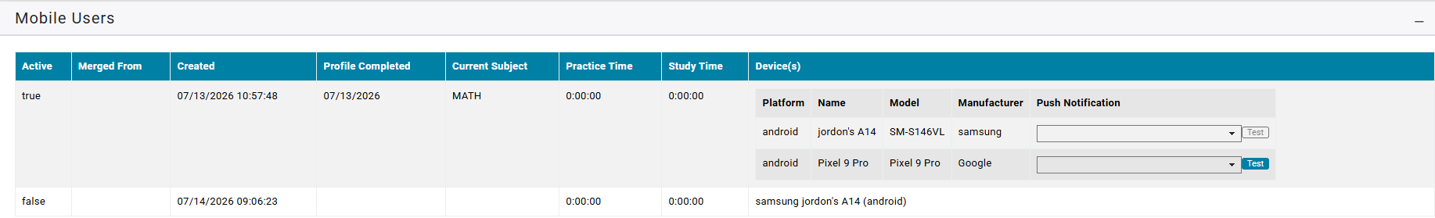
Reporting tool in GED Manager (Student Detail)
Mobile App Users – Progress oversight
Mobile User Metrics
Active
Created
Profile Created
Completed Date
Current Subject
Practice Time
Study Time
Device(s)

Slide 35
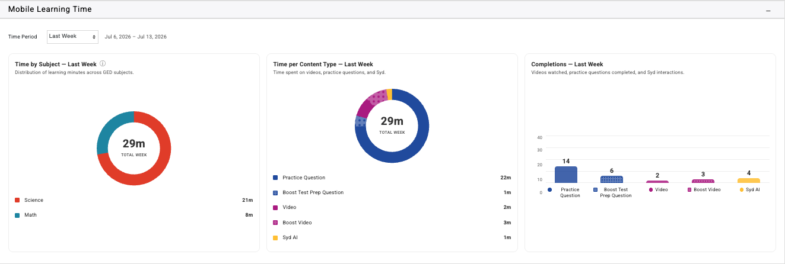
Reporting in GED Manager:
Introducing mobile learning time
Front-end outreach

Slide 36




Our Social Media push
Early this year, we ran this campaign in the GED Graduates community—rallying learners who passed 3 of 4 subjects to conquer math with Syd, the in-app AI tutor.
Battling just math? Meet Syd, your in-app AI math tutor.
Step-by-step math help
Worked solutions that build real understanding.
Personalized explanations
Answers tailored to each learner's question.
Replies in 250+ languages
Support in the language learners think in.
Download the GED & Me app today — on iPhone & Android

Slide 37
Staller Outreach Plan Close the math gap for students one subject from their GED
01
Diagnose the Gap
A short skill-level math diagnostic pinpoints exactly where each student stalls.
02
Targeted Practice
Assign personalized math modules on weak skills instead of generic full-length review.
03
Guided Outreach
Time proactive nudges and tutor connections to re-engage stallers before they drop off.
Because stallers are already engaged, closing the skill gap—is what earns the fourth pass.

Slide 38
Questions?
Reach us at Operations@ged.com

Slide 39

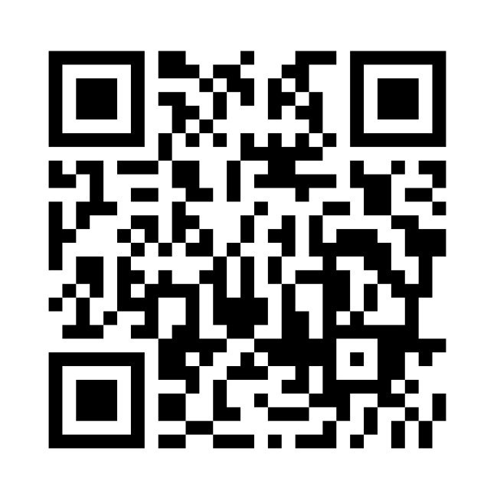
Session Survey
Your feedback is important. Please take a moment to rate this session and help us improve future ones.

