Slide 1
From Readiness to Results: Co-designing GED Ready® and offline mobile learning for Corrections learners
Jane Bledsoe, Product Portfolio & Technology Director
Jared Brandau, Product Development Director
Victor Fitzjarrald, Sr Product Manager

Slide 2
Session overview
This interactive session will explore the potential for delivering GED Ready® on approved tablets and Chromebooks in corrections settings and gather educator input on requirements for building an offline version of the GED & Me™ mobile app.
GED®Testing Service will share data and insights on learner outcomes associated with GED Ready and the GED & Me mobile app, including how readiness indicators, personalized study guidance, and mobile engagement can support persistence and test success.
Participants will be active contributors throughout the session.

Slide 3
1
6
Discussion: Mobile app requirements for usage in Corrections
Corrections data overview
2
7
GED Ready insights
Share out from small group discussions
3
GED & Me Mobile App efficacy
4
Discussion: GED Ready usage in Corrections
5
Discussion: Tablet usage and content needs in Corrections

Slide 4
Corrections data overview

Slide 5

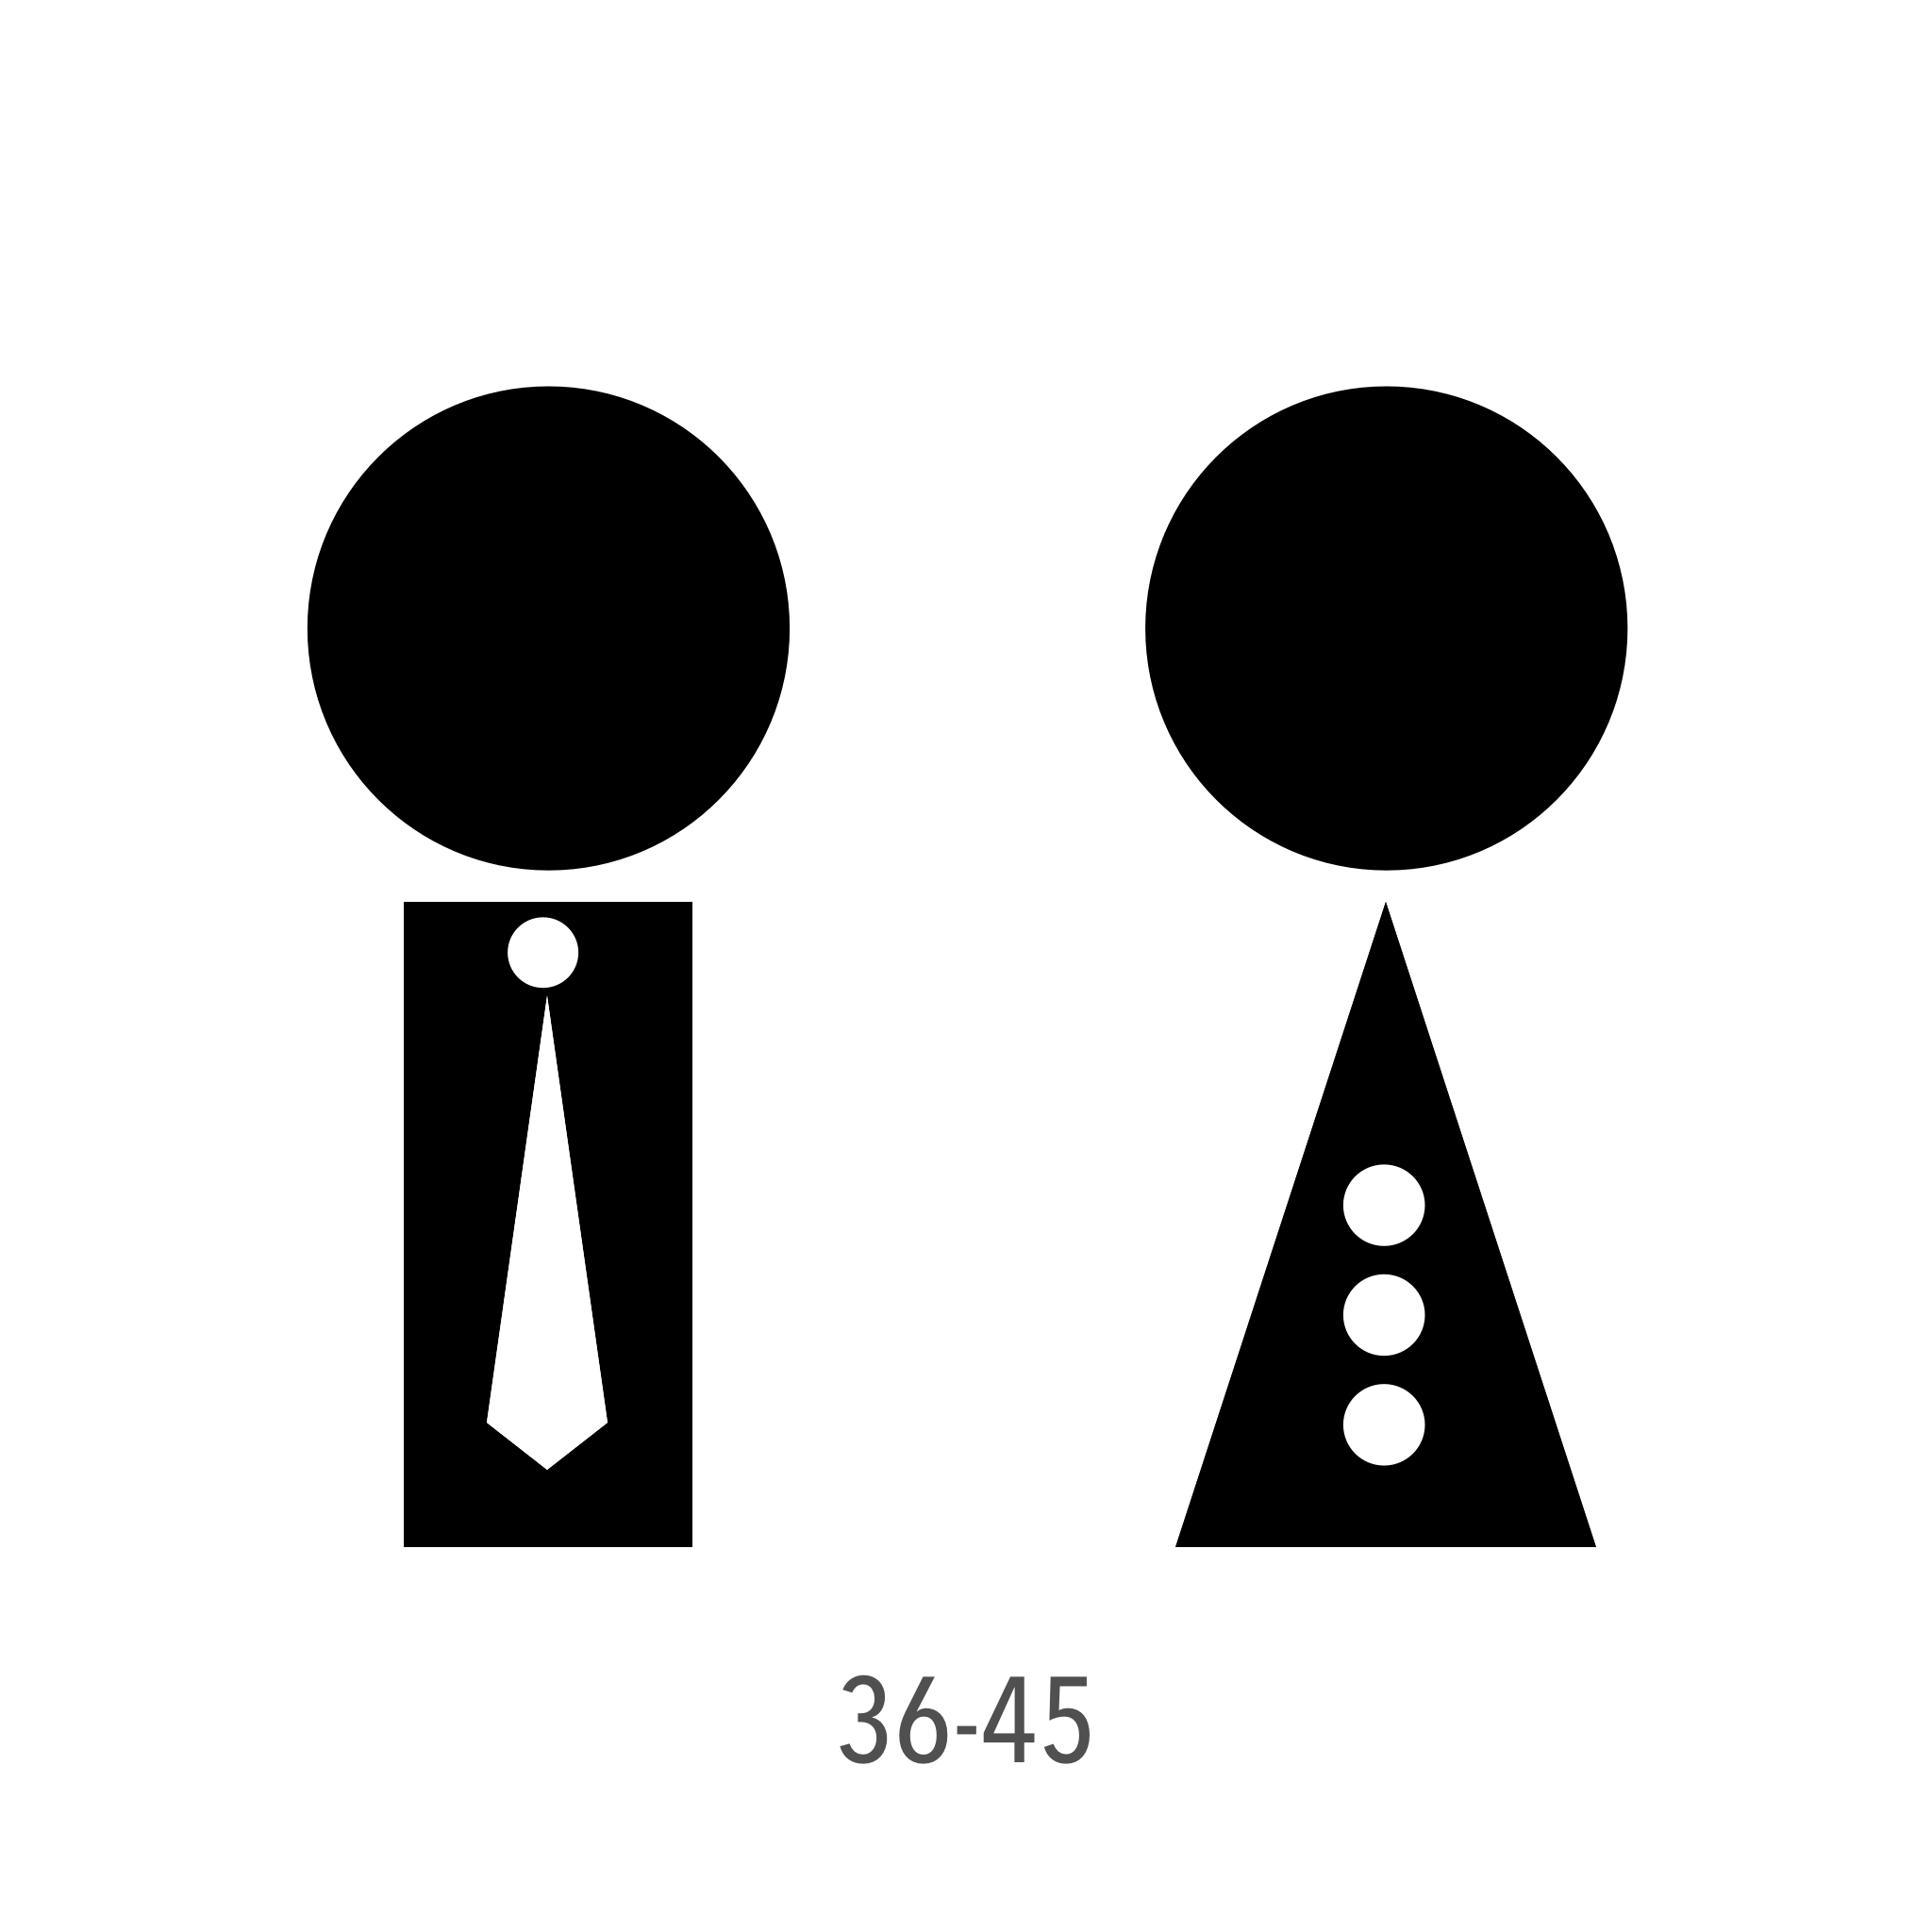


Corrections vs. General Public: By the Numbers
16.7% of test-takers from Corrections in 2026, down from 17.9%
Average age 32–33 in Corrections vs. 21–22 for the general public
74.8% Corrections pass rate vs. 81.3% for the general public in 2026
6.5-point average pass-rate gap between Corrections and gen public, unchanged since 2023
24,884 Corrections passers in 2025, up 11% since 2023

Slide 6
Pass-Rate Gaps by Subject
Where the gaps are widest
RLA: gap widened from –8% to –9% since 2023
Social Studies: gap widened from –6% to –9%
Both now show the largest gaps vs. the general public
RLA pass rate sits at 73% for Corrections learners
Social Studies pass rate sits at 76%
Where the gap is closing
Math: gap narrowed sharply from –6% to –2%
Suggests targeted math support is paying off
Science: smallest, steady gap near –6%
Science is the strongest subject at 82% pass rate
Math is still the hardest subject overall at 68% pass rate

Slide 7
The Preparation Resource Gap
Shrinking share
Down from 17.9% of test-takers in 2023 to 16.7% in 2026
A steady decline across all 3.5 years
Corrections volume grew even as its share shrank
Practice-test shortfall
Corrections is only ~7% of all GED Ready practice tests
despite making up ~17% of all test-takers
Points to a practice-resource access barrier in facilities
3x fewer practice reps
Corrections learners average 1.17 practice tests each
The general public averages 3.21 – nearly 3x more
Fewer reps likely widen the outcome gap

Slide 8
Key Insights & Takeaways
Persistent gap: Corrections trails the general public by about 6.5 points on average, across every subject.
Widening subjects: RLA and Social Studies gaps reached –9% in 2026, the widest in 3.5 years.
Bright spot: the Math gap narrowed from –6% to –2%, a sign targeted support is working.
Preparation divide: Corrections learners take about 3x fewer practice tests, a likely driver of the gap.
Shrinking share: Corrections slipped to 16.7% of all GED test-takers, from nearly 18% 3 years ago
Source: GED Testing Service — Corrections vs. General Public analysis, 2023–2026 YTD (data through 7/18/2026). 2026 reflects a partial year.

Slide 9
Solution to the practice gap: GED Ready®

Slide 10
GED Ready®: A Proven Path to Success
A proven readiness signal
The only official practice test, built by the exam’s creators
Score zones map to real outcomes: green (145–200) signals “likely to pass”
About 80% of learners who score green go on to pass the actual GED
Same-day scoring with targeted skill feedback by subject
One of the strongest single predictors of GED success
Why it matters for learner success
Turns test anxiety into confidence with a clear, trusted readiness signal
Focuses limited study time and builds persistence toward test day
Corrections learners take 3x fewer practice tests (1.17 vs. 3.21 per taker)
That preparation gap tracks with their lower pass rates
Expanding GED Ready access is a direct lever to close the gap

Slide 11
GED Ready®: Readiness You Can Trust
Correlation & What It Means
GED Ready is predictive by design—“Likely to Pass,” “Too Close to Call,” and “Not Likely to Pass” map to real test outcomes.
It remains one of the strongest predictors of GED test success.
More than 1 million GED Ready tests were taken in 2025.
Classroom tip: use the score bands to guide confident test-scheduling decisions.
Watch for a “red” score too early, which can discourage lower-confidence learners.
Score Report Research & Updates
Score report research shows the stoplight display makes learners compare across zones—even “likely to pass” scorers second-guess their readiness.
The red, yellow, and green zone colors also fall short of accessibility contrast standards.
An A/B test is piloting a clearer, confidence-building score presentation.
Messaging is shifting from “you scored green” to “you are likely to pass.”
Educators still value the familiar stoplight view for their own planning.

Slide 12
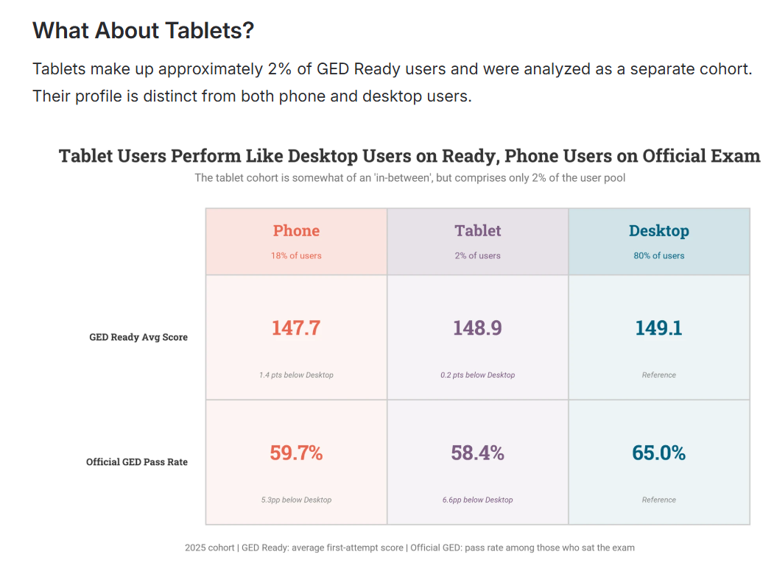
GED Ready analysis of usage on alternate devices: Tablet usage doesn’t hurt overall results

Slide 13
Solution to the practice gap: GED & Me mobile app

Slide 14
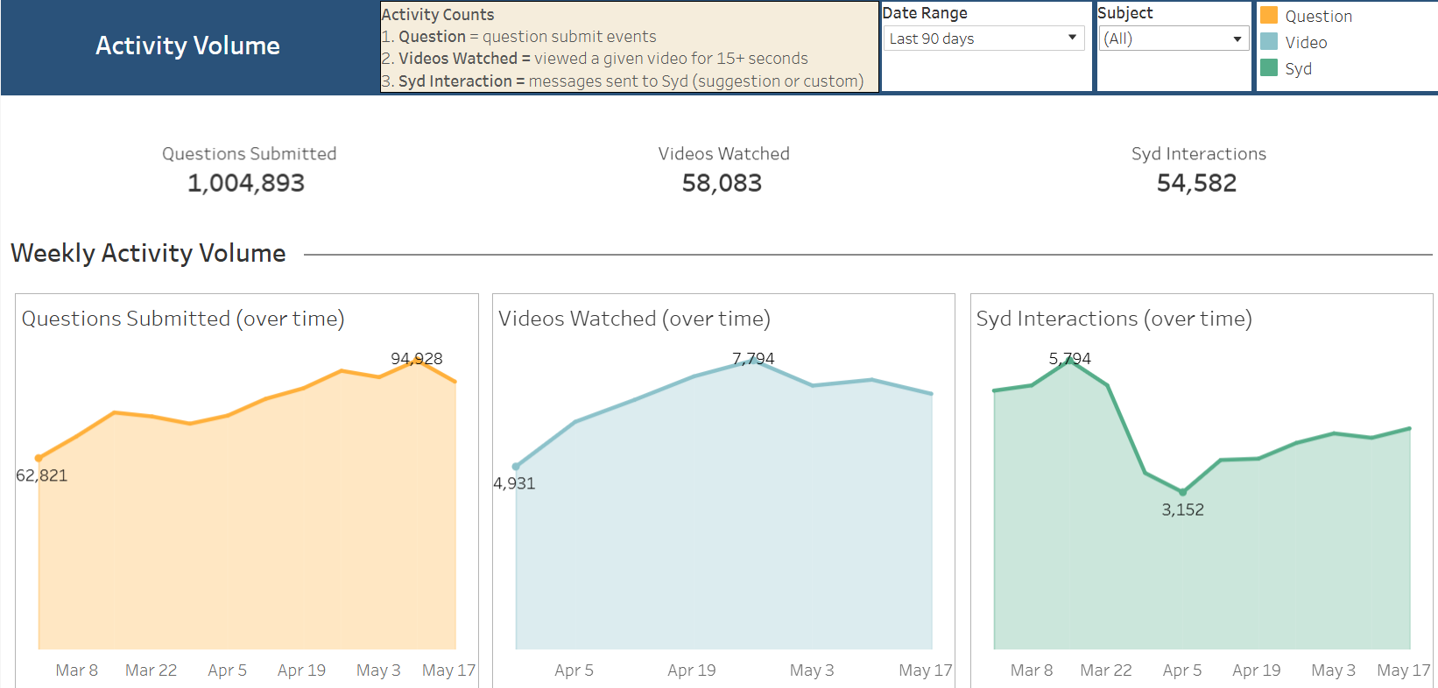
Learners using the mobile app have answered more than 1 million questions in the past 90 days, watched more than 58,000 videos and had more than 54,000 interactions with the AI tutor

Slide 15
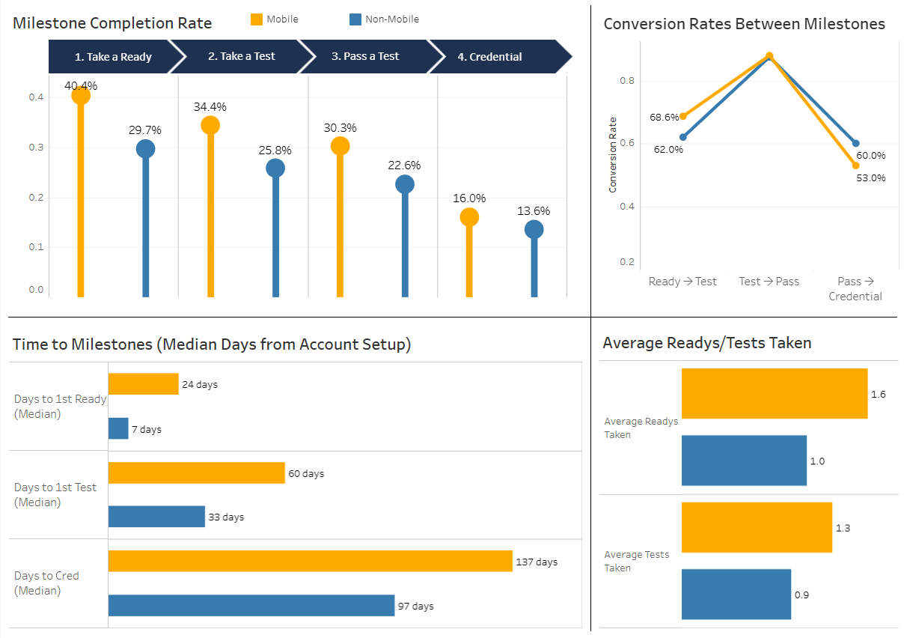
App users are more likely to take GED Readys, take tests, pass more tests, and credential at a higher rate
Take-away
Mobile users move through the pipeline slower but at a higher rate.
The credential rate is 18% higher for mobile users regardless of engagement level.
https://tableau.ged-cloud.com/#/views/MobilevNon-Mobile/Summary?:iid=1

Slide 16
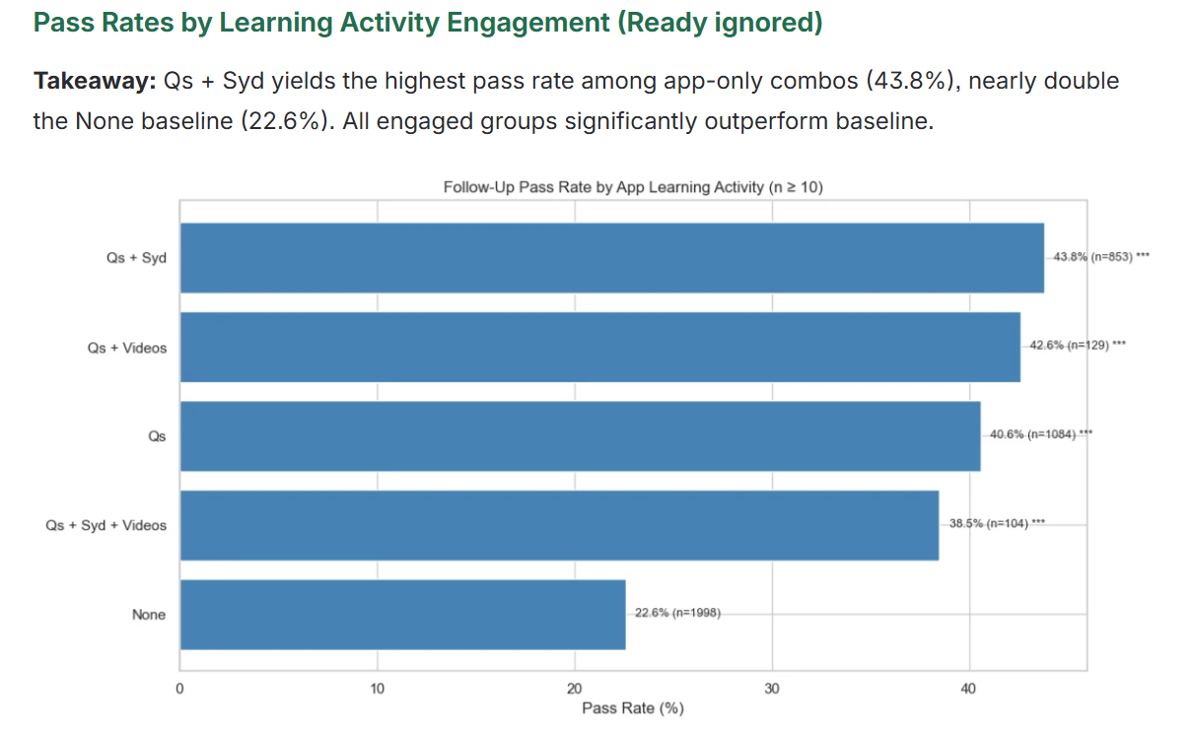
Among Math learners testing after a failed attempt, app engagement nearly doubles the odds of passing on the next try

Slide 17
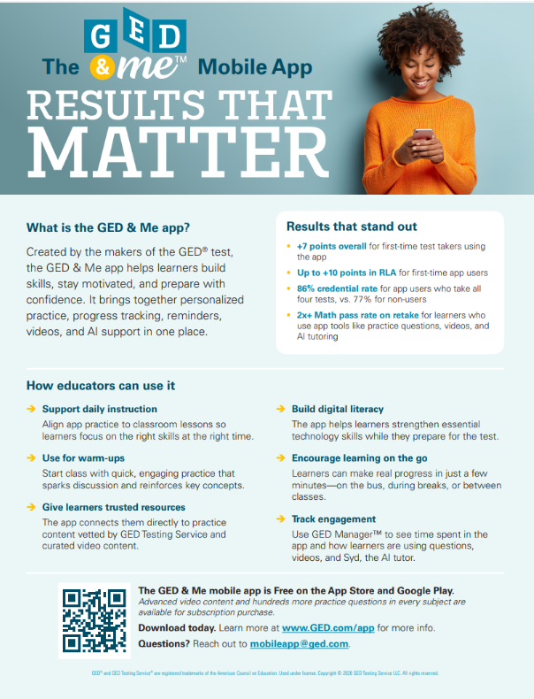
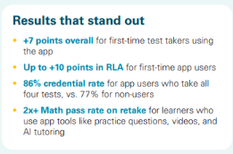
Teachers are using the mobile app in public adult ed classes to improve outcomes …. We would like Corrections educators to use it, too!

Slide 18
Summary & Discussion

Slide 19

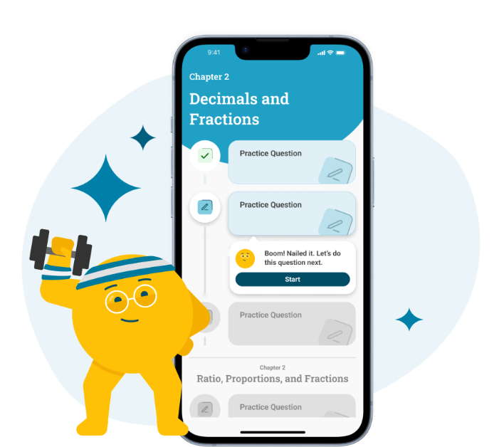
Summary
GED Ready and GED & Me Mobile App are proven to help learners succeed
Currently, Corrections learners have limited access to GED Ready and no access to the mobile app
GED Ready can be delivered on tablet/chrome book without any inconsistency with the predictiveness of the score on the actual GED test(s)
Corrections learners are slipping behind the performance of the public learners; more practice, more GED Readys are needed

Slide 20
Do not edit
How to change the design
Are you currently delivering GED Ready to learners in your facility?
The Slido app must be installed on every computer you’re presenting from

Slide 21
GED Ready discussion (small group with facilitator): 10 minutes
For those successfully delivering GED Ready in your facility today, how does it work?
  Do you have ideas about how it might be delivered differently?
  What are the criteria you use for determining who will take a GED Ready practice test?
  What happens after the GED Ready when you receive scores?
    Green: what’s the cut score you require for testing? Within what timeframe do they test?
    Yellow: what additional preparation is required? Do they take another GED Ready? In what timeframe?
    Red: what are the next steps?
  If you could deliver the GED Ready on a tablet/chromebook, would that be a way to get more learners progressing?

Slide 22
Do not edit
How to change the design
If you are using Tablets/chromebooks in your facility, do you have sufficient GED practice content available to help learners prepare for the test?
The Slido app must be installed on every computer you’re presenting from

Slide 23
Tablet/Chromebook & Content discussion (small group with facilitator): 10 minutes
What kind of content do you have available on tablets/chromebooks for preparing for the GED test?
  How is this content downloaded to or accessed by the tablets/chromebooks to ensure security?
If you could wave your magic wand, what would you LIKE to have on tablets/chromebooks to help prepare for the GED Test?
  What would have to be true for this content to be made available to your learners?
If you don’t have tablets/chromebooks for learners, is it likely in the future?
  Why or why not?
  What kind of content do you use to help learners prepare for the GED?

Slide 24
Do not edit
How to change the design
What components of the GED & Me mobile app would be most valuable to your learners?
The Slido app must be installed on every computer you’re presenting from

Slide 25
GED & Me mobile app discussion (small group with facilitator): 10 minutes
What has to be true to deliver your preferred App content to learners in Corrections facilities? (Ex. Offline access, white-labeled URLs, specific file types, etc)
Describe learners access to mobile devices – often, occasional, never?
Can learners have their own ‘account’ with a mobile device? How do you track their progress?
Can you launch the mobile app from a connected device in your facility and broadcast on a screen during class?
What obstacles to using the mobile app haven’t we discussed?

Slide 26
Share-out – 10 minutes
Takeaways from the GED Ready discussion
What are the obstacles to delivery?
Would GED Ready on tablet be valuable to your facility?
Any takeaways about how other facilities deliver GED Ready differently?
Takeaways from the Content/tablet discussion
Are tablets being used widely in your Corrections facilities? Or are they expected in the future?
Do you struggle with having enough content for GED test prep?
What’s on the wish list for test prep?
Takeaways from the mobile app discussion
Do learners in Corrections have access to mobile devices? Their own learning accounts?
Are internet connections common in education facilities to access the mobile app in a group setting?
What’s the most important content in the mobile app for Corrections learners?

Slide 27
Q&A
Jared.Brandau@pearson.com
Jane.Bledsoe@pearson.com
Victor.Fitzjarrald@pearson.com
Cameron.Gross@pearson.com

Slide 28

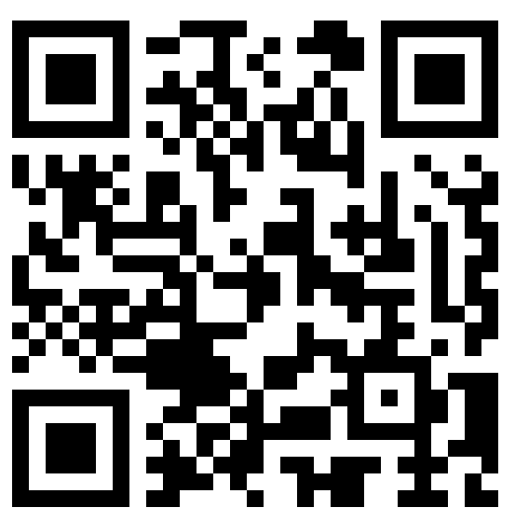
Session Survey
Thank you!
Your feedback is important. Please scan the QR code below to rate this session.
https://www.surveymonkey.com/r/K9J7DZ9

Slide 29
Appendix: Additional Discussion Questions
What would need to be true for GED Ready to be delivered successfully in your facility?
What offline capabilities would be most valuable for learners preparing for the GED test?
How do device access, connectivity, security review, rostering, and learner identity management work in your environment today?
What reporting or educator-facing tools would help you support learners more effectively?
What implementation barriers should GED Testing Service understand before designing a solution?

