Slide 1
From Local Impact to Global Mobility
What U.S. Adult Educators Can Learn from GED Pathways in Pakistan
Dr. Ghulam Ali Mallah
Notes:
Welcome and thank the audience.
Briefly introduce yourself and IBCC Frame the session: “Today I want to take you beyond the U.S. and show how GED is transforming lives globally—and what that means for your work here at home.

Slide 2
What if the GED was a global passport to opportunity?
Not just a second chance, but a scalable pathway

Slide 3
The Global GED Opportunity
GED recognized in 120+ countries
Alternative pathway for non-traditional learners
Increasing demand for flexible education models
The GED offers a flexible and recognized pathway
Notes:
GED is already international, but has potential to be more leveraged
Many learners worldwide cannot access traditional schooling
This mirrors challenges seen in U.S. adult education populations

Slide 4
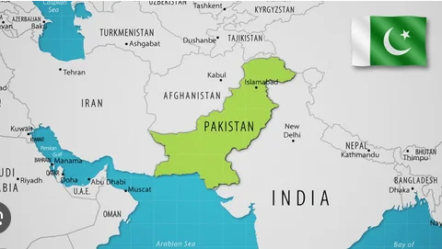
Introducing Pakistan
Population approximately 241 million, one of the most populous countries in the world.
Large youth population.
High demand for higher education.
Gaps in traditional education pathways.
Notes:
Provide context: why Pakistan matters as a case study
Many students face disruption, mobility issues, or non-linear education paths

Slide 5

Role of IBCC
Serves as the national coordinating body for secondary and higher secondary education in Pakistan.
Functioning under the Ministry of Federal Education and Professional Training (MoFE&PT).
Committed to ensuring standardized academic evaluation, examination policies, and assessment frameworks across all examination boards in the country.
IBCC advances collaboration among local and global education stakeholders, promotes curricular and co-curricular activities, and supports professional development for educators and examiners.
Notes:
IBCC ensures quality, consistency, and recognition
Without this regulatory role, alternative credentials lack trust
Key idea: recognition = opportunity

Slide 6
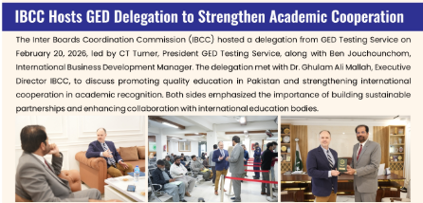
GED and IBCC: A Structured Pathway
The GED is a registered Qualification Awarding Body (QAB) with the IBCC.
A QAB is accepted as meeting the established standards of quality and compliance in Pakistan.
Enables university eligibility.
Alignment with national policy.
Notes:
GED is not operating “outside” the system, it is integrated into it
This is why it becomes powerful and credible
Stress importance of policy alignment

Slide 7
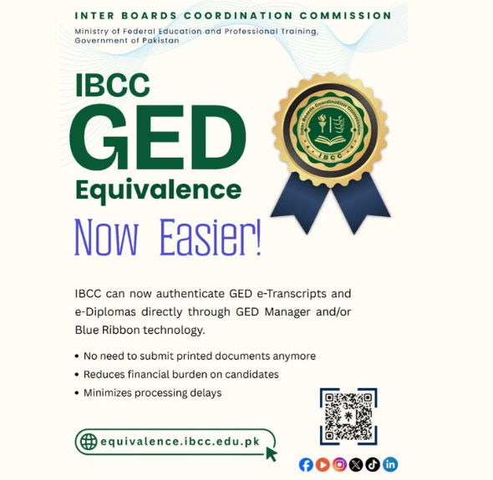
Student Impact
Alternative pathway to higher education.
Supporting students unable to complete traditional schooling.
Issue local Pakistan equivalency.
Opens access to local and global universities.
Clear progression pathway.
Strong institutional alignment.
Notes:
Share narrative: GED gives “second chances” globally

Slide 8
Reframing Student Opportunities
GED not only changes lives locally, it also unlocks opportunity globally.
Growing global demand.
More regulatory partnerships.
Increasing relevance in digital & mobile learning environments.
Notes:
Strong reframing moment
Encourage audience to rethink how they describe GED
Language matters for perception and policy

Slide 9

The Impact of the GED in Pakistan

Slide 10


Session Survey
Your feedback is important. Please scan the QR code below to rate this session.

