Slide 1
Empowerment through Care:
The Foundations of Trauma-Informed Instruction in Adult Education

Slide 2


Alex Wright-Ropp
SpEd Inclusion and Trauma Consultant
Hardt2Heart Adult Education Services LLC

Slide 3

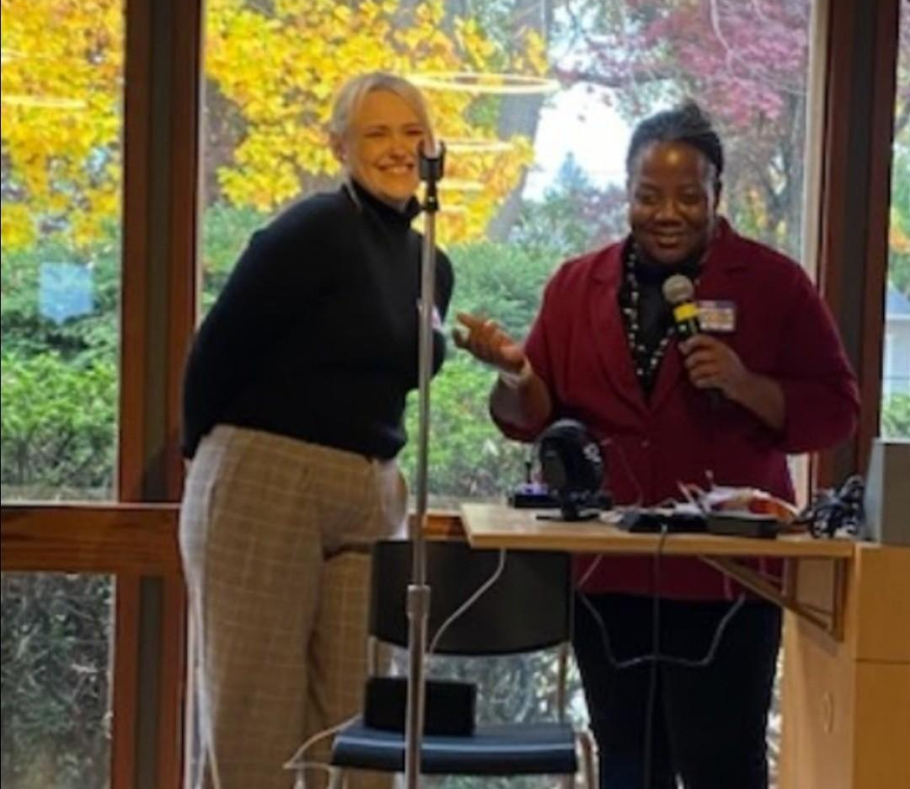
Egalitarian Education
Relationship-oriented work leads to mutual exchanges of knowledge
Everyone has the capacity to be a learner and an educator
Kellie Blair Hardt
Demonstrating Andragogy and the principles of Adult Learning Theory

Slide 4
“If it’s blue, it’s for you!”
Session Overview
Getting on the same page…
Realize
Recognize
Respond
Resist
What comes to your mind when I say “trauma”?

Slide 5



Do not edit
How to change the design
What comes to your mind when I say "Trauma"
Presenting with animations, GIFs or speaker notes? Enable our Chrome extension
Notes:
📣 This is Slido interaction slide, please don't delete it.
✅ Click on 'Present with Slido' and the poll will launch automatically when you get to this slide.

Slide 6
Realize
the prevalence of trauma

Slide 7
Defining the “Trauma” in “Trauma-Informed”
The PTSD Diagnosis
The Experience Itself
Exposure* to actual or threatened death, serious injury, or sexual violation, which results in one or more of the following symptoms for longer than a month:
Re-experiencing
Avoidance
Negative cognitions
Arousal**
- The DSM 5, American Psychiatric Association
A severe form of stress that does not exist as a point on a stress continuum
- “Trauma-Informed Corrections” by Sherly P. Kubiak, Stephanie S. Covington, and Carmen Hillier
Notes:
*Exposure can mean experiencing a significant event directly, witnessing it, being made aware of it, and repeated or extreme exposure to aversive details (ex. Being repeatedly told about a loved one’s abuse)
**Arousal in a psychological context is hypo- or hyper-reactive responses that are marked by aggressive, reckless, or self distructive behavior, sleep disturbances, hypervigilance, etc.

Slide 8

Dr. Resmaa Menakem
Psychotherapist
“Trauma is the body’s protective response to an event – or series of events – that it perceives as potentially dangerous.”

Slide 9



The HPA Axis
Amygdala: The Security System
Uses the 5 senses to categorize information (positive stimulus, negative stimulus, threat, etc.)
Overrides the Prefrontal Cortex to initiate emotional reaction
Can engage threat response system
Prefrontal Cortex: The Command Center
Analyzes information to produce our behaviour and thoughts
Sends and retrieves information from memory storage
Directs emotions and reactions
Hippocampus: The Data Storage
Information storage, maintenance, and release
(can be biochemical signals to bodily systems, memory retention and recall, etc.)
Notes:
Make it connect to math for the example!!

Slide 10
Everyone has potential for trauma responses
70% of Adults…
90% of Adults…
Internationally, over 70% of adult respondents report having experienced at least 1 potentially traumatic event, 1/3 having experienced 4 or more
yet,
In the United States, approximately 90% of adults report having experienced at least 1 potentially traumatic event
21% of Men…
61% of Women
One study found that in the United States, approximately 21% of men in jail and prison were found to have PTSD*
and,
Another study finding that 61% of women in prison and 13% of women in jails were found to have PTSD
47% of Immigrants
Relational Learning
Adult ESL learners reported improved learning in response to educators who were closely attentive to non-verbal communication and attentive to interpreting their learner English
The prevalence rates of PTSD among immigrants in the United States are up to 47%
therefore,
Notes:
* With research also showing that significantly more people suffer from trauma-related symptoms than the number of people who are diagnosed with PTSD

Slide 11
Recognize
when a trauma response is affecting you or others

Slide 12
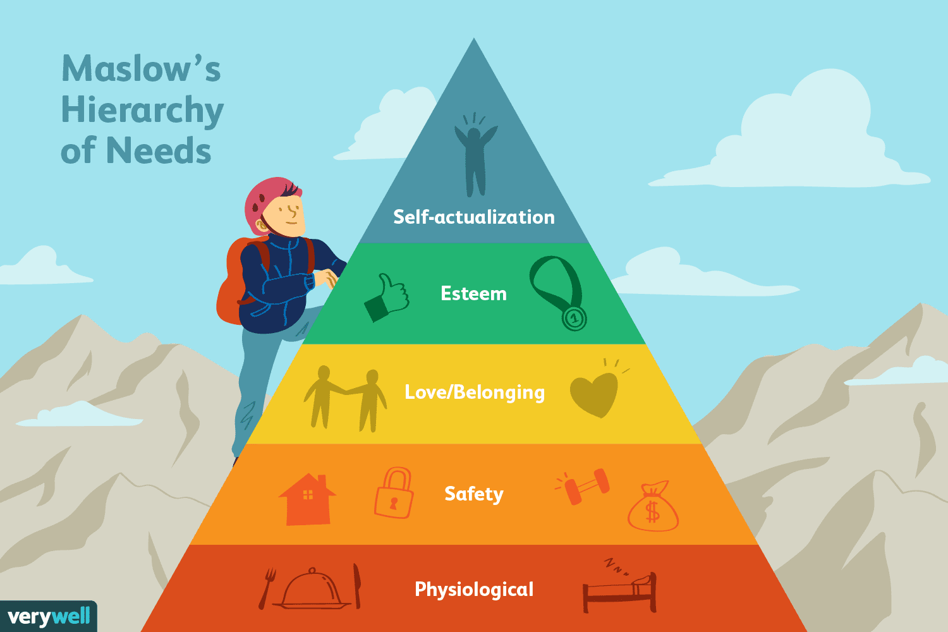
Maslow’s Hierarchy of Needs

Slide 13

The Past Matters
What we experience teaches us
What we learn shapes us
What we do directs how others perceive us
How others perceive us will decide what we experience

Slide 14
Common Triggers
When we’re too tired
When we’re too hungry
When vulnerability is too hard
Exhaustion
Hunger
Lack of Trust
When we have to risk ourselves
When we must adapt to sudden change
When we face external challenges
The Unknown
The Unexpected
The Uncontrolled

Slide 15
Common Trauma Responses
Hyperarousal
High anxiety
Exaggerated startle reflexes
Restlessness
Digestive problems
Sleeplessness
Rage or aggression
Hypoarousal
Depression
Prolonged exhaustion
Dissociation
Numbness
Apathy
Avoidance
It will happen
The disruptive and distracting vs the learner who avoids and disappears
Notes:
**the learner that would shout things like “this is dumb” or “that makes no sense” or “I don’t even know what this means” is demonstrating a hyperaroused response to the stress that academics caused him whereas my learner who started attending less and less, would sit silently for long periods of time without expressing his need for help, and his aloof shrugs or quiet “I dunno” when I would check in (he demonstrates a hypoaroused response to the stress that academics caused him)

Slide 16
Respond
by reducing pedagogical habits to minimize power imbalances and empower learners

Slide 17
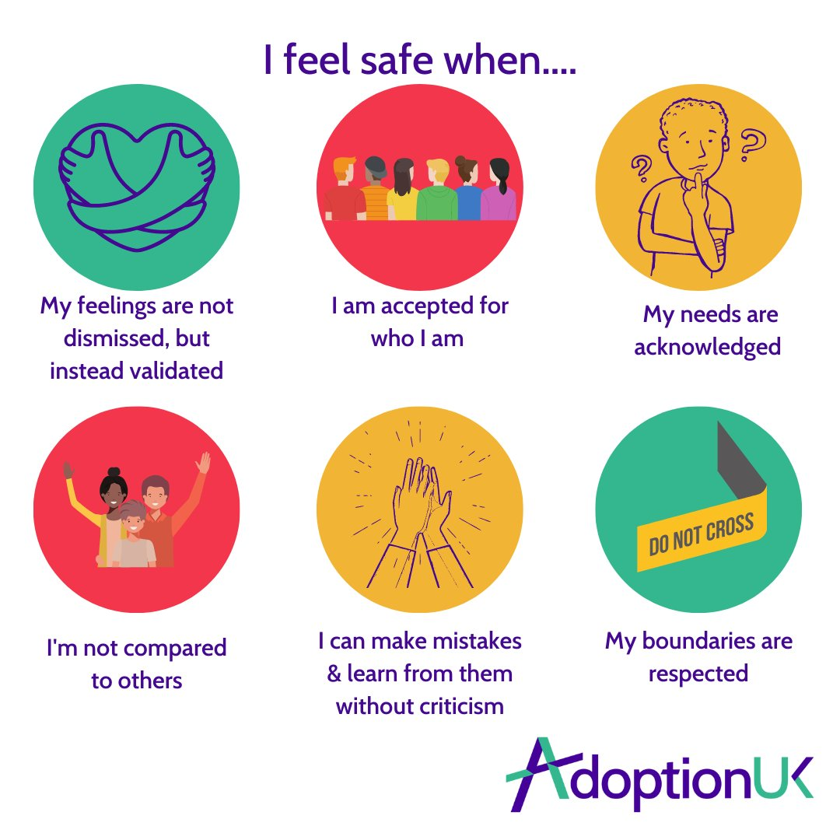
5 Key Principles of Trauma-Informed Instruction
Safety
Physical and Psychological Safety
Have I created a welcoming environment for my learners?
Do I manage classroom culture in a way that includes and protects everyone?
Is my attitude and behavior consistent?
Do I proactively check in with learners who appear anxious or uncomfortable?
Notes:
For safety: the learner could be a middle aged man who is struggling to balance his work shift and the timing of services, could attendance be more flexible for him? Could you prepare some take-home content for missed teaching for him or any other learners who may be late, need to leave early, etc.? Timing and location could be factors especially influential on women. They may not feel that they can travel to and from their class safely due to location or timing (and available modes of transportation)
For trust: the key to building trust is honesty, even when it can be uncomfortable for you. Your learners are adults and expect to be treated as such. This means building in meaningful opportunities for them to have control over their education. This is actually one of the easiest principles to address but also one of the hardest to maintain. As an educator, you are expected to build choices into your instruction for learners so they feel empowered to pursue their own learning partially or fully independently. Alongside building choices or creative opportunities into instruction, you will also need to maintain self awareness about why you behave or conduct your classes in certain ways. You should always be prepared for a learner to question a source of information, the structure of a concept or program, your phrasing or instructional practices, etc. “I don’t know” is a perfectly valid answer! However, it always needs to be followed by some suggestion of where else they could seek the answer OR a commitment from you to find the answer and provide it later. This response style is a habit that takes time to develop, and therefore is often hard to maintain initially. Practice truly is what makes perfect here! If you catch yourself responding in a way that you later (or immediately) recognize as unhelpful or harmful, it is usually a good idea to speak to the learner(s) impacted. You can apologize for the impact your response had, while also explaining why you responded the way you did. This can be uncomfortable, but please take comfort in remembering that regardless of whether that learner accepts your apology and explanation, your reasons for not being perfect are valid. You are growing and learning. This uncomfortable moment will pass and you will be better equipped for the future as a result of it.

Slide 18

5 Key Principles of Trauma-Informed Instruction
Trust
Learner and educator’s ability to trust
Do I understand and explain my methods? My reasoning?
Am I honest and upfront with learners? My peers?
Have I followed through on my word consistently? Am I reliable?
Do I respect the boundaries of others?
Notes:
For safety: the learner could be a middle aged man who is struggling to balance his work shift and the timing of services, could attendance be more flexible for him? Could you prepare some take-home content for missed teaching for him or any other learners who may be late, need to leave early, etc.? Timing and location could be factors especially influential on women. They may not feel that they can travel to and from their class safely due to location or timing (and available modes of transportation)
For trust: the key to building trust is honesty, even when it can be uncomfortable for you. Your learners are adults and expect to be treated as such. This means building in meaningful opportunities for them to have control over their education. This is actually one of the easiest principles to address but also one of the hardest to maintain. As an educator, you are expected to build choices into your instruction for learners so they feel empowered to pursue their own learning partially or fully independently. Alongside building choices or creative opportunities into instruction, you will also need to maintain self awareness about why you behave or conduct your classes in certain ways. You should always be prepared for a learner to question a source of information, the structure of a concept or program, your phrasing or instructional practices, etc. “I don’t know” is a perfectly valid answer! However, it always needs to be followed by some suggestion of where else they could seek the answer OR a commitment from you to find the answer and provide it later. This response style is a habit that takes time to develop, and therefore is often hard to maintain initially. Practice truly is what makes perfect here! If you catch yourself responding in a way that you later (or immediately) recognize as unhelpful or harmful, it is usually a good idea to speak to the learner(s) impacted. You can apologize for the impact your response had, while also explaining why you responded the way you did. This can be uncomfortable, but please take comfort in remembering that regardless of whether that learner accepts your apology and explanation, your reasons for not being perfect are valid. You are growing and learning. This uncomfortable moment will pass and you will be better equipped for the future as a result of it.

Slide 19

5 Key Principles of Trauma-Informed Instruction
Collaboration and Peer Support
Reducing Power Imbalances
Do I actively embrace and encourage learners’ curiosity?
Do I create opportunities for self-expression in class?
Do learners share and accept knowledge from each other in class?
Can learners share knowledge with with me?
Notes:
This may feel repetitive but these are very individual components. The previous slide of safety and trust heavily rely on your day-to-day interactions and reactions for the most part. As we discussed, there are ways to be proactive despite them being primarily reactive components. However, with Collaboration and Voice, the questions become more complicated and require more proactive effort. You have to consider how you behave as an educator and whether that behavior welcomes learners in, or shuts them out. As adults, we typically accept and adapt to systems as we are initially presented them. As an educator, your job is to build systems and habits that encourage your learners to step beyond this. When learners feel a sense of control and RESPONSIBILITY for their education, and that of others, they are significantly more likely to engage in a meaningful way. I don’t know about you, but I am a lot more inclined to absorb information when I’m feeling respected as an individual. I also struggle with engaging my peers due to trauma-informed self-esteem issues, so I am highly unlikely to engage with peers without educator facilitation. Yet, we know that discussions of understandings, asking questions without judgement, and creative/practical application of our content builds the best chances for information retention. We’re not just passing tests, we’re building skills. How are you not just telling your learners this, but showing this?

Slide 20

5 Key Principles of Trauma-Informed Instruction
Voice and Choice
Building Choices
Does the learner have control of how information is presented to them?
Does the learner have control of how they demonstrate their understanding?
Does the learner feel seen and represented as an individual?
Do I encourage learners to self-advocate? Do I facilitate opportunities for them to do so?
Notes:
This may feel repetitive but these are very individual components. The previous slide of safety and trust heavily rely on your day-to-day interactions and reactions for the most part. As we discussed, there are ways to be proactive despite them being primarily reactive components. However, with Collaboration and Voice, the questions become more complicated and require more proactive effort. You have to consider how you behave as an educator and whether that behavior welcomes learners in, or shuts them out. As adults, we typically accept and adapt to systems as we are initially presented them. As an educator, your job is to build systems and habits that encourage your learners to step beyond this. When learners feel a sense of control and RESPONSIBILITY for their education, and that of others, they are significantly more likely to engage in a meaningful way. I don’t know about you, but I am a lot more inclined to absorb information when I’m feeling respected as an individual. I also struggle with engaging my peers due to trauma-informed self-esteem issues, so I am highly unlikely to engage with peers without educator facilitation. Yet, we know that discussions of understandings, asking questions without judgement, and creative/practical application of our content builds the best chances for information retention. We’re not just passing tests, we’re building skills. How are you not just telling your learners this, but showing this?

Slide 21
Andragogy and The Principles of Adult Learning Theory
Experience
Self Concept
Readiness to Learn
Problem-Centered
Intrinsic Motivation
Why & How
Notes:
I referred to my mutual mentor’s work that inspired me previously. Dr. Hardt by no means has ownership over these concepts, but my understanding of them was built and continues to be influenced by her enthusiastic and holistic coverage of these concepts. Each of these concepts applies to what we’ve discussed in our trauma-informed principles. These concepts boil down to a few simple practices: creating opportunities for learners to actively participate in and control their education, proactively considering how we build our lessons and design our classrooms, offices, etc., so that people are welcomed and represented, and ensuring that we connect to each learner enough to always see the humanity in each other.
HYPERLINK: each principle needs to be hyperlinked with a description of how it connects to the trauma informed practices with examples

Slide 22
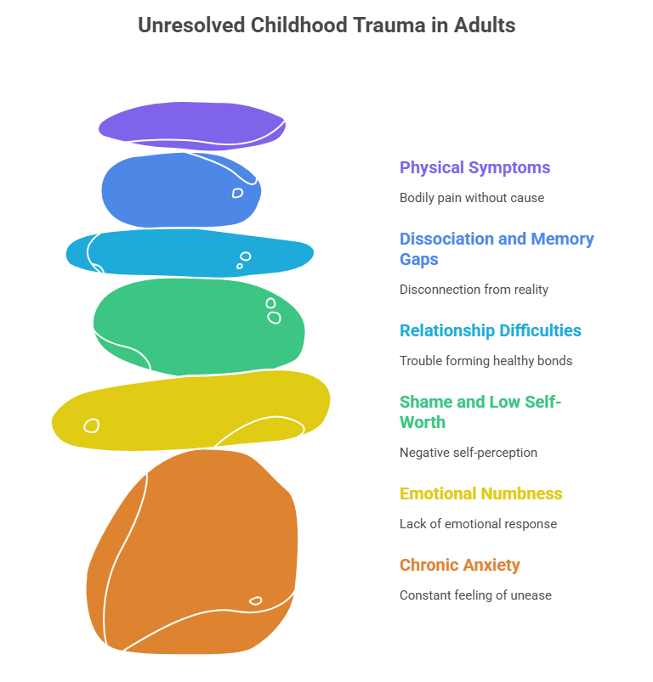
5 Key Principles of Trauma-Informed Instruction
Awareness
Recognition of Humanity
Do you recognize how you show up?
Do you proactively address learners and their needs?
Do you manage your classroom in a way that supports learners individually AND as a community?
Do you set boundaries for your well-being and that of the learner?
Do you have support systems to manage your individual needs?

Slide 23
Resist
re-traumatization of others and vicarious trauma within yourself

Slide 24
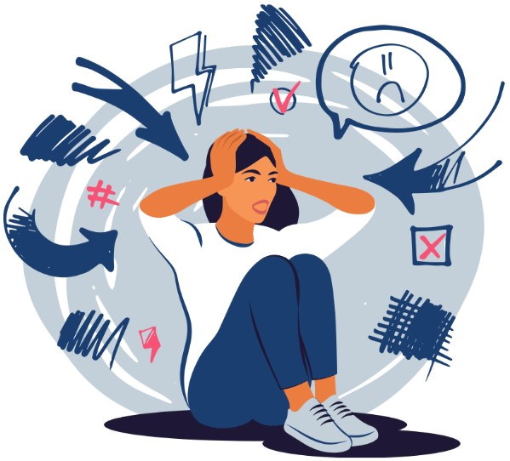

Vicarious Trauma
What to look for:
Feeling a higher sense of responsibility or guilt for a situation or learner
Ruminating on traumatic events you’ve learned about
Avoidance of engagement with triggering learner (for fear of being triggered)
Increased difficulty maintaining professional boundaries or increased feelings of resentment towards your job

Slide 25
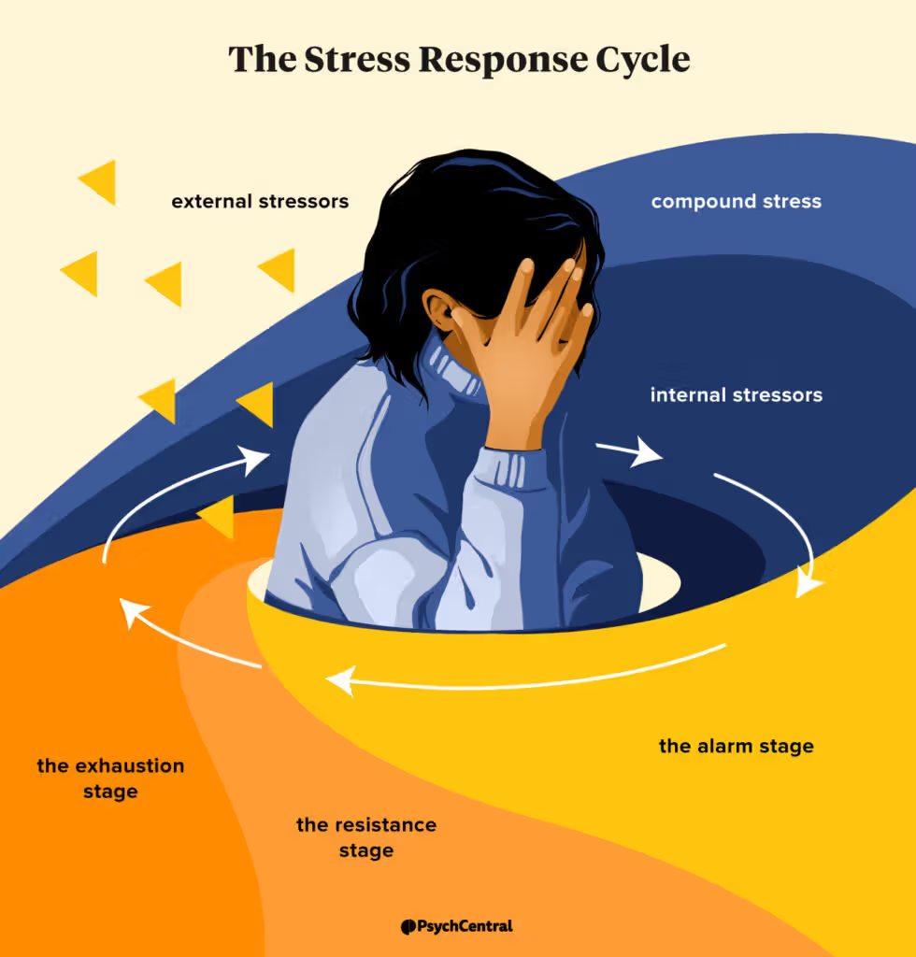
Catching the Cycle
What to look for in a cycle of trauma
Fight, flight, freeze, and fawn responses in non-dangerous situations
Persistent anxiety, depression, anger, or irritability
Difficulty thinking and/or focusing
Feeling that your emotions are controlling your actions and/or reactions (instead of having a conscious and intentional control)

Slide 26
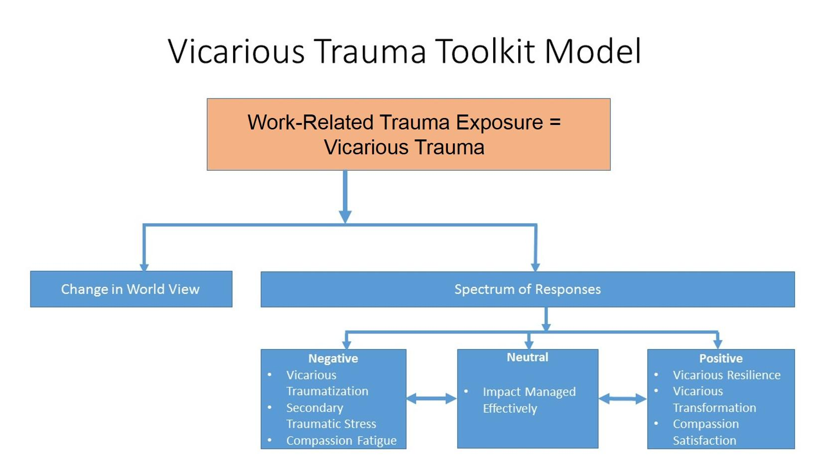
Breaking the Cycle
Thank the trauma response
  Your brain is trying to protect you. Trauma programs our brains in unhealthy ways, but the intention to help is always there. It is a part of you that needs comfort, not judgement
Trust yourself
  Recognize your self-worth and that, again, your brain is only trying to help you. Trust that you have the tools available to persevere through this moment and heal your trauma over time
Transform what doesn’t belong
  Whatever isn’t helpful is still designed to solve a problem. Patiently work with yourself to transform the trauma response into an actually helpful response
Take back your power
  As you heal and transform your trauma, celebrate yourself for the hard work and continue to encourage your continued resilience instead of judging your struggle
Respond → Learn → Prevent

Slide 27
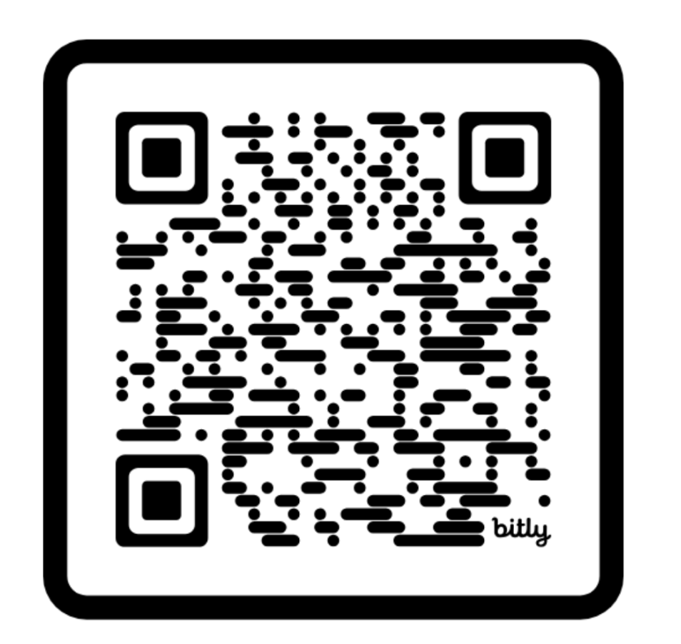
Your feedback is important!
Scan me to rate this session!
Thank you!
Questions?
Reach out directly at: alexkwrightropp@gmail.com

Slide 28
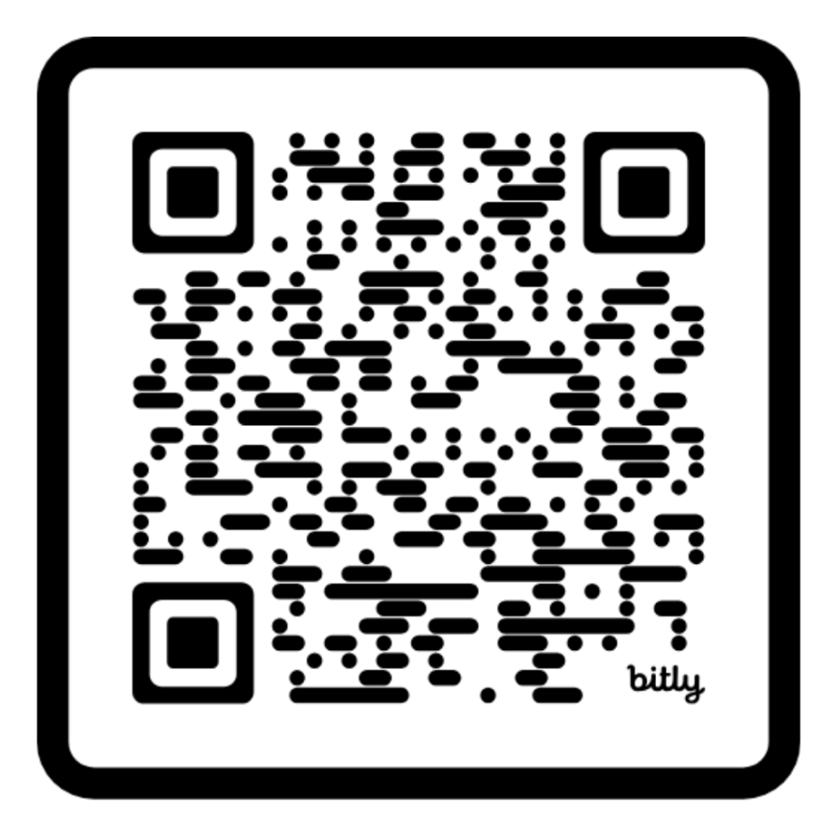
Your feedback is important!
Scan me to rate this session!
Thank you!
Questions?
Reach out directly at: alexkwrightropp@gmail.com

Slide 29
Additional Resources
Building Self-Awareness
Setting Boundaries
GED Playbook
Self-awareness requires looking in the mirror. Journaling is a common and scientifically supported method!
It’s important for our own well-being and others that we set boundaries. This is for everyone!
A guide to the fundamentals of a GED program. This a starting point for folks running a GED program and instructors!
Learning About Others
Andragogy/ADL
GED Educator Handbook
No easy answers here. There are countless resources for learning about a given identity or community. Just a google search away!
This is just a place to start researching on your own. Reach out to Hardt2Heart Adult Education Services for trainings!
A great resource in general, but especially for educators new to GED! This will guide what to focus on and provides helpful resources.
Communicate with Adult Learners
Strengths-Based Practices
“Student” Handbook
This provides guidance for adult learners in GED education programs, self-paced learners, and advocates of GED learners. Helpful resources, fundamentals of GED, and more!
How do you build “relationships” with adult learners as an educator? (relational instruction)
Note: This resource specifies indigenous peoples as the target population, but all this content applies to most people with marginalized identities

