Slide 1
Driving Student Success:
Leading Meaningful Change in GED Preparation Programs
Phyllis Kelley

Slide 2
Change
is
inevitable!
Effective Change is intentional!
Notes:
When the GED Classroom Stood Still: A Story About Embracing Change in Adult Education
For more than 30 years, Smith’s Station Adult Learning Center was a respected and trusted resource in its community. The program provided literacy instruction, Adult Basic Education, GED preparation, English language learning, and workforce readiness services. Thousands of adult learners walked through its doors and left with stronger skills, a GED credential, and renewed opportunities for employment, college, and career advancement.
The program had a dedicated staff, experienced instructors, and a strong reputation. For decades, its traditional classroom model worked well.
But the world around the program began to change.
Adult learners were balancing work schedules, family responsibilities, transportation challenges, and increasing technology demands. Students began asking:
“Do you offer online or hybrid GED classes?”
“Can I study on my phone after work?”
“Can I access lessons from home?”
“Will this program help me build digital workplace skills?”
Employers were also changing their expectations. Digital literacy, online communication, and technology skills became essential in nearly every career field. Workforce partners encouraged adult education programs to become more flexible and responsive to learner needs.
Some instructors and staff recognized these changes and suggested new approaches:
Offering hybrid and virtual GED classes
Incorporating digital literacy into instruction
Using online assessment and practice tools
Expanding partnerships with workforce agencies and employers
Using data to identify barriers and improve student outcomes
One instructor, Ms. Lopez, even began experimenting with new strategies herself. She shared instructional videos, emailed assignments, and hosted virtual study sessions. Her students remained engaged and appreciated the flexibility. However, her efforts remained isolated and were not supported by a larger program-wide strategy.
Leadership remained cautious.
The common response became:
“This is how we’ve always done it.”
As months turned into years, the consequences became clear.
Adult learners increasingly chose programs that offered flexible schedules, online options, and technology-enhanced learning. Enrollment steadily declined. Attendance rates dropped. Student outcomes began to suffer. Funding decreased as participation numbers fell.
Within a few years, enrollment had fallen significantly, forcing the program to reduce evening classes, eliminate staff positions, and limit services. The very students who needed flexible learning opportunities the most found fewer options available.
Meanwhile, another adult education program in the region chose a different path.
Rather than resisting change, they listened to learners and employers. They invested in professional development, implemented hybrid and mobile learning options, strengthened workforce partnerships, and used data to guide decision-making. They were not perfect, but they were willing to adapt.
As a result, enrollment increased, student engagement improved, and more learners earned their GED and achieved career goals. The program became recognized as a model for innovation and student success.
The Lesson for Adult Education
The story of Smith’s Station is not really about technology, online learning, or funding.
It is about mindset.
In Adult Education, change is not a disruption to avoid—it is a responsibility. Our learners' lives, careers, and educational needs continue to evolve. If we remain committed to old methods simply because they are familiar, we risk becoming less effective in serving those who depend on us.
Change does not mean abandoning what works. It means building upon our strengths while adapting to new realities.
When we create urgency, work collaboratively, invest in innovation, and focus on learner needs, we strengthen our programs and expand opportunities for the adults we serve.
The programs that thrive are not necessarily the ones with the most resources—they are the ones willing to learn, adapt, and grow.
And ultimately, that is what Adult Education is all about: helping people transform their lives by embracing the possibilities of change

Slide 3
1
3
Introduction to Change Management
Practical Tools and Strategies
2
4
Four Principles of Change
Interactive Q&A Session

Slide 4

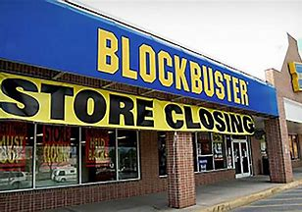
The inevitability of change in adult education and its impact on instruction, enrollment, funding, and student outcomes. Recognizing the role of mindset in navigating change effectively.
What happens when change is not embraced?
Blackberry
Blockbuster
Notes:
“Too Established to Change?”
Who remembers Blackberry? This brand was once the industry leader
What about blockbuster – Growing up we could not wait to go to blockbuster to rent movies or video gams for the weekend!
By the time business leaders were read to embrace change it was too late – Apple took over Streaming platforms offer the convenience of accessing movies from your living room or mobile device.
Moral
Change does not pause for comfort or tradition. In adult education, past success does not guarantee future relevance. Our learners’ realities shift. Workforce expectations evolve. Funding priorities adjust.
Programs that cultivate a growth mindset—one that sees change as an opportunity rather than a disruption—remain strong and sustainable.
In GED preparation classrooms, the question is not whether change will happen. The question is whether we will lead it—or be forced to react to it.

Slide 5
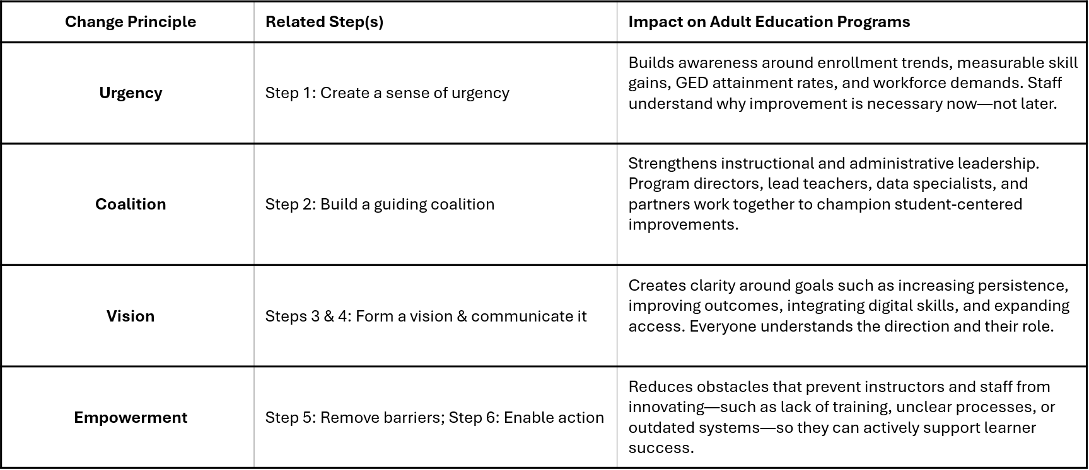
Four Change Principles in Adult Education (GED Prep Classrooms)
Notes:
In GED preparation and adult education programs, successful change does not happen by accident. It requires intentional leadership and alignment around key principles.
Urgency - might come from declining enrollment, performance benchmarks, funding requirements, or shifting workforce expectations. When staff clearly understand the data and the needs of adult learners, they recognize that change is not optional—it is necessary to improve student outcomes.
Coalition means change cannot rest on one director or one enthusiastic instructor. It requires a team: administrators, teachers, support staff, data managers, and community partners. When influential leaders model commitment to improvement, others follow.
Vision provides direction. In adult education, that vision might focus on increasing GED attainment rates, expanding hybrid instruction, improving measurable skill gains, or strengthening career pathways. When the vision is clearly communicated, instructors understand how their classroom practices connect to broader program goals.
Empowerment ensures staff have the tools and authority to act. This may include professional development in digital instruction, streamlined data systems, flexible scheduling policies, or removing bureaucratic barriers that slow innovation. When barriers are removed, instructors feel confident implementing new strategies that benefit learners.
When These Principles Work Together
Urgency creates momentum and motivates action.
A strong coalition sustains leadership and accountability.
A shared vision reduces confusion and aligns efforts.
Empowerment increases engagement, ownership, and innovation.
When adult education programs apply these principles together, they are not just responding to one immediate challenge. They are building a culture of continuous improvement—one that allows GED prep classrooms to evolve, adapt, and consistently meet the needs of adult learners.

Slide 6
Create A Sense of Urgency
It Starts in the GED Classroom
Do you see a major opportunity to improve outcomes for adult learners?
Can you clearly identify, articulate, and communicate that opportunity to staff and students?
Can you connect external changes—like workforce demands, digital skills, funding requirements, or community needs—to the strengths of your program?
What are the stakes if you succeed?
What are the consequences if you do not act?
Notes:
Do you see a major opportunity to improve outcomes for adult learners?
(Can we increase GED attainment, persistence, measurable skill gains, or workforce transitions?)
Can you clearly identify, articulate, and communicate that opportunity to staff and students?
Can you connect external changes—like workforce demands, digital skills, funding requirements, or community needs—to the strengths of your program?
What are the stakes if you succeed?
(More graduates, stronger funding, greater community impact.)
What are the consequences if you do not act?
(Declining enrollment, reduced funding, missed opportunities for learners.)
Step 1: Establishing a Sense of Urgency in Adult Education
“Change begins when people are motivated to move.”
In GED preparation programs, urgency means helping instructors, staff, and even students recognize that maintaining the status quo is not enough.
Urgency may stem from:
Declining enrollment
Low post-testing rates
Gaps in measurable skill gains (missed opportunities to post-test due to students stopping out)
GED completion rates below target
Workforce shifts requiring stronger digital literacy
Changes in state or federal performance expectations
Creating urgency is about building the right climate for improvement—appealing to both the head and the heart.
Appeal to the Head (Data & Facts)
Share clear, concrete data:
“Our post-test rate dropped 12% this quarter.”
“Only 55% of our students are persisting beyond 40 hours.”
“Local employers are requesting digital skills that our curriculum doesn’t currently emphasize.”
When staff see the data, they understand why action is necessary.
Appeal to the Heart (Mission & Purpose)
Data alone does not inspire change.
Remind the team:
Each percentage point represents real adult learners.
Every delayed improvement means someone may not earn their GED this year.
Our work changes families (generations), careers, and communities.
When staff reconnect with purpose, urgency becomes personal—not just procedural.
Paint the Stakes Clearly
Use a “burning platform” approach adapted for adult education:
“If we don’t improve student persistence, we risk losing funding tied to performance.”
“If we don’t modernize instruction, learners will enroll in programs that offer more flexibility.”
“If we act now, we could increase GED attainment by 15% this year.”
Clarity about consequences builds momentum.
Practical Method
Conduct a program-level SWOT analysis with your team: (ask the group to share SWOT examples for there classrooms or programs)
Strengths: Dedicated instructors, strong community reputation, supportive partnerships
Weaknesses: Limited hybrid options, inconsistent data tracking
Opportunities: Workforce alignment, digital learning expansion
Threats: Funding changes, competing programs, declining enrollment
This process makes the need for change visible and shared.
Key Takeaway
Without a shared sense of urgency, improvement efforts stall.
With urgency:
Staff feel motivated
Leadership gains traction
Conversations shift from “Why change?” to “How do we improve?”
In adult education, urgency is not about pressure—it is about responsibility. Our learners cannot wait for us to get comfortable.

Slide 7
Activity :
The Change Challenge
Imagine you program is experiencing a challenge!
Notes:
Interactive Activity: "The Change Challenge"
Time Required
10–15 minutes
Purpose
Help participants identify a real challenge in their GED or Adult Education program and apply Kotter's change principles to it.
Instructions
Step 1: Form Small Groups (2 minutes)
Ask participants to form groups of 3–5 people.
Step 2: Present the Scenario (1 minute)
Display the prompt:
"Imagine your program is experiencing one of the following challenges:"
Declining enrollment
Low retention/persistence
Low post-testing rates
Poor attendance
Difficulty integrating technology
Limited workforce partnerships
Each group selects one challenge.
Step 3: Complete the Change Challenge Worksheet (5 minutes)
Provide a handout or slide with the following questions:
Question
Group Response
What data creates urgency for this issue?
Who should be on your guiding coalition?
What would your vision statement be?
What barriers must be removed?
What quick win could be achieved within 60 days?
Step 4: Rapid Report-Out (5 minutes)
Each group has 30–60 seconds to share:
Their challenge
Their vision
Their quick win
Record responses on a flip chart or slide.

Slide 8

Build a Guiding Coalition
Trust
Representation
Best Interests of Learners
Notes:
Step 2: Forming a Powerful Guiding Coalition in Adult Education “Change is not a solo effort.”
In GED preparation and adult education programs, meaningful change cannot be led by one person alone. Successful improvement requires a guiding coalition—a group of trusted, influential individuals who can lead, support, and sustain change efforts.
This coalition should include representatives from across the program, such as:
Program directors or coordinators
Lead instructors and veteran teachers
Intake, advising, or support staff
Data or compliance specialists
Workforce or community partners
Former students or current adult learners, when appropriate
This group should represent the voices of the entire program and ensure decisions reflect classroom realities as well as program goals. The goal is not hierarchy, but influence and credibility.
People are more likely to embrace change when they see it modeled by peers they respect. In adult education, instructors and staff must trust that the change:
Reflects classroom realities
Represents their voices
Is truly focused on improving outcomes for adult learners
A coalition built on trust becomes the face of the change—visible, approachable, and consistent.
Representation Is Key
A strong guiding coalition reflects the diversity of the program:
Different roles and levels of responsibility, different instructional levels, backgrounds, skills, and perspectives.
This strengthens problem-solving and helps the coalition connect with a wide range of staff and students.
Most importantly, coalition members must be viewed as people who:
Represent others fairly
Communicate honestly
Have the program’s and learners’ best interests in mind
When trust is present, people are more willing to follow.
Best Interest of Learners
At every step, the coalition must keep the best interests of adult learners at the center:
Will this improve access, persistence, or GED attainment?
Will it support working adults, parents, or learners with barriers?
Will it strengthen pathways to employment or postsecondary education?
When staff believe the coalition is advocating for learners—not just compliance—they are more willing to engage and support change.
Key Takeaway
A guiding coalition in adult education:
Builds credibility and momentum
Reduces resistance and fear
Creates shared ownership of improvement
When trusted voices lead together, change feels less imposed—and more like a collective commitment to better serve adult learners.

Slide 9

Create a Strategic Vision
Clear
Vibrant
Motivating
Desired Destination
Elevator Pitch
Notes:
Step 3: Create a Strategic Vision:
Clear
A focused direction that defines what success looks like in your GED program.
Vibrant
Inspiring and future-oriented—energizing staff and learners.
Motivating
Connects daily work to meaningful student outcomes.
Desired Destination
A specific picture of where the program is headed and what it aims to achieve.
Elevator Pitch - Has anyone here had the opportunity to give an elevator speech for your GED/AE Program? What did you say/focus on?
A short, compelling statement (30–60 seconds) that clearly communicates the vision to staff, partners, and learners.
“If you can’t describe the change in five minutes or less—and see understanding and interest—you’re not finished.”
In GED preparation and adult education programs, a strong vision must be clear, practical, and inspiring. It should answer two questions:
Where are we going?
Why does it matter for our adult learners?
Your vision should describe what success looks like after the change and connect directly to student outcomes.
Example:
“We envision a GED program where every adult learner has access to flexible instruction, builds strong digital skills, and successfully transitions to employment or postsecondary education.”
Make the Vision SMART
A powerful vision is not vague—it is measurable and achievable.
For example:
Increase GED attainment by 15% within one year
Improve post-testing rates to 75%
Expand hybrid instruction to serve 40% of enrolled learners
Increase measurable skill gains by 10%
When the destination is specific, staff can align their daily work to it.

Slide 10
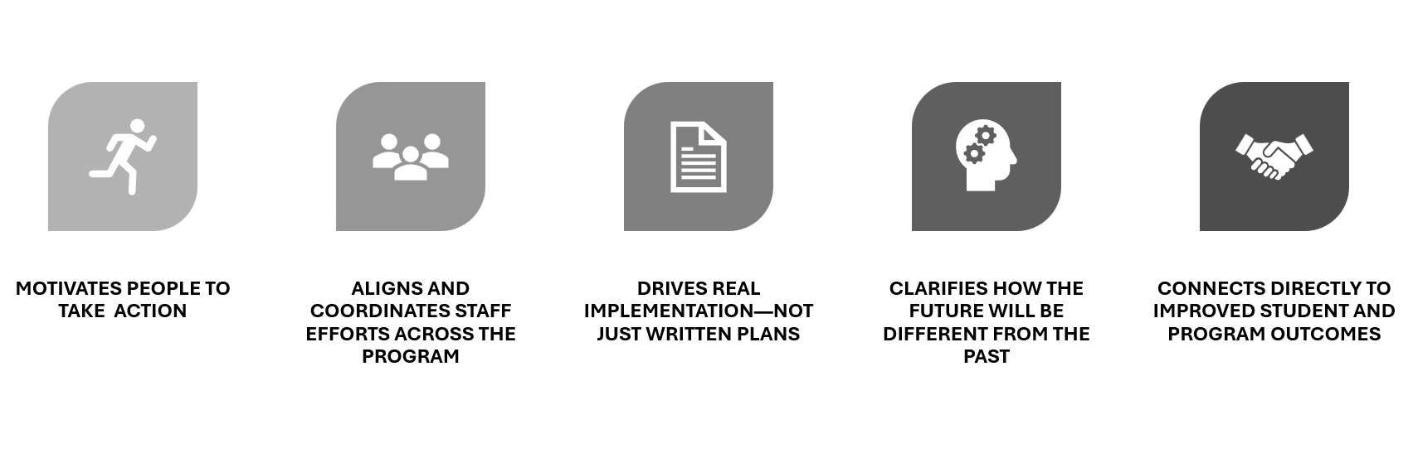
What Makes a Great Strategic Vision?
Notes:
Build the Vision (3 minutes)
Ask each table to fill in one answer for each category.
WHO WHAT HOW WHY
Adult learners Earn a GED Innovative instruction Transform their lives
Parents Gain workforce skills Flexible learning Obtain family-sustaining careers
English learners Build confidence Technology and support Strengthen their communities
Step 3: The 25-Word Challenge (3 minutes)
Challenge each group:
Using your four answers, create a vision statement in 25 words or fewer.
Example:
"We empower adult learners to earn their GED through innovative, flexible instruction so they can achieve meaningful careers and stronger futures."

Slide 11

Communicate the Vision
Notes:
A strong strategic vision in GED preparation programs is more than a statement on paper. It is a tool that guides decisions, shapes instruction, and drives measurable improvement.
1. Motivates People to Take Action
A great vision inspires instructors, staff, and partners to move beyond routine practice.
For example:
Increasing GED attainment rates
Expanding flexible learning options
Improving measurable skill gains
Strengthening workforce transitions
When staff understand how their daily work contributes to a meaningful goal, engagement increases.
2. Aligns and Coordinates Efforts
Without a clear vision, different parts of the program may move in different directions.
A strong vision ensures:
Instructors align lesson planning with program goals
Data tracking supports targeted improvements
Support services reinforce student persistence
Leadership decisions reflect shared priorities
Alignment reduces confusion and strengthens teamwork.
3. Drives Implementation
Strategies without vision often stall because people do not see the bigger picture.
A clear vision answers:
Why are we making this change?
How does it benefit adult learners?
What does success look like?
When the vision is understood and embraced, action follows.
4. Clarifies the Future
A strong strategic vision clearly explains:
How the GED classroom will operate differently
How learners will experience improved support
How technology, instruction, or scheduling will evolve
It paints a realistic and achievable picture of improvement—not just aspiration.
5. Ties Directly to Outcomes
In adult education, vision must connect to measurable success:
Higher GED completion rates
Improved measurable skill gains
Increased post-testing
Stronger persistence
Successful workforce or postsecondary transitions
A vision that does not connect to outcomes risks becoming abstract. A vision tied to data and student success becomes powerful.
Key Takeaway
A great strategic vision in adult education:
Inspires action
Aligns people
Clarifies direction
Connects to measurable results
When staff, instructors, and leadership share a clear picture of success, the entire GED program moves forward together with purpose and focus.
Step 4: Elevator Pitch (2 minutes)
Each group selects one spokesperson.
They have 30 seconds to present their vision as if speaking to:
A new instructor
A college president
A community partner
A legislator
Debrief
Ask:
Which vision inspired you the most?
Which was the clearest?
Could you remember it after hearing it only once?
Explain:
If people can't remember your vision, they can't follow it. Great visions are simple, memorable, and motivating.

Slide 12

Empowerment
Leaders become great, not because of their power, but because of their ability to empower others.
- John Maxwell
Notes:
Step 4– Empower Others to Act on the Vision
“Remove barriers. Unleash potential.”
In GED preparation and adult education programs, empowerment happens after urgency is established, a guiding coalition is formed, and the vision has been clearly communicated.
Now the focus shifts from talking about change to enabling action.
Remove Barriers to Implementation
To empower instructors and staff, identify and eliminate obstacles that prevent progress. In adult education, barriers often include:
Outdated policies that limit flexible scheduling
Limited access to digital tools or instructional technology
Inconsistent data systems
Lack of professional development
Fear of trying new instructional strategies
Low confidence in integrating technology
Heavy administrative burdens
If barriers remain in place, even motivated staff will struggle to act.
Provide Tools, Training, and Support
Empowerment is not simply encouragement—it is equipping people.
In GED classrooms, this may include:
Professional development in digital instruction
Training on data-informed teaching practices
Access to online learning platforms
Peer mentoring or instructional coaching
Clear expectations and practical implementation guides
When instructors feel prepared and supported, confidence increases.
Encourage Innovation in Teaching and Learning
Empowerment also means creating space for responsible experimentation.
Encourage:
Pilot hybrid class models
New engagement strategies
Integrated digital literacy lessons
Creative scheduling solutions
Cross-collaboration between instructors
Normalize learning from both successes and setbacks.
Address the Four Common Sources of Barriers
Barriers typically arise from:
Structural systems – policies, procedures, or scheduling constraints
Skill gaps – lack of training or confidence
Resource limitations – technology, staffing, time
Cultural resistance – fear of change or lack of trust
Effective leadership actively works to reduce these obstacles.
What Empowerment Looks Like in Adult Education
Instructors feel trusted to adjust instruction to meet learner needs.
Staff have access to data and understand how to use it.
Leadership responds quickly when barriers are identified.
Innovation is recognized and celebrated.
When empowerment is genuine, action spreads across the program—not just from leadership, but from classrooms outward.
Key Takeaway
In GED prep programs, empowerment transforms vision into daily practice.
When barriers are removed and support is strong:
Confidence grows
Initiative increases
Implementation accelerates
Student outcomes improve
Empowered educators are the driving force behind sustainable change in adult education.

Slide 13


Create Quick Wins
Notes:
In Adult Education and GED preparation programs, monitoring, observations, and reporting can sometimes feel overwhelming. However, these tools are not just compliance requirements—they are essential for improving student outcomes.
The key question is:
What is the data telling you about your program?
How many students stop out during the reportable period or POP – period of participation?
What is your retention rate?
Are students post-testing at expected intervals?
Are measurable skill gains increasing year over year?
When used intentionally, these tools guide better decisions.
1. Evaluation Tools
a. Surveys and Questionnaires
Learner feedback (entry, mid-point, and exit surveys)
Instructor self-reflection or evaluations
Employer or partner feedback (for workforce-aligned programs)
These tools provide insight into student experience and instructional effectiveness.
b. Focus Groups and Interviews
Gather deeper insights from:
GED learners
Instructors
Intake/advising staff
Community or workforce partners
Qualitative data helps explain the “why” behind performance numbers.
c. Pre- and Post-Assessments
Measure academic skill growth
Compare baseline scores to post-test results
Track readiness for GED testing
These assessments provide measurable evidence of progress.
2. Data Analysis
a. Learning Management System (LMS) or Data System Analytics
Track attendance and instructional hours
Monitor persistence
Review post-testing timelines
Identify patterns in performance
b. Outcome Tracking
GED subject pass rates
GED credential attainment
Measurable skill gains
Transitions to employment or postsecondary education
c. Key Performance Indicators (KPIs)
Enrollment trends
Retention and dropout rates
Cost per participant
Performance against state benchmarks
Regular monthly, quarterly, and year-over-year

Slide 14
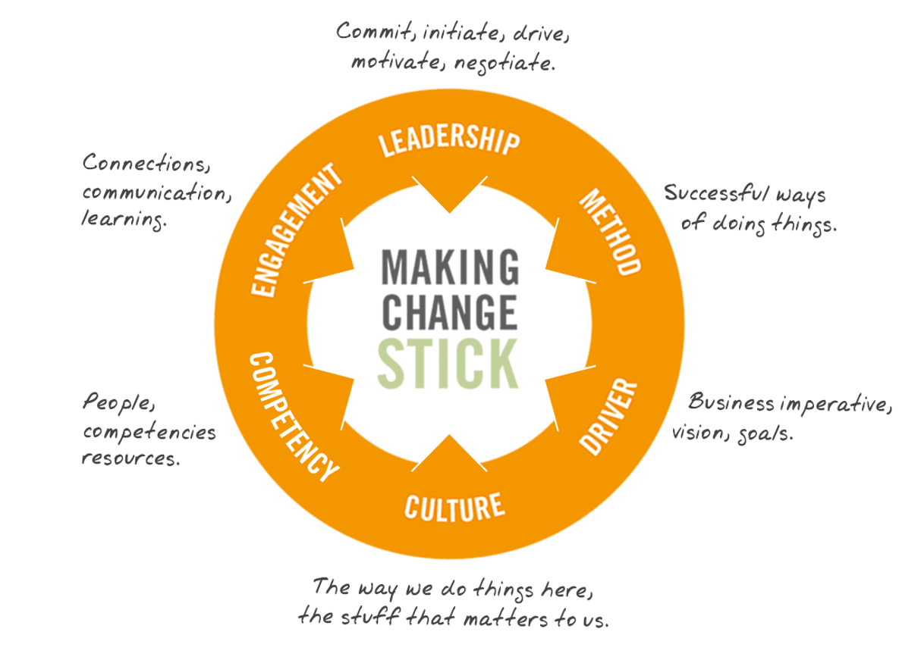

Build on the Change
Embed the Change
Notes:
Build on the Change
Sustain Acceleration in Adult Education
Early wins are momentum—not the finish line
Expand and deepen successful strategies
Prevent regression to old habits
Keep aligning improvements to student outcomes
Step 7: Build on the Change (Sustain Acceleration)
In GED preparation and adult education programs, early successes—such as improved attendance, higher post-test rates, or successful pilot classes—are important. But they are only the beginning.
One win is not the goal. It is the launchpad.
What It Means in Adult Education
After achieving short-term wins:
Don’t declare victory too soon.
Use momentum to strengthen and expand improvements.
Continue refining instruction, systems, and student supports.
Real transformation in adult education requires sustained effort over time.
Why It Matters
Early success can create a false sense of completion. Staff may feel:
“We fixed the issue.”
“The hard part is over.”
However, deep change—such as improving GED completion rates, strengthening measurable skill gains, or integrating technology program-wide—requires long-term consistency.
If momentum slows:
Old instructional habits may return.
Data monitoring may decline.
Energy and accountability may fade.
Sustaining acceleration ensures improvement becomes embedded into the program culture.
Key Actions to Build on Change in GED Programs
1. Celebrate Wins—Then Raise the Bar
Recognize improvement in outcomes, but clarify the next milestone goal.
For example:
If post-testing improved by 10%, set a new persistence goal.
2. Analyze and Replicate Success
Identify what worked:
Was it professional development?
A new scheduling model?
Stronger data reviews?
Replicate effective strategies across other classrooms or content areas.
3. Continue Removing Barriers
As improvements expand, new challenges will appear:
Technology gaps
Staffing limitations
Scheduling conflicts
Address them quickly to prevent stalled progress.
4. Introduce New Initiatives Aligned to the Vision
Layer improvements strategically:
Expand hybrid instruction
Add contextualized workforce lessons
Strengthen career transition services
Improve onboarding and orientation processes
Build while momentum is strong.
5. Bring More People Into the Effort
Invite additional instructors, staff, and partners to contribute ideas and leadership. Fresh energy helps sustain growth.
Example in a GED Program
A program launches a digital learning pilot and sees improved engagement and measurable skill gains.
Instead of stopping:
More instructors receive digital training.
Additional GED content areas integrate online practice tools.
Partnerships with local employers introduce job-aligned digital skills.
Leadership reviews outdated policies that limit hybrid flexibility.
The initial pilot becomes a catalyst for broader transformation.
Takeaway
In adult education:
Early success builds credibility.
Sustained effort builds culture.
Building on change means staying focused, energized, and committed—until improved instruction, strong student outcomes, and innovative practices become the norm in every GED classroom.

Slide 15
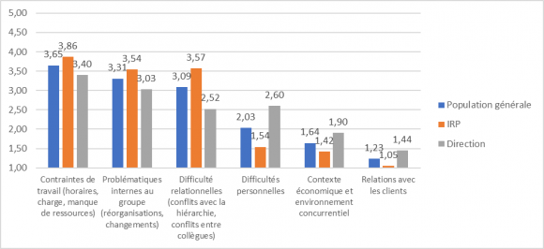
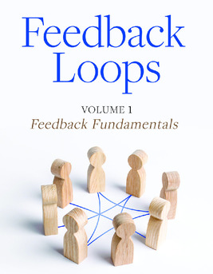

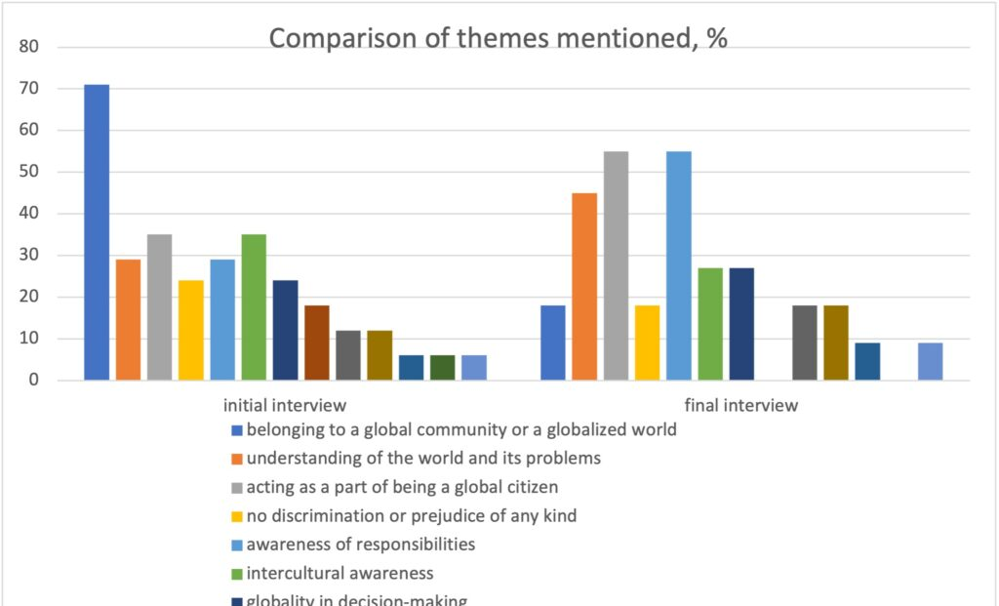
Practical Tools & Strategies
Evaluation Tools
Data Analysis
Observation Tools
Benchmarking and Standards Comparison
Continuous Improvement Strategies
This Photo by Unknown Author is licensed under CC BY-SA
Notes:
I know sometimes we feel bogged down by monitoring, observations, reports,
Review the data (Monthly, Quarterly, Year-over-Year) – What is the data telling you about your program? How many students stop out during the reportable period? What is your program’s retention rate?
Evaluation Tools:
Surveys and Questionnaires
Learner feedback surveys (pre- and post-program)
Instructor evaluations
Employer/partner feedback (if relevant)
b. Focus Groups and Interviews
Gather in-depth insights from:
Learners
Instructors
Program staff
Stakeholders
c. Pre- and Post-Assessments
Measure knowledge or skills gained
Compare baseline data to final results
Data Analysis : Learning Management System (LMS) Analytics
Track attendance, participation, and completion rates
Monitor learner progress and performance
b. Outcome Tracking
Employment rates (for workforce programs)
Certification or credential attainment
Advancement in education or career
c. Key Performance Indicators (KPIs)
Enrollment numbers
Retention and dropout rates
Cost per learner
Return on Investment (ROI)
Observation Tools:
Classroom Observations
Review teaching quality, engagement strategies, and learner interaction
b. Peer Reviews
Instructors observe and provide feedback to one another
c. Compliance and Desktop Monitoring
Benchmarking and Standards Comparison-
Compare against:
Regional and state standards
Similar programs (internal or external)
Best practices in adult education
Continuous Improvement: SWOT Analysis
Identify Strengths, Weaknesses, Opportunities, and Threats
b. Logic Models or Theory of Change
Assess if the program’s structure leads to intended outcomes
c. Feedback Loops
Regular reviews and adjustments based on ongoing feedback

Slide 16
Why This Matters?
Notes:
Adult learners deserve programs that are flexible, learner-centered, and future-ready.
Standing still in adult education means falling behind.
Sustainable change protects funding, strengthens outcomes, and improves lives.
Structured leadership and a clear vision make transformation possible.
When we change well, we expand opportunity—not just instruction.
Final Thought for Adult Education Leaders
Lasting change in GED and Adult Education programs must be:
Human-centered – focused on real learner needs
Purpose-driven – connected to life-changing outcomes
Strategically supported – backed by structure, systems, and leadership
Whether improving curriculum, expanding hybrid access, strengthening measurable skill gains, or increasing GED attainment, structured change ensures improvement is sustainable—not temporary.
Why This Matters
1. Adult Learners Are Changing
Today’s adult learners:
Balance work, family, and education
Expect flexible scheduling and digital access
Need job-aligned, real-world skills
Require supportive, barrier-reducing environments
If programs do not adapt, learners disengage—or choose other options. Continuous improvement keeps programs relevant and accessible.
2. Funding and Accountability Depend on Results
Adult education programs rely heavily on:
Public funding
Grants
Performance-based outcomes
Community and workforce partnerships
Stakeholders increasingly expect:
Measurable skill gains
GED credential attainment
Transition to employment or postsecondary education
Data-informed decision-making
Programs that evolve and demonstrate impact retain support. Those that stagnate risk losing it.
3. The Workforce Is Rapidly Evolving
Modern jobs demand:
Digital literacy
Critical thinking
Adaptability
Industry-recognized credentials
Adult education must serve as a bridge between learners and today’s labor market. Strategic change ensures programs remain workforce-aligned and future-focused.
4. Educator and Staff Morale Depends on It
Poorly managed change creates:
Burnout
Confusion
Resistance
Well-led change builds:
Shared purpose
Collaboration
Professional growth
Innovation
When educators see real impact in student outcomes, morale strengthens.
5. It’s About Lives, Not Just Lessons
GED preparation is not simply academic instruction.
It represents:
A parent earning a credential to support their family
A worker earning their GED to qualify for a promotion
A learner rebuilding confidence
A pathway to postsecondary education
When programs adapt effectively, they remove barriers, expand access, and change life trajectories.
Final Takeaway
In Adult Education:
Standing still is falling behind.
Structured, strategic change is not optional—it is essential.
When we lead change intentionally, we strengthen programs.
When we strengthen programs, we improve outcomes.
When we improve outcomes, we change lives.

Slide 17


Slide 18


Slide 19

Session Survey
Your feedback is important. Please scan the QR code below to rate this session.
QR CODE PLACEHOLDER

