Slide 1
Building a Strong Adult Education Team and Creating Balance as a Program Administrator
Ms. Angela Moseley

Slide 2

#1
#4
Program Needs Assessment
Program Schedules
#2
#5
Building the Right Team
Team Responsibilities and
Professional Development
#3
#6
Onboarding
Creating Balance

Slide 3


Warm-Up: Quick Discussion
In your ideal world, what would a strong Adult Education Team look like at your program?
Do you feel like your program is well balanced and is meeting all state requirements?

Slide 4

Assess Department Needs
What do we need to make the program run as smoothly as possible, within our financial means?
  More student intake opportunities?
  More class options? Class structure?
  More support staff?
  More faculty?
What do we currently offer that is no longer a need for student success?
  Sites with low enrollment?
  Positions that can be restructured or relocated?
  Class times with low interest?

Slide 5

Build the Right Team
Find people who:
Have the Skill Set Needed for the Position
Are Team Players
Are Flexible to Work Multiple Locations and Times
Want Longevity In the Department
Do Not:
Hire out of desperation!
Remember – No Team is Perfect!

Slide 6

Hiring – The Right People Make All the Difference!
Job Descriptions – Should be as accurate as possible
  Instructor Example:
    Must have at least 3 to 5 years teaching experience in K-12 or Adult Education Classes. Must have a strong knowledge of standards-based instruction. Prefer teaching experience at the middle or high school level.
  Career Services Example:
    Prefer a combination of education and work experience directly related to education, counseling and/or social services.

Slide 7

Hiring – Interview Questions
List an interview question for each position below:
  ABE Instructor
  ESL Instructor
  Online Instructor
  Data Manager
  Career Services Specialist
  Instructional Coordinator (Lead)

Slide 8

Hiring – The Right People Make All the Difference!
Interview Questions – Should properly vet for the position
  Instructor Example:
    What are your strengths and weaknesses? – No
    Explain the difference between student-centered and teacher directed learning. How and when can each method be both useful for student learning? - Yes
  Career Services Example:
    Tell me about yourself. – No
    What are some common barriers adults face when pursuing education or job opportunities, specifically those who do not have a high school diploma or English is their second language? How could you assist students with minimizing or eliminating those barriers? – Yes

Slide 9

New Hires - Disussion
What is your training process for new hires?

Slide 10

Onboarding – New Hire Training
New hire training should be well planned and targeted to their specific job needs
Should be ongoing with regular check-ins
Provide a checklist of daily/weekly/monthly duties
New hires should be paired with a mentor

Slide 11

Onboarding – Training Schedule Instructor Sample – Part Time
Week 1
Thursday February 19
5:00pm – 6:15pm Adult Ed Orientation with Dean– (In-person, Main Campus)
6:15pm – 7:00pm Observe Math Bootcamp with Teacher A (Main Campus)
Monday, February 23
5:30pm – 8:30pm TABE Proctoring Certification: Part 1 - https://www.brainshark.com/drc/TABECertPartI , Part 2 - https://www.brainshark.com/drc/TABECertPartII. *Email Ms. Admin Assistant a copy of your certificates (Independent, Remote)
Tuesday, February 24
5:30pm – 7:30pm Observe Teacher B (Location: Office Campus Site 1)
Thursday February 26
4:30pm – 5:00pm Entering Work Time in the system with Ms. Admin Assistant (Main Campus)
5:00pm – 7:30pm GED Ready Math and Reading with Ms. Admin Assistant (Main Campus)
Week 2
Monday, March 2
5:30pm – 6:30pm Essential Education Tutorials Beginner & Intermediate Educator Training Videos (essentialed.com) (Independent, Remote)
6:30pm – 7:30pm Essential Education Tutorials Advanced Educator Training Videos (essentialed.com) (Independent, Remote)
Wednesday March 4
5:00pm – 7:30pm Professional Development Training Session with Dean (Main Campus)
Thursday March 5
5:30pm – 7:30pm Lesson planning, MSG, HSE with Ms. Instructional Coordinator (Main Campus)

Slide 12
Onboarding – Training Schedule Instructor Sample
Week 3
Monday March 9
5:30pm – 7:30pm GALIS Training Ms. Data Manager (Main Campus)
Thursday March 12
5:30pm – 6:30pm DRC Training Ms. Testing Lab Assistant (Main Campus)
6:30pm – 7:00pm Observe Teacher C – Room (Main Campus)
7:00pm – 7:30pm Observe Teacher D – Room (Main Campus)
Monday March 16
5:00pm – 5:30pm Career Services Overview with CSS – Room (Main Campus)
5:30pm – 7:30pm GED Ready Science and Social Studies with CSS (Main Campus)
Week 4
Tuesday, March 17
5:30pm – 6:30pm Observe Teacher E Blackboard Class (Instructor will send guest link) (remote)
6:30pm – 7:30pm Local College Training (Instructional Coordinator, please assist Ms. Trainee with locating training prior to this date) (remote)
Thursday March 19
5:30pm – 7:30pm Understanding HSE, Bootcamps, and HOPE HSE with Ms. Instructional Coordinator (Main Campus)
Monday March 23
5:30pm – 6:30pm Training Wrap-Up Debrief with and Instructional Coordinator (Virtual, Remote)
6:30pm – 7:30pm Local College Training Continued (remote)
Tuesday, March 24
5:30pm – 7:30pm Bootcamp Lesson Planning (remote)

Slide 13

Onboarding – Training Schedule Career Services Specialist Sample –Fulltime
Week 1
Monday June 17th
9:30am – 10:30am Adult Ed Orientation with Dean– (In-person, Main Campus)
11:30am – 12:30 pm One-Stop Training with One- Stop Coordinator (One Stop Partner)
1:30pm – 2:30pm Career Services Training with College’s Career Services Director (Building A)
Tuesday, June 18th
9:00am – 9:30am CSS Meeting with OAE Career Services Coordinator, Via WebEx Link
1:00pm – 2:00pm Campus Life Training/Tour with College’s Coordinator of Campus Life & Recruitment (Building A)
2:00pm – 2:45pm Marketing Overview/Training with Executive Director of Marketing and Public Relations (Building B)
Wednesday, June 19th
College Closed
Week 1 Cont.
Thursday, June 20th
10:00am – 2:00pm Adult Ed IET Training with IET Coordinator (Main Campus)
3:00pm – 4:30pm Fiscal Year Planning with Dean 200 Building (Main Campus)
Friday, June 21st
9:00am – 10:30am HSE HOPE Grant Application Process with Adult Ed Instructor A (Main Campus)
11:30am – 1:00pm Adult Ed Front Office Basics with Admissions Assistant (Main Campus)

Slide 14
Onboarding – Training Schedule Career Services Specialist Sample – Fulltime
Week 2
Monday, June 24th
9:00am – 12:00pm Basics of Adult Ed Instruction with Instructional Coordinator (Main Campus)
1:30pm – 3:30pm NorthStar Digital Literacy Training and Proctoring Certification, Independent
Tuesday, June 25th
9:00am – 10:30am Creating Tickets in DRC for ABE and ESL with Admissions/Testing Lab Assistant (Main Campus)
2:30pm – 3:30pm College Admissions Training with Director of Enrollment Services (Building A)
Wednesday, June 26th
10:00am – 12:00pm Data System Basics & CSS Tables with Adult Education Data Manager
2:00pm – 3:00pm Continuing Education Training with Director of Continuing Education (Building C)
Week 2 Cont.
Thursday, June 27th
9:30am – 10:30am ABE Classroom Observation with Teacher B (Main Campus)
11:00am – 12:00pmm ESL Classroom Observation with Teacher C (Main Campus)
Thursday, June 28th
9:30am – 10:30am Observe Teacher D Blackboard Class (Instructor will send guest link)
11:00am – 12:00pmm Observe Teacher E Blackboard Class (Instructor will send guest link)

Slide 15



Adult Ed Team – Key Roles
Admissions/Intake Team
Admissions Assistant(s)
Testing Assistant(s)
Data Manager
Faculty
ABE Instructor(s)
ESL Instructor(s)
Corrections Instructor(s)
Instructor Aides
Support Staff
Administrative Assistant
Instructional Coordinator
Career Services Specialist
IET Specialist

Slide 16

Adult Ed Team – Tips
Quality vs. Quantity
Pair New Hires with a Mentor
Cross-Training is Key
Create Checklist for Faculty/Staff
Provide Ongoing Professional Development Opportunities
Live Shared Documents for Student Tracking
Daily Email Communication

Slide 17

Adult Ed Team – Sample Checklist Questions
Instructional Coordinator
☐ Which (3 minimum) instructors did I observe this week? Were the observations announced or unannounced?
☐ Did I bring a copy of the instructor’s lesson plans with me and ensure the observation matched the lesson plan?
☐ Did I check for student conferencing?
☐ Did I debrief with each instructor within 24 hours of the observation?
☐ Did I provide support to new and/or low performing instructors this week?
☐ Did I provide a written copy (via email) of the observation feedback to the instructor? Did I include a copy for the observation form and rubric?
☐ Did I provide a written copy (via email) of the observation feedback to the Dean? Did I include a copy for the observation form and rubric?
Instructor
☐ Have I submitted a class entry form for all student in my class?
☐ Have I submitted my class attendance each day after class (by noon the next day)?
☐ Have I submitted all sign-in sheets this week? Did I ensure all students signed in & out at exact times?
☐ Have I pulled (non- Essential Education) weekly proxy hours (out of class) and submitted to the data manager?
☐Do I have any students who have or will take a post-test this week?
☐ Did any post-testers move up a level this week? If so, did you update their scores or levels in Essential Education, Burlington English, or other online platforms?
☐ ABE - Do I have any ABE2 students who have moved to 490 or higher? If so, have I requested GED Ready vouchers for the students? Did I assign a date of completion for the GED Ready?

Slide 18

Scheduling
In-Person/Face-To-Face
Registration/ Orientation
Testing
ABE Classes
ESL Classes
Career Services
Integrated Education and Training
Classroom Observations
Online/Distance Education
Virtual Registration /Orientation
Virtual TABE or CASAS Testing
ABE Classes – DE, Blackboard, Independent Study, Hybrid
ESL Classes - DE, Blackboard, Independent Study, Hybrid
Career Services – DE, Blackboard
Integrated Education and Training - DE, Blackboard, Independent Study, Hybrid
Classroom Observations - DE

Slide 19

Scheduling Game Changers
Assigning A/B or A/B/C classes – to allow more class options and to grow enrollment
  Example: Previously Instructor Smith had one morning class that ran Monday – Friday from 8am – 12p. Now Instructor Smith has 2 morning classes that run form 8am – 12pm and a 3rd that runs 8am – 2:30pm (Class A: Mon/Wed, Class B: Tues/Thurs, Class C: Friday)
Online Options – allows various learning/scheduling options:
  Online via Blackboard: Example 2 days per week with a live instructor from 8am – 12pm
  Classroom Distance Ed: Use video technology to merge classes
  Online Independent Study: Students work online modules
Bootcamp Instructors – allows fast track graduation opportunities
IET Workforce Training – Hybrid Options
Evening Support Team – staff available to support evening classes

Slide 20
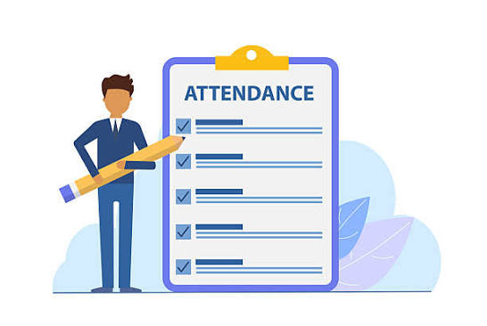
Student Attendance Policy
Students Need Accountability in Adult Education
Create a policy that works for your program

Slide 21


Who is Responsible For…
Admissions/Intake Team, Faculty, Support Staff
Admissions/Intake Team, Faculty, Support Staff
Enrollment
Instruction
HSE Attainment
IET Credentials
Admissions/Intake Team, Faculty, Support Staff
Admissions/Intake Team, Faculty, Support Staff

Slide 22

Who is Responsible for Enrollment?
Admissions/Intake Team
First impression of the program
Excellent Customer Service
Professionalism
Inform prospective students about program offerings and options
Follow-up with interested students
Follow-up with no-shows
Review Data
Faculty
Engage with students before they start class
Provide pre-class assignment or activity
Follow-up with no-shows
Provide targeted and engaging lessons
Conference with students and check-up on student goal progress
Inform students of upcoming IETs or other activities
Review Data
Support Staff
Ensure classes are running on time and properly
Assist Instructors with lesson plan development
Assist students with applying to college or career opportunities
Assist with recruitment efforts
Provide target student workshops
Assist with student barriers
Review Data

Slide 23

Who is Responsible for Instruction?
Admissions/Intake Team
Ensure students are assigned to the correct classes
Ensure class loads are balanced
Faculty
Reviews student data (prior to student entry)
Make targeted study plans for each student using score reports
Create student centered lesson plans
Student conferencing
Provide robust standard based instruction
Monitor student learning/progress
Support Staff
Ensure lesson plans support student centered learning
Provides professional development when needed
Monitors data to assist with needs
Helps eliminate student barriers to learning

Slide 24

Who is Responsible for HSE Attainment?
Admissions/Intake Team
Inform prospective students about how Adult Education can assist with HSE Attainment
Monitors TABE or CASAS pre-test scores for class placement
Assigns GED Ready vouchers to students recommended TABE or CASAS scores
Faculty
Reviews student data (prior to student entry)
Reviews GED Ready Score Reports
Makes fast-track plans for students who score green on GED Ready
Assist ESL students with HSE prep
Provides bootcamps to fast-track students
Develops an “end date” goal for students
Support Staff
Monitors data to assist with needs
Manages bootcamp efforts
Provides college and career counseling, assistance and information
Assists students with HSE funding options
Assist instructors with fast-track plans and student awareness

Slide 25

Who is Responsible for IET Credentials?
Admissions/Intake Team
Inform prospective students about IET offerings and options
Remain knowledgeable about IET dates
Faculty
Remain knowledgeable about IET dates
Tie in IET opportunities with student’s career goals
Provide IET workforce preparation instruction
Provide flexible class options for IET participants
Support Staff
Provide classroom workshops about IET opportunities
Provide career opportunities
Work closely with IET trainers
Assist with college admission and financial aid
Check in weekly with participants and trainers
Assist with barriers

Slide 26

Local Professional Development
Use Data, Observations, Needs Assessment
Whole group, Targeted Areas of the Department, One-on-One
In-Person and Virtual Options
Have Themed PD Days
Incorporate Action Items

Slide 27

Balancing It All
Establish Boundaries
Set Measurable Goals for Each Member of the Team (Monthly, Quarterly Semester, Yearly)
Delegate and Assign Responsibilities
Have Regularly Scheduled One-on-One Meetings with Team Members
Crosstrain and Have Back-Up Plans
Schedule Fulltime Employees in Key Positions
Clear Communication and Transparency
Set Daily, Weekly, and Monthly Priorities for Yourself
Don’t Micromanage

Slide 28



Additional Support Resources from GED® Testing Services
The GED Playbook
The Educator Handbook
The GED Student Handbook
GED-Playbook-Updates-v1.pdf
Educator-Handbook-Ed7-US-ebook.pdf
Student-Handbook-ED2-v1.pdf

Slide 29
Wrap-Up: Quick Discussion
What tips from today’s session will help you build a stronger team?
What tips from today’s session will help your program (and you) become more balanced and will help you with meeting state requirements ?

Slide 30

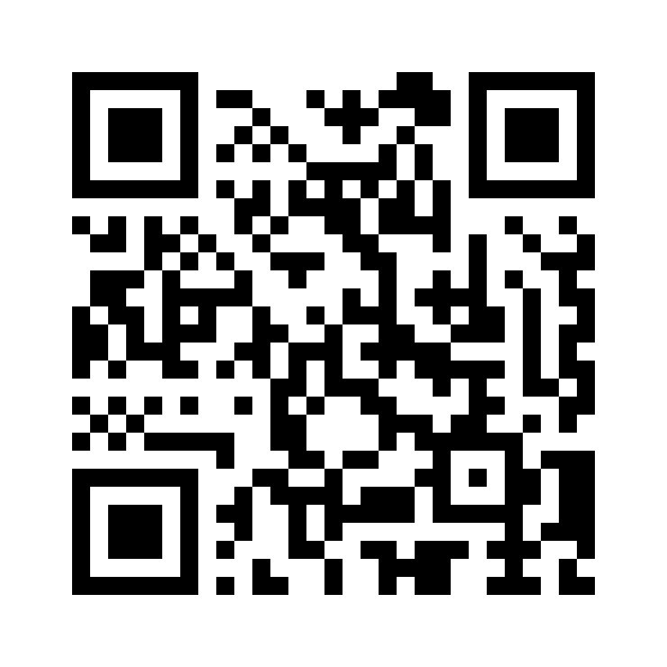
Session Survey
Your feedback is important. Please scan the QR code below to rate this session.
https://www.surveymonkey.com/r/RWZYBP5

