Slide 1

Beyond Cheating
Teaching AI Literacy & Rethinking Assessments
Vi Hawes, M.Ed. | VH Ed Tech Consulting

Slide 2
Before We Start…
You are welcome to…
Stand as you work.
Take breaks
Work with those that best support you.
Work with those outside your comfort zone to grow and learn from others.
You can show your learning by…
Writing on paper.
Drawing your ideas.
Talking to your group
Listening
Use your preferred AI chatbot to assist you.
Use other technology that may be helpful.

Slide 3
Quick Poll: Where are you with AI in your classroom? (Insert Mentimeter)
Banning it — AI is off-limits in my program
Ignoring it — not addressed either way
Experimenting — trying things out, no clear plan yet
Integrating — already building it into instruction
Hold your answer in mind — we’ll come back to it at the end.

Slide 4

Introductions
Vi Hawes, M.Ed
Ed Tech Specialist / Consultant
VH Ed Tech Consulting
✨Fun Facts!
I’ve completed both a half/full marathon!
I can speak three languages
I completed my Master’s AND gave birth to my second child, AT. THE. SAME. TIME!

Slide 5


Let’s stay connected!

Slide 6
1
4
Understanding the Landscape
Apply It to Your Lessons
2
5
Two frameworks: the DOL and SEE framework
Rethink Assessment
3
6
Come and SEE
Takeaways

Slide 7
This isn’t about catching cheaters.
It’s about preparing learners.
AI literacy is becoming the baseline in today’s job market.
Notes:
A growing majority of hiring leaders say the wouldn’t bring on someone without it. For GED and career readiness programs, workforce prep is AI literacy now.

Slide 8


Slide 9
Why AI Literacy Matters in Adult Education
Part 1 — The landscape, the stakes, and the opportunity

Slide 10

The Reality for Adult Learners
AI is already here
Learners meet AI at work, in job applications, and in daily life
Many have used it without ever being taught how it works
They are forming habits — with or without our guidance
Workforce readiness has changed
AI literacy is now a baseline employability skill
Career readiness programs are exactly where this belongs
Teaching it is preparation, not permission to cut corners
Notes:
Your learners aren’t waiting for AI to arrive. IT’S ALREADY IN THEIR LIVES: job applications, workplace tools, government portals, and everyday decisions.

Slide 11
Guess the Stat!
____%
of U.S. workers now use AI at work.
Gallup Workforce survey, 23,000+ workers (2025). https://www.gallup.com/workplace/701195/frequent-workplace-continued-rise.aspx
____%
of leaders won’t hire without AI literacy.
LinkedIn. (2025). AI and the Global Economy: Unlocking Growth and Reshaping Work. https://www.linkedin.com/pulse/ai-global-economy-66-trillion-opportunity-karin-kimbrough-pk7pc/
____%
of workers are worried about AI’s future impact on their work
Pew Research Center (2025). https://www.pewresearch.org/social-trends/2025/02/25/u-s-workers-are-more-worried-than-hopeful-about-future-ai-use-in-the-workplace/
45
66
52
Notes:
Maybe turn this into a mentimeter?

Slide 12
The Evidence Is Striking
45%
of U.S. workers now use AI at work.
79%
of older adults want to learn more, but have limited resources.
66%
of leaders won’t hire without AI literacy skills
👷‍♂️
📖
💻
WIOA funds
now support AI literacy
52%
of workers worried about AI at work.
Equity gap
AI use is lower in frontline sectors.
💵
😟
⛓️‍💥
Notes:
1. AI adoption among working adults is mainstream
45% of U.S. workers use AI at work at least occasionally; nearly 1 in 4 use it weekly — Gallup Workforce survey, 23,000+ workers (2025). https://www.gallup.com/workplace/701195/frequent-workplace-continued-rise.aspx
Alternative/companion: 54.6% of U.S. adults (18–64) used generative AI as of August 2025, up ~10 points in a year — St. Louis Fed, Real-Time Population Survey. https://www.stlouisfed.org/on-the-economy/2025/nov/state-generative-ai-adoption-2025
2. Employers now expect AI literacy
66% of leaders say AI fluency is a non-negotiable for hiring — Microsoft / LinkedIn (2025). https://www.linkedin.com/pulse/ai-global-economy-66-trillion-opportunity-karin-kimbrough-pk7pc/
3. The federal workforce system is now funding this
DOL now directs WIOA Title I (Adult, Dislocated Worker, Youth) funds toward AI literacy — U.S. DOL, TEGL 03-25 (Aug. 2025). https://www.dol.gov/sites/dolgov/files/ETA/advisories/TEGL/2025/TEGL%2003-25/TEGL%2003-25.pdf
This is a strong one for your audience — it directly ties to the WIOA/NRS alignment you flagged earlier and signals this work is fundable.
4. The access/equity gap among adults
AI use is far lower in frontline sectors — 33% retail, 37% healthcare, 38% manufacturing vs. 76% in tech — Gallup (2025). https://www.hrgrapevine.com/us/content/article/2025-12-16-gallup-report-sees-uneven-growth-in-workplace-ai-use
This reframes your equity message around the exact industries many adult/workforce learners are entering.
5. Older adult learners are eager but under-supported
Among older adults who've tried AI, learning is the top use case (79%), yet many want easier guides and training — EY/AARP OATS survey of adults 60–85 (2026). https://www.ey.com/en_gl/newsroom/2026/04/new-ey-survey-reveals-ai-literacy-training-opportunity-for-baby-boomer-users
6. Workers feel unprepared / wary
52% of workers are worried about AI's future impact on their work; 33% feel overwhelmed — Pew Research Center (2025). https://www.pewresearch.org/social-trends/2025/02/25/u-s-workers-are-more-worried-than-hopeful-about-future-ai-use-in-the-workplace/

Slide 13
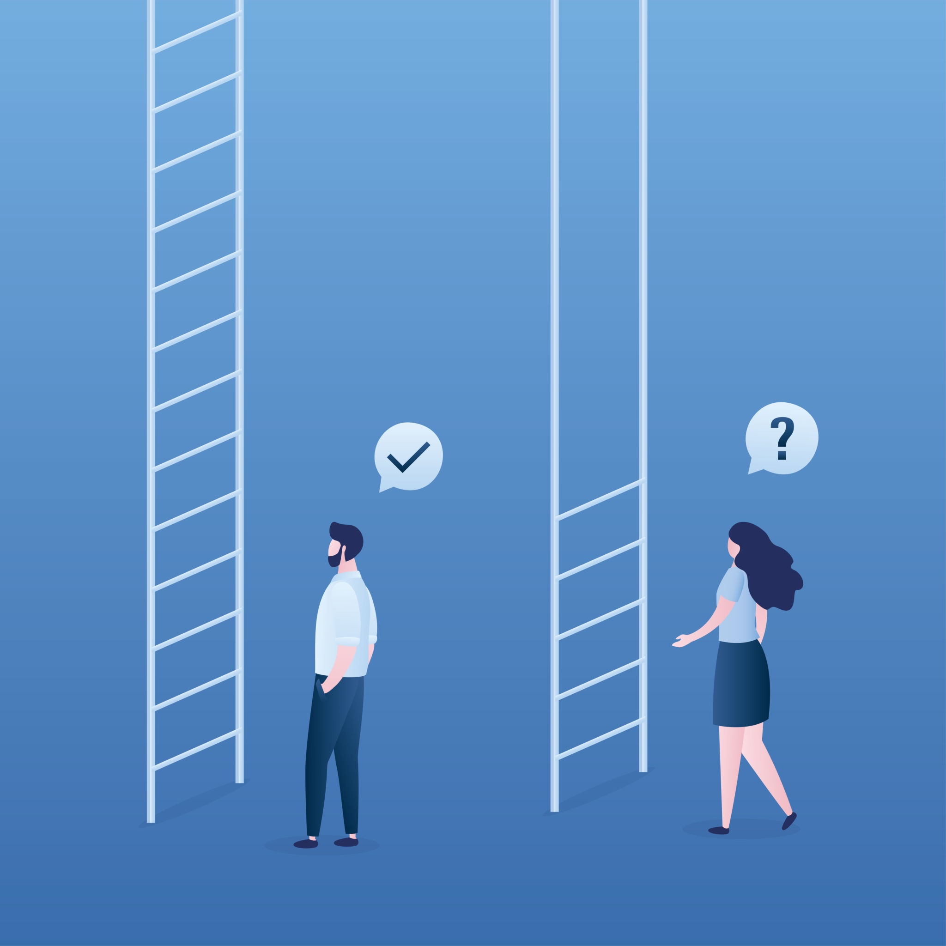
The Equity Stakes
Who’s at Risk?
Adult learners - especially those in GED and workforce programs. They are disproportionately impacted when AI literacy is absent from instruction.
Why it matters:
Ignoring AI in Adult Education isn’t neutral. It actively widens the opportunity gap for the learners we serve.

Slide 14
Permissible ≠ Appropriate

Slide 15

Permissible ≠ Appropriate
Allowed is not the same as appropriate. A tool being permitted doesn’t mean it fits every task or every learner.
The instructor’s role is to guide, helping learners make deliberate, intentional choices.
Some tasks call for AI; others require the learner’s own thinking, because the thinking is the point.
OUR GOAL:
Learners who can decide when and when not to use AI.
Notes:
Just because a tool is ALLOWED doesn’t mean it’s the right choice for every task or moment. Our role as instructors isn’t to police AI use. It’s to help learners develop the judgment to make deliberate, purposeful choices about when and how to use it.

Slide 16
Two Frameworks for AI Literacy
Part 2 — The workforce “why” and the classroom “how”

Slide 17
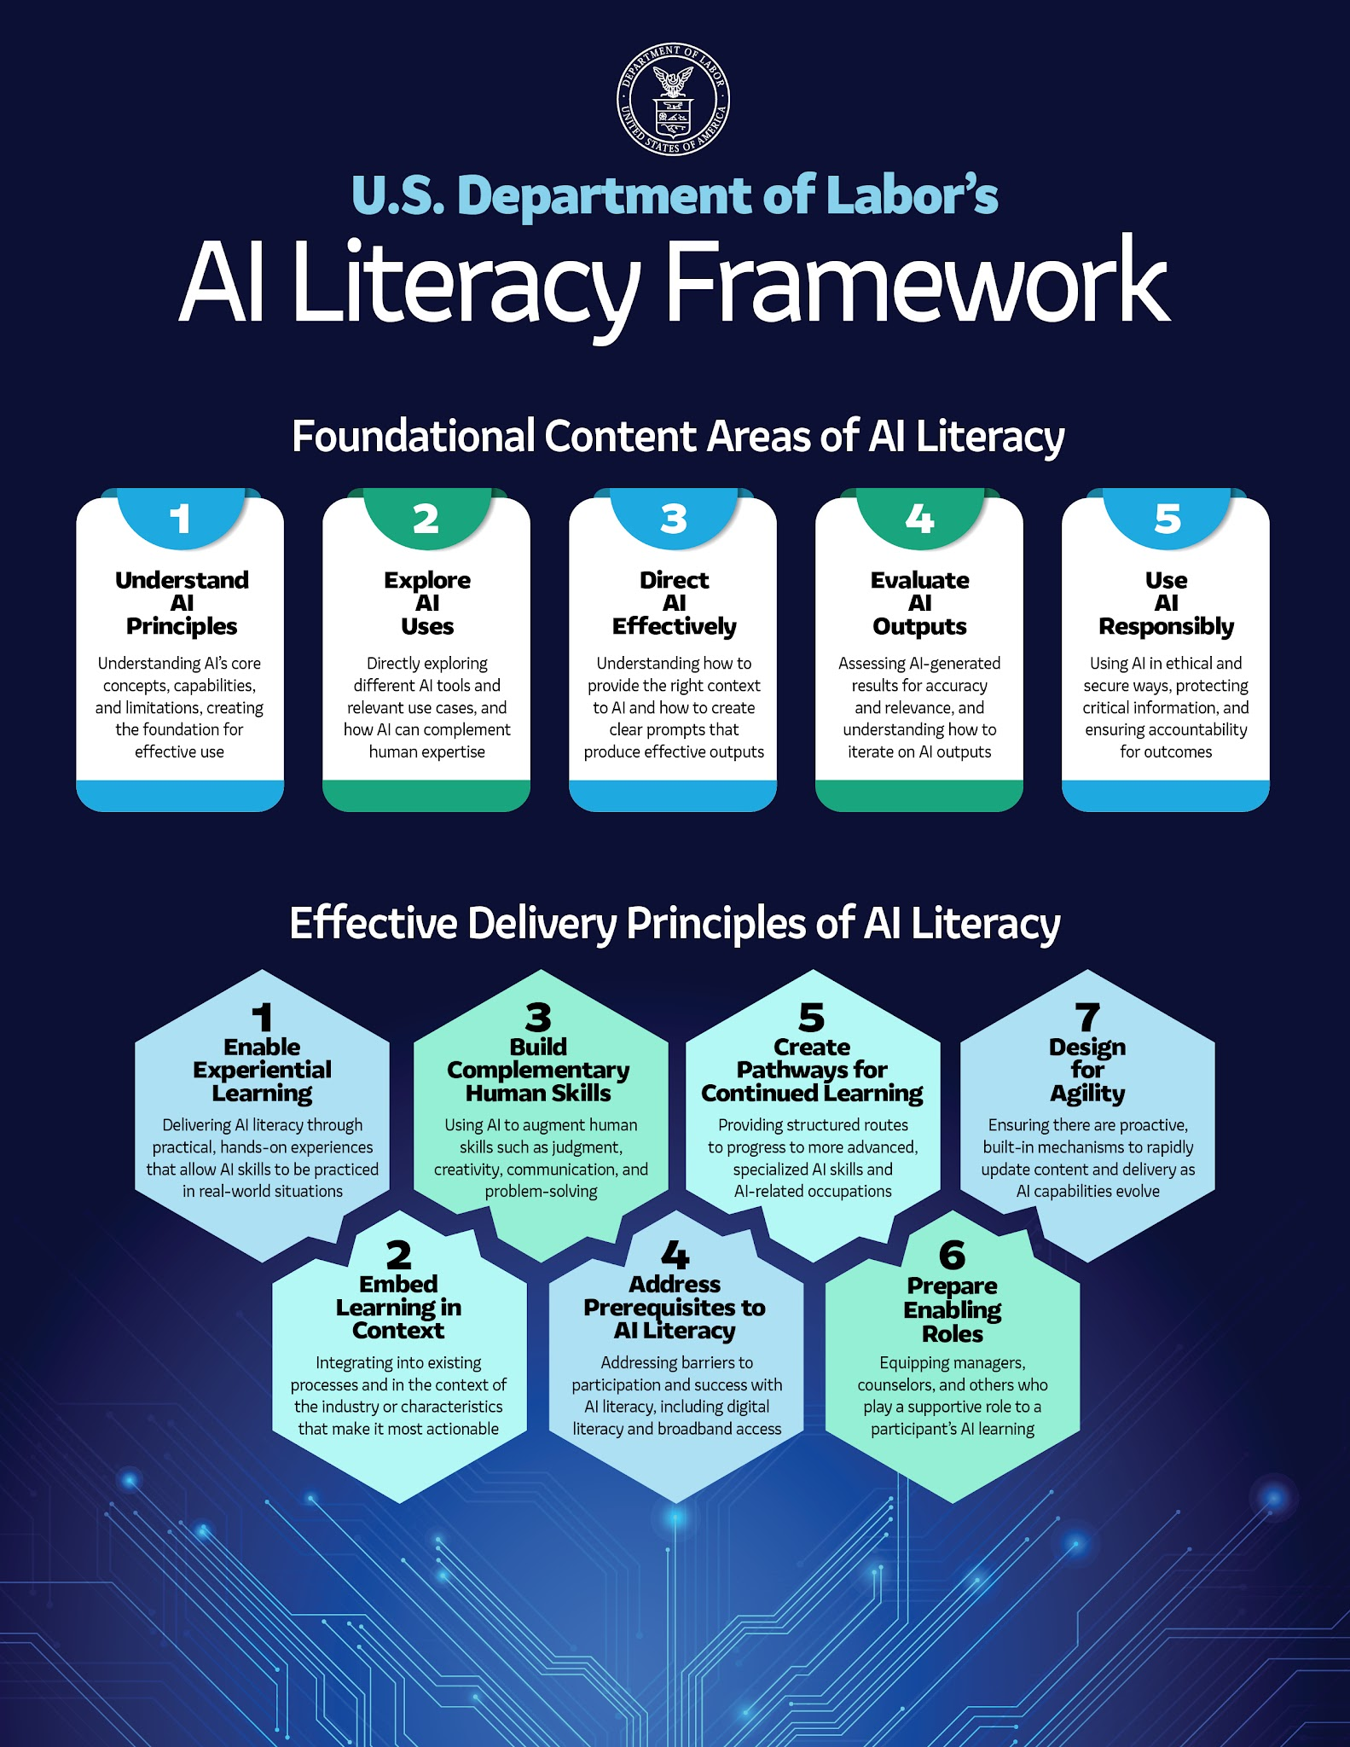
Notes:
The AI literacy framework is workforce-oriented, built explicitly for career readiness contexts.

Slide 19
DOL Framework: Foundational Content Areas
1. Understand AI Principles
How AI systems work and their limitations.
4. Evaluate AI Outputs
2. Exploring AI Uses
Critically assess accuracy, bias, and relevance.
Recognize AI applications across industries and daily life.
5. Use AI Responsibly
3.Direct AI Effectively
Ethics, privacy, and appropriate disclosure
Crafting prompts and guiding AI toward useful outputs.

Slide 21
Two Principles Stand out for Adult Ed…
Embed Learning in Context
AI skills stick when taught alongside relevant workforce skills and career contextualization.
Build Complementary Human Skills
Critical thinking, communication, and judgment: skills AI cannot replace.

Slide 22
The SEE Framework

Slide 23
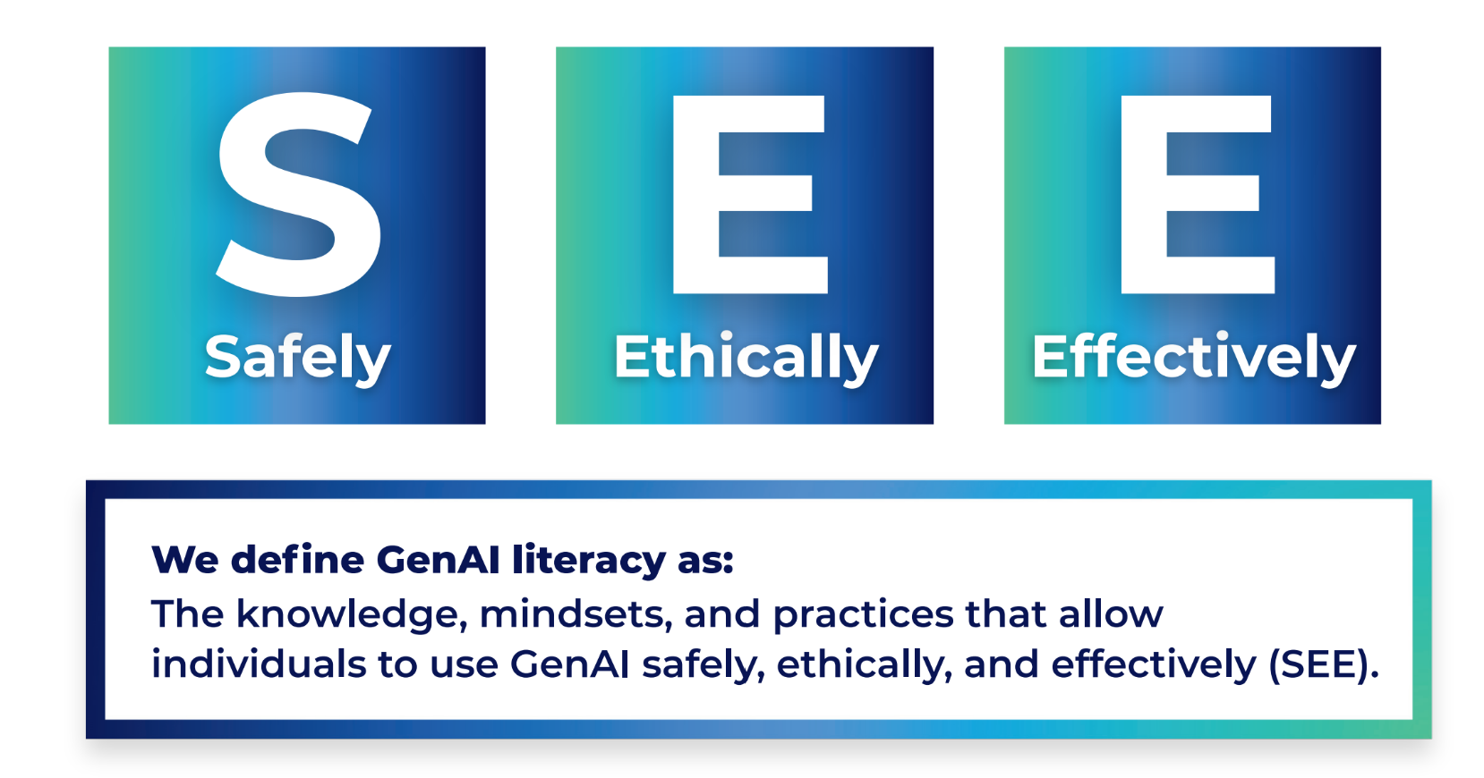

Slide 24

Three Domains:
🛡️
⚖️
🚀
Safely
Protect yourself and others; keep human agency and judgment
Ethically
Consider impact on others; be honest and transparent
Effectively
Combine human expertise with AI to do better work
Using only one lens is inadequate. AI literacy requires all three working together.

Slide 25

Why We’ll Focus on SEE Today
DOL Framework
Workforce Why: The labor market case for AI Literacy
SEE Framework
Classroom How: practical ideas, reflection, hands-on

Slide 26






The Foundation: What Learners Need to Know
AI predicts, NOT thinks
It can hallucinate
It has a knowledge cutoff
It’s trained on biased data
It’s designed to agree
AI-literate learners understand these concepts.
Notes:
AI-literate users understand how GenAI works, without needing to be experts.
It predicts, not thinks:
AI generates the likely next word, it doesn’t reason or know facts
It can hallucinate:
Wrong outputs are common. Always verify important information.
It has a knowledge cutoff
Training data is frozen at a point in time. It doesn’t know what happened last week.
It’s trained o biased data
The internet’s biases are baked in. Outputs can reflect and amplify them.
It’s designed to agree
Sycophancy is real. AI tends to validate what you say, even when you’re wrong.

Slide 27
SEE Mindsets: Beliefs That Drive Behavior
🎯
🫴
📖
Be Intentional
Stay Critical
Be Transparent
Act Responsibly
Keep Learning
Notes:
Be Intentional
Choose when to engage AI — don’t default to it
Protect your own capacity for independent thought
Stay Critical
Treat every output as a draft to evaluate
Watch for confident-but-wrong, biased, or agreeable answers
Be Transparent & More
Be honest about how AI was used
Act Responsibly • Keep Learning across any tool

Slide 28
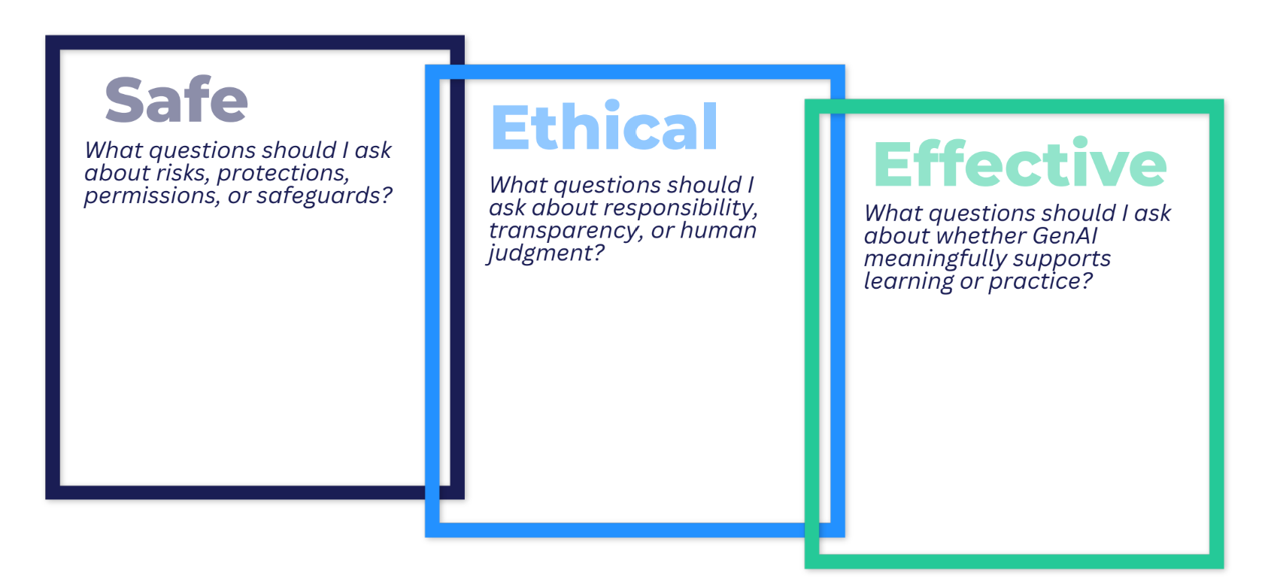
The Framework: (S)afe, (E)thical, (E)ffective
Evaluation risks before sharing info.
Maintain human agency in decisions.
Protect personal/sensitive data
Disclose AI use
Uphold academic and professional integrity
Avoid outputs that could harm others.
Decide when to use AI.
Avoid cognitive offload on important thinking.
Craft useful prompts and evaluate outputs.
Notes:
Safe
Evaluate risk before, during, after use
Keep human agency — you decide
Protect personal data & privacy
Ethical
Disclose AI use honestly
Honor academic & professional integrity
Avoid harm; get consent for others’ info
Effective
Decide when AI is the right tool
Avoid cognitive offload — extend your thinking
Prompt well, then evaluate and refine

Slide 29
The Framework: (S)afe, (E)thical, (E)ffective
Notes:
PASS OUT SEE FRAMEWORK WORKSHEET
Safe
Evaluate risk before, during, after use
Keep human agency — you decide
Protect personal data & privacy
Ethical
Disclose AI use honestly
Honor academic & professional integrity
Avoid harm; get consent for others’ info
Effective
Decide when AI is the right tool
Avoid cognitive offload — extend your thinking
Prompt well, then evaluate and refine

Slide 30
SEE Framework in Action
Part 3 — Apply the three lenses to your own lesson content

Slide 31
Example: A Learner Drafts a Cover Letter with AI
Safe
Am I sharing personal info (address, phone)?
Do I know how this tool stores my data?
Ethical
Am I representing this as my own work?
Does it honestly reflect my real experience?
Effective
Does this still sound like me?
Can I use it iin an interview as myself?

Slide 32
Choose Your Scenario
Pick the one that fits you best — there’s no wrong choice. You’ll use it for the activity that follows.
Option A:
Your Own Lesson
Option B:
GED Scenario
Option C:
Workforce Scenario
Have a real lesson, assignment, or assessment you already use
Provided for you: evaluating an AI-generated GED essay response
Provided for you: a learner writing a cover letter using AI

Slide 33
Choose Your Lens
Move to the corner for the lens you care about most right now. Apply it to your scenario, then we’ll share across groups. (10 minutes)
Group 1:
SAFE
Group 2:
ETHICAL
Group 3:
EFFECTIVE
Join this group if data privacy and human agency worry you most
Ask: what could go wrong? What data is at risk?
Join this group if disclosure and integrity are your top concern
Ask: where is the line? What should be disclosed?
Join this group if you most want AI to deepen real learning
Ask: does AI extend thinking, or replace the point of the task?
Notes:
pull up 10 minute timer

Slide 34
Share out! 💬

Slide 35
Rethinking Assessments
Part 4 — Make thinking visible

Slide 36

Why Traditional Assessments Are Don’t Work
Easy AI Outsourcing
AI Detection is NOT the Solution
Assessments that focus only on a polished final product are susceptible to being generated by AI, often bypassing learning and critical thinking.
These tools are unreliable and prone to false positives, affecting multilingual learners and those with disabilities.
They create an unfair and ineffective assessment environment.

Slide 37
Shift from “How do I stop AI use?” to “How do I make thinking visible?”
Notes:
This paradigm shift challenges us to move beyond simply policing AI use. Instead, we focus on redesigning assignments to be process- and reflection-focused, making the learner's cognitive journey—not just the final output—the core of assessment.
By emphasizing transparency and critical engagement, we leverage the same principles we explored in the "Framework in Action" exercise to cultivate genuine learning.

Slide 38
Strategies for AI-Resilient Assessment
Process over product
Collect drafts, outlines, and revision history
Build in reflection
Have learners explain their choices and thinking
Authentic demonstration
Oral explanation, in-person tasks, real workforce skills
🕑
🧠
🧑‍🏫
Normalize disclosure
Ask how AI was used — transparency, not punishment
Design hybrid tasks
Some AI-enabled, some intentionally AI-free
Skip the detectors
Unreliable — they unfairly flag multilingual learners
🔓
⚖️
🚫

Slide 39


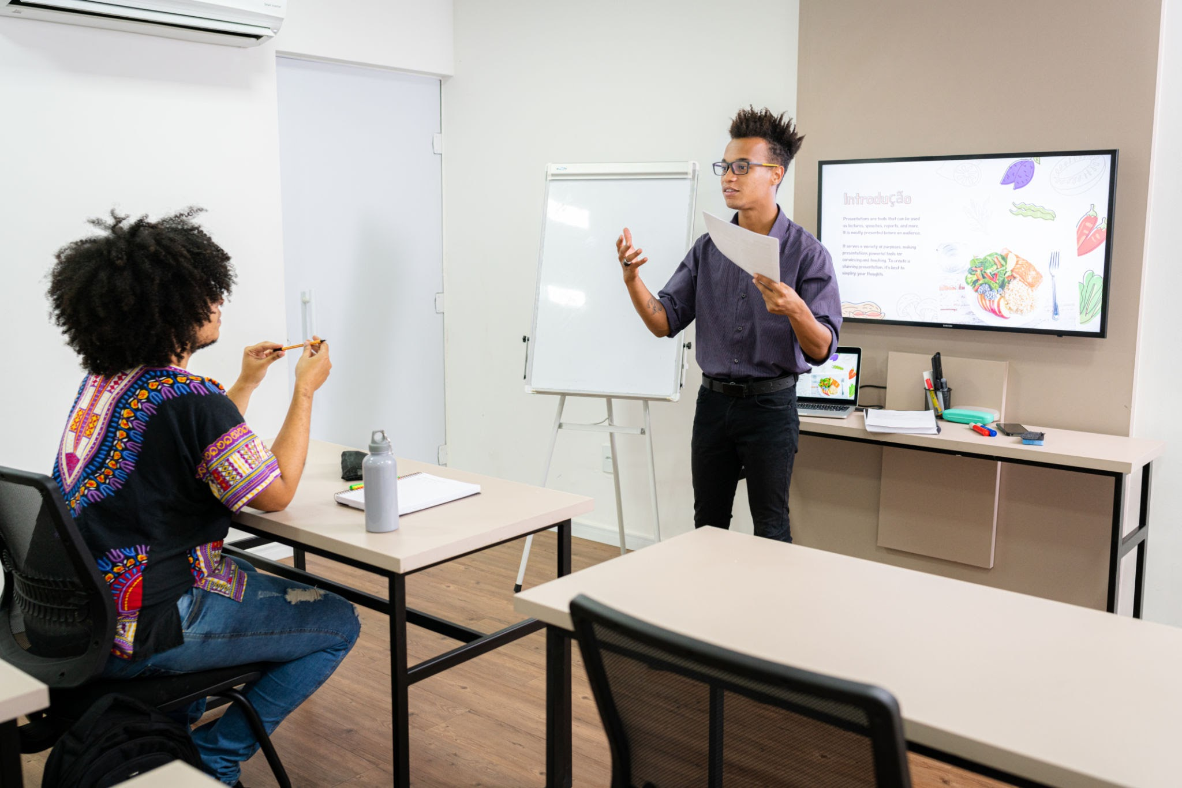
Assessment Ideas
Mock Interviews:
Test conversational skills and presentation.
Project-Based Learning: Provide an issue to be solved.
In-person presentations:
Showcase communication and synthesis skills.
Notes:
To build durable skills in the age of AI, assessments should require learners to perform as themselves, demonstrating competencies that cannot be outsourced to a machine. This mirrors the real demands of the workforce.
These assessment methods focus on developing and evaluating the essential human sills: critical thinking, communication, and interpersonal skills that employers value and AI can only augment, not replace.

Slide 40

Quick Assessment Redesign (5 min)
Revisit the lesson you analyzed earlier. In pairs or groups, discuss the following:
Name ONE change that would make this assessment/lesson plan AI-resilient and more authentic for learners to demonstrate their understanding.

Slide 41

The Big Picture
AI Literacy as Community Practice
Teach When Not to Use AI
Instructors model curiosity.
Learners build judgment.
Continuous learning and adaptation.
Cultivate critical discernment in learners about appropriate AI usage.

Slide 42
Your Takeaways
Before you leave, set one concrete goal. Complete this sentence:
“On Monday, to make my AI use more [ Safe / Ethical / Effective ], I will
____________________________.”

Slide 43
References
AI for Education. (2026). The SEE framework: A practical guide to building generative AI literacy. https://aiforeducation.io
Capraro, V., Lentsch, A., Acemoglu, D., Akgun, S., Akhmedova, A., Bilancini, E., . . . Viale, R. (2024). The impact of generative artificial intelligence on socioeconomic inequalities and policy making. PNAS Nexus, 3(6), pgae191. https://doi.org/10.1093/pnasnexus/pgae191
Diliberti, M. K., Lake, R. J., & Weiner, S. R. (2025). More districts are training teachers on artificial intelligence: Findings from the American School District Panel. RAND. https://www.rand.org/pubs/research_reports/RRA956-31.html
Freeman, J. (2025). Student generative AI survey 2025 (Policy Note 61). Higher Education Policy Institute. https://www.hepi.ac.uk/reports/student-generative-ai-survey-2025/
Kharbach, M. (2026). What AI-literate students do differently. https://www.medkharbach.com
Liang, W., Yuksekgonul, M., Mao, Y., Wu, E., & Zou, J. (2023). GPT detectors are biased against non-native English writers. Patterns, 4(7), 100779. https://doi.org/10.1016/j.patter.2023.100779
LinkedIn. (2025). AI and the global economy: Unlocking growth and reshaping work. https://economicgraph.linkedin.com/content/dam/me/economicgraph/en-us/PDF/ai-and-the-global-economy.pdf
Perkins, M., Roe, J., Vu, B. H., Postma, D., Hickerson, D., McGaughran, J., & Khuat, H. Q. (2024). Simple techniques to bypass GenAI text detectors: Implications for inclusive education. International Journal of Educational Technology in Higher Education, 21(53). https://doi.org/10.1186/s41239-024-00487-w
Pew Research Center. (2026). How teens use and view AI. https://www.pewresearch.org/internet/2026/02/24/how-teens-use-and-view-ai/
Powers-O'Brien, A., & Rochman, A. (2025). Generative AI in uncertain times: How teens are navigating a new digital frontier. Family Online Safety Institute. https://fosi.org/research/generative-ai-in-uncertain-times-how-teens-are-navigating-a-new-digital-frontier/

Slide 44

Session Survey
Your feedback is important. Please scan the QR code below to rate this session.

