Slide 1
Ask Pearson Testing! Question and Answer Time with Experts
Natalie E. Cummins

Slide 2


Your Pearson Representative
Natalie E. Cummins
Specialist, Test Center Support
Pearson Professional Assessments
Liaison between GED Testing Service and Pearson regarding testing centers
Former adult educator and GED Administrator™

Slide 3
This is your time!
Some common questions I receive:
Who do I contact with technical issues?
Who can answer Online Proctored questions?
How do I become a GED® testing center?
I have an active application, but I haven’t heard anything. Who do I talk to?
Now let’s hear yours!

Slide 4

Natalie E. Cummins
Specialist, Test Center Support
Pearson
(859) 285-7099
gedccom@pearson.com

Slide 5

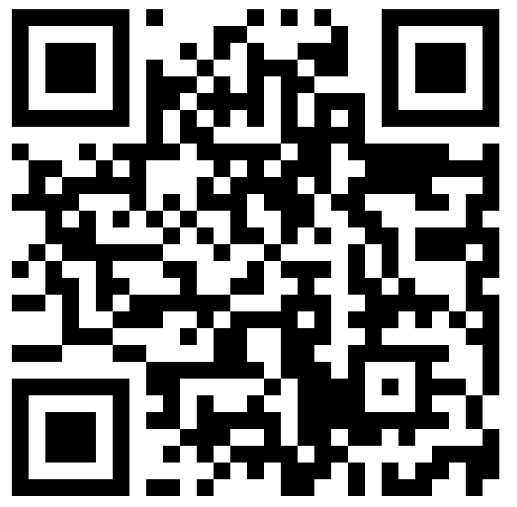
Session Survey
Your feedback is important. Please scan the QR code below to rate this session.

