Slide 1

Using Practice Test Data to Accelerate Student Progress Without TABE Barriers
Dr. Jeff Arnott, President of Lot 12 Education – Las Vegas, NV

Slide 2
#1
#4
Understand why TABE / CASAS can become a barrier for some learners.
Explore alternative instructional models that shorten time to credential.
#2
#5
Examine how GED Ready predicts GED success.
Leave with practical implementation ideas.
#3
#6
Learn how programs can use practice test data to drive instruction.
Question and answer session.

Slide 3

The Challenge
Many adult learners:
Need employment quickly
Lose motivation after multiple assessments
Become frustrated with long testing cycles
Spend months preparing for assessments instead of earning credentials
Question
Are we measuring learning...or delaying opportunity?

Slide 4

Why We Use TABE / CASAS
TABE / CASAS helps programs:
Determine instructional level
Meet accountability requirements
Measure Educational Functioning Level gains
Guide instructional placement
But...
TABE was never designed to predict GED success.

Slide 5
The Problem….
Common challenges include:
Students score low on TABE / CASAS but perform well on GED content.
Learners become discouraged after repeated testing.
Programs spend valuable instructional time preparing for TABE / CASAS instead of the GED.
Students leave before earning a credential.
Barrier ≠ Ability

Slide 6
A Different Question…
Instead of asking:
"Has the student gained enough TABE / CASAS points?"
Ask:
"Is the student ready to pass the GED?"
The goal is employment and postsecondary success—not simply higher assessment scores.

Slide 7

Why GED Ready Matters!
GED Ready:
Developed by GED Testing Service
Predicts likelihood of passing the official GED
Uses actual GED item types
Provides diagnostic skill reports
Gives students immediate feedback
It measures readiness for the actual goal.

Slide 8

The Power of Practice Test Data
Practice test reports provide:
Strengths
Weaknesses
Standards needing remediation
Estimated passing probability
Individual skill analysis
This creates a personalized learning roadmap.

Slide 9

Data-Driven Instruction
Traditional Model: TABE / CASAS → Class → TABE / CASAS → Class → TABE / CASAS
Alternative Model
GED Ready
↓
Analyze Skills
↓
Target Instruction
↓
Retest
↓
Official GED
More targeted instruction.

Slide 10

Using Diagnostic Reports
Instead of reteaching everything, focus only on:
Number Operations
Algebra
Reading Comprehension
Science Practices
Extended Response
Social Studies reasoning
Teach exactly what students need

Slide 11

Individual Learning Plans
Each student receives:
GED Ready Test Scores
Skill gaps
Learning assignments
Short-term goals
Practice schedule
Retesting timeline
Students clearly understand: "What do I need to learn next?"

Slide 12
Accelerating Instruction
Move away from:
Time-based instruction
Toward
Mastery-based instruction
Students progress when they demonstrate competency—not when the calendar says so.

Slide 13

Technology Can Help
Use:
Learning management systems
Online practice
AI tutoring
Adaptive learning platforms
Digital diagnostics
Technology helps personalize instruction at scale.

Slide 14

Sample Student Journey
Enrollment
↓
Orientation
↓
GED Ready Practice Test
↓
Diagnostic Analysis
↓
Targeted Lessons
↓
Retake GED Ready
↓
Official GED Test
↓
Career or College

Slide 15

Benefits for Students
Students experience:
Faster progress
Clear learning goals
Greater confidence
Less testing fatigue
Earlier credential attainment
Improved motivation
\

Slide 16

Benefits for Programs
Programs gain:
More efficient instruction
Better student persistence
Increased credential attainment
Improved transition outcomes
Better use of instructional time
Stronger student engagement

Slide 17
Considerations
Programs should still:
Meet state assessment requirements
Follow NRS accountability guidelines
Use TABE / CASAS when required
Ensure instructional quality
This is not replacing accountability—It improves instructional decision making.

Slide 18
Implementation Steps
Review current assessment practices.
Train instructors on GED Ready Enhanced Score Reports.
Create individualized learning plans.
Align instruction to GED skills.
Monitor progress with practice data.
Celebrate quick wins.
Utilize Teaching Resources on GED.com
  Performance Level Descriptors
  High Impact Indicators
  Assessment Guide for Educators

Slide 19
Discussion Questions
How could your program:
Reduce unnecessary testing?
Increase instructional efficiency?
Better use practice test diagnostics?
Help students reach GED success sooner?

Slide 20
Key Takeaways
Keep the focus on student outcomes.
Use data that directly predicts success.
Personalize instruction.
Remove unnecessary barriers.
Help students earn credentials faster.
The goal is changing lives through successful GED completion.

Slide 21
Closing Activity
Scenario: A student:
TABE Reading: Low Adult Secondary
TABE Math: High Intermediate
GED Ready Reading: Green
GED Ready Social Studies: Green
GED Ready Math: Yellow
GED Ready Science: Yellow
Ask:
Would you continue TABE preparation?
What instructional plan would you create?
Which GED test would you recommend first?
What supports would you provide?
Notes:
Optional Closing Activity (10–15 minutes)
Have participants work in small groups.

Slide 22
Questions?
"Every assessment should move students closer to success—not become another obstacle on the path.“
Notes:
This presentation is likely to resonate well with adult education directors and instructors because it doesn't argue against TABE's accountability role; instead, it reframes how programs can use GED Ready diagnostic data as an instructional tool to personalize learning, reduce unnecessary delays, and accelerate students toward their ultimate goal: earning the GED.

Slide 23
Thank You!
Dr. Jeff Arnott
Jeff@Lot12Education.com
X @ JefferyArnott
LinkedIn @JeffArnottEd.D.
407-719-7123

Slide 24

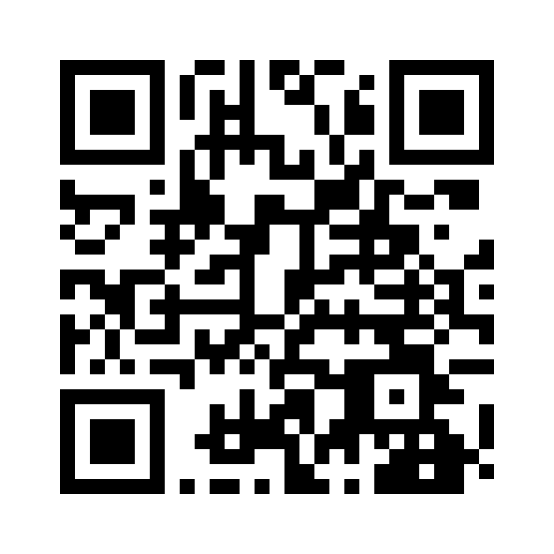
Session Survey
Your feedback is important. Please scan the QR code below to rate this session.
QR CODE PLACEHOLDER

