Slide 1
All About Accommodations
Mellissa Hultstrand & Brian Smith

Slide 2

Agenda
Overview
Disability Categories
Accommodation Process
Documentation Requirements
Best Way to Assist
Questions

Slide 3
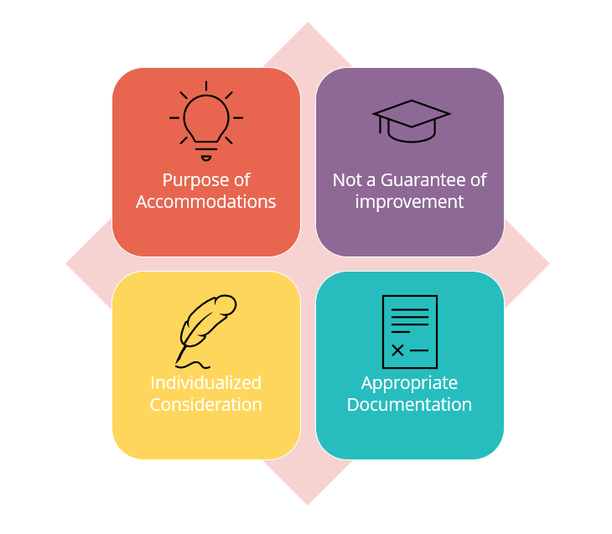
Accommodations Overview
Notes:
*Accommodations are not a guarantee of improved or passing scores, but are intended to level the playing field and provide access

Slide 4

Categories of Disabilities
Learning and Other Cognitive Disabilities Documentation within the last 5 years | Attention Deficit Hyperactivity Disorder Documentation within the last 5 years | Psychological and Psychiatric Disorders Documentation within the last 1 year | Physical Disorders and Chronic Health Conditions Documentation within the last 1 year
Notes:
*the importance of documentation guidelines, which are available on the GED.com accommodations page, and highlighted the need for programs to encourage students to submit documentation even if it is older.

Slide 5
Requesting Accommodations
Create an account at GED.com
  Click yes to the question about accommodations (modified testing)
  Create an account in the GED Accommodations Request System
  Only click the activation link once
  Contact accommodations@ged.com with questions/concerns
Notes:
*Each accommodation request is considered individually, with documentation generally required within the last five years
*a letter from a teacher of a student who is blind can be accepted – meaning the teacher can write it. Does not have to be from a doctor
*provision of written explanations for incomplete or denied requests.

Slide 6
Important Update
Effective August 1, 2023, accommodation approvals will be valid for 2 years.
(some exceptions apply)

Slide 7
What is NOT considered a disability?
ESL (English as Second Language)
“Slow Learner”
Active substance abuser
Test Anxiety
Homemade diagnoses

Slide 8

Reader/
recorder
Extra Time
Separate Room
Extra “stop-the-clock” breaks
Commonly Requested Accommodations
Notes:
*100% extra time is almost always approved for reader/recorder requests and that the accommodation team will review and reach out as needed.

Slide 9

Documentation Guidelines
Review documentation guidelines:
https://ged.com/about_test/accommodations/

Slide 10

Accommodation Request Volume – National
Year | Total Requests | Approved/Partial Approval | Incomplete | Denied
2026 | 4,411 | 3,918 | 473 | 20
2025 | 6,932 | 6,068 | 818 | 46
2024 | 7,621 | 6,300 | 1,278 | 43

Slide 11
Accommodation System Features
Online Request System
Candidates request accommodations online. Starts with them clicking “yes” to the accommodation question on GED.com
Web Rescheduling
Candidates with approvals of extra time, breaks and other things that do not require manual intervention are directed to schedule online. nice point to be made

Slide 12

Assistive Technology
Universal Access
features
Adaptive
equipment
Magnification
JAWS
Notes:
*Universal Access Features – font is up to 20 point font, highlight and color contrast is available for everyone. IF they need font size that is larger than 20 point then they will have to request the accommodation
*Correct terminology is “JAWS proficient”
*GED Testing Service pays for all accommodations, including adaptive equipment like keyboards and mice, and ships them to test centers for student use.

Slide 13



Emerging Trends in Accommodations and Accessibility
Accommodation vs Fundamental Alteration
Accommodations vs Security
Non-standard requests
Notes:
*non-standard requests include sit/stand work station and lights out
*including allowing cell phones for medical monitoring with proper accommodation approval

Slide 14

Outer Limits of Accommodations
Unlimited time
The accommodation cannot be so extreme that test validity is compromised
Waiving a portion of the test
The accommodation cannot fundamentally alter the test’s purpose
Administer medical care
The accommodation cannot jeopardize test security or the safety of staff/others
Notes:
*accommodations cannot fundamentally alter the test or compromise security*100% of time is most available
*PCA is personal care attendant – test centers can not assist with health care – all they can do is call 911
-they can apply for accommwodatins for this person (PCA) to be at test center and even in the room.
*test anxiety alone is not sufficient for accommodation approval; documentation must indicate a diagnosis of generalized anxiety, and teachers should empower students to request proper testing and documentation.
*Debbie explained that ESL status and test anxiety are not considered disabilities under ADA, encouraging programs to look for other qualifying conditions and to document effects of medication or other disabilities if present.

Slide 15
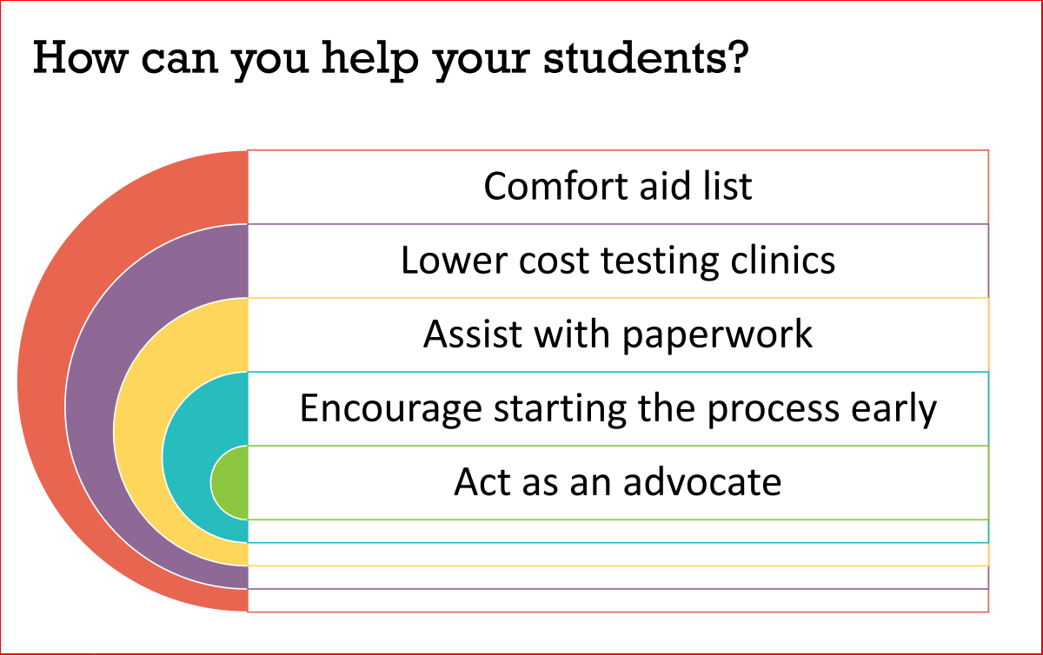
Notes:
*lower cost test clinics – old list but could contact university psychology dept because they might have students who could do the testing or Shriner’s.
*Also, there are federally qualified health centers. Almost all counties will have access to one of these:

Slide 16
Federally Qualified Health Centers
They operate under a federal grant.
They are required to serve under insured and provide service on a sliding fee scale.
Anyone can go there with or without insurance.
They have yearly reporting requirements and are reviewed yearly and have extremely high quality healthcare.
Most have multiple services including primary health care, dental, and mental/behavior health services.
Most have access to a psychiatrist if needed for certain types of assessments, and most have either psychologists or social workers who can do a lot of the assessments needed also.

Slide 17
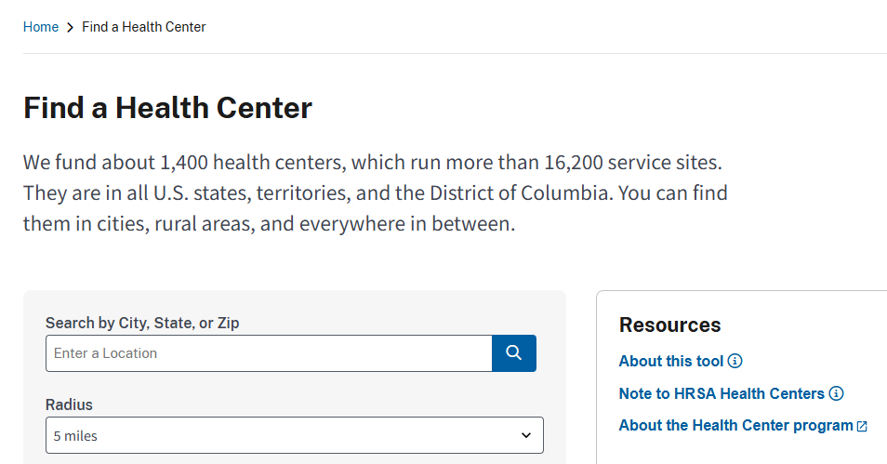
Federally Qualified Health Centers
https://findahealthcenter.hrsa.gov/

Slide 18

Resources on the Accommodation Page
Frequently Asked Questions
Lower-cost Testing Clinics in the United States
Personal Items and Minor Modifications
Questions? Email accommodations@GED.com

Slide 19
Scheduling Information
The determination letter will have scheduling instructions
Separate room approvals require a call back
Approvals of reader and recorder require 8 business day lead and a call back
If there is no answer when the agent calls back and they are unable to leave a message, an email will be sent to the candidate's email
If the advocate should receive the call back, tell the scheduling agent the name and phone number to call
If a message is left with an appointment offer, it is only for 2 days. After the two days, the candidate must call again
Candidates and advocates should not call test centers directly

Slide 20
New Form Option
??????
?????

Slide 21
Your State Relationship Team
Brian Smith, Director
Brian.Smith@ged.com
Mellissa Hultstrand
IL,MI,MN,TN,VT,WI,
PR,VI
Mellissa.Hultstrand@ged.com
Scott Salesses
MA,NY,FBOP
Scott.Salesses@ged.com
Adora Beard
DC,DE,MD,VA,PA,PR
Military
Adora.Beard@ged.com
Lisa Pool-Osorio AK,AZ,CA,ID,NV,OR,UT, WA, Guam
Lisa.Pool-Osorio@ged.com
Diane Vaccari
CT,FL,KY,NH,NJ,OH,RI,,WV
Bermuda
Diane.Vaccari@ged.com
Liz Lanphear CO,HI,IN,KS,MO,NE,NM,ND,SD
Elizabeth.Lanphear@ged.com
Shawn Watts
AL,AR,GA,LA,NC,SC
Shawn.Watts@ged.com
Jonna McDonough
CA,MS,MT,OK,TX,WY
Jonna.Mcdonough@ged.com

Slide 22

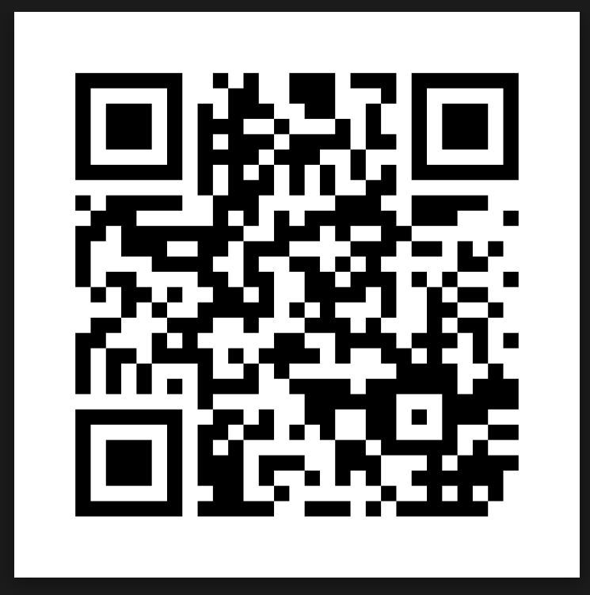
Session Survey
Your feedback is important. Please scan the QR code below to rate this session.

Slide 23
Questions

Slide 24

Contact
Information
Mellissa Hultstrand
State Relationship Manager
Mellissa.Hultstrand@GED.com
Accommodations@GED.com
Brian Smith
Director, State Accounts & Government Relations
Brian.Smith@GED.com

