Slide 1
Accessibility in Action
Designing GED Prep & Assessment for Every Learner
Jane Bledsoe, Product Portfolio & Technology Director

Slide 2
Session Overview
01
04
Why Accessibility is Important for GED Learners and Educators
From Accessibility Reviews to Action
02
05
Accessibility Frameworks for Adult Learners
Designing For Real Learners
03
06
Accessibility Across the GED Ecosystem
Teacher-aligned practices

Slide 3



Session Goals
Understand accessibility standards, frameworks and barriers.
Aligning to accessibility frameworks and standards improves access to GED test content, study tools and educator materials.
Discover how and why GEDTS is focused on accessibility.
Accessibility reviews, remediation, and training improve GED products and services.
Identify practical strategies for the classroom.
Our goal is that you leave with at least one new idea for your teaching materials and practices to support diverse learners.

Slide 4
Why is Accessibility Important for GED Learners and Educators?
U.S. Disability and GED Testing Statistics

Slide 5

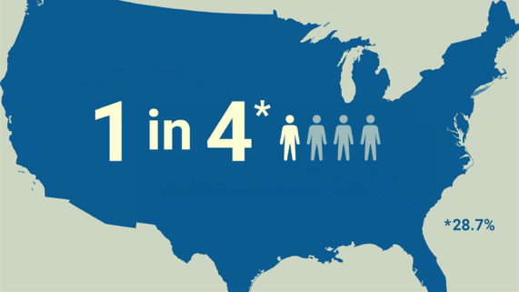

2025 Disability Statistics
15-20%
of the world’s population lives with some form of disability
1 in 4 adults
in the U.S. have some type of disability
15%
of school-aged children in the U.S. receive special education services
Notes:
The adult learners we serve come from a diversity of backgrounds, education, and life experiences. They have a diversity of abilities and learning challenges, and our purpose is to help all of them have a fair GED testing journey.

Slide 6
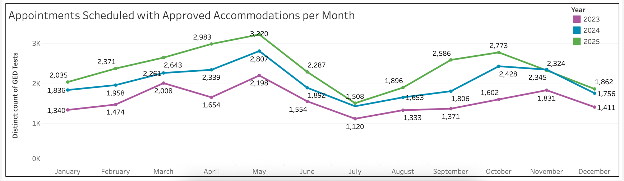
GED Accommodations Statistics
66% increase from 2023 to 2025
GED Tests booked with accommodations increased from 18,000 per year to 28,500 over a 3-year period.
Notes:
Data statistics from Tableau Dashboard
Our GED data shows a 66% increase over 3 years in the number of GED test takers with accommodations for tests scheduled at the Pearson Vue test centers.
That's an increase from18,800 people in 2023 to 28,500 in 2025.
This data puts us on notice that accessibility should be a key focus for GED.
Prior to 2024, we were releasing online products and tools without really thinking about how accessible they were. Not until we started doing accessibility reviews, did we learn what was blocking some learners from accessing our education content and tools.
In the last 2 years, GED has changed the way it works. We have a regular cycle of accessibility audits revealing where we can make improvements.
However, with global standards being continually updated, and rapidly changing technology we now find ourselves in a constant state of refinement with our products and delivery platforms,

Slide 7
Accessibility frameworks for Adult Learners
A plain language overview of accessibility standards, inclusive design and universal design principles
Notes:
Modern accessibility frameworks increasingly view accessibility as an ongoing process rather than a checklist. In adult education, this means continuously improving learning materials, assessments, and technology based on learner feedback, advances in technology, and evolving best practices.

Slide 8

Quick Poll 1
Are you familiar with any of these accessibility frameworks?
Web Content Accessibility Guidelines (WCAG)
The P.O.U.R principles
Universal Design for Learning (UDL)
QR CODE PLACEHOLDER

Slide 9
What's your familiarity with these accessibility frameworks: WCAG (Web Content Accessibility Guidelines), the P.O.U.R. principles and UDL (Universal Design for Learning)?
Do not edit
How to change the design
The Slido app must be installed on every computer you’re presenting from

Slide 10

WCAG - Web Content Accessibility Guidelines
What is WCAG?
Internationally recognised standards for making digital content accessible to people with disabilities.
Examples for Adult Educators
Clear headings
Logical structure
Readable fonts
Captions for videos
Sufficient colour contrast
Screen-reader compatible documents
Accessible online testing platforms
Notes:
2.1 Web Content Accessibility Guidelines (WCAG)
Created by the global W3C organisation, WCAG provides internationally recognized standards for making digital content accessible to people with disabilities. The framework focuses on ensuring content is perceivable, operable, understandable, and robust.
Accessibility audits are based on alignment to the WCAG standards criteria and the U.S. Section 508 standards.

Slide 11
The four P.O.U.R Principles
1.Perceivable
Alternative text for images
Video captions
High contrast color between text and backgrounds
Textual clues alongside color
2.Operable
Keyboard navigation
Extending time limits
Skip to main content links
3.Understandable
Plain language
Clear helpful error messages
Form fields have labels
Consistent navigation
4.Robust
Properly structured documents and code
Compatibility across devices and operating systems
Remains usable as technologies evolve
Notes:
2.2 The four P.O.U.R principles
The four key principles created by WCAG are the foundational framework for digital accessibility. These are the criteria that we consider when creating digital material for learners.

Slide 12
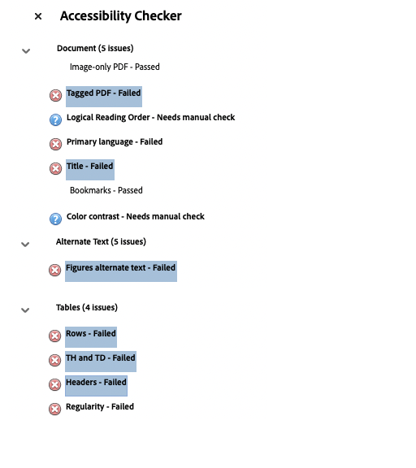
PDF Example- non accessible
Notes:
Let’s use a PDF document to show the application of some of the WCAG criteria.
GED provides learners, educators and administrators with reference guides and study guides in PDF forma including this Math formula sheet
A customer recently let us know that the Math Formula Sheet reference guide was not formatted for accessibility when a screen reader user tried to use it.
Slide- annotated -Math Formula Sheet PDF
Adobe Acrobat has an accessibility checker that indicates any accessibility issues in a PDF.
This is an image of a section of the document before corrections and to the right is a screen shot of the Accessibility Checker that highlights the items that ‘failed’:
The document's underlying structural markup is not coded with accessibility tagging- this is a major blocker for screen reader and keyboard navigation access
The document title is not tagged as ‘title’ or an ‘H1’ heading to call out the title of the document
No alternative text tagging is present to describe the GED logo (figure)
Tables are not tagged with header rows and data cells for screen reader/voice over navigation, so the user can't read through the table content and identify the logical order of the content.
If you wanted to do some checking with your own PDFs, you can use Adobe Accessibility Tracker, or you can also use Copilot or AI to scan the document and make suggestions to you for fixes

Slide 13
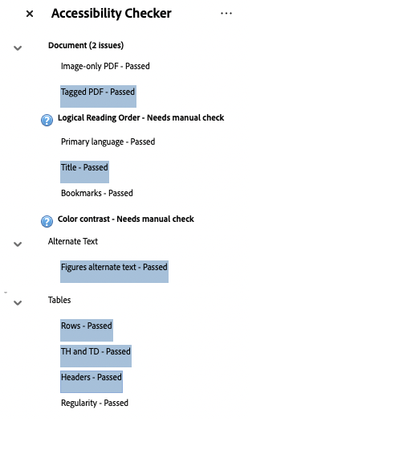
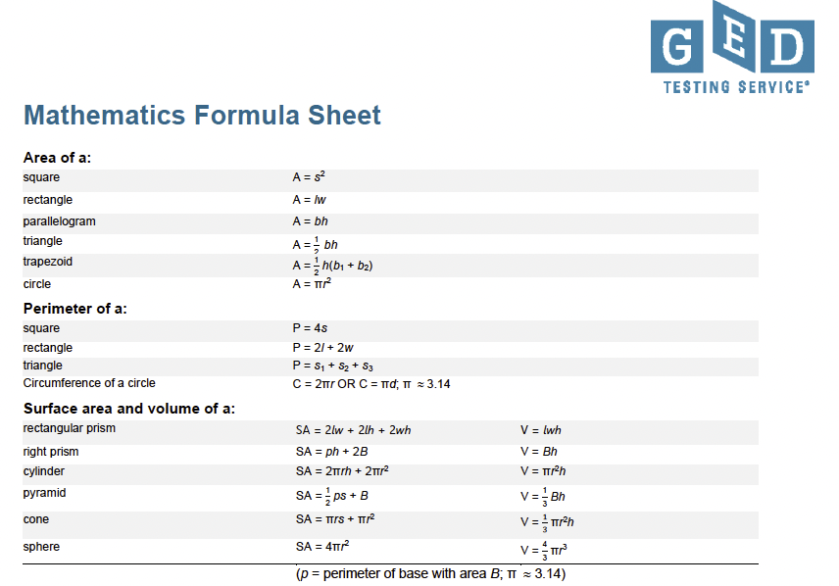
PDF Example- accessible
Notes:
In the corrected version of the document, you can see that those issues are checked as ‘passed’. These corrections are non-visible when you look at the document – they are provided in the underlying structural markup code that determines the format of the document data.
What you can see is that the colors have also been modified to align with color contrast standards, updates have been made to font style and size for readability, and some content is simplified.
The reference sheet was corrected to meet accessibility needs and both the English and Spanish corrected versions have been updated on the ged.com website.
The changes made help with the concepts of Perceivable, Operable, Understandable and Robust
GED has more than 1,000 PDF links from GED.com; we are in the process of ensuring they are all accessible.

Slide 14
Universal Design for Learning (UDL)
3 Principles
Multiple ways for learners to engage with content (the “WHY” of learning)
Multiple ways to present information to learners (the “WHAT” of learning)
Multiple ways for learners to demonstrate learning ( the “HOW” of learning)
Adult GED Education
Adjust the design, not the learner
Offering lessons in text, audio, and video formats
Allowing learners to complete assessments orally or digitally
Giving learners choices that connect content to real-life goals such as employment, parenting, or further education
Notes:
Universal Design for Learning (UDL) is a teaching framework that helps educators design learning experiences that are flexible and accessible for all learners from the beginning, rather than adding accommodations later.
UDL is based on three principles:
Multiple ways for learners to engage with content
Multiple ways to present information to learners
Multiple ways for learners to demonstrate learning (the “How” of learning)
Instead of expecting learners to adapt to one teaching method, instructors can adapt teaching practices to meet varied learner needs.
In adult GED education, accessibility considerations might include
Offering lessons in text, audio, and video formats (GED Mobile App may expand your variety of options!)
Allowing learners to complete assessments orally or digitally
Giving learners choices that connect content to real-life goals such as employment, parenting, or further education.

Slide 15
Accessibility Across the GED Ecosystem
Considering accessibility in content development, digital tools, prep experiences, and testing environments

Slide 16
GED Accessibility Strategy
GEDTS Accessibility Program
Audits
Compliance documentation
Issues remediation
KPI reporting
Accessibility by Design
Content guidelines for accessibility
Accessibility checklists related to WCAG
QA during development and before release
Internal Accessibility Training
User impact
Frameworks and standards
Design for learning
Fundamentals of Accessibility in Digital Environments
Everyday Accessibility
Digital Accessibility Best Practices for Product and Content Development
Notes:
In late 2024, GED Testing Service adopted an Accessibility Strategy and Policy that supports us to meet global WCAG standards for accessibility in our online study prep tools, assessment content, platforms and services.
We now audit and remediate accessibility of all our study prep tools on a regular cycle aimed at continuous improvement.
GEDTS Accessibility Program:
A dedicated Accessibility Program lead manages a schedule of GED product accessibility audits and documentation, accessibility training for internal employees, accessibility knowledge sharing.
Accessibility KPI reporting for GED leadership makes GED accountable for measuring and improving the accessibility of our products and services.

Slide 17

GED Commitment to Product Accessibility
Q2 Update | Progress, priorities, and next steps
Q2 focus: Move from audit visibility to execution — complete high-priority remediation, keep accessibility QA embedded in release workflows, and scale accountability through training & champions.
TRAINING REACH
COMPLETION
TEAMS
MOBILE APP
96
44%
6
100%
team members allocated
training courses completed to date with goal of 80% by EOY
cross-functional teams working on Accessibility
Oof remediation issues complete by Q3
Accessibility feature updates
Governance & operating model
GED Manager
39
items
VPAT coverage
GED & Me
84
items
Current VPATs in place for GED.com, Manager, Ready, Test; GED & Me Mobile App, and updated GED Flash VPAT Q3 2026
GED Ready
47
items
Accessibility QA embedded
QA is built into development workflows for new and updated products.
Priority: issues are remedied within months of identification and VPATS are updated for public use
*Note that there are always accessibility features we can improve; and we are on a bi-annual cadence to review all products again
Champions Network launches
Accessibility Champions Network begins activities in July across product, technology, operations and assessment.
Q3 next up
Complete GED Flash Student VPAT and resolve any remediation items.
Source: GED Accessibility Audit - Q2 update email from Lisa Woodland, received July 9, 2026
Notes:
Speaker notes:
Use this slide to reinforce that Q2 accessibility work is shifting from reporting visibility into execution discipline. The biggest leadership themes are: identifying and developing accessibility solutions; maintaining accessibility QA in development workflows; and using the Accessibility Champions Network to support broader accountability.
[Sources]
Email: GED Accessibility Audit- Q2 update, from Lisa Woodland, received July 9, 2026.
Visual on this slide was generated with Microsoft Copilot.

Slide 18


Accessibility in action
Accessibility by Design: build accessibility requirements in from the start of development, not as a fix after release.
Built in from the start
Accessibility is considered in the initial development of new content and products, the preferred quality standard and a major saving versus post-release remediation.
WCAG-based checklists
Accessibility checklists based on WCAG standards are integral to the content, product and technology teams' development and QA processes.
Embedded QA & testing
Accessibility QA and testing is built into the production and product lifecycle during development and before release.
1
2
3
Examples in action
Alt Text for New Practice Questions-Diagrams
New study practice questions have accessibility built into the content briefs, such as alt text for math diagrams, with accessibility QA checks during content review and approval.
GED Accessible Free Practice Test
The Accessible Free Practice Test embeds accessibility requirements and QA into the initial content development and product UX design stages.
Notes:
Accessibility by Design means designing products and services with accessibility requirements included at the beginning of development.
GED now considers accessibility requirements in the initial development stages of new content and products, not just when an audit review after product release highlights issues to be fixed. Not only is this a preferred option for embedded quality standards, but it is a huge cost saving compared to post release remediation.
Accessibility checklists based on the WCAG standards are an integral part of the content, product and technology teams’ development and QA processes.
Accessibility QA and testing is embedded in the production and product lifecycle during development and before release.
Examples:
GED Testing Service is developing new study practice questions with accessibility requirements built into the briefs for content creation- such as alt text for Math diagrams.
During the initial content review and approval process, there are QA checks that include accessibility considerations.
We are currently working with a vendor on an Accessible Free Practice Test that has embedded accessibility requirements and QA into the initial content development and product UX design stages.

Slide 19
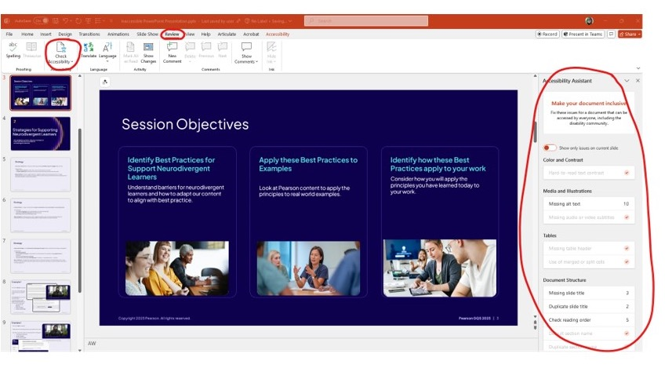
PowerPoint Accessibility- Accessibility Checker
Using the inbuilt Accessibility Checker to catch issues and walk you through how to make changes
Notes:
Internal Accessibility Training
GED employees in product, assessment, technology, operations, student support and marketing have accessibility training goals that enable an improved understanding of
user impact
frameworks and standards
design for learning
We are building shared accessibility knowledge and capability across the GED teams.
Training includes learning modules provided by the Pearson Quality Standards group to include the latest accessibility standards, tools and best practices.
Examples:
Within that training we have seen examples of the visual challenges that our own colleagues who are color blind must deal with in everyday working situations.
And a colleague with low vision, who demonstrated by video how a screen reader can’t navigate through on-screen content on a website that is not formatted correctly and misses content entirely that is not coded correctly.
As far as everyday working examples go, it has been enlightening to learn that how we format power point presentations, word and PDF documents determines how accessible those documents are for others including our own colleagues.
Example -Powerpoint presentations
As an example, let's look at how you can work with PowerPoint presentations to improve accessibility.
Using the inbuilt Accessibility Checker to catch issues - the checker tool walks you through each of the issues and how to make changes
Providing alt text descriptions for diagrams supports people with low vision and color blindness. Presentations are more likely to have complex graphics requiring descriptions. You can easily add alt text in the alt text panel.
Correct Reading Order is visible on the PPT outline panel – this assists screen readers and aids with a logical, understandable flow of content. Each item can be reordered from the list.
The Outline view on the left provides text only view-perfect for access to content for those overwhelmed by visuals and formats. It indicates if correct formatting of content placeholders for text and images has been applied. Content missing in the outline view can create navigation and reading-order problems,

Slide 20
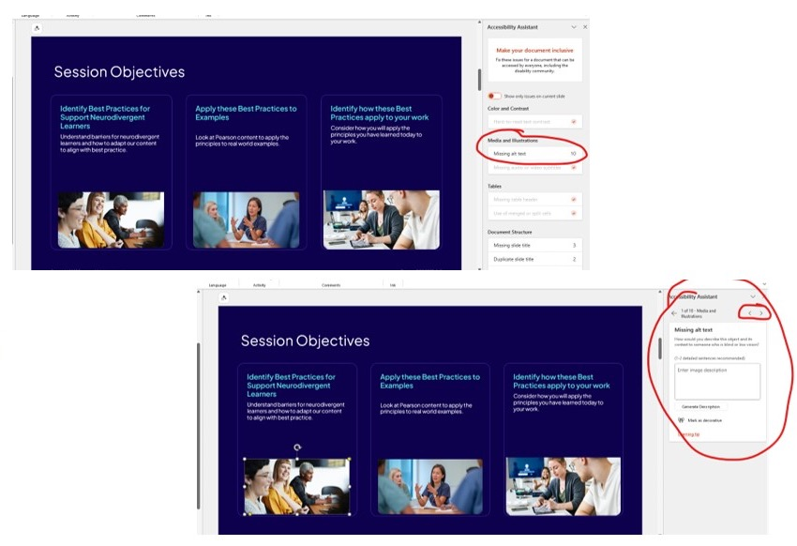
PowerPoint Accessibility- Alt text
The same rule applies to alt text in presentations as it does in documents.
PowerPoints are more likely to have complex graphics requiring detailed descriptions.
Notes:
Providing alt text descriptions for diagrams supports people with low vision and color blindness. Presentations are more likely to have complex graphics requiring descriptions. You can easily add alt text in the alt text panel.

Slide 21
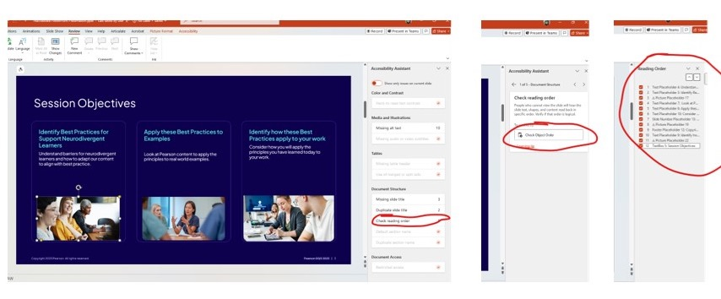
PowerPoint Accessibility- Reading Order
Reading order tells assistive technology, like a screen reader, the order in which the content on the slide should be interacted with
Notes:
Correct Reading Order is visible on the PPT outline panel – this assists screen readers and aids with a logical, understandable flow of content. Each item can be reordered from the list.

Slide 22
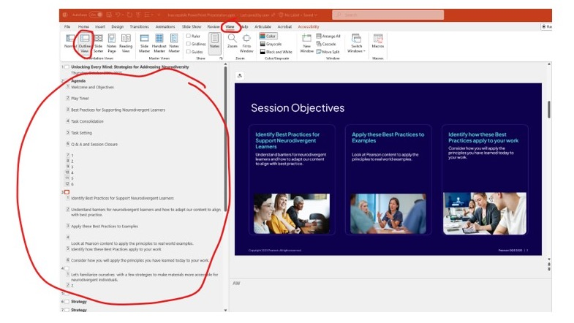
PowerPoint Accessibility- The Outline View
The PPT outline panel provides a text-only view perfect for people overwhelmed by too many visuals or formatting.
You can also check correct formatting for assistive technology.
Notes:
The Outline view on the left provides text only view-perfect for access to content for those overwhelmed by visuals and formats. It indicates if correct formatting of content placeholders for text and images has been applied. Content missing in the outline view can create navigation and reading-order problems,

Slide 23

GED testing platforms and environments
On-screen visual adjustments
Color and contrast settings
Magnification/Zoom
Font Scaling/Text Size
Highlighting tools and navigation supports
User accommodations
Extended testing time
Additional/extended breaks
Permission to use assistive technology
Separate private testing room
Reader and recorder (scribe) support
Notes:
GED Test platforms and testing environments:
Pearson VUE test centers delivering the GED Test provide test takers with a combination of timing adjustments, alternative testing environments, physical accessibility, assistive tools, and on-screen accessibility features.
The GED test and practice test have on‑screen visual adjustments enabled for all test takers.
Color and Contrast settings
Magnification/Zoom
Font Scaling/Text Size
Highlighting tools and navigation supports
Specific user accommodations can be requested. These include
Extended Testing time
Additional/extended breaks
Permission to use Assistive technology
Separate Private testing room
Reader and recorder (scribe) support
Enhanced accessibility versions of the GED Test and the GED Ready suitable for use with screen readers are available through the accommodations service.

Slide 24
From Accessibility Reviews to Action
What reviews look like, why they matter, and how findings translate into better learner experiences

Slide 25
GED Accessibility Reviews
Products Tested
GED.com website
GED Ready®
GED Manager™
GED & Me™ Mobile App
GED® Test
What do we test?
Consistent keyboard navigation
Navigation for screen readers
Logical heading order for content navigation and understanding
Labelling and functioning of links and buttons
Color contrast of text to background
Alternative text for images
Video captions and audio alternatives
Format and style of text content
Notes:
In 2025 GED conducted professional accessibility reviews on our delivery platform GED.com, on Study Prep tools such as GED Ready and the GED & Me Mobile app.
The GED official test was also reviewed to enable accessibility improvements to be applied when the test is updated. GED Flash for students has a review underway now
An accessibility review is an independent external review and testing of a digital product, platform or service conducted by a qualified accessibility specialist.
Testing is undertaken across a range of digital devices, browsers and tools.
The review tests alignment to the WCAG standards and reports on issues that don’t meet standards and may impact accessibility such as:
Consistent keyboard navigation for screen readers
logical heading order for content navigation and understanding
labelling and functioning of links and buttons
color contrast of text to background
alternative text for images
video captions and audio alternatives
format and style of text content to reduce cognitive load
The audit forms the basis of a technical report that GED can use to plan and prioritise fixes for any accessibility issues. The report enables us to act quickly to fix major functionality accessibility blockers for learners and provides the information our technology teams need to plan any additional remediation.

Slide 26
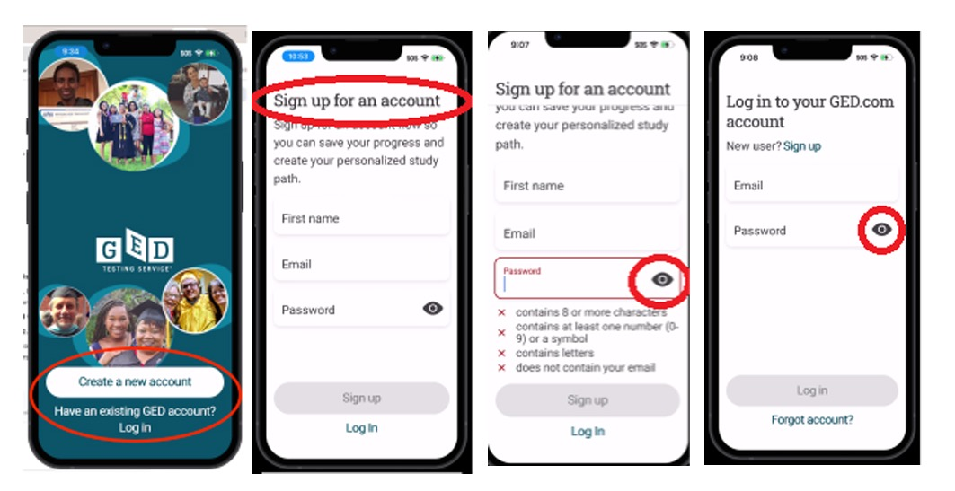
Example: GED & Me Mobile App
Notes:
Example: GED & Me mobile App
When testing the GED Mobile app last year, the reviewer found content that was not accessible to assistive technology- effectively blocking new users from progressing from the first introductory screen of the app to sign up and log in.
The app's initial screen for new users included logo content and two button elements that were not accessible to assistive technologies. A person using ‘VoiceOver’ (this simulates screen reader in a mobile app) would be unable to read or act on this content.
The ‘Create a new account’ and ‘Login’ buttons could not be focused or activated using the keyboard.
The headers, such as ‘Sign up for an account’’ were not announced
The keyboard skipped the Password button entirely, jumping from the Password field directly to the next focusable element in the view
These early alerts by the tester prior to completion of the audit allowed us to fix these critical accessibility blockers within weeks and we now have the fixes in place

Slide 27

Accessibility and usability for all learners
Designing for screen reader users and keyboard navigation improves clarity, structure, and flexibility—which directly enhances comprehension, efficiency, and confidence for all GED learners.
Notes:
Our GED Accessibility strategy requires a regular review cycle of 2 years for current products, or when there are new products or major updates.
As we update and release new versions of products like the GED Mobile App, GED Ready, and GED Flash these audits will assist us to uphold quality standards and continually improve the learner experience in a regular cycle of review and remediation.
Accessibility and usability are interconnected.- slide image
Evidence shows us that designing for screen reader users and keyboard navigation improves clarity, structure, and flexibility—which directly enhances comprehension, efficiency, and confidence for all GED learners.

Slide 28
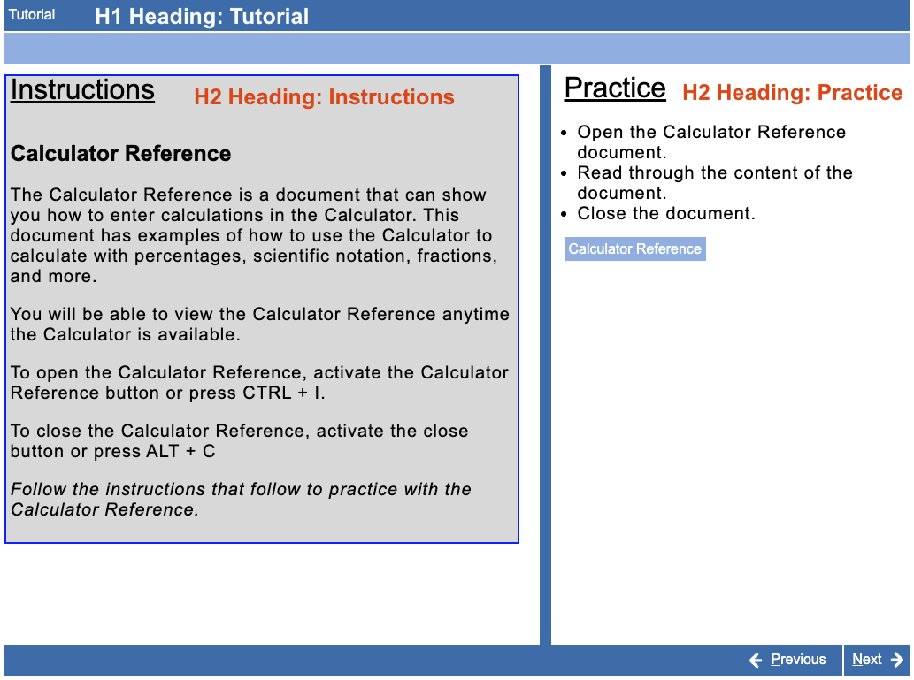
Semantic headings for navigation
* Source: GED Accessible Free Practice Test
Notes:
Examples
Using semantic headings (H1, H2, etc.) so that screen readers can jump between sections and understand hierarchy.
This GED Ready practice tutorial screen shows clearly structured sections
INSTRUCTIONS → PRACTICE - this helps any learner trying to quickly locate instructions or revisit questions.

Slide 29
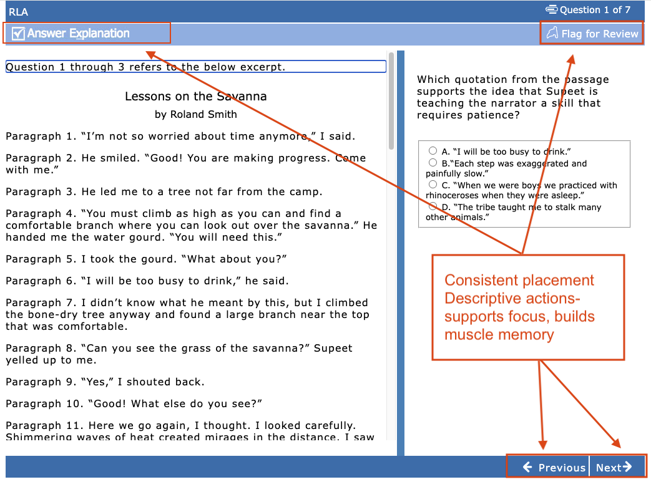
Predictable structure
* Source: GED Accessible Free Practice Test
Notes:
Predictable structure and navigation for assistive technologies
This sample GED Ready practice test screen shows buttons for ANSWER EXPLANATION, FLAG FOR REVIEW and PREVIOUS and NEXT that provide
Descriptive actions → no ambiguity for screen readers or learners
Consistent placement → users build muscle memory across questions
Task-oriented wording → supporting focus in timed test conditions

Slide 30
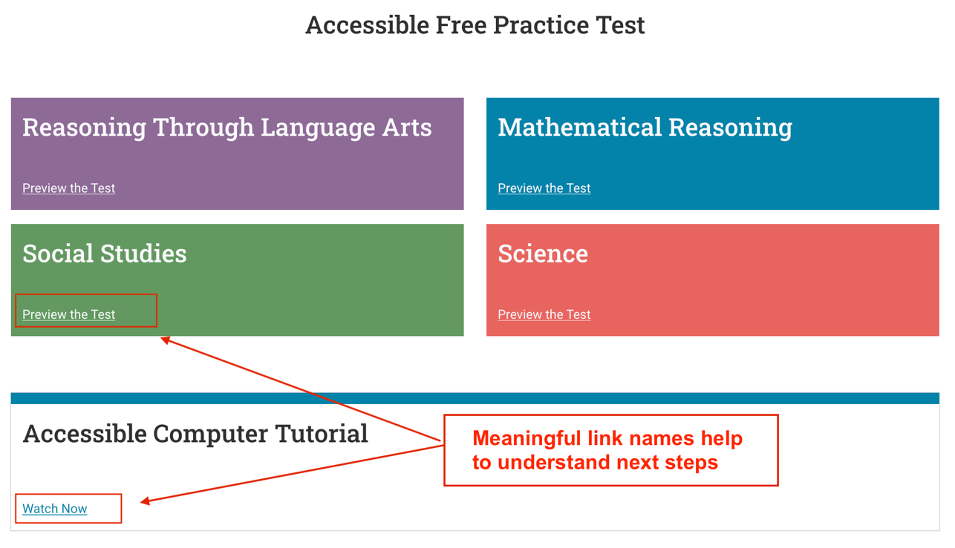
Meaningful Links
* Source: GED Accessible Free Practice Test Tutorial
Notes:
Meaningful Links name- Replacing “click here” with a meaningful link –
for example on this GED webpage “Preview the test” or “Watch Now” so screen readers announce destination clearly- this helps all learners immediately understand next steps.

Slide 31
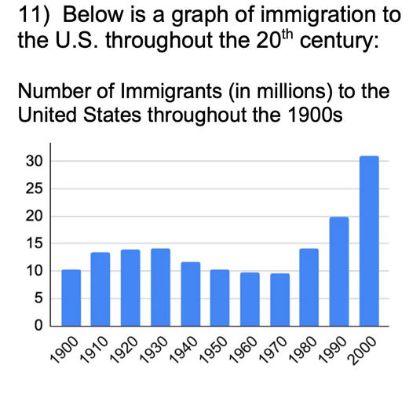
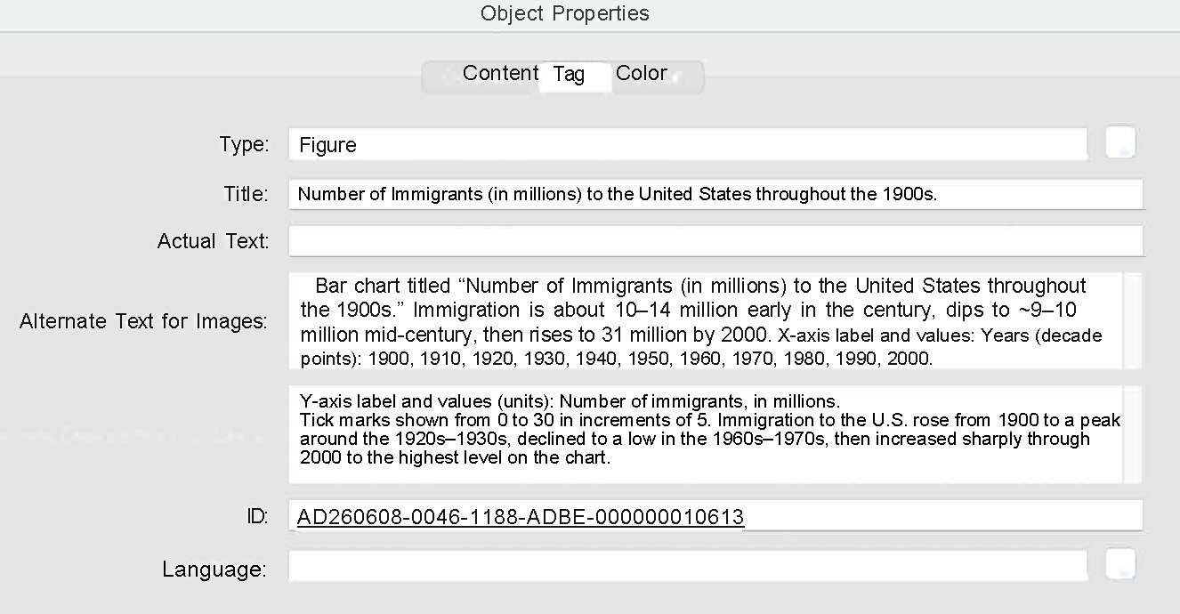
Alternative text example
PDF Image Alt text drop down dialog example
* Source: Get Sum Math GED SS Practice Test,
https://www.getsummath.com/fullss
Notes:
Providing alternative text so screen readers can describe visuals.
This is a graph example from Get Sum Math Social Studies online practice.
An example Alt Text dialog box shows the alt text long description for the graph.
The trend summary description of “rise...decline...then increase” helps all learners interpret the data, not just screen reader users.

Slide 32
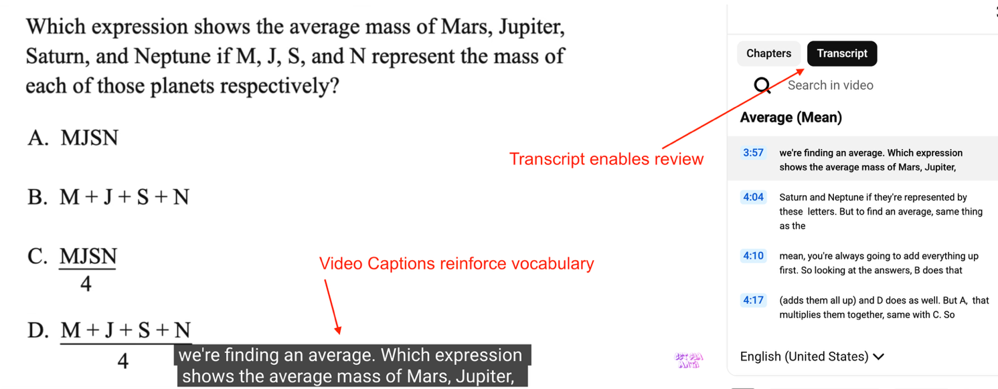
Captions/Transcripts for audio/video
* Source: Get Sum Math YouTube video screen shot, https://www.youtube.com/watch?v=uv6s_7Hi2nw
Notes:
This example is a screen shot from a Get Sum Math Practice Test prep video. Adding captions and transcripts to videos
Helps non-native English speakers and auditory learners
Improves retention through dual input (text + audio )
Helps learners review key vocabulary and concepts- here it’s “expression” and “average mass”
If accessibility functionality is not a blocker, this broadens the reach of the practice prep tools to enable more learners of all abilities to succeed in getting their GED.

Slide 33



What is a VPAT?
A VPAT (Voluntary Product Accessibility Template) is a standardized document detailing how a digital product conforms to accessibility standards.
WCAG 2.2 level AA criteria
U.S. Revised Section 508
EN 301 54
VPATs serves as a structured framework to assess products using manual and automated testing against accessibility standards.
A final VPAT report document clearly communicates product accessibility compliance results.
GED VPATs are updated every 2 years or when there is a major update.
Notes:
Foundational standards like WCAG, Section 508 and the European EN 301 54
define digital product accessibility and ensure inclusive design.
A VPAT (Voluntary Product Accessibility Template) is a standardized document detailing how a digital product conforms to those accessibility standards.
VPATs serves as a structured framework to assess products using manual and automated testing against accessibility standards.
GED audits align with WCAG 2.2 level AA criteria and the U.S. Revised Section 508.
As part of the audit process GED receives a final VPAT report document to clearly communicate product accessibility compliance results
VPAT’s can be provided with State Education Department contracts to validate that the GED products and services for their students are designed to the WCAG and Section 508 standards that their organisations are legally required to meet.
VPATs are updated with the accessibility audit every 2 years or when a product or platform has a major update.
We also work with partner publishers and service providers to record their product VPATs. It is important that their accessibility standards align with GED standards and we collaborate with partner publishers to check on updates and improvements.

Slide 34
Designing for Real Learners
Practical examples of accessible content: clear language, flexible formats, microlearning, and supportive scaffolding

Slide 35
Disabilities Adult Educators are likely to encounter
Rank | Disability/Condition | Likelihood
1 | Dyslexia | Very High
2 | ADHD | Very High
3 | Executive Function Difficulties | Very High
4 | Dysgraphia (Reading) | High
5 | Dyscalculia (Math) | High
6 | Language Processing Disorders | Moderate-High
7 | Autism Spectrum Disorder | Moderate
8 | Mild Intellectual Disability | Moderate
9 | Traumatic brain Injury | Moderate
10 | Memory impairments | Moderate
Difficulty in concentrating, remembering, or making decisions affect 13.9% of the adult population
Dyslexia, ADHD, executive functioning challenges, and Dyscalculia are generally the highest-impact conditions for adult education
Notes:
Disabilities adult educators are most likely to encounter
Reports from the CDC determine that cognitive impairments associated with difficulty in concentrating, remembering, or making decisions affect 13.9% of the adult population. This is a higher percentage than mobility, vison or hearing disabilities.
The cognitive and learning disabilities you are most likely to encounter in adult learners range from Dyslexia, ADHD, Dysgraphia (reading) and Dyscalculia (math) to autism spectrum disorder, mild intellectual disability and memory impairments.
Dyslexia, ADHD, executive functioning challenges, and dyscalculia are generally the highest-impact conditions to consider because they affect a large proportion of adult learners and significantly influence reading, navigation, instructions, testing, and digital interactions. - and many of these challenges may be undiagnosed.

Slide 36
Quick Poll 2
How many of you teach students with cognitive and learning, vision or hearing access needs.
Cognitive and Learning
Vision
Hearing
QR CODE PLACEHOLDER

Slide 37
Do you teach learners with cognitive and learning, vision or hearing access needs?
Do not edit
How to change the design
The Slido app must be installed on every computer you’re presenting from

Slide 38

Accessible content for GED learners
Educators can improve understanding by
Writing instructions in plain language
Breaking complex ideas into short sentences
Avoiding unnecessary jargon while still teaching key academic vocabulary
Flexible formats to help learners access information to suit their needs
Text
Audio
Captions
Visuals
Mobile friendly materials
Microlearning strategies to make learning less overwhelming
5-10 minute videos
Short quizzes
Single-skill practice activities
Supportive scaffolding can include
Guided examples
Step-by-step checklists
Sentence starters
Graphic organizers
Frequent feedback
Notes:
Content can be made more practical and engaging for all learners by using clear language, flexible formats, microlearning, and supportive scaffolding together.
Educators can improve understanding by
writing instructions in plain language
breaking complex ideas into short sentences
avoiding unnecessary jargon while still teaching key academic vocabulary
Flexible formats help learners access information in ways that suit their needs
Text
Audio
Captions
Visuals
mobile-friendly materials so students can review lessons at their own pace.
Microlearning strategies make learning less overwhelming for adults balancing work and family responsibilities
5–10-minute videos
short quizzes
single-skill practice activities
Supportive scaffolding can include
guided examples
step-by-step checklists
sentence starters
graphic organizers
frequent feedback

Slide 39

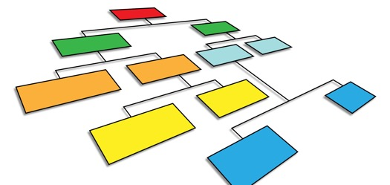

Examples- Engagement, Representation, Expression
Motivate learners and sustain interest
Offer choices in topics
Use collaborative and individual working options
Gamify review and practice
Build confidence with scaffolding and feedback
Present information in multiple ways
Provide multimodal input-text+audio+visuals
Pre-teach vocab and symbols
Use step-by-step worked examples
Highlight structure and relationships
Give learners different ways to show what they know
Offer different ways to respond
Use flexible practice test that mirror GED formats
Provide templates for responses
Use applied demonstrations
Notes:
Microlearning strategies make learning less overwhelming for adults balancing work and family responsibilities
5–10-minute videos
short quizzes
single-skill practice activities
Supportive scaffolding can include
guided examples
step-by-step checklists
sentence starters
graphic organizers
frequent feedback
Motivate learners and sustain interest
Offer choices in topics –let learners choose reading passages-health, parenting, current events. For math let them pick scenarios such as shopping or wages
Use collaborative and individual working options –rotate between solo work like quiet reading or problem solving, pair work –peer tutoring, small group discussions – for test strategies
Gamify review and practice- use timed quizes, Kahoot-style games, create GED style challenge rounds
Build confidence with scaffolding and feedback- break tasks into smaller steps, provide frequent, specific feedback
Present information in multiple ways
Provide multi-modal input- text + audio + visuals –pair readings with diagrams and graphics; for math show visual worked examples
Pre-teach vocab and symbols – create a simple glossary of terms, use real-life examples to explain terms
Use step-by-step worked examples- model how to break down an RLA passage, solve a math problem, use color coding
Highlight structure and relationships- use graphic organisers like cause/effect charts, paragraph structure maps, maths problem solving steps
Give learners different ways to show what they know
Offer different ways to respond – allow learners to explain answers verbally, write short responses, record audio or video answers
Use flexible practice test that mirror GED formats –provide multiple choice questions, short answer explanations, ‘talk me through your thinking’ activities
Provide templates for responses – sentence starters for writing, math solving frameworks
Use applied demonstrations- create a weekly budget, summarise an article verbally, explain a concept to a fellow student

Slide 40
Teacher-Aligned Practices
Simple, high-impact ways instructors can improve accessibility in lesson planning, assignments, and learner support

Slide 41



GED Educators – Q&A
Inclusive pedagogy
Culturally responsive examples
flexible pacing
Collaborative learning opportunities
Trauma-informed teaching practices
Effective classroom support
Normalize accessibility features used on computer-based tests
Run a 'functional needs' intake
Explicit instruction + cognitive load reduction strategies
Teach the GED accommodations pathway (when appropriate)
What accommodations are
What documentation is needed
How to request them, including expected timelines.
Notes:
Motivate learners and sustain interest
Offer choices in topics –let learners choose reading passages-health, parenting, current events. For math let them pick scenarios such as shopping or wages
Use collaborative and individual working options –rotate between solo work like quiet reading or problem solving, pair work –peer tutoring, small group discussions – for test strategies
Gamify review and practice- use timed quizes, Kahoot-style games, create GED style challenge rounds
Build confidence with scaffolding and feedback- break tasks into smaller steps, provide frequent, specific feedback
Present information in multiple ways
Provide multi-modal input- text + audio + visuals –pair readings with diagrams and graphics; for math show visual worked examples
Pre-teach vocab and symbols – create a simple glossary of terms, use real-life examples to explain terms
Use step-by-step worked examples- model how to break down an RLA passage, solve a math problem, use color coding
Highlight structure and relationships- use graphic organisers like cause/effect charts, paragraph structure maps, maths problem solving steps
Give learners different ways to show what they know
Offer different ways to respond – allow learners to explain answers verbally, write short responses, record audio or video answers
Use flexible practice test that mirror GED formats –provide multiple choice questions, short answer explanations, ‘talk me through your thinking’ activities
Provide templates for responses – sentence starters for writing, math solving frameworks
Use applied demonstrations- create a weekly budget, summarise an article verbally, explain a concept to a fellow student

Slide 42
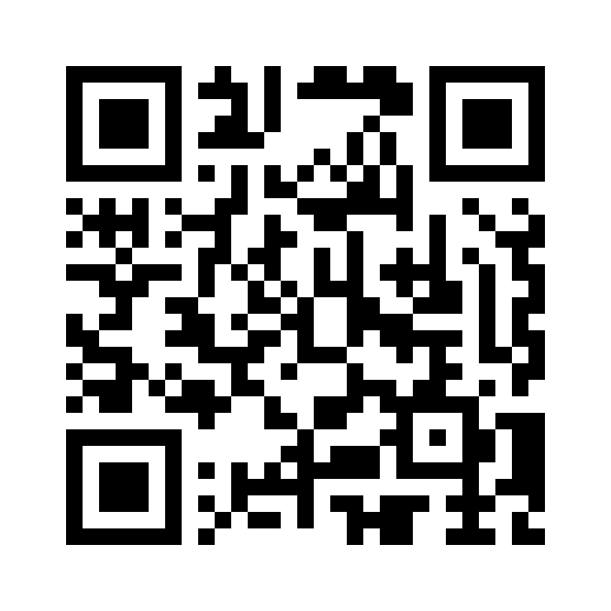
Session Survey
Your feedback is important. Please scan the QR code below to rate this session.

